Slide 1

Genetic Algorithms and Evolution Strategies
Presented by:
Julie Leung
Keith Kern
Jeremy Dawson

Slide 2
What is Evolutionary Computation?
An abstraction from the theory of biological evolution that is used to create optimization procedures or methodologies, usually implemented on computers, that are used to solve problems.

Slide 3
The Argument
Evolution has optimized biological processes;
therefore
Adoption of the evolutionary paradigm to computation and other problems can help us find optimal solutions.
An example ...

Slide 4
Components of Evolutionary Computing
Genetic Algorithms
  invented by John Holland (University of Michigan) in the 1960’s
Evolution Strategies
  invented by Ingo Rechenberg (Technical University Berlin) in the 1960’s
Started out as individual developments, but have begun to converge in the last few years

Slide 5
Presentation Agenda
What is evolutionary computing?
Primer on evolutionary theory from a biological perspective
Why use evolution as a model for solving computational problems?
When to use evolutionary computing strategies

Slide 6
Presentation Agenda (2)
Genetic Algorithms - in depth
Evolution Strategies - in depth
Drawbacks of GA’s and ES’s
When to use GA’s over ES’s
Questions

Slide 7
A primer on evolutionary theory from a biological perspective

Slide 8
The Concept of Natural Selection
Limited number of resources
Competition results in struggle for existence
Success depends on fitness --
    fitness of an individual: how well-adapted an individual is to their environment. This is determined by their genes (blueprints for their physical and other characteristics).
Successful individuals are able to reproduce and pass on their genes

Slide 9
When changes occur ...
Previously “fit” (well-adapted) individuals will no longer be best-suited for their environment
Some members of the population will have genes that confer different characteristics than “the norm”. Some of these characteristics can make them more “fit” in the changing environment.

Slide 10
Major Agents of Genetic Change in Individuals
Mutation in genes
  may be due to various sources (e.g. UV rays, chemicals, etc.)
  Start:
  1001001001001001001001
Location of Mutation
  After Mutation:
  1001000001001001001001

Slide 11
Major Agents of Genetic Change in Individuals (2)
Recombination (Crossing-Over)
  occurs during reproduction -- sections of genetic material exchanged between two chromosomes

Slide 12
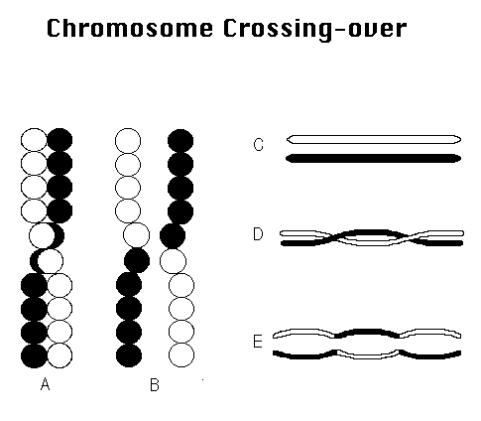
Recombination
(Crossing-Over)
Image from http://esg-www.mit.edu:8001/bio/mg/meiosis.html

Slide 13
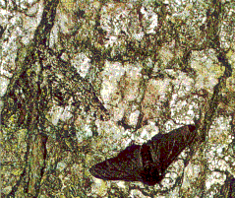
Example of Natural Selection and Micro-Evolution
Peppered moth during Industrial Revolution (Manchester, England, 1848)
Pre-Industrial Revolution -->
Image copyright Lawrence M. Cook
(http://www.trueorigin.org/pepmoth1.htm)

Slide 14
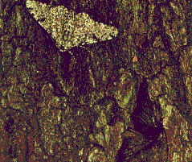
Example of Natural Selection and Micro-Evolution (2)
During Industrial Revolution -->
Image copyright Lawrence M. Cook
(http://www.trueorigin.org/pepmoth1.htm)

Slide 15
Why use evolution as a model for solving computational problems?

Slide 16
The Nature of Computational Problems
Require search through many possibilities to find a solution
    (e.g. search through sets of rules for one set that best predicts the ups and downs of the financial markets)
  Search space too big -- search won’t return within our lifetimes
  These types of problems are better solved using a parallel approach

Slide 17
The Nature of Computational Problems (2)
Require algorithm to be adaptive or to construct original solution
    (e.g. interfaces that must adapt to idiosyncrasies of different users)

Slide 18
Why Evolution Proves to be a Good Model for Solving these Types of Problems
Evolution is in effect a method of searching for the best (optimal) solution from a great number of possibilities
    Possibilities -- all individuals
    Best solution -- the most “fit” or well-adapted individual
Evolution is a parallel process
    Testing and changing of numerous species and individuals occur at the same time (or, in parallel)

Slide 19
Why Evolution Proves to be a Good Model for Solving these Types of Problems (2)
Evolution can be seen as a method that designs new (original) solutions to a changing environment

Slide 20
When to Use Evolutionary Computing Strategies
When space to be searched is large
When the “best” solution is not necessarily required
Approach to solving a problem not well-understood
Problems with many parameters that need to be simultaneously optimized
Problems that are difficult to describe mathematically

Slide 21
Genetic Algorithms
Closely follows a biological approach to problem solving
A simulated population of randomly selected individuals is generated then allowed to evolve

Slide 22
Encoding the Problem
Express the problem in terms of a bit string
x = (1001010101011100)
where the first 8 bits of the string represent the X-coordinate and the second 8 bits represent the Y-coordinate

Slide 23
Basic Genetic Algorithm
Step 1. Generate a random population of n chromosomes
Step 2. Assign a fitness to each individual
Step 3. Repeat until n children have been produced
  Choose 2 parents based on fitness proportional selection
  Apply genetic operators to copies of the parents
  Produce new chromosomes

Slide 24
Fitness Function
For each individual in the population, evaluate its relative fitness
For a problem with m parameters, the fitness can be plotted in an m+1 dimensional space

Slide 25
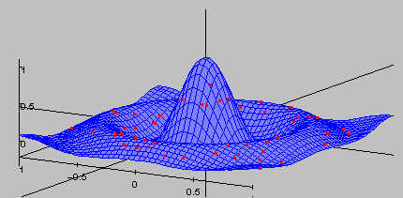
Sample Search Space
A randomly generated population of individuals will be randomly distributed throughout the search space
Image from http://www2.informatik.uni-erlangen.de/~jacob/Evolvica/Java/MultiModalSearch/rats.017/Surface.gif

Slide 26
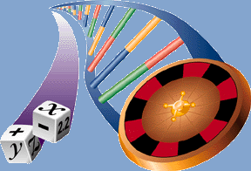
Natural Selection
The likelihood of any individual becoming a parent is directly proportional to its relative fitness
Image from http://www.genetic-programming.org

Slide 27
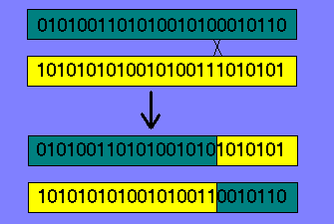
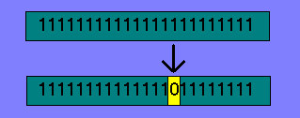
Genetic Operators
Cross-over
Mutation

Slide 28
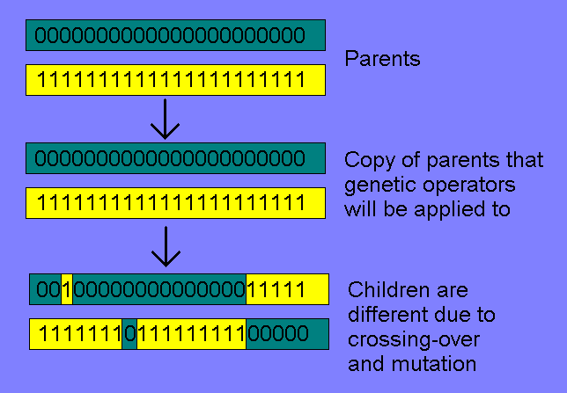
Production of New Chromosomes
2 parents give rise to 2 children

Slide 29
Generations
As each new generation of n individuals is generated, they replace their parent generation
To achieve the desired results, 500 to 5000 generations are required

Slide 30
Ultimate Goal
Each subsequent generation will evolve toward the global maximum
After sufficient generations a near optimal solution will be present in the population of chromosomes

Slide 31
Example
Flywheel design

Slide 32
Dynamic Evolution
Genetic algorithms can adapt to a dynamically changing search space
Seek out the moving maximum via a parasitic fitness function
  as the chromosomes adapt to the search space, so does the fitness function

Slide 33
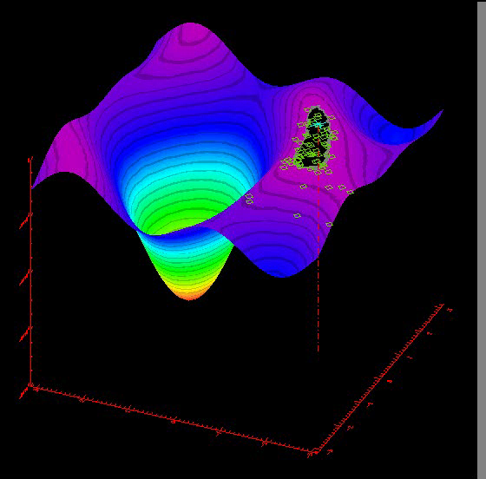
Example
“Moving Optimum”
Image from http://www.wi.leidenuniv.nl/~gusz/ Flying_Circus/

Slide 34
Evolution Strategies
Similar to Genetic Algorithms
  find a (near-)optimal solution to a problem within a search space (all possible solutions)
Developed by Ingo Rechenberg, independently from genetic algorithms
Often used for empirical experiments
Based on principal of strong causality: Small changes have small effects

Slide 35
Basic Evolution Strategy
1. Generate some random individuals
2. Select the p best individuals based on some selection algorithm (fitness function)
3. Use these p individuals to generate c children
4. Go to step 2, until the desired result is achieved (i.e. little difference between generations)

Slide 36
Encoding
Individuals are encoded as vectors of real numbers (object parameters)
  op = (o₁, o₂, o₃, … , o_{m})
The strategy parameters control the mutation of the object parameters
  sp = (s₁, s₂, s₃, … , s_{m})
These two parameters constitute the individual’s chromosome

Slide 37
Fitness Functions
Need a method for determining if one solution is more optimal than another
Mathematical formula
Main difference from genetic algorithms is that only the most fit individuals are allowed to reproduce (elitist selection)

Slide 38
Forming the Next Generation
Number of individuals selected to be parents (p)
  too many: lots of persistent bad traits
  too few: stagnant gene pool
Total number of children produced (c)
  limited by computer resources
  more children ⇒ faster evolution

Slide 39
Forming the Next Generation
Similar operators as genetic algorithms
  mutation is the most important operator (to uphold the principal of strong causality)
  recombination needs to be used in cases where each child has multiple parents
The parents can be included in the next generation
  smoother fitness curve

Slide 40
Mutation
Needed to add new genes to the pool
  optimal solution cannot be reached if a necessary gene is not present
  bad genes filtered out by evolution
Random changes to the chromosome
  object parameter mutation
  strategy parameter mutation
    changes the step size used in object parameter mutation

Slide 41
Object Parameter Mutation
affected by the strategy parameters (another vector of real numbers)
op = (8, 12, 31, … ,5)
op_{mutated} = (8.2, 11.9, 31.3, …, 5.7)
sp = (.1, .3, .2, …, .5)

Slide 42
Discrete Recombination
Similar to crossover of genetic algorithms
Equal probability of receiving each parameter from each parent
  (8, 12, 31, … ,5) (2, 5, 23, … , 14)
  (2, 12, 31, … , 14)

Slide 43
Intermediate Recombination
Often used to adapt the strategy parameters
Each child parameter is the mean value of the corresponding parent parameters
  (8, 12, 31, … ,5) (2, 5, 23, … , 14)
  (5, 8.5, 27, … , 9.5)

Slide 44
Evolution Process
p parents produce c children in each generation
Four types of processes:
  p,c
  p/r,c
  p+c
  p/r+c

Slide 45
p,c
p parents produce c children using mutation only (no recombination)
The fittest p children become the parents for the next generation
Parents are not part of the next generation
c ≥ p
p/r,c is the above with recombination

Slide 46
p+c
p parents produce c children using mutation only (no recombination)
The fittest p individuals (parents or children) become the parents of the next generation
p/r+c is the above with recombination

Slide 47
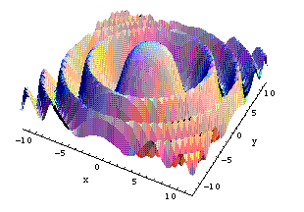
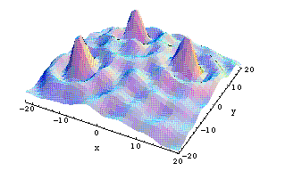
Example - Hill Climbing
2-dimensional search space
3rd dimension is the fitness
Goal: find the global maximum (most fit solution in the space)
Avoid local maxima
global
local

Slide 48
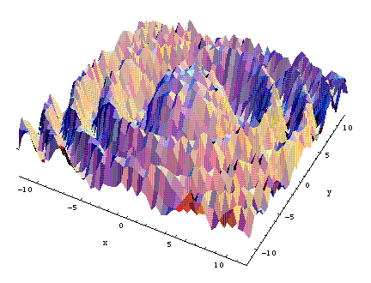
Rugged Terrain
More of a challenge to optimize
  easy to get stuck in the many local maxima
Need to adjust mutation and crossover rates

Slide 49
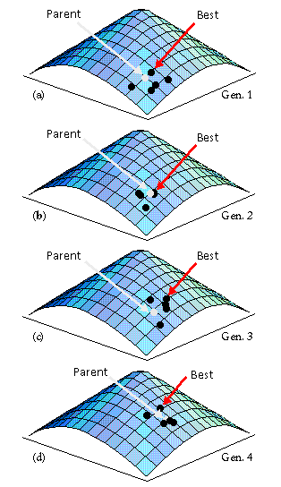
Climbing Strategy
1,5 - ES
Hill climbing in action…
Image from http://www2.informatik.uni-erlangen.de/IMMD-II/Lehre/SS99/NaturAlgorithmen/Presentations/05.EvolutionStrategies/Presentation/mutation.html

Slide 50


Evolution of a Two-Phase Jet Nozzle
Goal: obtain maximum thrust
Nozzle represented by a series of conical segments
Segments replaced by rules of 1+1-ES
Unexpected outcome
Starting Nozzle (55%)
Optimized Nozzle (80%)
Images from http://www.wi.leidenuniv.nl/~gusz/Flying_Circus/3.Demos/Movies/Duese/index.html

Slide 51
Evolution of a Two-Phase Jet Nozzle
Each frame represents one generation
image from http://www.wi.leidenuniv.nl/~gusz/Flying_Circus/3.Demos/Movies/Duese/index.html

Slide 52
Applications of Evolution Strategy
Configuration of ventilation systems
Piping systems
Wing profiles and fuselage configurations
Optical cable system layout

Slide 53
Drawbacks of GA’s and ES’s
Difficult to find an encoding for the problem
Difficult to define a valid fitness function
May not return the global maximum

Slide 54
When to Use GA’s vs. ES’s
Genetic Algorithms
More important to find optimal solution (GA’s more likely to find global maximum; usually slower)
Problem parameters can be represented as bit strings (computational problems)
Evolution Strategies
“Good enough” solution acceptable (ES’s usually faster; can readily find local maximum)
Problem parameters are real numbers (engineering problems)

Slide 55
Nothing tends so much to the advancement of knowledge as the application of a new instrument. The native intellectual powers of men in different times are not so much the causes of the different success of their labours, as the peculiar nature of the means and artificial resources in their possession.
- Sir Humphrey Davy
quoted from Thomas Hager, Force of Nature, Simon and Schuster, New York, 1995, p 86.

