Slide 1
Evolutionary Computation:
Genetic Algorithms
------------------------------------------------------------------
Copying ideas of Nature
Madhu, Natraj, Bhavish and Sanjay

Slide 2

Evolution
Evolution is the change in the inherited traits of a population from one generation to the next.
Natural selection leading to better and better species

Slide 3
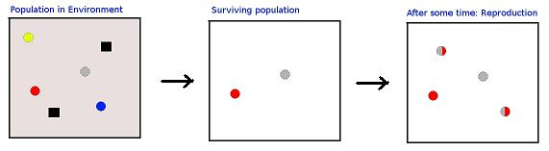
Evolution – Fundamental Laws
Survival of the fittest.
Change in species is due to change in genes over reproduction or/and due to mutation.
An Example showing the concept of survival of the fittest and reproduction over generations.

Slide 4
Evolutionary Computation
Evolutionary Computation (EC) refers to computer-based problem solving systems that use computational models of evolutionary process.
Terminology:
  Chromosome – It is an individual representing a candidate solution of the optimization problem.
  Population – A set of chromosomes.
  gene – It is the fundamental building block of the chromosome, each gene in a chromosome represents each variable to be optimized. It is the smallest unit of information.
Objective: To find a best possible chromosome to a given optimization problem.

Slide 5
Evolutionary Algorithm:
A meta-heuristic
Let t = 0 be the generation counter;
create and initialize a population P(0);
repeat
Evaluate the fitness, f(x_{i}), for all x_{i} belonging to P(t);
Perform cross-over to produce offspring;
Perform mutation on offspring;
Select population P(t+1) of new generation;
Advance to the new generation, i.e. t = t+1;
until stopping condition is true;

Slide 6
Roadmap
Overview of Genetic Algorithms (GA).
Operations and algorithms of GA.
Application of GA to a tricky TSP problem.
A complex application of GA in sorting problem.
Other Evolutionary Computation Paradigms
Conclusion of EC and GA.

Slide 7
Genetic Algorithms

Slide 8
On Overview
GA emulate genetic evolution.
A GA has distinct features:
  A string representation of chromosomes.
  A selection procedure for initial population and for off-spring creation.
  A cross-over method and a mutation method.
  A fitness function be to minimized.
  A replacement procedure.
Parameters that affect GA are initial population, size of the population, selection process and fitness function.

Slide 9
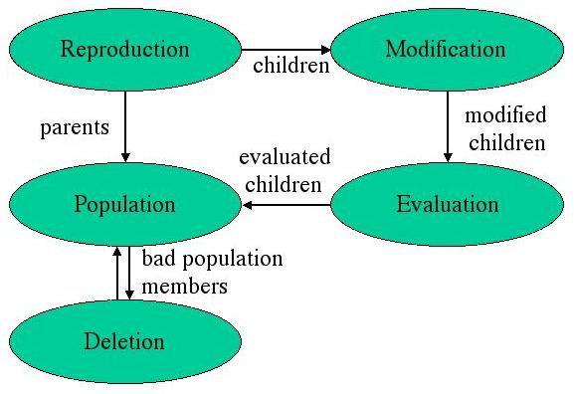
Anatomy of GA

Slide 10
Selection
Selection is a procedure of picking parent chromosome to produce off-spring.
Types of selection:
  Random Selection – Parents are selected randomly from the population.
  Proportional Selection – probabilities for picking each chromosome is calculated as:
  P(x_{i}) = f(x_{i})/Σf(x_{j}) for all j
  Rank Based Selection – This method uses ranks instead of absolute fitness values.
  P(x_{i}) = (1/β)(1 – e^{r(x}i⁾)

Slide 11
Roulette Wheel Selection
Let i = 1, where i denotes chromosome index;
Calculate P(x_{i}) using proportional selection;
sum = P(x_{i});
choose r ~ U(0,1);
while sum < r do
i = i + 1; i.e. next chromosome
sum = sum + P(x_{i});
end
return x_{i} as one of the selected parent;
repeat until all parents are selected

Slide 12
Reproduction
Reproduction is a processes of creating new chromosomes out of chromosomes in the population.
Parents are put back into population after reproduction.
Cross-over and Mutation are two parts in reproduction of an off-spring.
Cross-over : It is a process of creating one or more new individuals through the combination of genetic material randomly selected from two or parents.

Slide 13
Cross-over
Uniform cross-over : where corresponding bit positions are randomly exchanged between two parents.
One point : random bit is selected and entire sub-string after the bit is swapped.
Two point : two bits are selected and the sub-string between the bits is swapped.
 | Uniform Cross-over | One point Cross-over | Two point Cross-over
Parent1 Parent2 | 00110110 11011011 | 00110110 11011011 | 00110110 11011011
Off-spring1 Off-spring2 | 01110111 10011010 | 00111011 11010110 | 01011010 10110111

Slide 14
Mutation
Mutation procedures depend upon the representation schema of the chromosomes.
This is to prevent falling all solutions in population into a local optimum.
For a bit-vector representation:
  random mutation : randomly negates bits
  in-order mutation : performs random mutation between two randomly selected bit position.
 | Random Mutation | In-order Mutation
Before mutation | 1110010011 | 1110010011
After mutation | 1100010111 | 1110011010

Slide 15
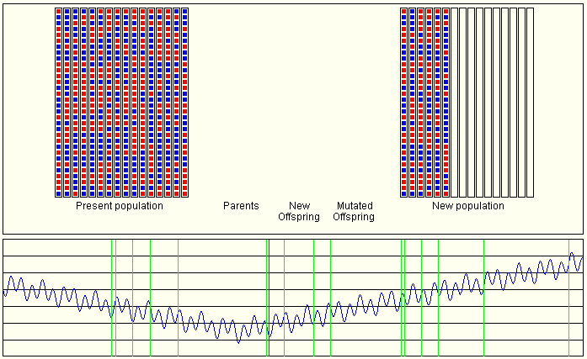

Slide 16
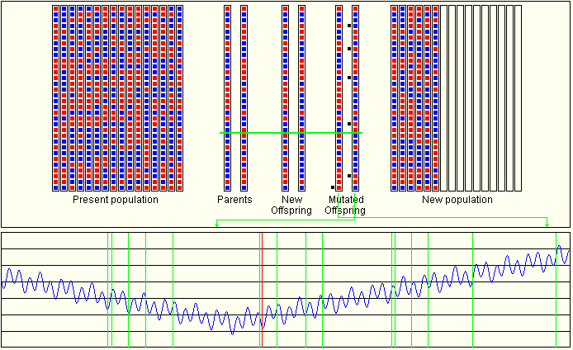

Slide 17
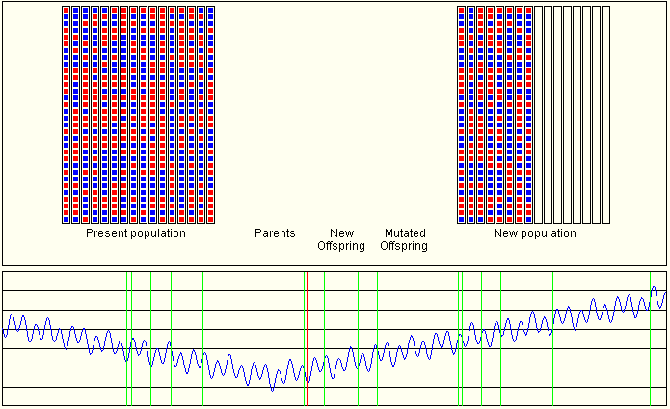

Slide 18
Travelling Salesman - GA
The traveling salesman problem is difficult to solve by traditional genetic algorithms because of the requirement that each node must be visited exactly once.
One way to solve this problem is by introducing more operators. Example in simulated annealing.
Idea is change the encoding pattern of chromosomes such that GA meta-heuristic can still be applicable.
transfer the TSP from a permutation problem into a priority assignment problem.

Slide 19
TSP – Genetic Algorithm with Priority Encoding (GAPE)
Steps of the algorithm:
  In the encoding process, the gene encoding policy is to assign priorities to all edges.
  we randomly scatter these priorities to the chromosomes in the initial population.
  In the evaluating process, we use a greedy algorithm to construct a suboptimal tour, whereas greedy algorithm consults both the edges’ priorities and costs.
  The tour cost returns the chromosome’s fitness value, and we can apply traditional genetic operators to these new type of chromosomes to continue the evolutions.

Slide 20
Greedy Algorithms
Now we can convert the problem of finding path in TSP to priority problem if we have an algorithm to find the sub-optimal tour.
We use greedy algorithms to find a sub-optimal tour in a symmetric TSP (the edge E(A,B) is same as edge E(B,A)).
The two algorithms are:
  Double-Ended Nearest Neighbor (DENN).
  Shortest Edge First (SEF).

Slide 21
DENN for STSP - algorithm
Sort the edges by their costs into sequence S.
Initialize a partial tour T = {S[l]}. Let S[l] = E(A, B) be the current sub-tour from A to B.
Suppose the current sub-tour is from X to Y, trace S – {E(X,Y)} to find the first edge E(P,Q) that satisfies {P, Q}n{X,Y} ≠ Φ.
If the above edge E(P, Q) is found, add it into T to extend the current sub-tour and repeat step 3; otherwise, add E(Y, X) into T and return T as the searching result.

Slide 22
SEF for STSP - algorithm
Sort the edges by their costs into sequence S.
Initialize a partial tour T = {S[l]}. T may contain disconnected sub-tours.
Suppose the next element in sequence S is E(X,Y), add E(X,Y) into T if neither X nor Y already has degree 2 and E(X,Y) does not give rise to a cycle with fewer than all vertices.
If T does not contain a complete tour, repeat step 3; otherwise, return T as the searching result.

Slide 23
GAPE
The first step of greedy algorithms is sorting of the edges by their costs into a sequence. While using the GAPE, we change this step to sorting these edges by the priorities before the costs.
a greedy algorithm never drops an object once this object is selected. Therefore, we can construct any given tour T by a greedy algorithm as long as the following condition holds: for every two consecutive edges E(r,s) and E(s,t) contained in this tour, all the other s-adjacent edges with lower cost than these two edges have lower priority than these two edges.

Slide 24

To sum up:
  the GAPE encodes edge priorities into chromosomes
  uses a greedy algorithm to construct the TSP tours,
  evaluates fitness values as the tour costs,
  and follows evolutionary processes to search the optimal solution.
Time complexity of GAPE is :
  O(kmn²) for DENN.
  O(kmn²log(n)) for SEF.
  where k is number of iterations, m is population size, n is number of vertices.

Slide 25
Optimizing Sorting
Normal sorting algorithms do not take into account the characteristics of the architecture and the nature of the input data
Different sorting techniques are best suited for different types of input

Slide 26
Optimizing Sorting
For example radix sort is the best algorithm to use when the standard deviation of the input is high as there will be lesser cache misses (Merge Sort better in other cases etc)
The objective is to create a composite sorting algorithm
The composite sorting algorithm evolves from the use of a Genetic Algorithm (GA)

Slide 27
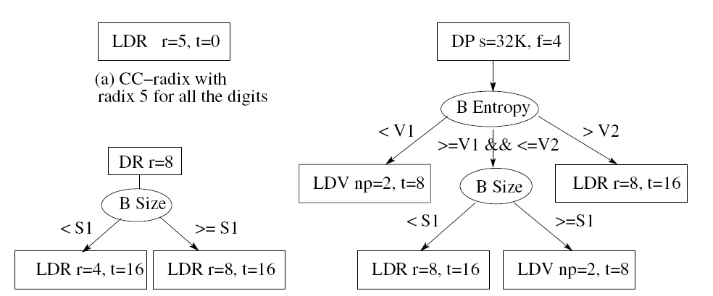
Optimizing Sorting - Chromosome

Slide 28
Optimizing Sorting
Sorting Primitives – these are the building blocks of our composite sorting algorithm
Partitioning
  - Divide by Value (DV) (Quicksort)
- Divide by Position (DP) (Merge Sort)
- Divide by Radix (DR) (Radix Sort)

Slide 29
Optimizing Sorting – Selection Primitives
Branch by Size (BS) : this primitive is used to select different sorting paths based on the size of the partition
Branch by Entropy (BE): this primitive is used to select different paths based on the entropy of the input

Slide 30
Branch by Entropy
The efficiency of radix sort increases with standard deviation of the input
A measure of this is calculated as follows. We scan the input set and compute the number of keys that have a particular value for each digit position. For each digit the entropy is calculated as Σ_{i} –P_{i} * log P_{i}
where P_{i} = c_{i}/N where c_{i} = number of keys with value ‘i’ in that digit and N is the total number of keys

Slide 31
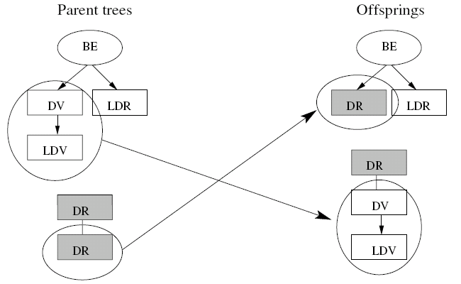
Sorting - Crossover
New offspring are generated using random single point crossovers

Slide 32
Sorting - Mutation
Change the values of the parameters of the sorting and selection primitives
Exchange two subtrees
Add a new subtree. This kind of mutation is useful where more partitioning is needed along a path of the tree
Remove a subtree

Slide 33
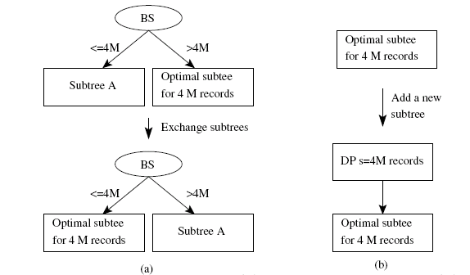
Sorting - Mutation

Slide 34
Fitness Function
We are searching for a sorting algorithm that performs well over all possible inputs hence the average performance of the tree is its base fitness
Premature convergence is prevented by using ranking of population rather than absolute performance difference between trees enabling exploring areas outside the neighbourhood of the highly fit trees

Slide 35
Why use Genetic Algorithms
Processors have a deep cache hierarchy and complex architectural features.
Since there are no analytical models of the performance of sorting algorithms in terms of architectural features of the machine, the only way to identify the best algorithm is by searching.
Search space is too large for exhaustive search

Slide 36
Results
The GA was run on a number of processor + operating system combinations
On average gene sort performed better than commercial algorithm libraries like INTEL MKL and C++ STL by 30%

Slide 37
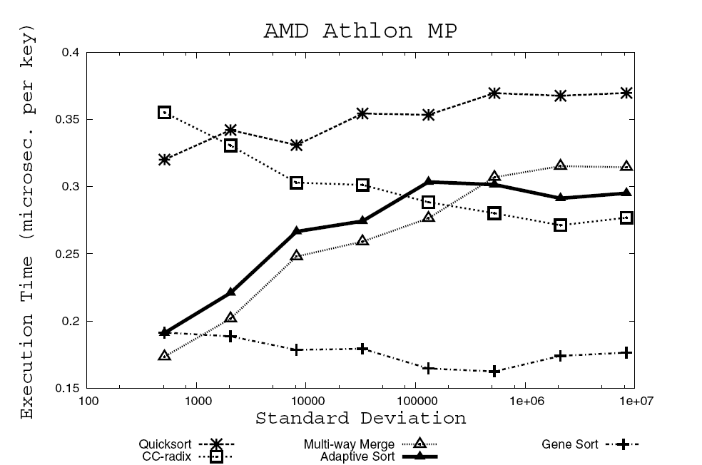
Results (cont ....)

Slide 38
Genetic Algorithms -Advantages
Because only primitive procedures like "cut" and "exchange" of strings are used for generating new genes from old, it is easy to handle large problems simply by using long strings.
Because only values of the objective function for optimization are used to select genes, this algorithm can be robustly applied to problems with any kinds of objective functions, such as nonlinear, indifferentiable, or step functions;

Slide 39
Genetic Algorithms - Advantage
Because the genetic operations are performed at random and also include mutation, it is possible to avoid being trapped by local-optima.

Slide 40
Other Evolutionary Algorithms
Evolutionary Programming : Emphasizes the development of behavioural models rather than genetic models
Evolutionary Strategies : In this not only the solution but also the evolutionary process itself evolves with generations (evolution of evolution)
Differential Programming : Arithmetic cross-over operators are used instead of geometric operators like cut and exchange.

Slide 41
Conclusion
Evolutionary Algorithms are heavily used in the search of solution spaces in many NP-Complete problems
NP-Complete problems like Network Routing, TSP and even problems like Sorting are optimized by the use of Genetic Algorithms as they can rapidly locate good solutions, even for difficult search spaces.

Slide 42
References
“A New Approach to the Traveling Salesman Problem Using Genetic Algorithms with Priority Encoding”, Jyh-Da Wei, D. T. Lee, Evolutionary Computation, 2004. CEC2004, Volume: 2, On page(s): 1457- 1464
“Optimizing Sorting with Genetic Algorithms” ,Xiaoming Li, Maria Jesus Garzaran and David Padua. Code Generation and Optimization, 2005. CGO 2005. International Symposium, On page(s): 99- 110
“Dynamic task scheduling using genetic algorithms for heterogeneous distributed computing” , Andrew J. Page and Thomas J. Naughton. Proceedings of the 19th IEEE International Parallel and Distributed Processing Symposium (IPDPS’05).
“A Dynamic Routing Control Based on a Genetic Algorithm”, Shimamoto, N. Hiramatsu, A. Yamasaki, K. , Neural Networks, 1993., IEEE International Conference. On page(s): 1123-1128 vol.2
wikipedia

Slide 43
Thank You….
Questions…..???

