Slide 1

Scientific reasons behind various superstitions across the world

Slide 2
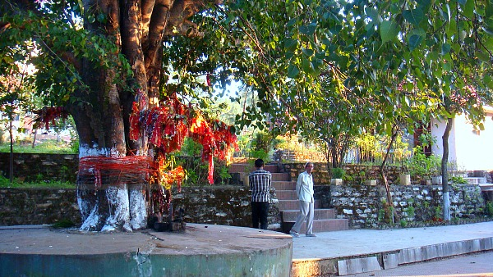
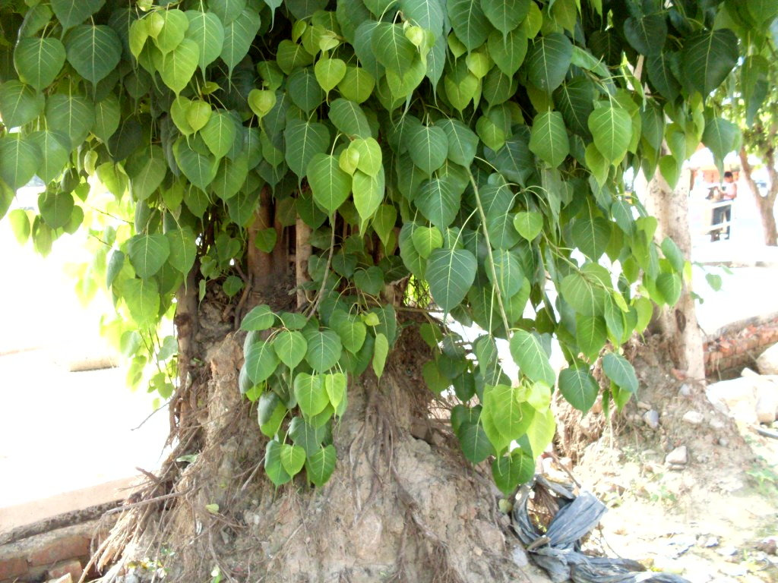
Why peepal tree is worshipped?

Slide 3
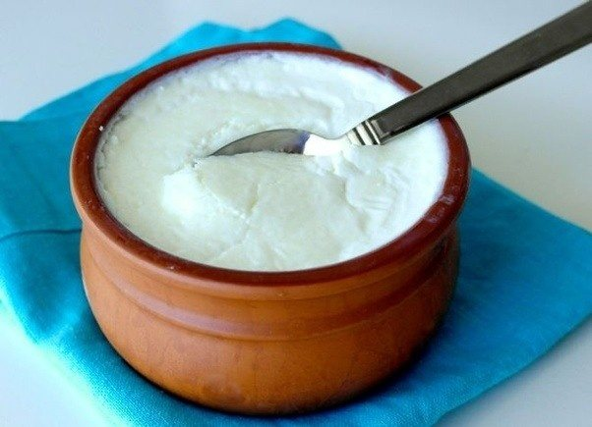
Eating curd and sugar before heading out for a good luck

Slide 4
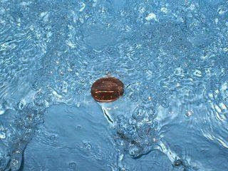
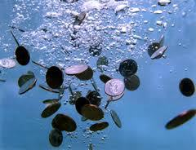
Throwing coins in the river

Slide 5
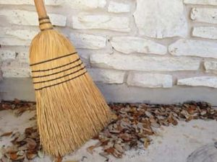
Don’t sweep after the sunset

Slide 6
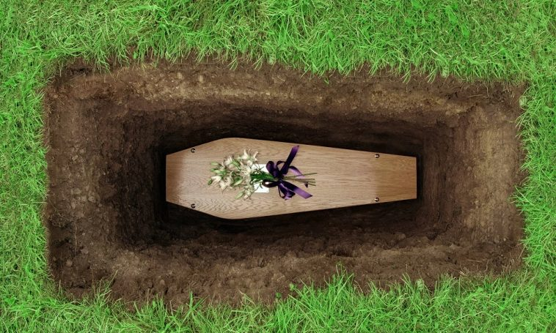
Bathe after attending a funeral ceremony

Slide 7
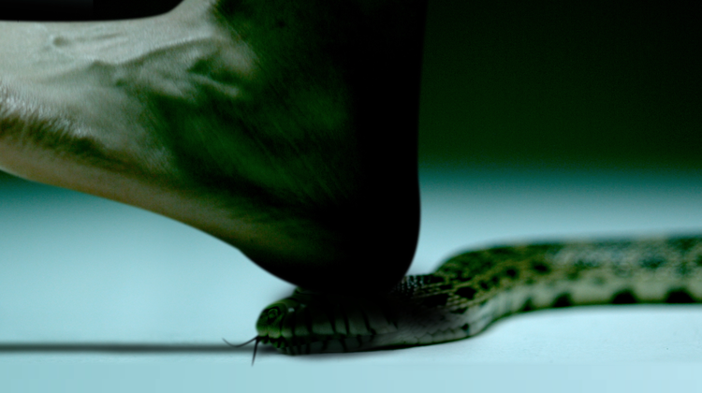
Why snake’s head should be crushed after killing it?

Slide 8
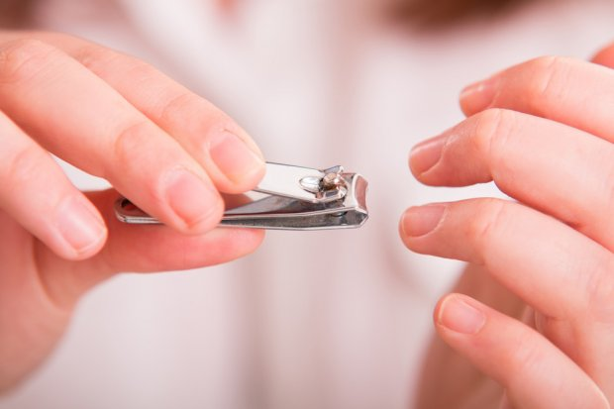
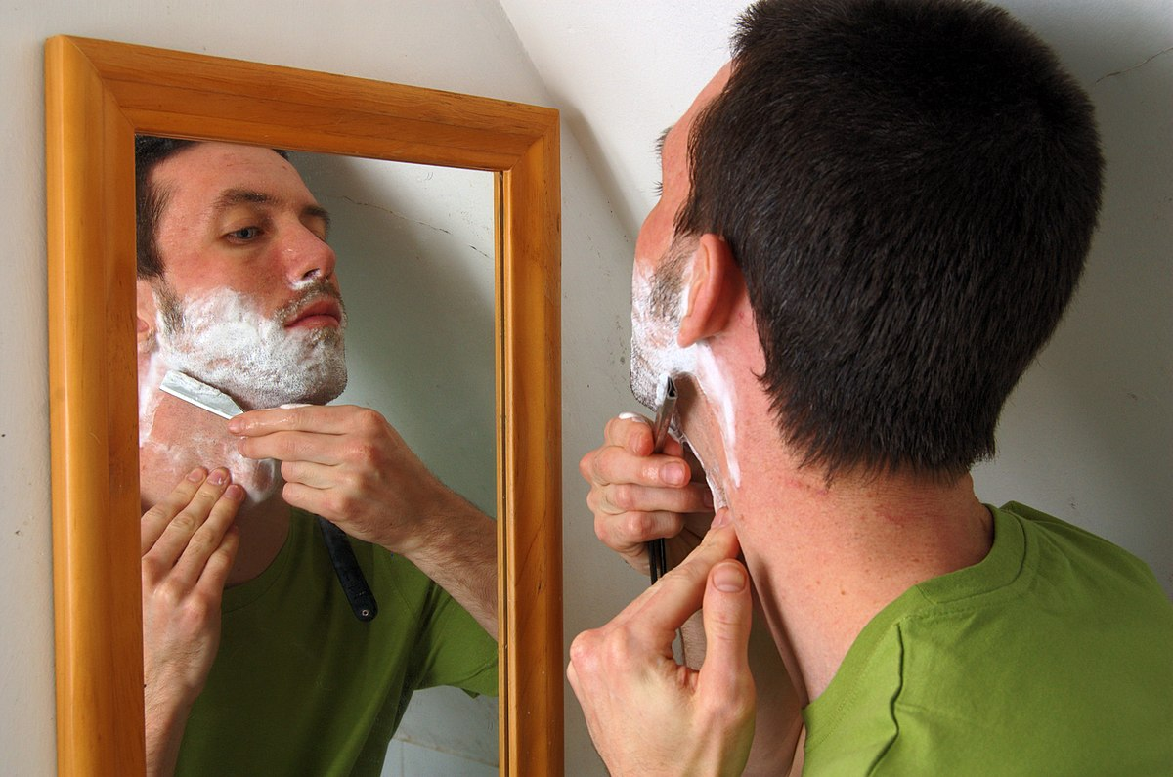
Never shave or cut the nails after sunset

