Slide 1

- Group 13
COE17B002
COE17B020
COE17B023
CED17I028

Slide 2

What is superstition?
How it is spread?
Few examples

Slide 3
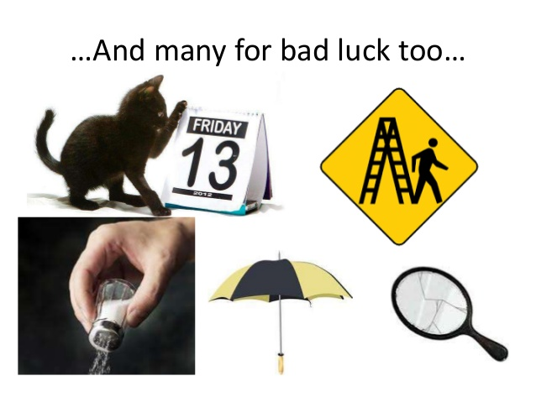
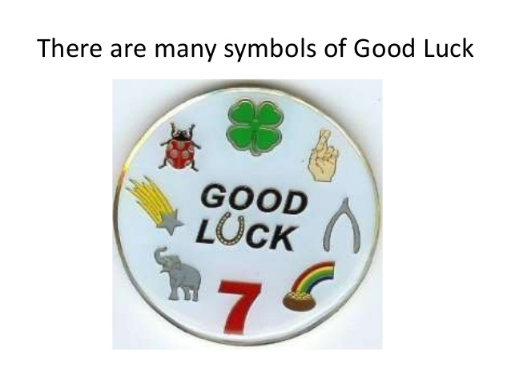
What is Superstition?
A superstition is a false belief based on ignorance.
Belief that some events bring good or bad luck.
“Beliefs, or half-beliefs that lead to ignorance, fear, or belief in magic.“

Slide 4
DO YOU BELIEVE IN SUPERSTITIONS?
Do you Believe that if certain thing happens it will change your luck?
OR DO YOU BELIEVE WE MAKE OUR OWN LUCK?

Slide 5
How it is spread?

Slide 6
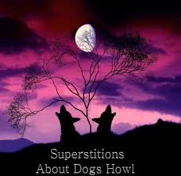
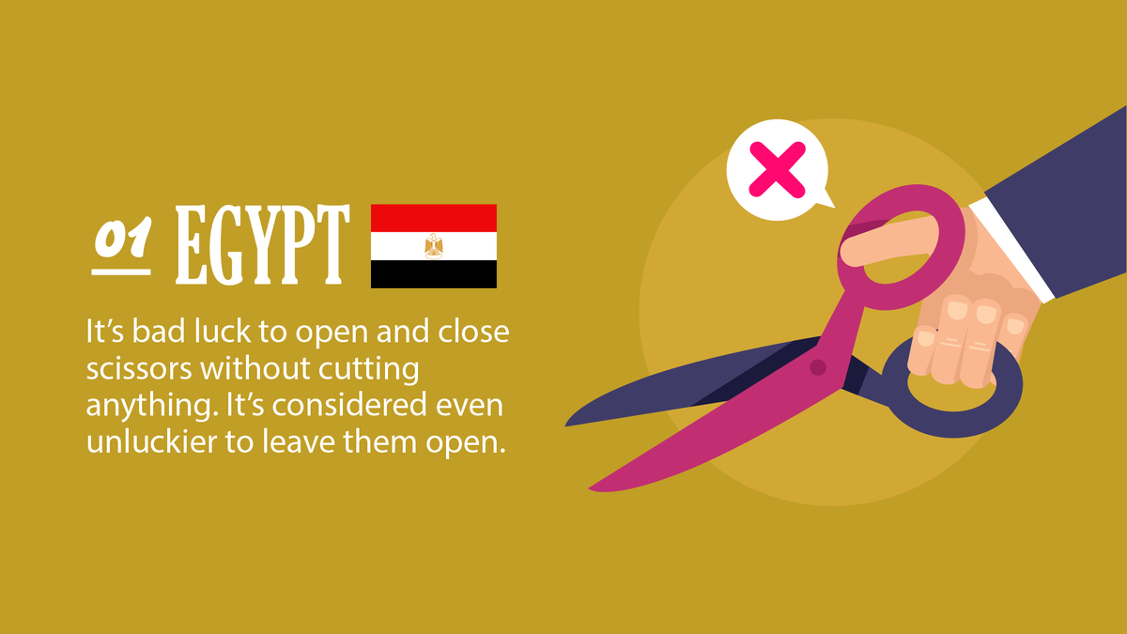
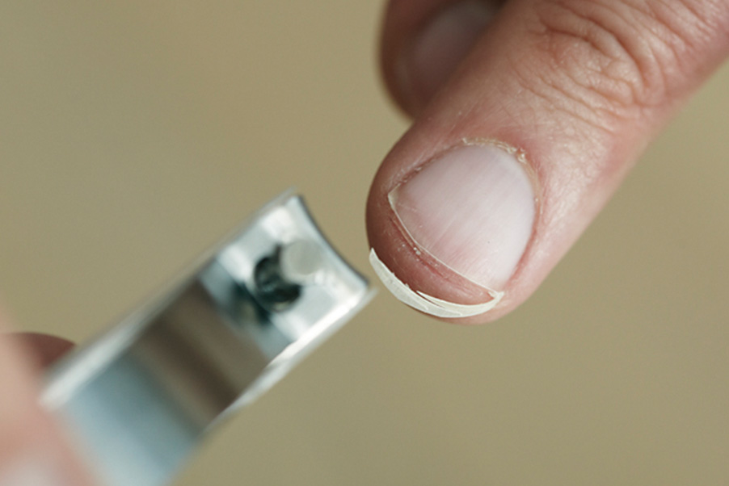
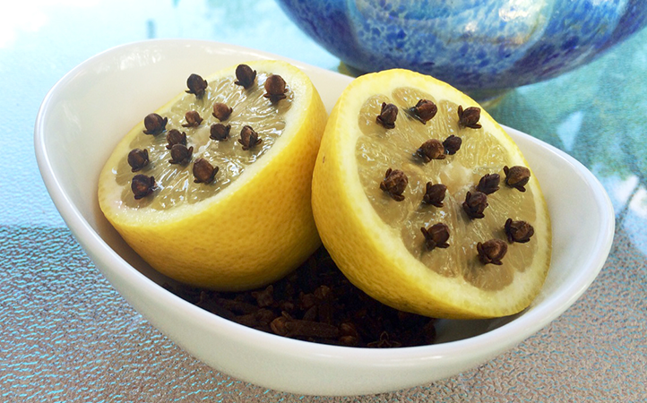
Few Examples

Slide 7
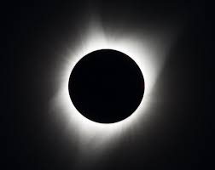
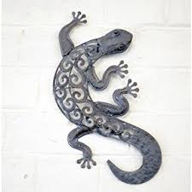
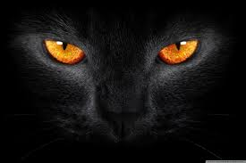

Slide 8




