Slide 1
Association Rule Mining

Slide 2
Frequent Pattern Mining
Frequent pattern (FP) mining is the most important step in mining association rules and useful for other data mining tasks like classification, clustering, etc ..
FP- patterns showing that some items in a dataset frequently appearing along with other data items
Two types of FPs
Frequent itemset
Unordered collection of items: bread, butter, pillow
Frequent sequential pattern
Ordered collection of items (buying first a PC, then a digital camera, and then a memory card)

Slide 3
Definitions
Set of items: I={I₁,I₂,…,I_{m}}
Transactions: D={t₁,t₂, …, t_{n}}, t_{j}⊆ I
Itemset: is a set of items where each item is an element drawn from a finite set of possible items.
{I_{i1},I_{i2}, …, I_{ik}} ⊆ I
An itemset having k items is said to have length k and often denoted as a k-itemset
Count – The count of an itemset X in D: (number of transactions of D that contain X as a subset)
Support- The support of an itemset X in D is the fraction of transactions of D that contain X as a subset
Support(X) = count(X)/ |D|

Slide 4
Definitions (2)
Minimum support: The minimum support (or minsup) is a used defined threshold indicating that the itemsets whose support is less than this threshold are not interesting
Frequent itemset: An itemset X is frequent if support(X) >= minsup
Association rule: Given two itemsets X, Y such that X ∩ Y = ⱷ (empty set) , an association rule is of the form X → Y, and it semantically means that the presence of X is good indicator of the presence of Y

Slide 5
Definitions (3)
Support of AR (X → Y) : Given an association rule X → Y, its support is defined as
Support ( X → Y) = Support(X U Y)
Confidence: Given a AR X → Y, its confidence is defined as
Confidence(X → Y) = Support(X → Y) / Support (X)
Minimum confidence: Minimum confidence (or minconf) is a user defined threshold indicating that the association rules with confidence less than this threshold are not interesting
Interesting association rule: An interesting association rule is one whose support and confidence is not less than the minsup and minconf, respectively.

Slide 6
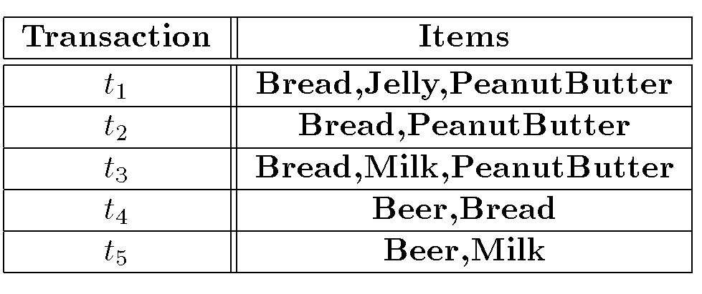
Sample Data to Illustrate Association Rules

Slide 7
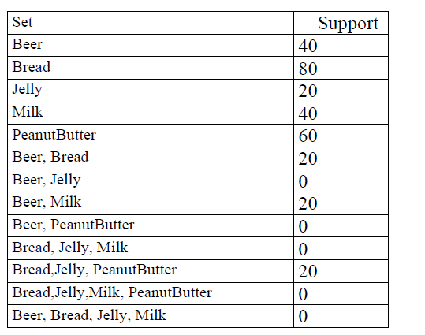
Support Values for few Itemsets

Slide 8
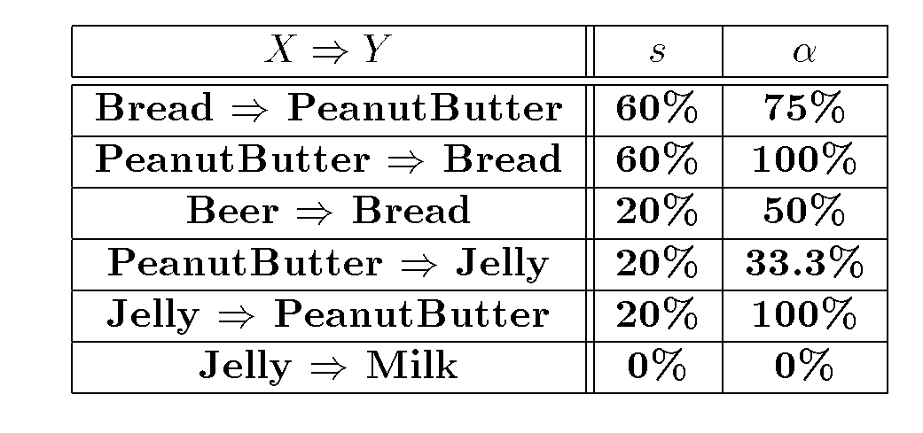
Confidence Values for few ARs

Slide 9
Association Rule Problem
Given a set of items I={I₁,I₂,…,I_{m}} and a database of transactions D={t₁,t₂, …, t_{n}} where t_{i}={I_{i1},I_{i2}, …, I_{ik}} and I_{ij} ∈ I, the Association Rule Problem is to identify all association rules X → Y with a minimum support and confidence.
note: (Support of X → Y is same as support of X ∪ Y)
Steps involved in Finding Association Rules
Find Frequent Itemsets
Generate rules from Frequent Itemsets

Slide 10
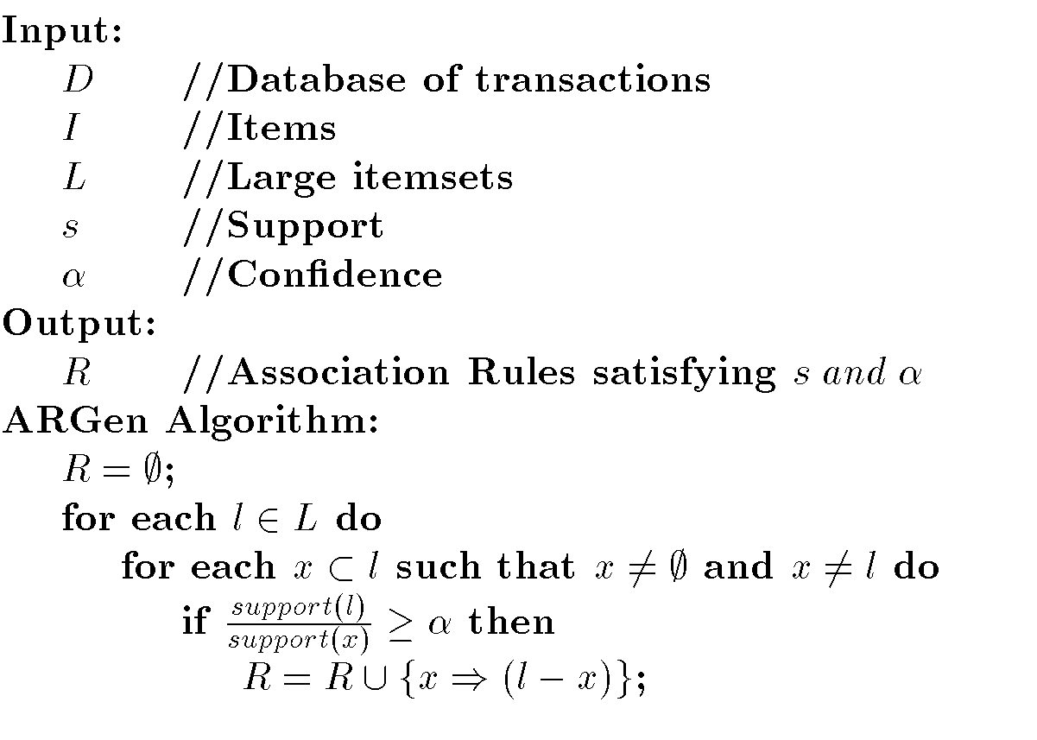
Algorithm to generate ARs

Slide 11
Generation of ARs for D (example set of transactions)
S= 30% and C (confidence) = 50%
set of Frequent Itemsets (L) = { {Beer}, {Bread}, {Milk}, {PeanutButter}, {Bread, PeanutButter} }
l={Bread, PeanutButter} and two non-empty sets for this are {Bread} and {PeanutButter}
For {Bread} set … we can generate
Support( {Bread,PeanutButter}) /Support({Bread}) = 60/80=0.75 (75%) (above C and a valid association rule)

Slide 12
Generation of ARs for D (example set of transactions) -2
Likewise for {PeanutButter} set … we can generate
Support( {Bread,PeanutButter}) /Support({PeanutButter}) = 60/60= 1 (100%) (above C and a valid association rule)
Efficiency of Association rule mining algorithms is discussed
Number of scans of the database are required
The maximum number of itemsets that must be counted
All ARM algorithms that we are going to discuss primarily focus on ways to efficiently discovering Frequent Itemsets

