Slide 1
Association Rule Mining

Slide 2
Frequent Pattern Mining
Frequent pattern (FP) mining is the most important step in mining association rules and useful for other data mining tasks like classification, clustering, etc ..
FP- patterns showing that some items in a dataset frequently appearing along with other data items
Two types of FPs
Frequent itemset
Unordered collection of items: bread, butter, pillow
Frequent sequential pattern
Ordered collection of items (buying first a PC, then a digital camera, and then a memory card)

Slide 3
Definitions
Set of items: I={I₁,I₂,…,I_{m}}
Transactions: D={t₁,t₂, …, t_{n}}, t_{j}⊆ I
Itemset: is a set of items where each item is an element drawn from a finite set of possible items.
{I_{i1},I_{i2}, …, I_{ik}} ⊆ I
An itemset having k items is said to have length k and often denoted as a k-itemset
Count – The count of an itemset X in D: (number of transactions of D that contain X as a subset)
Support- The support of an itemset X in D is the fraction of transactions of D that contain X as a subset
Support(X) = count(X)/ |D|

Slide 4
Definitions (2)
Minimum support: The minimum support (or minsup) is a used defined threshold indicating that the itemsets whose support is less than this threshold are not interesting
Frequent itemset: An itemset X is frequent if support(X) >= minsup
Association rule: Given two itemsets X, Y such that X ∩ Y = ⱷ (empty set) , an association rule is of the form X → Y, and it semantically means that the presence of X is good indicator of the presence of Y

Slide 5
Definitions (3)
Support of AR (X → Y) : Given an association rule X → Y, its support is defined as
Support ( X → Y) = Support(X U Y)
Confidence: Given a AR X → Y, its confidence is defined as
Confidence(X → Y) = Support(X → Y) / Support (X)
Minimum confidence: Minimum confidence (or minconf) is a user defined threshold indicating that the association rules with confidence less than this threshold are not interesting
Interesting association rule: An interesting association rule is one whose support and confidence is not less than the minsup and minconf, respectively.

Slide 6
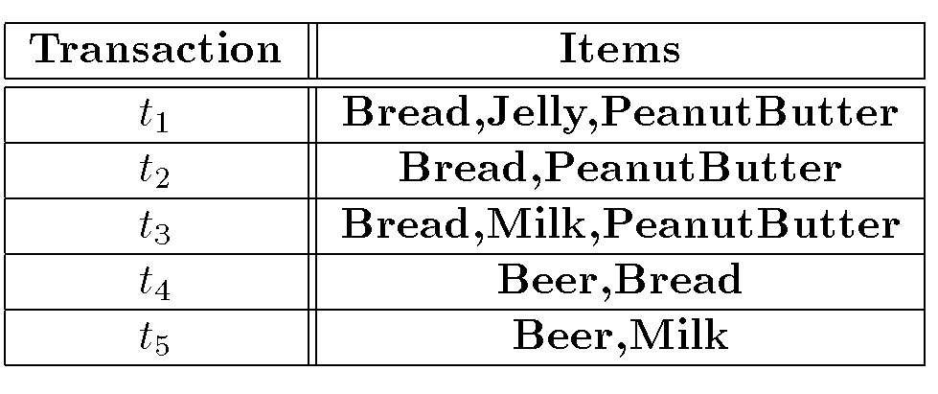
Sample Data to Illustrate Association Rules

Slide 7
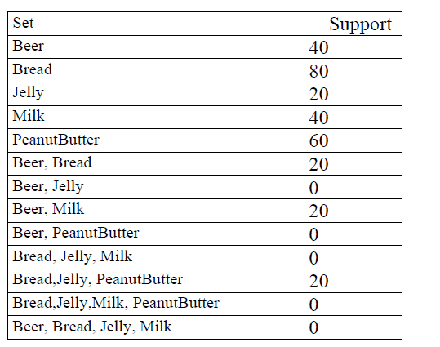
Support Values for few Itemsets

Slide 8
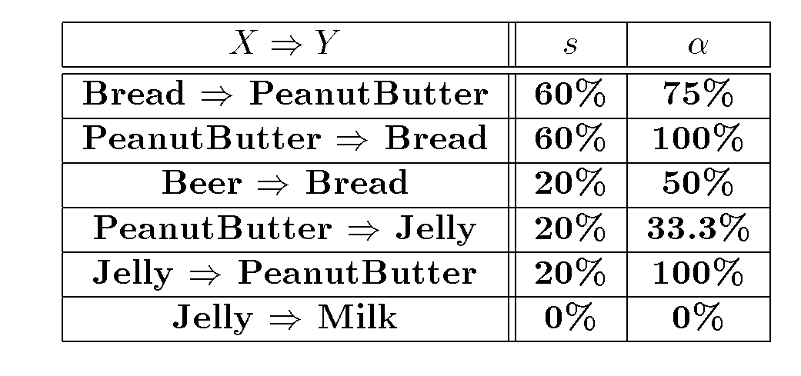
Confidence Values for few ARs

Slide 9
Association Rule Problem
Given a set of items I={I₁,I₂,…,I_{m}} and a database of transactions D={t₁,t₂, …, t_{n}} where t_{i}={I_{i1},I_{i2}, …, I_{ik}} and I_{ij} ∈ I, the Association Rule Problem is to identify all association rules X → Y with a minimum support and confidence.
note: (Support of X → Y is same as support of X ∪ Y)
Steps involved in Finding Association Rules
Find Frequent Itemsets
Generate rules from Frequent Itemsets

Slide 10
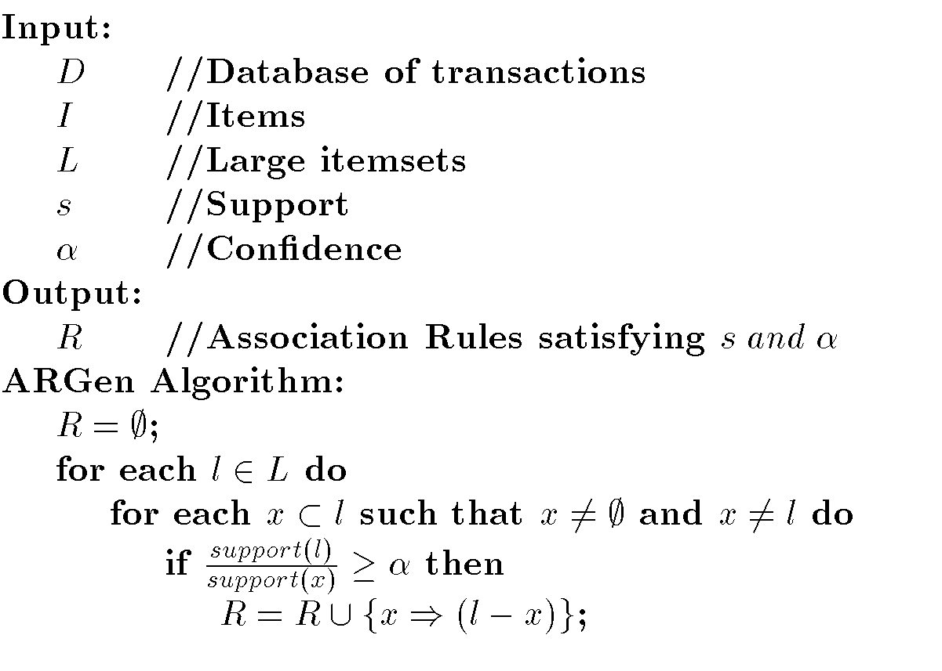
Algorithm to generate ARs

Slide 11
Sample Data to Illustrate Association Rules

Slide 12
Generation of ARs for D (example set of transactions)
S= 30% and C (confidence) = 50%
set of Frequent Itemsets (L) = { {Beer}, {Bread}, {Milk}, {PeanutButter}, {Bread, PeanutButter} }
l={Bread, PeanutButter} and two non-empty sets for this are {Bread} and {PeanutButter}
For {Bread} set … we can generate
Support( {Bread,PeanutButter}) /Support({Bread}) = 60/80=0.75 (75%) (above C and a valid association rule)

Slide 13
Generation of ARs for D (example set of transactions) -2
Likewise for {PeanutButter} set … we can generate
Support( {Bread,PeanutButter}) /Support({PeanutButter}) = 60/60= 1 (100%) (above C and a valid association rule)
Efficiency of Association rule mining algorithms is based on
Number of scans of the database are required
The maximum number of itemsets that must be counted
All ARM algorithms that we are going to discuss primarily focus on ways to efficiently discovering Frequent Itemsets

Slide 14
Frequent Itemset Generation
Brute-force approach:
Generate all candidate itemsets
Compute the support for each candidate itemset
Prune itemsets that fail the minsup threshold
Computationally expensive!

Slide 15
Frequent Itemset Generation (2)
Given n items, there are 2^{n} possible candidate itemsets

Slide 16
Brute-force approach
Each itemset in the lattice is a candidate frequent itemset
Count the support of each candidate by scanning the database
Match each transaction against every candidate
Complexity ~ O(NMw) => Expensive since M = 2^{d} !!!

Slide 17
Apriori Algorithm
Aprori algorithm- proposed by R. Agrawal and R. Srikanth in 1994
The name of the algorithm is based on the fact that algorithm uses prior knowledge of frequent itemset properties
Apriori property: (downward closure property of frequent patterns ). All nonempty subsets of a frequent itemset must also be frequent
Eg. ABC is Frequent Itemset (FI) … then
AB, BC, AC, and other subsets of ABC should be frequent
If one of the subsets of ABC (eg. AB, BC, AC, etc …) is not frequent , definitely ABC is not frequent (antimonotone property)
(if a set cannot pass a test, all of its supersets will fail the same test as well)

Slide 18
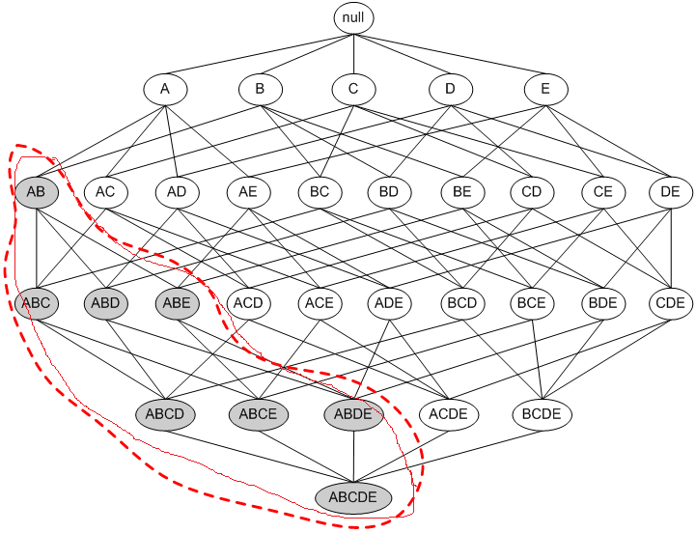
Illustrating Apriori Principle
If {a,b} is infrequent , then all supersets {a,b} are infrequent
Found to be Infrequent
Pruned supersets

Slide 19
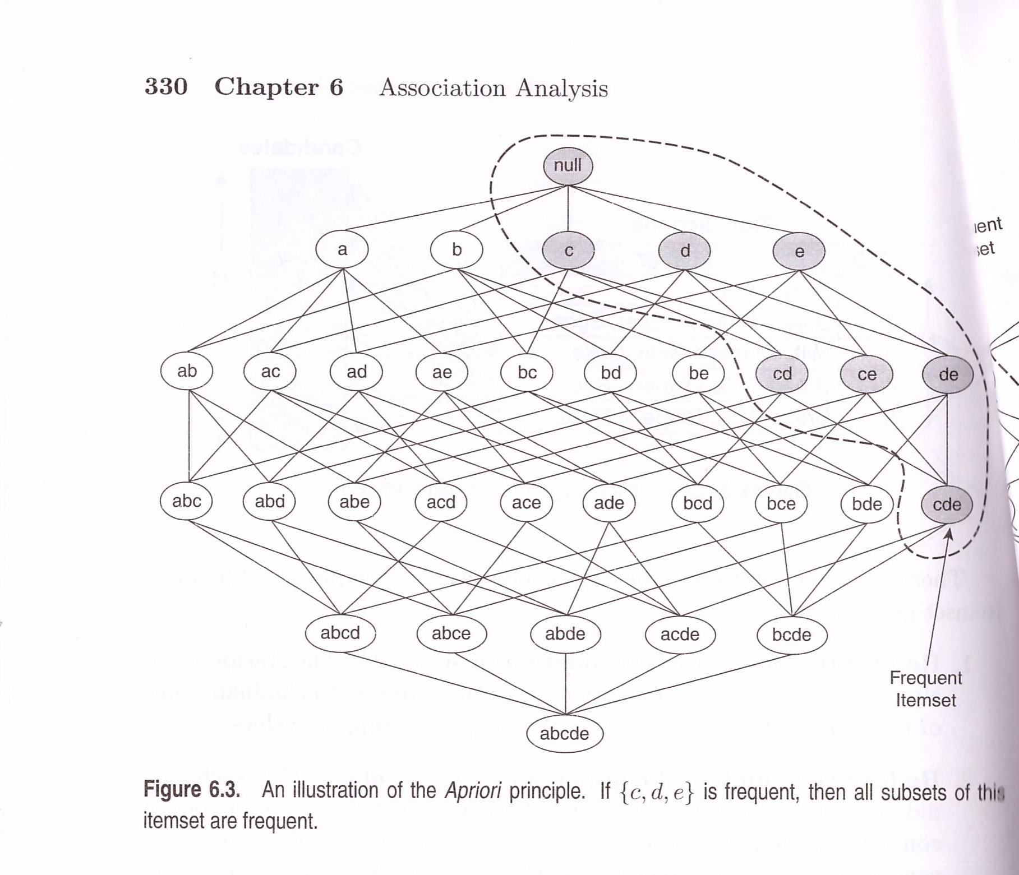
Illustrating Apriori Principle
If {c,d,e} is frequent
Then all subsets
of the itemset are
frequent

Slide 20
Apriori … general idea
Find frequent 1-items and put them to L_{k} (k=1)
Use L_{k} to generate a collection of candidate itemsets C_{k+1} with size (k+1)
Scan the database to find which itemsets in C_{k+1} are frequent and put them into L_{k+1}
If L_{k+1} is not empty
k=k+1
GOTO 2

Slide 21
Frequent Itemset Generation
Step 1: Make the single pass over the data set to determine the support of each item. Upon completion of this step, the set of all frequent 1-itemsets will be known.
Step 2: Genearte k-itemsets using the frequent (k-1) itemsets found in the previous iteration. (different candidate itemset generation techniques are available)
Step 3: Check the subsets of k-itemsets are frequent; if not discard that k-itemset
Step 4. Transactional database is scanned to count the support values of candidate itemsets and select k-1 itemsets by considering its support value >= minsup
Step 5: Repeat the steps 2 , 3 and 4 until no new frequent itemsets are generated

Slide 22
Frequent Itemset Generation (2)
Transactional database
Pairs (2-itemsets)
(No need to generate candidates involving Coke or Eggs)
Minimum Support = 3
If every subset is considered,
⁶C₁ + ⁶C₂ + ⁶C₃ = 41
With support-based pruning,
6 + 6 + 1 = 13

Slide 23
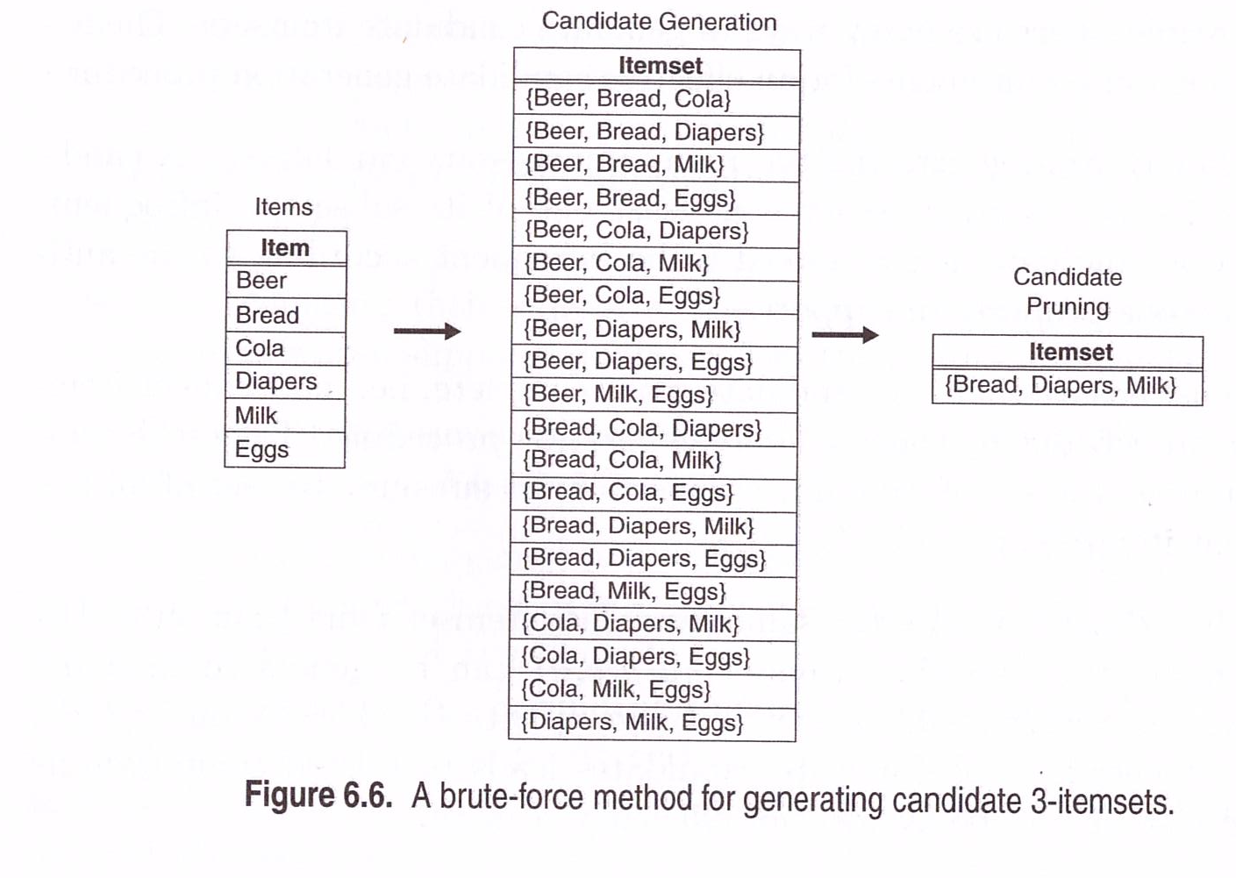
Brute-force approach (1)
Support = 60

Slide 24
Reducing the computational complexity of FI generation
Reduce the number of Candidate itemsets: The Apriori principle is an effective way to eliminate some of the candidate itemsets without counting their support values
Reduce the number of comparisons: Instead of matching each candidate itemset against ever transaction, we can reduce the number of comparisons by using more advanced data structures, either to store the candidate itemsets or to compress the data set .

Slide 25
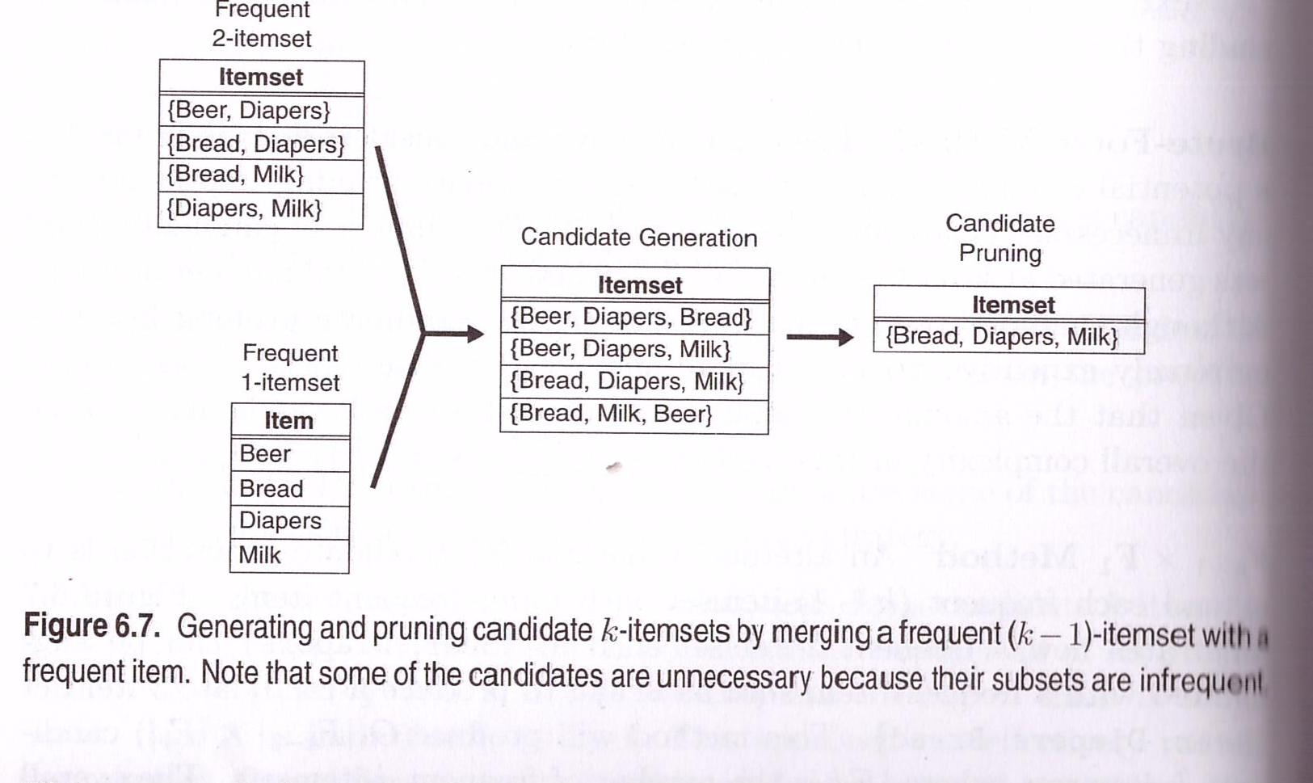
F_{k-1} × F₁ Method

Slide 26
F_{k-1} × F_{k-1} Method
Frequent (k-1)-itemsets are meregd only if their first k-2 items are identical.
Let A= {a₁,a₂, a₃, …,a_{k-1}} and B={b₁,b₂ ,…,b_{k-1}} be a pair of frequent (k-1) itemsets.
A and B are merged if they satisfy the following conditions.
a_{i} = b_{i} (for i=1,2, .., k-2) and a _{k-1} ≠ b_{k-1}

Slide 27
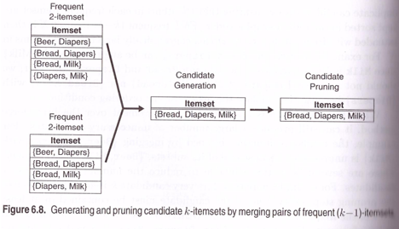
F_{k-1} × F_{k-1} Method
The FIs {Bread, Diapers} and {Bread, Milk}
are merged to form a 3-itemset
{Bread, Diapers, Milk}
{Beer, Diapers}, {Diapers, Milk} need not be
merged – first item is different

Slide 28
The Apriori Algorithm — Example
Database D
L₁
C₁
Scan D
min_sup=2=50%
C₂
C₂
L₂
Scan D
C₃
Scan D
L₃
Scan D

Slide 29
The Apriori Algorithm
Pseudo-code:
C_{k}: Candidate itemset of size k
L_{k} : frequent itemset of size k
L₁ = {frequent items};
for (k = 1; L_{k} !=∅; k++) do begin
C_{k+1} = candidates generated from L_{k};
// join and prune steps
for each transaction t in database do
increment the count of all candidates in C_{k+1} that are contained in t
L_{k+1} = candidates in C_{k+1} with min_support (frequent)
end
return ∪_{k} L_{k};
Important steps in candidate generation:
Join Step: C_{k+1} is generated by joining L_{k} with itself
Prune Step: Any k-itemset that is not frequent cannot be a subset of a frequent (k+1)-itemset

