Slide 1
Classification

Slide 2
Classification
Supervised learning
Supervision: The training data (observations, measurements, etc.) are accompanied by labels indicating the class of the observations
New data is classified based on the training set
Classification
A model or classifier is constructed to predict categorical labels (classes)
“safe” or “risky” – loan application data
“yes” or “no” for marketing data
“treatment A” or “treatment B” or “treatment C” for medical data
Fraud detection: if a transaction is fraudulent

Slide 3
Classification Problem
Given a database D={t₁,t₂,…,t_{n}} and a set of classes C={C₁,…,C_{m}}, the Classification Problem is to define a mapping f : D → C where each t_{i} is assigned to one class.

Slide 4
Prediction Problems: Classification vs. Numeric Prediction
Numeric Prediction
models continuous-valued functions or ordered value
Predicts unknown values.
How much money the customer will spend?
Regression is the technique used for prediction

Slide 5
Classification—A Two-Step Process
Model (classifier) construction: describing a set of predetermined classes or concepts
Each tuple/sample is assumed to belong to a predefined class, as determined by the class label attribute
The set of tuples used for model construction is training set
The model is represented as classification rules, decision trees, or mathematical formulae

Slide 6
Classification—A Two-Step Process (2)
Model built in the first step is used for classifying future or unknown data
Estimating accuracy of the model
The known label of test sample is compared with the classified result from the model
Accuracy rate is the percentage of test set samples that are correctly classified by the model
Test set is independent of training set (otherwise overfitting)
If the accuracy is acceptable, use the model to classify new data

Slide 7
Process (1): Model Construction
Classification
Algorithms
Training
Data
Classifier
(Model)
IF rank = ‘professor’
OR years > 6
THEN tenured = ‘yes’

Slide 8
Process (2): Using the Model in Prediction
Classifier
Testing
Data
Unseen Data
(Jeff, Professor, 4)
Tenured?

Slide 9
Issues: Data Preparation
Data preprocessing is required for improving accuracy, efficiency and scalability of the classification process
Data cleaning
Preprocess data in order to reduce noise and handle missing values
Relevance analysis (feature selection)
Remove the irrelevant or redundant attributes by using correlation analysis and attribute subset selection methods.
Data transformation
Generalization - Street to city
Normalization involves scaling all values for a given attribute so that they fall within a small specified range (eg. 0.0 to 1.0)

Slide 10
Issues: Evaluating Classification Methods
Accuracy
refers to the ability of a given classifier to correctly predict the class label of new or previously unseen data
Percentage of records in the test dataset that are correctly classified by the classifier.
Speed
time to construct the model (training time)
time to use the model (classification/prediction time)
Robustness
Ability of the classifier to make correct predictions given noisy data or data with missing values

Slide 11
Issues: Evaluating Classification Methods (2)
Scalability
efficiency in handling disk-resident databases
Interpretability
Level of understanding and insight provided by the model

Slide 12
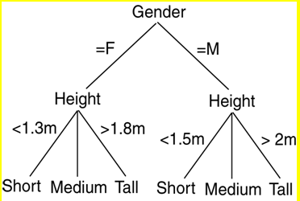
Decision Tree Induction
A decision tree is a flowchart-like structure, where
each internal node (nonleaf node) denotes a test on an attribute
each branch represents an outcome of the test
each leaf node (or terminal node) holds a class label

Slide 13
Decision Tree Induction: An Example Data Set
Youth
Youth
Middle aged
Senior
Senior
Senior
Middle aged
Youth
Youth
Senior
Youth
Middle aged
Middle aged
Senior

Slide 14
Decision Tree Induction: An Example (2)
Training data set: Buys_computer
Resulting tree:
age?
Youth
Middle-aged
Senior
<=30
overcast
>40
31..40
student?
yes
credit rating?
no
yes
excellent
fair
no
yes
no
yes

Slide 15
Decision Tree – Advantages
Decision trees can easily be converted to classification rules
Decision tree classifiers does not require any domain knowledge and it is appropriate for exploratory knowledge discovery
It can handle high dimensional data
It is easy for the human beings to understand
Steps of DT are simple and fast
Good accuracy
Application areas: medicine, manufacturing, financial analysis, astronomy and molecular biology

Slide 16
Algorithm for Decision Tree Induction
Basic algorithm (a greedy algorithm)
Tree is constructed in a top-down recursive divide-and-conquer manner
The training set is recursively partitioned into smaller subsets as the tree is being built
At start, all the training examples are at the root
Attributes are categorical (if continuous-valued, they are discretized in advance)
Examples are partitioned recursively based on selected attributes
Test attributes are selected on the basis of a heuristic or statistical measure (e.g., information gain)

Slide 17
Algorithm for Decision Tree Induction (2)
Conditions for stopping partitioning
All samples for a given node belong to the same class
There are no remaining attributes for further partitioning – majority voting is employed for classifying the leaf
There are no samples left
Time complexity : O(n× |D| × log(|D| ) –
n- number of attributes describing the tuples in D
|D| - number of training tuples in D

Slide 18
Information gain
This is the attribute selection measure
D – training data set (with class labels)
m – distinct classes - C_{i} (for i = 1, …, m)
C_{i,D} –set of tuples of class C_{i} in D
|D| , | C_{i,D} | - denote the number of tuples in D and C_{i,D} respetively
Node N – root - hold the tuples of partition D
The attribute with the highest information gain is chosen as the splitting attribute for node N

Slide 19

Information gain (2)
Info(D) =
(where p_{i} is the probability that an arbitrary tuple in D belongs to class C_{i} and it is estimated by, |C_{i,D} | / | D| .
A log function to the base 2 is used (because the information is encoded in bits)
Info(D) is the average amount of information needed to identify the class label of a tuple in D
Info(D) is also known as the entropy of D

Slide 20
Attribute Selection Measure: Information Gain (ID3/C4.5)
Select the attribute with the highest information gain
Let p_{i} be the probability that an arbitrary tuple in D belongs to class C_{i}, estimated by |C_{i, D}|/|D|
Expected information (entropy) needed to classify a tuple in D:
Information needed (after using A to split D into v partitions) to classify D:
Information gained by branching on attribute A
Notes:
I : the expected information needed to classify a given sample
E (entropy) : expected information based on the partitioning into subsets by A

Slide 21
Attribute Selection: Information Gain
Class P: buys_computer = “yes”
Class N: buys_computer = “no”
means “age <=30” has 5 out of 14 samples, with 2 yes’es and 3 no’s. Hence
Similarly,

Slide 22
Attribute Selection: Information Gain
Expected information required needed to classify a tuple in D:
Info(D)= - (9/14) * log₂(9/14) – (5/14 )*log₂(5/14)
= 0.940
Expected information required to classify a tuple in D if the tupes are partitioned according to age is
Info_{age}(D)= 5/14 * (-(2/5) * log2 (2/5) – (3/5) * log2(3/5) + 4/14 * ( -(4/4) * log2 (4/4) - (0/4)* log2 (0/4)) + 5/14 * ( -(3/5) * log2 (3/5) - (2/5) * log2 (2/5)) = 0.694
Gain in information from such a partitioning would be
Gain(age) = Info(D) - Info_{age}(d) = 0.940 - 0.694 = 0.246

Slide 23
Attribute Selection: Information Gain
Similarly we can compute Gain(income) = 0.029, Gain(student) = 0.151 and Gain(credit_rating) = .048.
age has highest information gain among the attributes, it is selected as the splitting attribute.
The tuples are partitioned as given in figure (shown in the next slide)

Slide 24
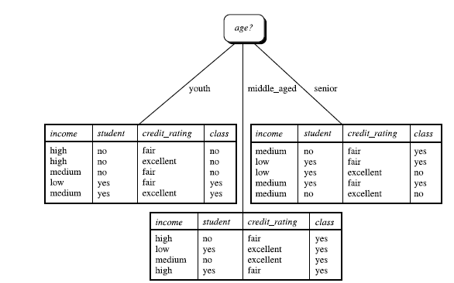

Slide 25
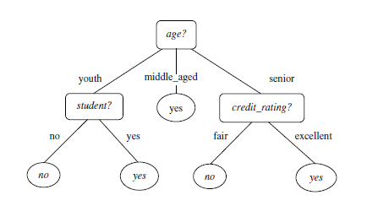

Slide 26
Computing Information-Gain for Continuous-Value Attributes
Let attribute A be a continuous-valued attribute
Must determine the best split point for A
Sort the value A in increasing order
Typically, the midpoint between each pair of adjacent values is considered as a possible split point
(a_{i}+a_{i+1})/2 is the midpoint between the values of a_{i} and a_{i+1}
For each possible split-point for A, we evaluate Info_{A}(D), where number of partitions is two.
The point with the minimum expected information requirement for A is selected as the split-point for A
Split:
D1 is the set of tuples in D satisfying A ≤ split-point, and D2 is the set of tuples in D satisfying A > split-point

