Slide 1
Classification

Slide 2
Classification
Supervised learning
Supervision: The training data (observations, measurements, etc.) are accompanied by labels indicating the class of the observations
New data is classified based on the training set
Classification
A model or classifier is constructed to predict categorical labels (classes)
“safe” or “risky” – loan application data
“yes” or “no” for marketing data
“treatment A” or “treatment B” or “treatment C” for medical data
Fraud detection: if a transaction is fraudulent

Slide 3
Classification Problem
Given a database D={t₁,t₂,…,t_{n}} and a set of classes C={C₁,…,C_{m}}, the Classification Problem is to define a mapping f : D → C where each t_{i} is assigned to one class.

Slide 4
Prediction Problems: Classification vs. Numeric Prediction
Numeric Prediction
models continuous-valued functions or ordered value
Predicts unknown values.
How much money the customer will spend?
Regression is the technique used for prediction

Slide 5
Classification—A Two-Step Process
Model (classifier) construction: describing a set of predetermined classes or concepts
Each tuple/sample is assumed to belong to a predefined class, as determined by the class label attribute
The set of tuples used for model construction is training set
The model is represented as classification rules, decision trees, or mathematical formulae

Slide 6
Classification—A Two-Step Process (2)
Model built in the first step is used for classifying future or unknown data
Estimating accuracy of the model
The known label of test sample is compared with the classified result from the model
Accuracy rate is the percentage of test set samples that are correctly classified by the model
Test set is independent of training set (otherwise overfitting)
If the accuracy is acceptable, use the model to classify new data

Slide 7
Process (1): Model Construction
Classification
Algorithms
Training
Data
Classifier
(Model)
IF rank = ‘professor’
OR years > 6
THEN tenured = ‘yes’

Slide 8
Process (2): Using the Model in Prediction
Classifier
Testing
Data
Unseen Data
(Jeff, Professor, 4)
Tenured?

Slide 9
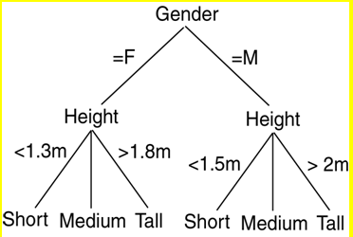
Decision Tree Induction
A decision tree is a flowchart-like structure, where
each internal node (nonleaf node) denotes a test on an attribute
each branch represents an outcome of the test
each leaf node (or terminal node) holds a class label

Slide 10
Decision Tree Induction: An Example Data Set
Youth
Youth
Middle aged
Senior
Senior
Senior
Middle aged
Youth
Youth
Senior
Youth
Middle aged
Middle aged
Senior

Slide 11
Decision Tree Induction: An Example (2)
Training data set: Buys_computer
Resulting tree:
age?
Youth
Middle-aged
Senior
<=30
overcast
>40
31..40
student?
yes
credit rating?
no
yes
excellent
fair
no
yes
no
yes

Slide 12
Decision Tree – Advantages
Decision trees can easily be converted to classification rules
Decision tree classifiers does not require any domain knowledge and it is appropriate for exploratory knowledge discovery
It can handle high dimensional data
It is easy for the human beings to understand
Steps of DT are simple and fast
Good accuracy
Application areas: medicine, manufacturing, financial analysis, astronomy and molecular biology

Slide 13
Algorithm for Decision Tree Induction
Basic algorithm (a greedy algorithm)
Tree is constructed in a top-down recursive divide-and-conquer manner
The training set is recursively partitioned into smaller subsets as the tree is being built
At start, all the training examples are at the root
Attributes are categorical (if continuous-valued, they are discretized in advance)
Examples are partitioned recursively based on selected attributes
Test attributes are selected on the basis of a heuristic or statistical measure (e.g., information gain)

Slide 14
Algorithm for Decision Tree Induction (2)
Conditions for stopping partitioning
All samples for a given node belong to the same class
There are no remaining attributes for further partitioning – majority voting is employed for classifying the leaf
There are no samples left
Time complexity : O(n× |D| × log(|D| ) –
n- number of attributes describing the tuples in D
|D| - number of training tuples in D

Slide 15
Information gain
This is the attribute selection measure
D – training data set (with class labels)
m – distinct classes - C_{i} (for i = 1, …, m)
C_{i,D} –set of tuples of class C_{i} in D
|D| , | C_{i,D} | - denote the number of tuples in D and C_{i,D} respetively
Node N – root - hold the tuples of partition D
The attribute with the highest information gain is chosen as the splitting attribute for node N

Slide 16

Information gain (2)
Info(D) =
(where p_{i} is the probability that an arbitrary tuple in D belongs to class C_{i} and it is estimated by, |C_{i,D} | / | D| .
A log function to the base 2 is used (because the information is encoded in bits)
Info(D) is the average amount of information needed to identify the class label of a tuple in D
Info(D) is also known as the entropy of D

Slide 17
Attribute Selection Measure: Information Gain (ID3/C4.5)
Select the attribute with the highest information gain
Let p_{i} be the probability that an arbitrary tuple in D belongs to class C_{i}, estimated by |C_{i, D}|/|D|
Expected information (entropy) needed to classify a tuple in D:
Information needed (after using A to split D into v partitions) to classify D:
Information gained by branching on attribute A
Notes:
I : the expected information needed to classify a given sample
E (entropy) : expected information based on the partitioning into subsets by A

Slide 18
Attribute Selection: Information Gain
Class P: buys_computer = “yes”
Class N: buys_computer = “no”
means “age <=30” has 5 out of 14 samples, with 2 yes’es and 3 no’s. Hence
Similarly,

Slide 19
Attribute Selection: Information Gain
Expected information required needed to classify a tuple in D:
Info(D)= - (9/14) * log₂(9/14) – (5/14 )*log₂(5/14)
= 0.940
Expected information required to classify a tuple in D if the tupes are partitioned according to age is
Info_{age}(D)= 5/14 * (-(2/5) * log2 (2/5) – (3/5) * log2(3/5) + 4/14 * ( -(4/4) * log2 (4/4) - (0/4)* log2 (0/4)) + 5/14 * ( -(3/5) * log2 (3/5) - (2/5) * log2 (2/5)) = 0.694
Gain in information from such a partitioning would be
Gain(age) = Info(D) - Info_{age}(d) = 0.940 - 0.694 = 0.246

Slide 20
Attribute Selection: Information Gain
Similarly we can compute Gain(income) = 0.029, Gain(student) = 0.151 and Gain(credit_rating) = .048.
age has highest information gain among the attributes, it is selected as the splitting attribute.
The tuples are partitioned as given in figure (shown in the next slide)

Slide 21
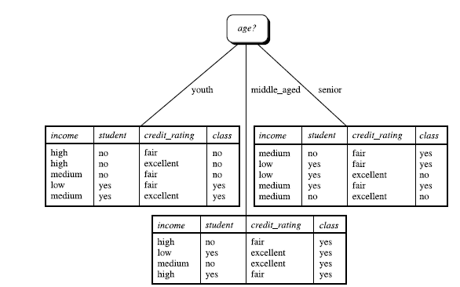

Slide 22
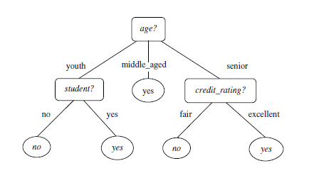

Slide 23
Issues: Data Preparation
Data preprocessing is required for improving accuracy, efficiency and scalability of the classification process
Data cleaning
Preprocess data in order to reduce noise and handle missing values
Relevance analysis (feature selection)
Remove the irrelevant or redundant attributes by using correlation analysis and attribute subset selection methods.
Data transformation
Generalization - Street to city
Normalization involves scaling all values for a given attribute so that they fall within a small specified range (eg. 0.0 to 1.0)

Slide 24
Issues: Evaluating Classification Methods
Accuracy
refers to the ability of a given classifier to correctly predict the class label of new or previously unseen data
Percentage of records in the test dataset that are correctly classified by the classifier.
Speed
time to construct the model (training time)
time to use the model (classification/prediction time)
Robustness
Ability of the classifier to make correct predictions given noisy data or data with missing values

Slide 25
Issues: Evaluating Classification Methods (2)
Scalability
efficiency in handling disk-resident databases
Interpretability
Level of understanding and insight provided by the model

Slide 26
Computing Information-Gain for Continuous-Value Attributes
Let attribute A be a continuous-valued attribute
Must determine the best split point for A
Sort the value A in increasing order
Typically, the midpoint between each pair of adjacent values is considered as a possible split point
(a_{i}+a_{i+1})/2 is the midpoint between the values of a_{i} and a_{i+1}
For each possible split-point for A, we evaluate Info_{A}(D), where number of partitions is two.
The point with the minimum expected information requirement for A is selected as the split-point for A
Split:
D1 is the set of tuples in D satisfying A ≤ split-point, and D2 is the set of tuples in D satisfying A > split-point

Slide 27
Gain Ratio for Attribute Selection (C4.5)
Information gain measure is biased towards attributes with a large number of values
C4.5 (a successor of ID3) uses gain ratio to overcome the problem (normalization to information gain)
GainRatio(A) = Gain(A)/SplitInfo(A)

Slide 28
Gain Ratio for Attribute Selection (C4.5) - 2
Ex.
gain_ratio(income) = 0.029/1.557 = 0.019
The attribute with the maximum gain ratio is selected as the splitting attribute

Slide 29
Gini Index (CART, IBM IntelligentMiner)
If a data set D contains examples from n classes, gini index, gini(D) is defined as
(where p_{j} is the relative frequency of class j in D)
If a data set D is split on A into two subsets D₁ and D₂, the gini index gini(D) is defined as

Slide 30
Gini Index (CART, IBM IntelligentMiner)
Reduction in Impurity:
The attribute provides the smallest gini_{split}(D) (or the largest reduction in impurity) is chosen to split the node (need to enumerate all the possible splitting points for each attribute)

Slide 31
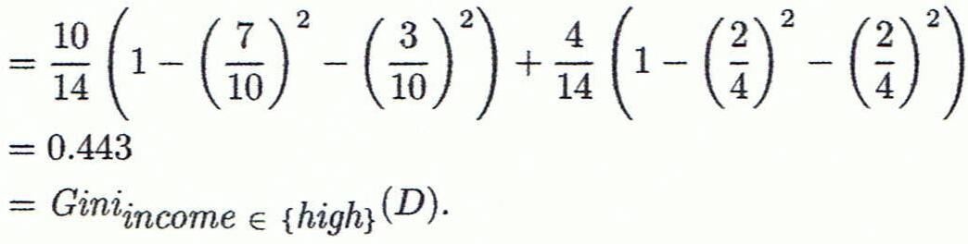
Computation of Gini Index
Ex. D has 9 tuples in buys_computer = “yes” and 5 in “no”
Suppose the attribute income partitions D into 10 in D₁: {low, medium} and 4 in D₂ {high}

Slide 32
Computation of Gini Index (2)
Gini_{{low,high}} is 0.458; Gini_{{medium,high}} is 0.450. Thus, split on the {low,medium} (and {high}) since it has the lowest Gini index

Slide 33
Overfitting and Tree Pruning
Classifiers should be built based on the general trends inherent in the training data and not on specific details. When a classifier begins to depend on specific details, it is said to over-fit the training data.
Over fitting: An induced tree may overfit the training data
Too many branches, some may reflect anomalies due to noise or outliers
Poor accuracy for unseen samples

Slide 34
Overfitting and Tree Pruning (2)
Two approaches to avoid overfitting
Prepruning: Halt tree construction early ̵ do not split a node if this would result in the goodness measure falling below a threshold
High threshold could result in oversimplified trees and low threshold result in very little simplification.
Difficult to choose an appropriate threshold

Slide 35
Overfitting and Tree Pruning (3)
Post pruning: Remove branches from a “fully grown” tree—get a sequence of progressively pruned trees
Use a set of data different from the training data to decide which is the “best pruned tree”
Pruning is done based on cost complexity (function of number of leaves in the tree and error rate of the tree (error rate: percentage of the tuples miss classified by the tree)

Slide 36
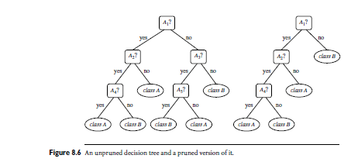
Post Pruning

Slide 37
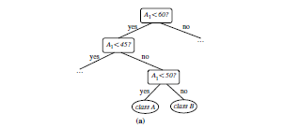
Repetition
Attribute of a tree is repeatedly tested along
a given branch of the tree

Slide 38
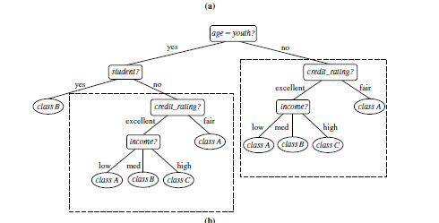
Replication
Duplicate sub trees exist within a tree

Slide 39
Bayesian Classification: Why?
A statistical classifier: performs probabilistic prediction, i.e., predicts class membership probabilities
Probability that a given tuple belongs to a particular class
Foundation: Based on Bayes’ Theorem.
Performance:
A simple Bayesian classifier, naïve Bayesian classifier, has comparable performance with decision tree and selected neural network classifiers
Exhibited high accuracy and speed when applied o large databases

Slide 40
Bayesian Classification: Why? (2)
Naïve Bayesian classifiers assume that the effect of an attribute value on a given class is independent of the values of other attributes – known as class conditional independence

Slide 41
Bayes’ Theorem: Basics
Bayes’ Theorem:
Let X be a data sample (“evidence”): class label is unknown
Let H be a hypothesis that X belongs to class C
Classification is to determine P(H|X), (i.e., posteriori probability): the probability that the hypothesis holds given the observed data sample X

Slide 42
Bayes’ Theorem: Basics (2)
P(H) (prior probability): the initial probability
E.g., X will buy computer, regardless of age, income, …
P(X): probability that sample data is observed
P(X|H) (likelihood): the probability of observing the sample X, given that the hypothesis holds
E.g., Given that X will buy computer, the prob. that X is 31..40, medium income

Slide 43
Prediction Based on Bayes’ Theorem
Given training data X, posteriori probability of a hypothesis H, P(H|X), follows the Bayes’ theorem
Informally, this can be viewed as
posteriori = likelihood x prior/evidence

Slide 44
Classification Is to Derive the Maximum Posteriori
Let D be a training set of tuples and their associated class labels, and each tuple is represented by an n-D attribute vector X = (x₁, x₂, …, x_{n})
Suppose there are m classes C₁, C₂, …, C_{m}.
Classification is to derive the maximum posteriori, i.e., the maximal P(C_{i}|X)

Slide 45
Classification Is to Derive the Maximum Posteriori (2)
This can be derived from Bayes’ theorem
Since P(X) is constant for all classes, only
needs to be maximized

Slide 46
Naïve Bayes Classifier
A simplified assumption: attributes are conditionally independent (i.e., no dependence relation between attributes):
x_{k} refers to the value of attribute A_{k} for tuple X
This greatly reduces the computation cost: Only counts the class distribution
If A_{k} is categorical, P(x_{k}|C_{i}) is the # of tuples in C_{i} having value x_{k} for A_{k} divided by |C_{i, D}| (# of tuples of C_{i} in D)

Slide 47
Naïve Bayes Classifier (2)
If A_{k} is continous-valued, P(x_{k}|C_{i}) is usually computed based on Gaussian distribution with a mean μ and standard deviation σ
and P(x_{k}|C_{i}) is

Slide 48
Naïve Bayes Classifier: Training Dataset
the probability that the tuple X is classified to C_{i} given the observed data sample X
the probability of observing
the sample X, given
that the hypothesis holds (tuples belonging to C_{i is known}
Class:
C1:buys_computer = ‘yes’
C2:buys_computer = ‘no’
Data to be classified:
X = (age <=30,
Income = medium,
Student = yes
Credit_rating = Fair)

Slide 49
Naïve Bayes Classifier: An Example
P(C_{i}): P(buys_computer = “yes”) = 9/14 = 0.643
P(buys_computer = “no”) = 5/14= 0.357
Compute P(X|C_{i}) for each class
P(age = “<=30” | buys_computer = “yes”) = 2/9 = 0.222
P(age = “<= 30” | buys_computer = “no”) = 3/5 = 0.6
P(income = “medium” | buys_computer = “yes”) = 4/9 = 0.444
P(income = “medium” | buys_computer = “no”) = 2/5 = 0.4
P(student = “yes” | buys_computer = “yes) = 6/9 = 0.667
P(student = “yes” | buys_computer = “no”) = 1/5 = 0.2
P(credit_rating = “fair” | buys_computer = “yes”) = 6/9 = 0.667
P(credit_rating = “fair” | buys_computer = “no”) = 2/5 = 0.4

Slide 50
Naïve Bayes Classifier: An Example (2)
X = (age <= 30 , income = medium, student = yes, credit_rating = fair)
P(X|C_{i}) : P(X|buys_computer = “yes”) = 0.222 x 0.444 x 0.667 x 0.667 = 0.044
P(X|buys_computer = “no”) = 0.6 x 0.4 x 0.2 x 0.4 = 0.019
P(X|C_{i})*P(C_{i}) : P(X|buys_computer = “yes”) * P(buys_computer = “yes”) = 0.028
P(X|buys_computer = “no”) * P(buys_computer = “no”) = 0.007
Therefore, X belongs to class (“buys_computer = yes”)

Slide 51
Avoiding the Zero-Probability Problem
Naïve Bayesian prediction requires each conditional prob. be non-zero. Otherwise, the predicted prob. will be zero
Ex. Suppose a dataset with 1000 tuples, income=low (0), income= medium (990), and income = high (10)

Slide 52
Avoiding the Zero-Probability Problem (2)
Use Laplacian correction (or Laplacian estimator)
Adding 1 to each case
Prob(income = low) = 1/1003
Prob(income = medium) = 991/1003
Prob(income = high) = 11/1003
The “corrected” prob. estimates are close to their “uncorrected” counterparts

Slide 53
Naïve Bayes Classifier: Comments
Advantages
Easy to implement
Good results obtained in most of the cases
Disadvantages
Assumption: class conditional independence, therefore loss of accuracy

Slide 54
Naïve Bayes Classifier: Comments (2)
Practically, dependencies exist among variables
E.g., hospitals: patients: Profile: age, family history, etc.
Symptoms: fever, cough etc., Disease: lung cancer, diabetes, etc.
Dependencies among these cannot be modeled by Naïve Bayes Classifier
How to deal with these dependencies? Bayesian Belief Networks

