Slide 1
Environment impact assessment (EIA)

Slide 2
Introduction
Planning tool
To assess the changes in the environment due to human activities & reliable monitoring
Formal process to predict the environmental consequences of any development process
Potential problems foreseen to be addressed at a later stage

Slide 3
Key elements
Screening
Scoping
Identifying and evaluating alternatives
Mitigation measure
Issuing environmental statement

Slide 4
Steps involved
Selection of a coordinator
Impact identification
Baseline study
Impact evaluation
Assessment
Documentation
Notes:
Selection of a coordinator
Impact identification
Baseline study
Impact evaluation
Assessment
Documentation

Slide 5
Need for EIA
Major developments
Power stations
Afforestation
Ports & harbours
Marine fish farming
Marine dredging for minerals
Transports – trunk roads,Railways and inland waterways
Purpose
Environmental protection

Slide 6
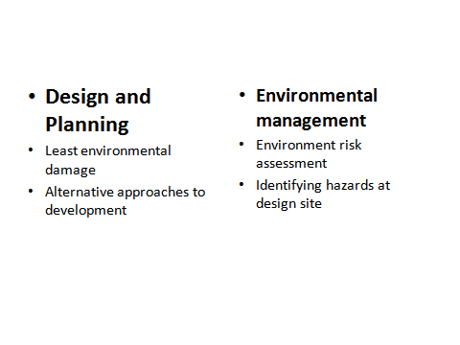

Slide 7
Process
Proposal development identified by scoping exercise
Provision made in regulation for formal scoping by consultation with parties
Iterative process of design
Environmental Statement
Review of existing information through desk and site surveys
Mitigation measures incorporated through-out

Slide 8
Screening
Base line studies
Scoping
Impact assessment
Terms of reference
Mitigation

Slide 9
Techniques
Adhoc method
Check list
Matrices
Networks
Overlays
Cost benefit analysis
Simulation modeling Technique

Slide 10
EIA Notification
Statutory for 29 development projects
Framed in Jan 1994
Amended in 1997

Slide 11
EIA for ports and harbours
Major sources of the adverse effects on account of development of port and harbour projects can be categorized into the following types:
(a) Location of port;
(b) Construction
(c) Port operation, including ship traffic and discharges,
(d) Cargo handling, storage and land transport.

Slide 12
Project description
Natural resources
Housing
Cargo handling
Man power requirment
Description of the environment
Land environment
Water environment
Noise air environment
Public utilities
Biological environment
Waste disposal facilities

Slide 13
EC
The environmental clearance process for new projects will comprise of a maximum of four stages. These four stages in sequential order:
Stage (1)-Screening
Stage (2)- Scoping
Stage (3)- Public consultation
Stage (4)- Appraisal

Slide 14
Terms of Reference (TOR) for preparation of EIA report
Generic structure of environmental impact assessment document
• Introduction
• Project Description
• Analysis of Alternatives (Technology and Site)
• Description of the Environment
• Anticipated Environmental Impacts & Mitigation Measures
• Environmental Monitoring Program
• Additional Studies
• Project Benefits
• Environmental Cost Benefit Analysis
• Environmental Management Plan
• Summary & Conclusion
• Disclosure of Consultants engaged

Slide 15
Environmental impacts
-Anticipated impact during construction &Operation
-Mitigation measures
-Environment monitoring programme
-Risk analysis and disaster management plan

