Slide 1

The Origin and Evolution of Life on Earth

Slide 2
When did life begin?
Quite early in Earth’s history
Cannot pinpoint time, but can narrow down a time period with 3 lines of evidence

Slide 3
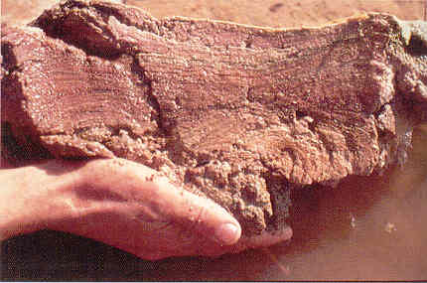
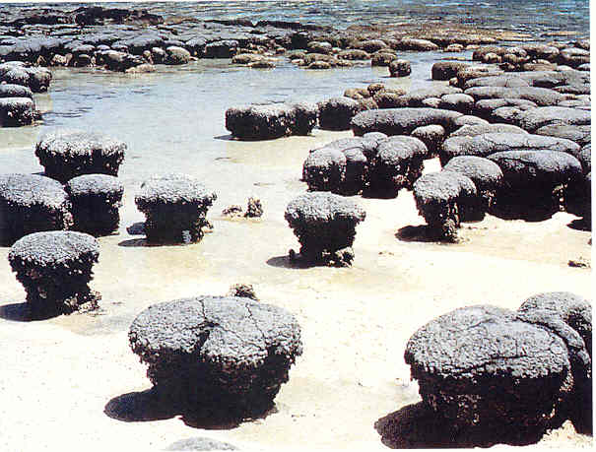
When did life begin?
Stromatolites (3.5 bill. Yr)
  Rocks with distinctive layer structure
Look identical to living mats of microbes
  Layers of microbes and sediment
  Top layer uses photosynthesis
  Lower layers use top layer’s byproducts

Slide 4
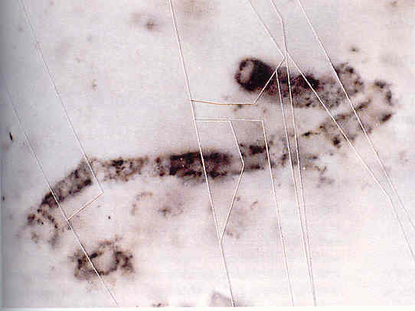
When did life begin?
Microfossils dating to 3.5 billion years ago
Difficult to distinguish from mineral structures
Analysis shows that some structures contain organic carbon
  -found in at least 3 sites

Slide 5
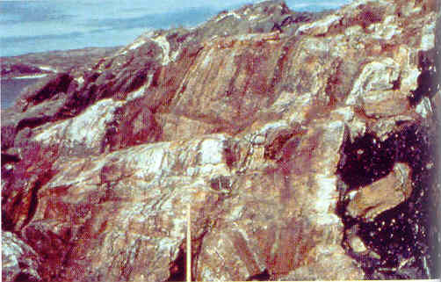
When did life begin?
Evidence in metamorphic rocks that life existed 3.85 billions years ago
Low C¹²/C¹³ fraction in rock layers suggests life
  Biological processes prefer C¹² to C¹³
    Find lower fraction of C¹³
  Non-biological processes have no preference, so find equal amounts

Slide 6
When did life begin?
Rocks before ~4 billion years old are rare and hard to find
Time of heavy bombardment ended about 3.8-4.0 billion years ago
  Last devastating impact between 4.2-3.9 bill. Yr ago
Evidence suggests life as long as 3.85 billion years ago and definitely at 3.5 billion years ago
Life rose and dominated the planet between 100-500 million years

Slide 7
Living Fossils
DNA used as living fossil
The more alike the DNA sequence between species, the more recent their divergence and extinction of their common ancestor

Slide 8
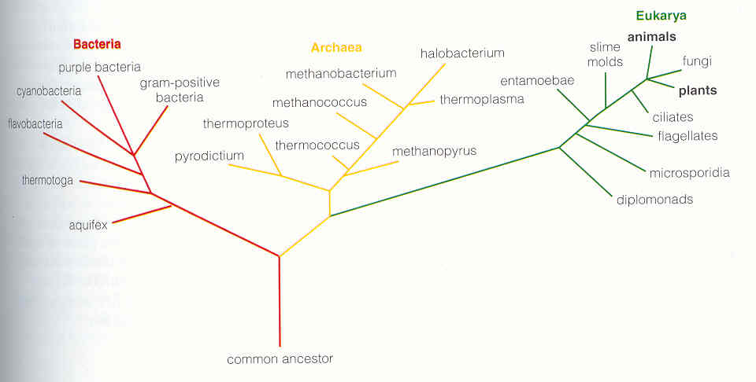
Living Fossils
Bacteria and Archaea: genetic material NOT separated from rest of cell
Eukarya: DNA separated from rest of cell by membrane
Extremophiles (live near deep-sea vents or in hot springs) closest to root of tree of life

Slide 9
Where did life begin?
Land is unlikely
  No O₂, no ozone: UV destroys molecular bonds
Shallow ponds
  Once favored, full of organic material
  When evaporated, organic chemical concentration increases making it easier to combine complex molecules leading to life
  Current experiments indicate lack of chemical energy sufficient to support life
Deep-sea vents/hot springs
  DNA evidence suggests that early organisms survived in conditions similar to deep-sea vents
  Plenty of chemical energy available

Slide 10
How did life begin?
Simplest organisms today and those dated 3.5 billion years ago are remarkable advanced
What are the natural chemical processes that could have led to life?
Assumptions
  Life began under chemical conditions of early Earth
  Life did not migrate to Earth

Slide 11
Organic Chemistry on Early Earth
In 1920’s, scientists hypothesized that the chemicals in the early atmosphere, fueled by sunlight, would spontaneously create organic molecules
Tested by Miller-Urey experiment 1950’s

Slide 12
Miller-Urey Experiment
First flask partially filled with water and heated to produce water vapor (sea)
Water vapor was moved to a second flask where methane and ammonia vapor was added (atmosphere)
Electric sparks (lightening) in second flask was energy source for chemical reactions
Below second flask, water vapor cooled (rain) and recycled to first flask (sea)
Result: turned brown with amino acids and other complex organic molecules

Slide 13
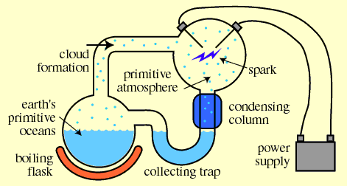

Slide 14
Time to think……
We have discussed the formation of the solar system and the formation of the terrestrial planets. Now, what is wrong with the Miller-Urey experiment?

Slide 15
Variations of Miller-Urey Experiment
Different mixes of gases to represent atmosphere
Different energy sources, like UV (sunlight)
Results: ALL PRODUCE AMINO ACIDS AND COMPLEX ORGANIC MOLECULES
  Not as much as original experiment
  MUST be more sources of organic material

Slide 16
Sources of Organic Molecules
Chemical reactions in atmosphere
  Lab experiments show this is likely
Organic material brought by impacts
  Chemical analysis of comets and carbonaceous chondrites show that they have organic molecules
Chemical reactions near deep-sea vents
  Heat from undersea volcano can fuel chemical reactions between water and minerals

Slide 17
Transition from chemistry to biology
Organic molecules are building blocks of life.
Low probability of forming life even if repeated several times.
Intermediate steps of high probability are necessary

Slide 18
Search for Self-Replicating Molecule
Work backward from organisms that live today
DNA is double-stranded = complicated
RNA obvious candidate, more simple than DNA
  Hereditary information
  Can serve as template for replication
  Fewer steps to produce backbone structure

Slide 19
Search for Self-Replicating Molecule
Problem: RNA and DNA require enzymes to replicate
In 1980’s determined that RNA might catalyze their own replication instead of other enzymes
Early Earth was an RNA-world

Slide 20
Search for Replicating Molecule
On Early Earth, short strands of RNA-like molecules were produced spontaneously partially or completely
RNA-like molecules that could replicate faster with less errors soon dominated population
Copying errors introduced mutations, ensuring the production of many variations of successful molecules
Allowed molecular evolution to continue
RNA-world gave way to DNA-world
  DNA less prone to copying errors
  DNA more flexible hereditary material
  RNA kept some of its original functions

Slide 21
Assembling Complex Organic Molecules
Organic soup was too dilute to favor the creation of complex organic molecules
Lab experiment with possible solution: When hot sand, clay or rock is placed in dilute organic solution, complex molecules self-assemble
  Organic molecules stick to surface of clay
  Increases density and likelihood of reactions
  Strands of RNA up to 100 bases have been produced this way

Slide 22
Assembling Complex Organic Molecules
Other inorganic minerals may have also had a similar role
Iron pyrite (fool’s gold)
  Positive charges on surface which allows organic molecules to adhere
  Formation of pyrite releases energy which could be used as fuel for chemical reactions

Slide 23
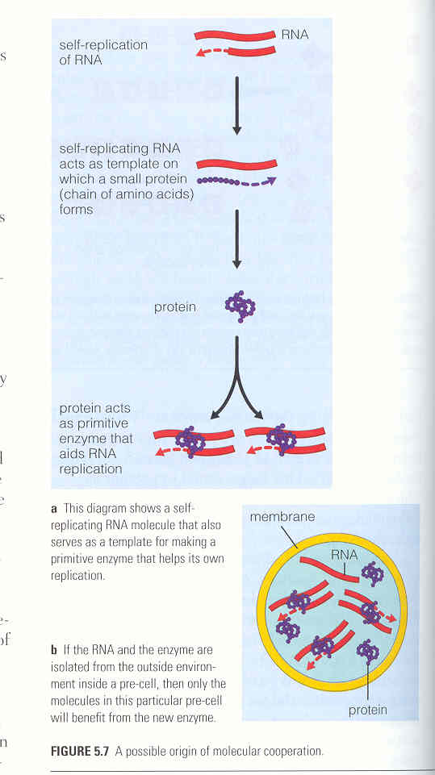
Early Cell-like Structures
Advantages to enclosing enzymes with RNA molecules
Close proximity increases rate of reactions between them
Isolate contents from outside world

Slide 24
Early Cell-like Structures
Lab experiments suggest that membrane structures existed on early Earth
Form spontaneously
  Cool down warm-water solution of amino acids
  Mix lipids (fats) with water

Slide 25
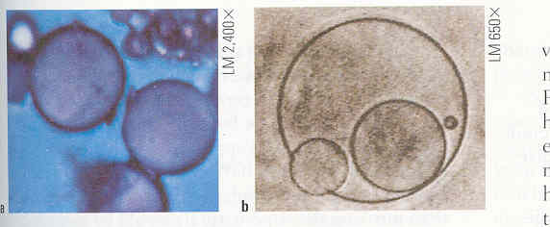
Nonliving Pre-Cells have Lifelike Behavior
Grow in size until unstable then split to form a ‘daughter’ cell
Selectively allow other types of molecules to pass in/out of membrane
Store energy in the form of electric voltage

Slide 26
Handedness
Organic molecules come in left- and right-handed forms
Non-biological processes have not preference
Biological processes DO have a preference
If both left- and right-handed RNA developed, why did one die out?

Slide 27
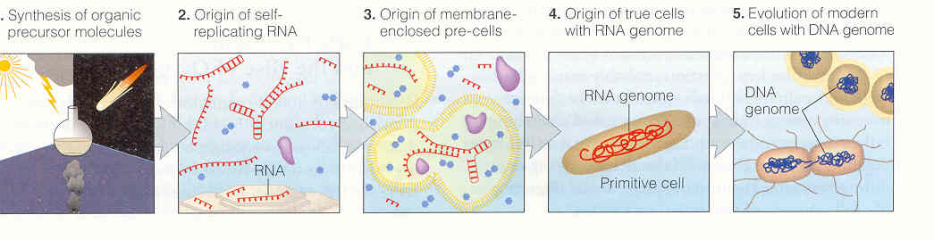
Quick Summary

Slide 28
Panspermia?
Panspermia = life originated elsewhere and migrated to Earth
Life began in rock, then kicked off the planet by an impact
Support: organic material is everywhere, and some bacteria can withstand large amounts of radiation and go dormant under low atmospheric conditions

Slide 29
Panspermia
2 schools of thought
School 1: life did not evolve as easily as imagined on early Earth in timescales we’ve determined
Problem: entire solar system was under heavy bombardment at the same time
Other possibility: interstellar migration
Problem: rock to be ejected out of its own system, then fall into ours and hit the tiny planet of Earth

Slide 30
Panspermia
School 2: life evolved easily and was everywhere with suitable conditions
Earth was not first planet with suitable conditions
Migration of life from another planet (say Mars) dominated before early life on Earth could
  We’re Martians!!!!

Slide 31
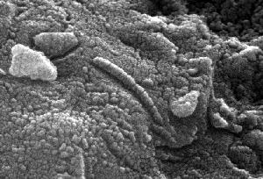
Panspermia
Martian meteorites
Both have possible fossil evidence of life on Mars

Slide 32
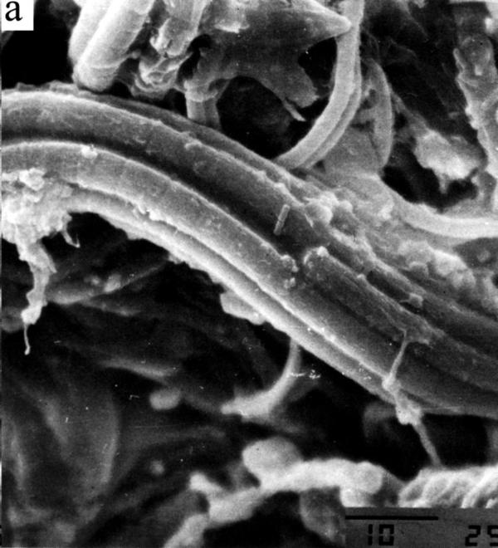
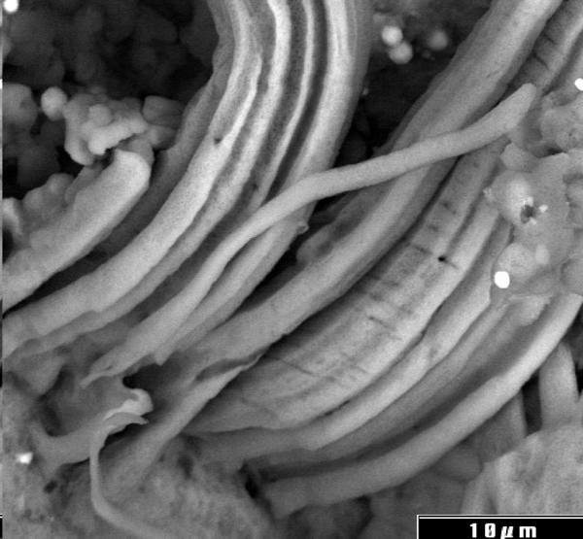
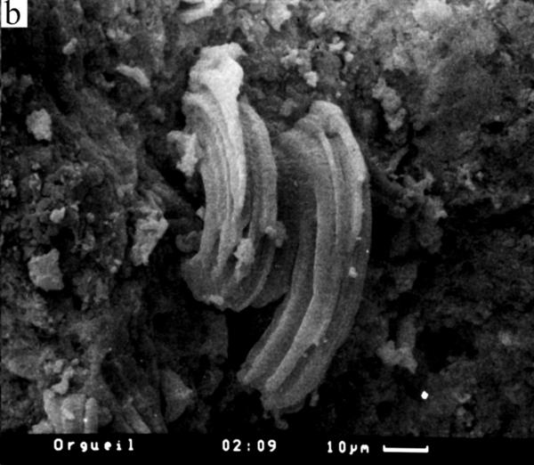
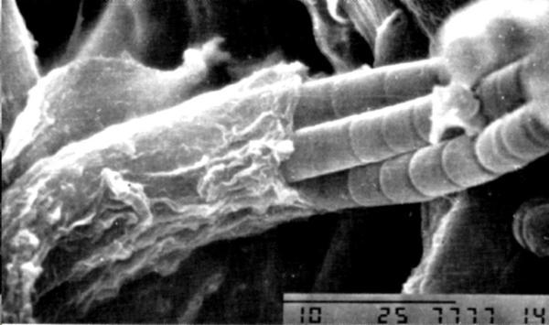
Living cyanobacteria
Microfossils in carbonaceous chondrites

Slide 33
Time to think……
Work out Exercise I. When, Where and How? in the class activity ‘Origins of Life on Earth’.

Slide 34
Early Evolution and Rise of O₂
First organisms had simple metabolism
Atmosphere was O₂ free, must have been anaerobic
Probably chemoheterotrophs
  Obtained nutrients from organic material
  Obtained nutrients from inorganic material
    Modern archaea appear to be close to the root of the tree of life
    Obtaining energy from chemical reactions involving hydrogen, sulfur and iron compounds (all abundant on early Earth)

Slide 35
Early Evolution
Natural selection probably resulted in rapid diversification
Modern DNA has enzymes that reduce the rate of mutations
RNA is not so lucky, more likely to have copying errors
Higher mutation rate in early evolution than now

Slide 36
Photosynthesis
Most important new metabolic process evolved gradually
Organisms that lived close to ocean surface probably developed means of absorbing sunlight (UV in particular)
Once absorbed, developed method of turning it into energy
  Modern organisms of purple sulfur bacteria and green sulfur bacteria much like early photosynthetic microbes, use H2S instead of H2O for photosynthesis

Slide 37
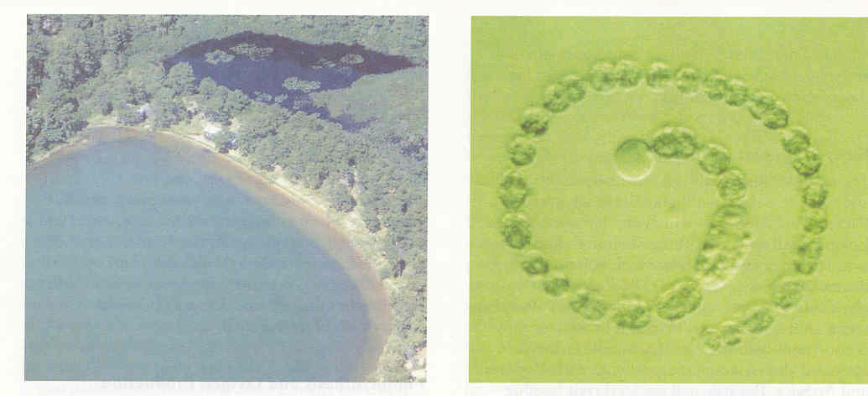
Photosynthesis
Using water for photosynthesis developed later, perhaps 3.5 billion years ago
First appearing in cyanobacteria (blue-green algae)
By product of O₂, released into atmosphere
Changed the world!

Slide 38
Rise of O₂
O₂ is highly reactive
All initial O₂ would react with rock and minerals in water
O₂ could not accumulate in atmosphere until surface rock was saturated
Rocks 2-3 bill. Yr old called banded iron formations, show atmosphere had <1% of current amount of O₂
Rock evidence suggests that O₂ amounts in atmosphere began to rise about 2.0 bill. Yr ago
Clear evidence of O₂ near current levels appears only 200 million yr ago
  Find charcoal (fossil fuel)
  Indicates enough O₂ in atmosphere for fires to burn

Slide 39
Rise of O₂
Rise of O₂ would have created a crisis for life
O₂ reacts with bonds of organic materials
Surviving species avoided effects of O₂ because they lived or migrated to underground locations
  Many anaerobic microbes found in such locales today

Slide 40
Early Eukaryotes
Fossil evidence dates to 2.1 bill. Yr ago
Dates to when O₂ rising in atmosphere
DNA evidence suggests that prokaryotes and eukaryotes separated from common ancestor much earlier
O₂ played a key role in eukaryote evolution
  Cells can produce energy more efficiently using aerobic metabolism than anaerobic metabolism
  Adaptations of aerobic organisms could develop adaptations that required more energy that would be available for anaerobic organisms

Slide 41
The Cambrian Explosion
Animal branch of the tree of life
Different classifications based on body plan
All known body plans made appearance in fossil record in a time span of 40 million years
  <1% of Earth’s age
  Animal diversity began 545 mill. Yr ago

Slide 42
Colonization of Land
Life flourished where liquid water exist
Life on land was more complicated
  Had to develop means of collecting solar energy above ground and nutrients below
Life in shallow ponds or edges of lakes
  Water evaporates
  Natural selection favored that which could withstand periods of drought

Slide 43
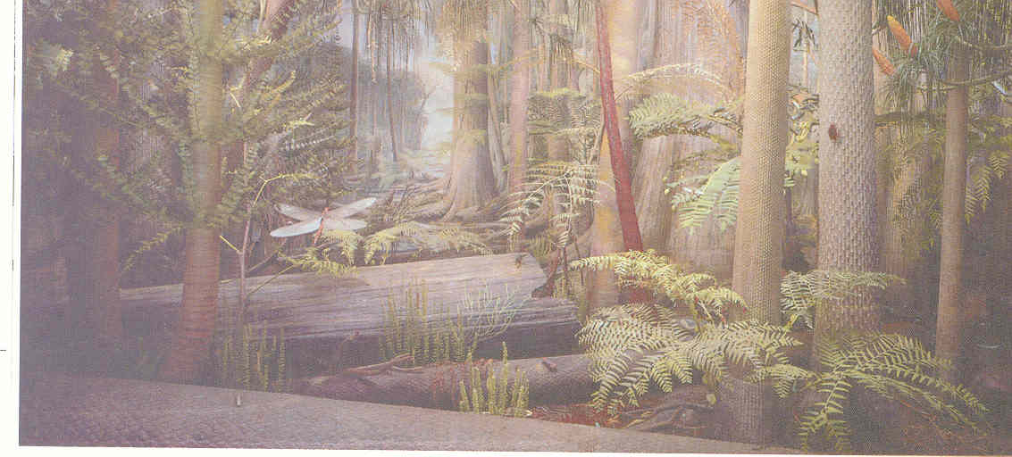
Colonization of Land
DNA evidence suggests that plants evolved from an algae
It took only 75 mill. Yrs for animals to follow plants out of water

Slide 44
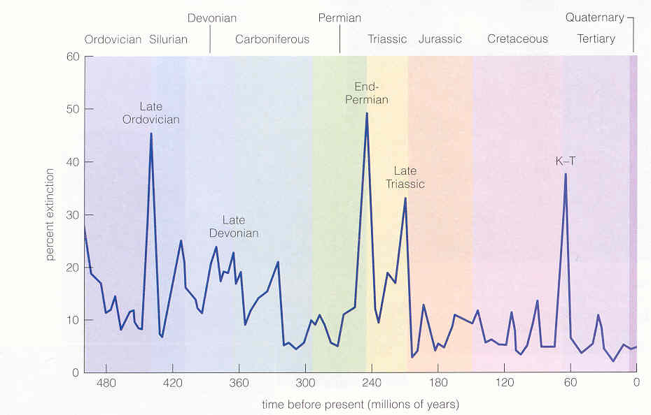
Mass Extinctions

Slide 45
Mass Extinctions
Possible Causes
  Impacts
    Impact sites found for K-T boundary
    Suspected for Permian extinction 245 mill yr ago
  Active volcanism
    Climate change
  External influence for copying errors
    Increase in solar particles or radiation hitting surface
    Local supernova

Slide 46
Primate Evolution
Monkeys, apes, lemurs and humans have common ancestor that lived in trees
Tree life
  Limber arms for swinging between branches
  Eyes in front of head for depth perception
  Offspring would be born more helpless than other animals

Slide 47
Emergence of Humans
Did NOT evolve from gorillas or monkeys
Share a common ancestor that lived just a few million years ago
98% of human genome is identical to genome of the chimpanzee
2% difference in genome separates the success of humans verses chimps
  Also indicates evolution of intelligence is complex

Slide 48
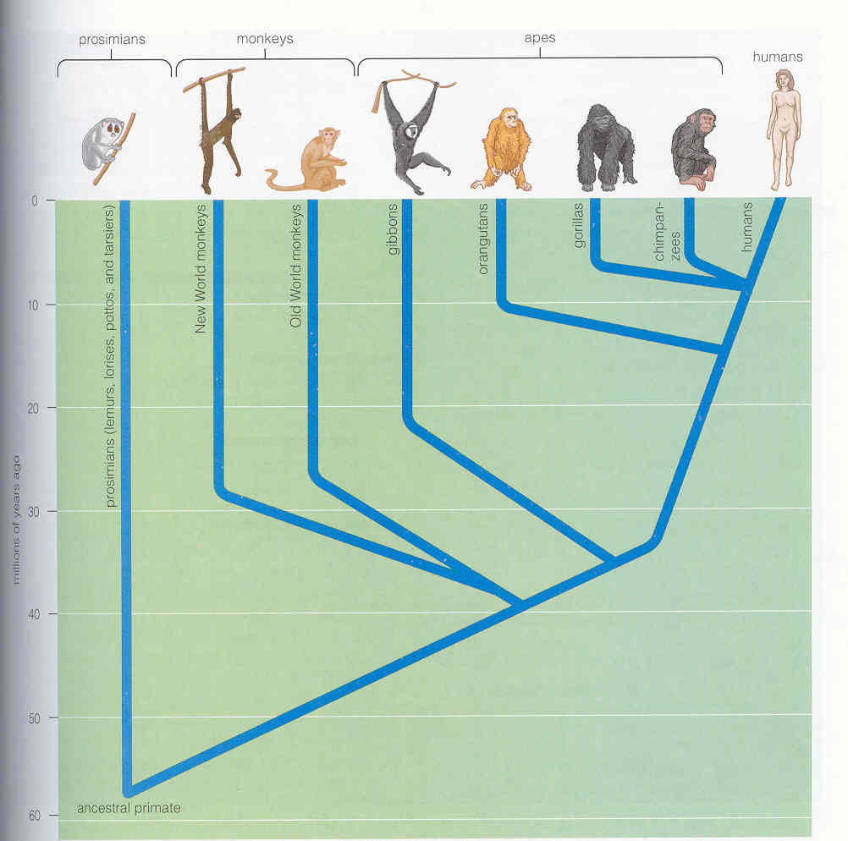
Emergence of Humans

Slide 49
Emergence of Humans
After hominids diverged from chimps and gorillas, evolution has followed a complex path
Numerous hominids species existed, some during the same time period
  All humans are the same species
First skull fossils that are identical to modern human skulls dates to 100,000 yr old
Our ancestors shared the Earth with Neanderthals
  Went extinct 35,000 years ago

Slide 50
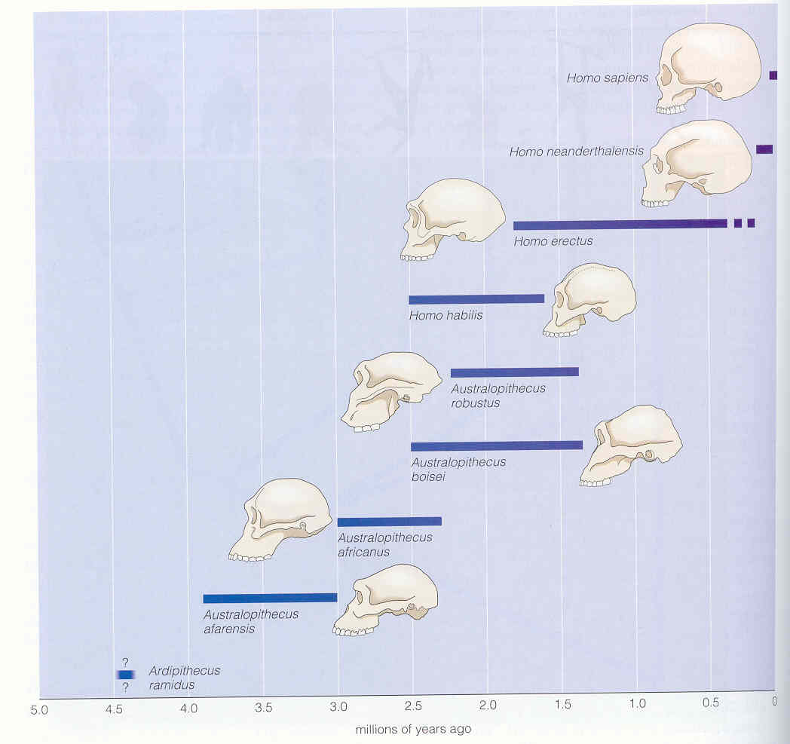
Emergence of Humans

Slide 51
Cultural and Technological Evolution
Have not undergone biological evolution in 40,000 years
  Mutation rates are slow
Dramatic cultural changes
  Transmission of knowledge between generations
    Spoken to written word, thousands of years
    agriculture
Technological evolution
  Result of coupling between science and technology
  About 100 years between industrial revolution to landing on the Moon and generating weapons of mass destruction

Slide 52
Time to think……
Work out Exercise II. From Microbes to Complex Organisms in class activity ‘Origins of Life on Earth’.

