Slide 1
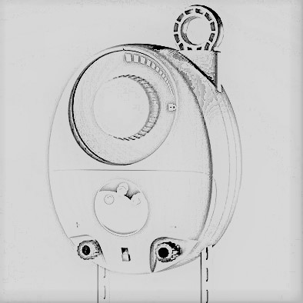
Gravity Light
GROUP NO: 01
AIM:
To generate electricity using the gravitational force exerted by the Earth.
OBJECTIVES:
To provide electricity in an efficient way.
To replace the kerosene lamps and other hazardous lamps.

Slide 2
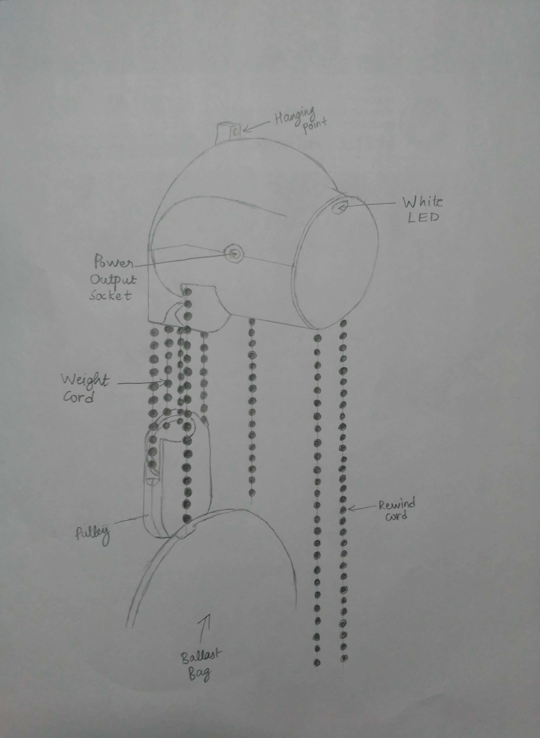
COMPONENTS:
Main frame
Pulley
Generator
Power Output Socket
Weight Cord
Rewind cord
LED bulb

Slide 3
PRINCIPLE OF GRAVITY LIGHT:
Combining kinetic and potential energy,
GravityLight works by connecting an elevated weight which is filled with rocks or sand and is attached to a pulley system that slowly powers a generator as the weight falls to the ground.
That generated power is sufficient to illuminate a LED bulb.
The gearbox ratio is chosen to make the fall of the heavy weight last about 30 minutes.

Slide 4
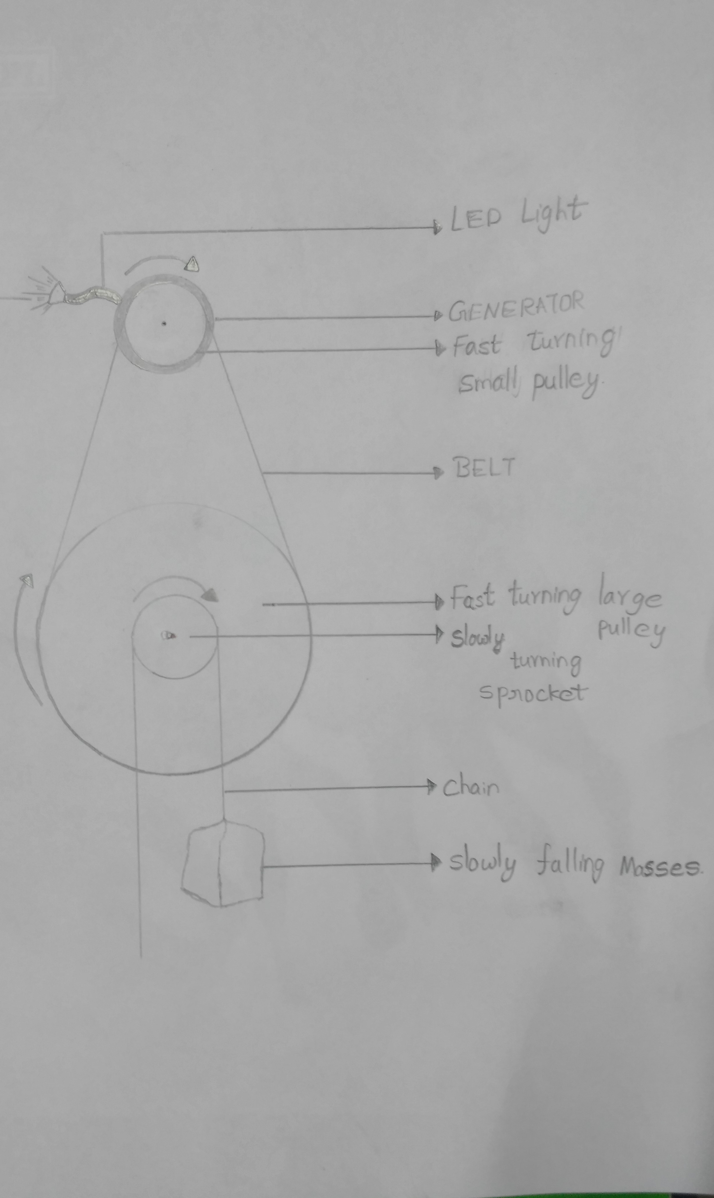
Working OF GRAVITY LIGHT:
The device generates electricity using the gravitational force of the Earth.
The ballast bag is filled with sand/rocks, and hung on the weight cord.
The ballast bag slowly moves down due to the force of gravity on it due to the Earth, which turns gears inside the device.

Slide 5
Working:
The gears turn an electric generator which generates electricity, which powers the light, and can also be used to recharge mobile phones, batteries.
When the ballast bag reaches the ground level, using the pulley, it is again raised. Using the pulley is easier compared to manually raising the ballast bag.

