Slide 1
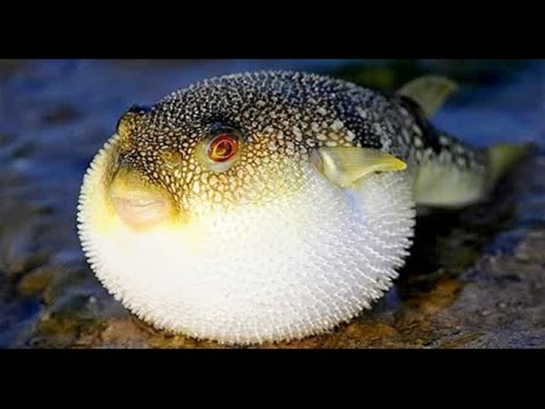
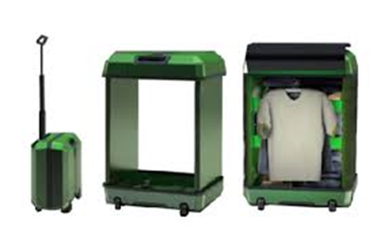
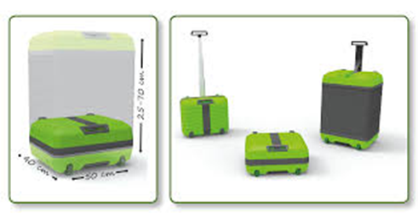
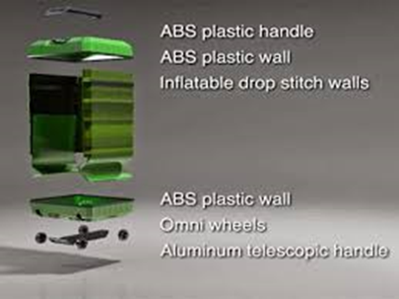
This concept is mimicked from the fugu fish ,which has the ability to vary is body size
This smart luggage bag has ability to vary its size ,to enable us to accommodate more luggage ,that too in a very organised manner .

Slide 2
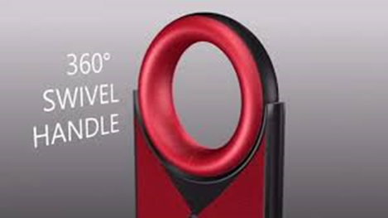
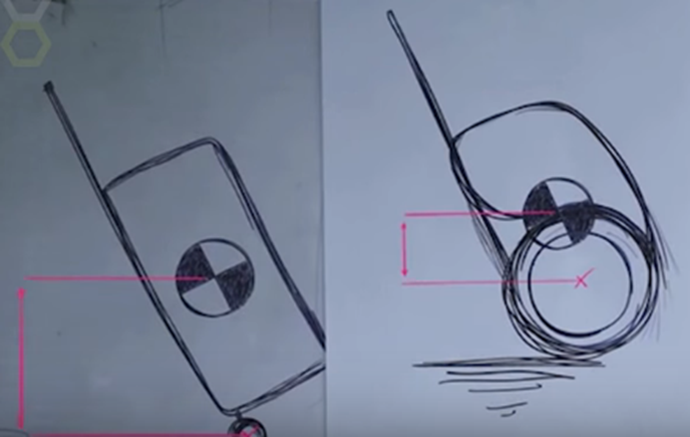
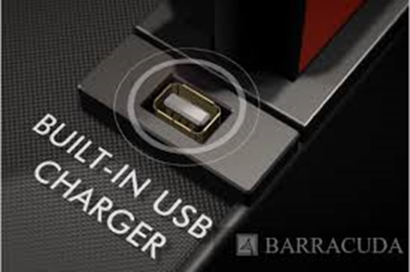
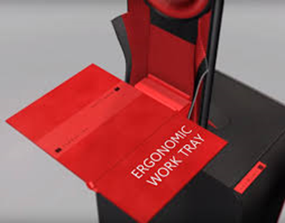
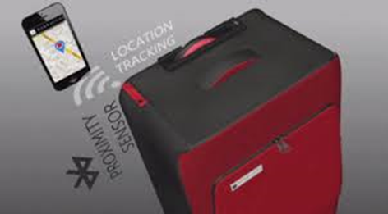
The large diametric wheels ensure that the C.O.G is as close as possible to the axis of rotation and there by ,it apparently seems that the weight is less by around 20%.
Swivel handle – 360(D) rotation .
Charging point – gets charged using the piezo electricity
Also has a ergonomic laptop working tray

Slide 3
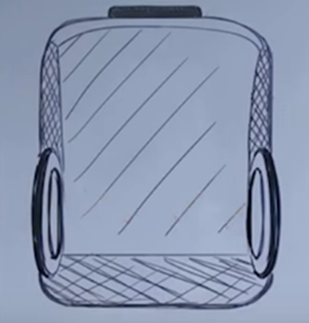
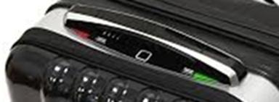

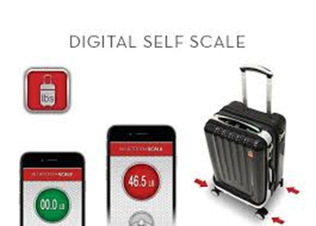
The smart luggage is incorporated with :
A finger print – unlocking system
Pressure sensors – to measure the weight of the luggage
A zipperless opening

