Slide 1

Sustainable Development
Concepts , Issues and Challenges
56th Senior Staff Course
BPATC, Savar, Dhaka.
Paper presented by
Md. Shamsul Arefin
Joint Secretary( OSD)
Ministry of Public Administration, Dhaka.
Dated: 29-07-2011

Slide 2
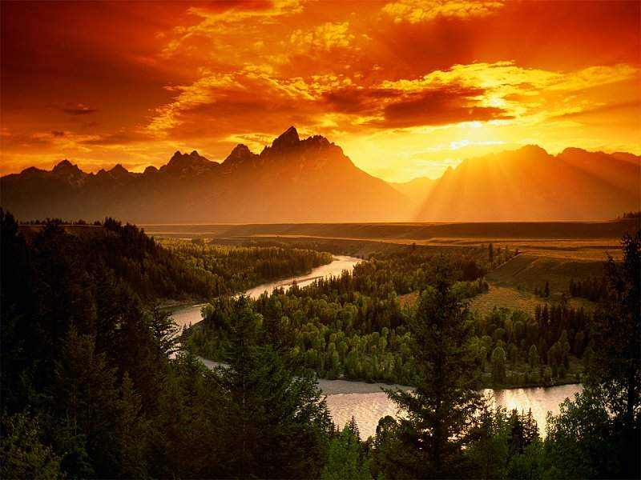
“Sustainable Development is development that meets the needs of the present without compromising the ability of future generations to meet their own needs.”

Slide 3
Historical Background
UN Conference on Environment and Development, or the 1992 Earth summit in Rio de Janeiro – unanimously adopted Agenda 21, a blueprint for sustainable development.
Millennium Development Goals – UN General Assembly resolution 55/2, outlined 8 targets aimed at reducing poverty and promoting sustainable development
World Summit on Sustainable Development – reaffirmed the commitment to Agenda 21 and Millennium Development Goals

Slide 4
Pillars of Sustainable Development
Economic Development – poverty eradication
Social Development – active participation of women; education; good governance
Environmental Protection – prevent environmental degradation and patterns of unsustainable Dev.
At the local, national, regional, and global levels

Slide 5
Economic Development
Poverty eradication
Halve, by 2015, the proportion of the world’s people with income less than $1/day
Basic health services for all, reduce health threats
Increase food availability
Combat desertification, mitigate effects of drought and floods
Provision of clean drinking water
Enhance industrial productivity

Slide 6
Changing Unsustainable Patterns of Consumption and Production
Cleaner production technologies
Developing cleaner, more efficient energy technologies
Maintain urban air quality and health, and reduce greenhouse gas emissions
Sound management of chemicals throughout the life cycle, and of hazardous wastes

Slide 7

Protecting the Natural Resource Base
Prevent water pollution to reduce health hazards and protect ecosystems
Watershed and groundwater management
Support desalination of seawater, water recycling
Ensure the sustainable development of oceans, marine environmental protection

Slide 8
Priority Areas for Action
Priority areas for action, identified by UN Secretary-General Kofi Annan
Water and sanitation
Energy
Health
Agriculture
Biodiversity protection and ecosystem management

Slide 9
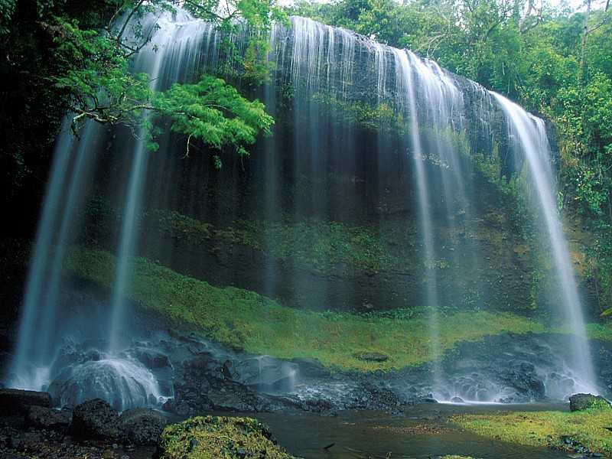
Water and Sanitation
“Water is not only the most basic of needs but is also at the center of sustainable development.”
Around 1.2 billion people still have no access to clean drinking water
Around 2.4 billion people do not have adequate sanitation.

Slide 10
Water and Sanitation
Some key issues:
Prevent water pollution to reduce health hazards
Protect ecosystems
Introduce technologies for affordable sanitation, industrial and domestic wastewater treatment
River basin, watershed and groundwater management
Support desalination of seawater, water recycling
Marine environmental protection - oceans, seas, the Earth’s ecosystem

Slide 11
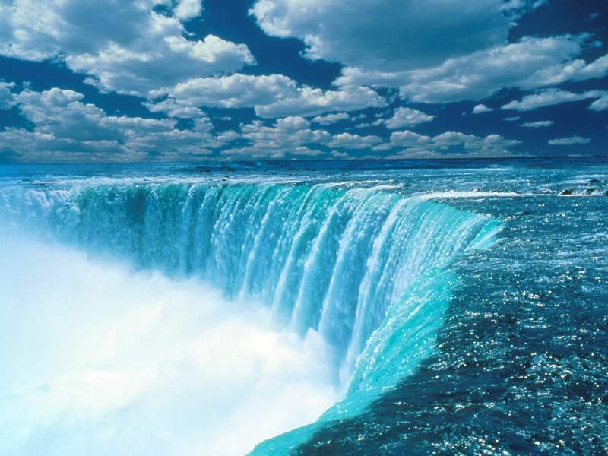
Energy
“Some 2 billion people lack access to electricity and rely on traditional fuel sources such as firewood, kerosene, or biomass for their cooking and heating.”

Slide 12
Energy
Some key issues:
Focus on access to energy in rural areas
Energy conservation and energy efficiency – building design & management, better mass transportation, advanced and innovative cleaner technologies
Promotion of renewable energy
Action on climate change – ratification by countries of the Kyoto Protocol

Slide 13
Health
“Good health is vital for eradicating poverty and achieving sustainable development.”
Some key issues:
  Reduce mortality rates in 2015: by 66.7% for children & infants under 5; by 75% for maternal mortality rates
  Control & eradicate communicable diseases, reduce HIV prevalence, combat malaria, tuberculosis
  Ensure that chemicals are not used and produced in ways that harm human health
  Reduce air pollution

Slide 14
Agriculture
“Agriculture is central to sustainable development. About 70% of the poor in developing countries live in rural areas and depend in one way or another on agriculture for their survival.”
Some key issues:
  Address serious soil fertility problems
  Diversification of crops
  Increase water-use productivity
  Apply R&D to increase productivity in crops and livestock
  (Sustainable development in the agriculture, forestry and fishery sectors conserves land, preserves water, plant and animal genetic resources, is environmentally non-degrading, technically appropriate, economically viable and socially acceptable." (FAO 994))

Slide 15
Take a look at the Global Agriculture
between 1960 and 2000:
  world population doubled from 3 to 6 billion people
  global economy increased more than sixfold
to meet this demand:
  food production increased 2 ½ times
  water use doubled
  wood harvests for pulp and paper production tripled
  timber production increased by more than half
Who is eating?
Source: http://www.millenniumassessment.org/

Slide 16

Livestock Development
Livestock development
  Sustainable animal production
  Improving productivity of animals
  Feed supplementation for increasing livestock production
  Improving fertility and disease diagnosis

Slide 17
Fertilizer Use
With high yielding varieties of crops, most soils are unable to supply the needed amounts of plant nutrients.
Fertilizers are chemicals that supply plant nutrients, mostly N, P and K.
Manufacture of N-based synthetic fertilizers requires fossil fuels as raw materials.

Slide 18
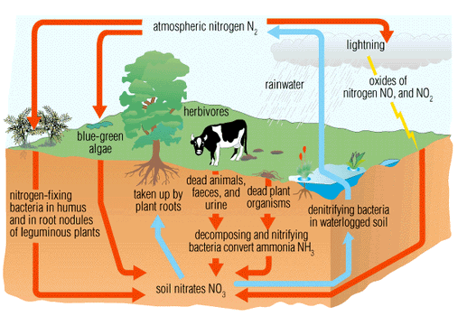
Nitrogen cycle
Fertilizer Use:
Source: http://www.allrefer.com/pictures/s4/p0001901-nitrogen-cycle
Notes:
Synthetic N was first manufactured in 1913.
Since 1750, the atmospheric concentration of carbon dioxide has increased by about 32% (from about 280 to 376 parts per million in 2003), primarily due to the combustion of fossil fuels and land use changes.

Slide 19
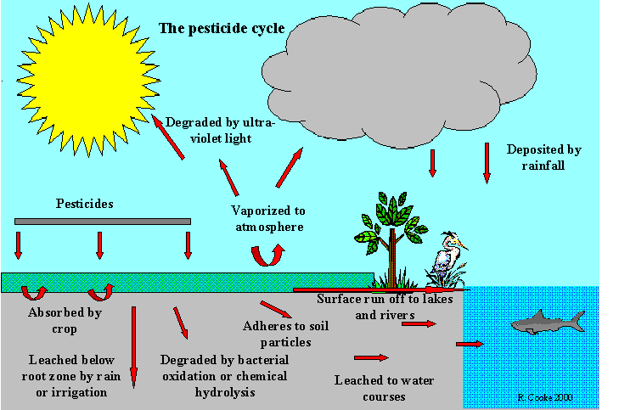
Pesticide Use:
Fate of pesticides in the environment
Source: http://www.ecifm.rdg.ac.uk/pesticides.htm

Slide 20
Biodiversity
Biodiversity is a modern term which simply means " the variety of life on earth". This variety can be measured on several different levels.
Genetic - variation between individuals of the same species. This includes genetic variation between individuals in a single population , as well as variations between different populations of the same species.
Species - species diversity is the variety of species in a given region or area. This can be determined by counting the number of different species
Ecosystem - Communities of plants and animals, together with the physical characteristics of their environment (e.g. geology, soil and climate) interlink together as an 'ecosystem'. Ecosystem diversity is more difficult to measure because there are rarely clear boundaries between different ecosystems

Slide 21
Biodiversity
Biodiversity - is a term we use to describe the variety of life on Earth.
It refers to the wide variety of ecosystems and living organisms like animals, plants, their habitats and their genes.
Biodiversity is the degree of variation of life forms within a given ecosystem.
Rapid environmental changes typically cause mass extinctions.

Slide 22

Biodiversity & Ecosystem Management
“Biodiversity and the ecosystems are the living basis of sustainable development.”

Slide 23
Biodiversity & Ecosystem Management
Some key issues:
  Significantly reduce the rate of biodiversity loss by 2015
  Reverse the trend in natural resource degradation
  Restore fisheries to their maximum sustainable yields
  Protection of the marine environment from land based sources of pollution

Slide 24
Ecology
The word "ecology" ("Ökologie") was used first in 1866 by the German scientist Ernst Haeckel (1834–1919).
Ecology is the interdisciplinary scientific study of the distribution and abundance of organisms and their interactions with their environment
Ecology is a sub-discipline of biology, the study of life. An observations on the natural history of plants and animals.
Ecology is not synonymous with environment. It is closely related to physiology, evolutionary biology, genetics.
An understanding of how biodiversity affects ecological function is an important focus area in ecological studies.
Ecosystems sustain every life-supporting function on the planet, including climate regulation, water filtration, soil formation.

Slide 25
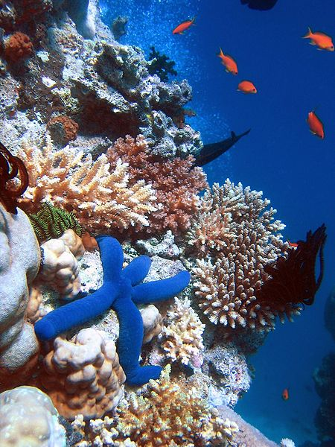
Picture of biodiversity
German Federal Environment Minister Sigmar Gabriel cited estimates that up to 30% of all species will be extinct by 2150.

Slide 26
Degradation of Ecosystems
Degradation of ecosystems (forest, fresh water, marine, etc.)
Upsetting the carbon cycle, resulting in global warming and climate change and the consequences
Depletion of the ozone layer
Pesticide, heavy metals and other persistent toxic chemicals like DDT poisoning the web of life
Loss of clean air

Slide 27
Issues of Sustainable Development
How can we all live well and live within the means of one planet?
This is the question of the 21st century. If we do not design ways to live within the means of one planet, sustainability will remain elusive

Slide 28
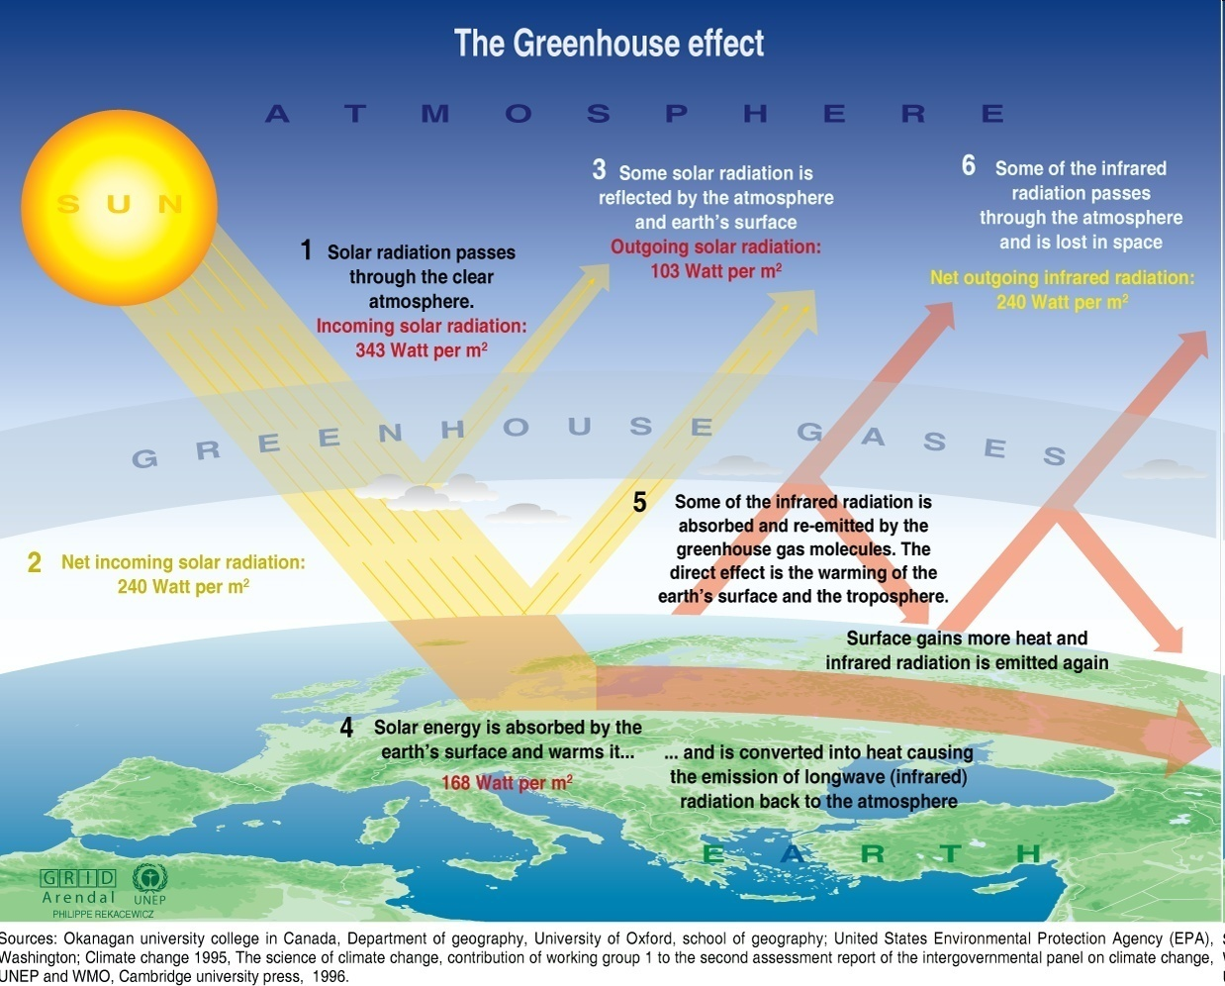
The Greenhouse Effect
A T M O S P H E R E
S U N
G R E E N H O U S E G A S E S

Slide 29
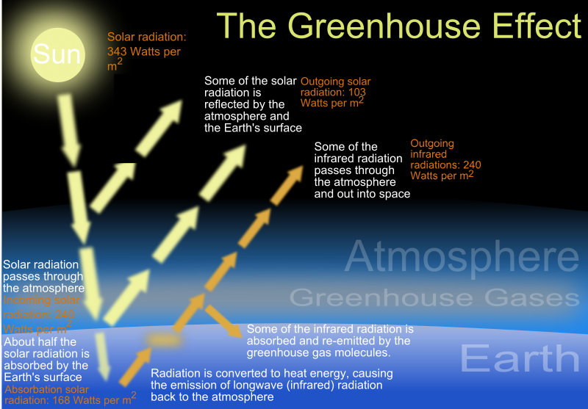
Source: Intergovernmental Panel on Climate Change (IPCC), UN

Slide 30
GHG
Gases that trap heat in the atmosphere are called greenhouse gases
Greenhouse gases are those that can absorb and emit infrared radiation.
In order, the most abundant greenhouse gases in Earth's atmosphere are
  Water vapor
  Carbon dioxide
  Methane
  Nitrous oxide
  Ozone

Slide 31
Emission of GHGs in Bangladesh
GHG emission is low and negligible
Per capita GHG emission is 230 kg only
Sectoral consumption of electricity
Industries (46%)
Residential (45%)
Commercial (7%)
Others (2%)
Large part of GHG is coming from electricity generation and transport sector
Landfills also generate GHG

Slide 32
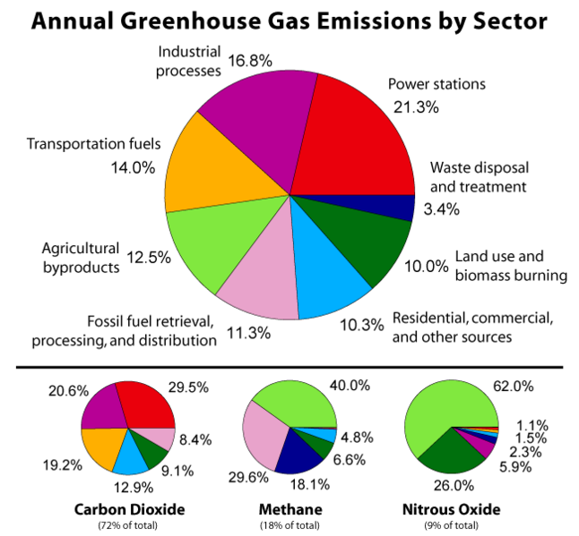
Source "Special Report on Emissions Scenarios: (Data) IPCC SRES Emissions Scenarios - Version 1.1 (July, 2000)"

Slide 33
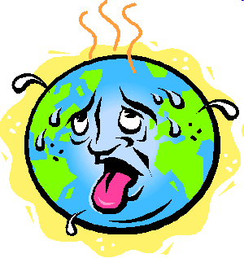
Global Warming
The burning of fossil fuels, land use change and other industrial activities since the industrial revolution have increased the GHGs in the atmosphere in such a level that the earth’s surface is heating up to temperatures that are very destructive to life on earth.

Slide 34
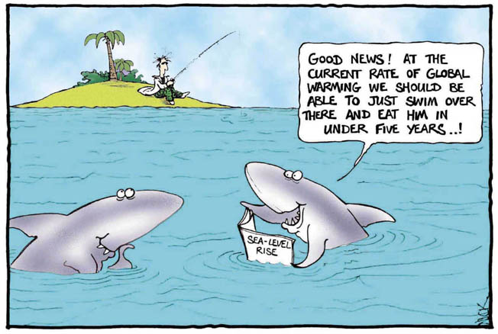
Consequences

Slide 35
Consequences
  Death of coral reefs
  Spread of dengue and other diseases
  Heavy rains & severe draughts
  Floods, storms, & hurricanes
  Changed rainfall patterns
  Warming and aridity
  Loss of biodiversity

Slide 36
Renewable energy
are flows of energy that are regenerative or virtually inexhaustible.
- Dr. Raymond Wright
Sustainable energy
is energy which is replenishable within a human lifetime and causes no long-term damages to the environment.
Source: http://www.jsdnp.org.jm/glossary.html

Slide 37
Global primary energy consumption in 2006
≈ 15.8 TW = 15.8 x 10¹² W
Global population in 2006 ≈ 6.56 billion
Global energy consumption per person in 2006
15.8 x 10¹² W
6.56 x 10⁹
≈ 2.4 kW
≈
Source: International Energy Annual 2006 (posted Dec 19, 2008)
http://www.eia.doe.gov/iea/

Slide 38
Energy Options
Fossil fuels (coal, oil and natural gas)
Hydropower
Nuclear energy
Solar energy
Wind energy
Geothermal energy
Ocean (wave, tidal and ocean thermal) energy
Biomass energy
Biofuels (bioethanol or biodiesel) energy

Slide 39
Nuclear Energy
Nuclear waste and the retired nuclear plants could remain radioactive for hundreds of future years.
Uranium is available on earth only in limited quantities. Uranium is being converted during the operation of the nuclear power plant so it won't be available any more for future generations.
Therefore nuclear power is not a sustainable source of energy.

Slide 40
Nuclear Energy
Nuclear fission provides 16% of the world electricity production and 7% of the total energy consumption.
Current usage of uranium is about 65,000 t/yr.
The world's present measured resources of uranium in the cost category somewhat below present spot prices is about 5.5 Mt.
They could last for over 80 years at the current usage rate.
Source: http://www.world-nuclear.org/info/inf75.html

Slide 41
Fossil fuels
Source: BP Statistical Review of World Energy June 2008

Slide 42
Fossil fuels
For energy (electricity and heat), we depend heavily on the combustion of fossil fuels like coal, oil and natural gas.
Fossil fuels burning is responsible for about 85% of the anthropogenic CO₂ emissions produced annually, and therefore the major cause for global warming.
Fossil fuels are non-renewable sources of energy.
Fossil fuel is not a sustainable energy source.

Slide 43
Fossil Fuels
Source: BP Statistical Review of World Energy June 2008

Slide 44
Nuclear fission energy is the best CO₂ emissions-free energy source so far.
IAEA2000

Slide 45
One option: Emissions Reduction
Reduce Population
More people
More pollution

Slide 46
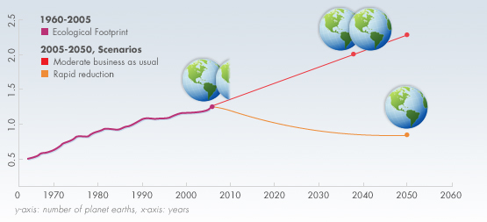
EF is 1.3 times the bio capacity in 2005. That is to say we need 1.3 planets to provide the resources we use and absorb our waste.
This means, in 2005, it took the Earth one year and four months to regenerate what we use in a year.
Source: http://www.footprintnetwork.org

Slide 47
EF will be 2 times the bio capacity by the mid 2030 if current population and consumption trends continue according to moderate UN scenarios.
It means by the mid 2030s we will need the equivalent of 2 Earths to support us.
Source: http://www.footprintnetwork.org

Slide 48
Ecological Footprint (EF)
EF measures how much land and water area
a human population requires to produce the
resource it consumes and to absorb its wastes,
using prevailing technology.
EF does not include an economic indicator.
Sustainable global EF per capita
= Total Bio capacity per capita
Source: http://www.footprintnetwork.org

Slide 49
Biocapacity
Biocapacity is shorthand for biological capacity, which is the ability of an ecosystem to produce useful biological materials and to absorb wastes generated by humans.
Source: http://www.footprintnetwork.org

Slide 50
For the World
Before 1986, the world consumed resources and produced CO₂ at a rate consistent with what the planet could produce and reabsorb.
Source: http://www.footprintnetwork.org

Slide 51
We should place a limit on CO₂ emissions to ensure sustainable development

Slide 52
Raw material
Unlimited
Energy
Capital
Labour
Industry
Products
Unlimited
Environmental
degradation
Unlimited
Unlimited
Waste material
Unlimited

Slide 53
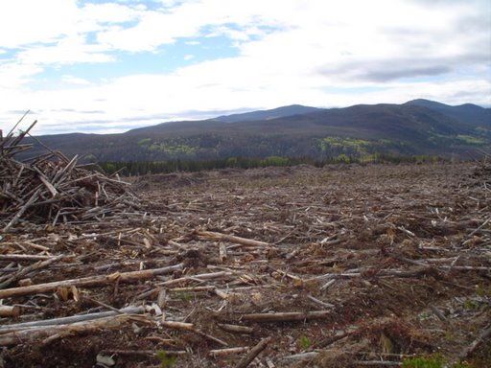
Forest industry waste
‘Most "wood" companies only handle one type of wood and burn the rest.’
These burn piles are 15 to 20 ft high.

Slide 54
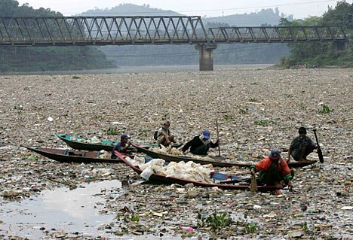
Factory waste
More than 500 factories (mostly textiles) line the banks of the 200-mile Citarum river, near the Indonesian capital of Jakarta.
Source: http://rekkerd.org/citarum-river-a-shocking-display-of-abuse/

Slide 55
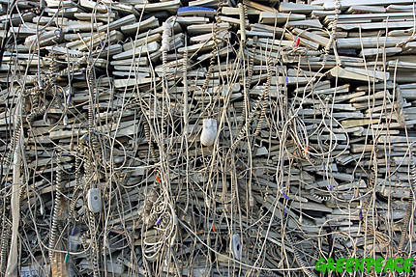
Computer industry waste
Source: http://www.greenpeace.org/international/photosvideos/photos/
close-up-of-a-huge-pile-of-com

Slide 56
WAY AHEAD
Measures of Human Well-being
stable
job
life free of
avoidable
morbidity
well paid
job
low infant
mortality
low
inflation
adequate
housing
long life
adequate
nutrition
high GDP
per capita
civil
liberties
care of the
environment
good
education
level
free
markets
good income
distribution
Source: Montenegro, A., An Economic Development Index,
http://129.3.20.41/eps/dev/papers/0404/0404010.pdf

Slide 57
Hydroelectric Power
Why hydroelectric power is important?
Once the dam is built, the energy is virtually free.
No waste or pollution produced.
Much more reliable than wind, solar or wave power.
Water can be stored above the dam ready to cope with peaks in demand.
Hydro-electric power stations can increase to full power very quickly, unlike other power stations.
Electricity can be generated constantly.

Slide 58
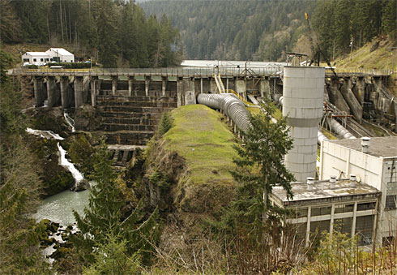
Hydroelectric power
Hydroelectric Power

Slide 59
Hydroelectric Power
Problems with hydroelectric power
Barriers in the natural flow of a river prevents fish from migration, alters ecosystems, and threatens the livelihoods of local communities
the world's 52,000 largest dams release 104 million metric tons of methane (a greenhouse gas) annually
reservoirs fill up with sediment and cost billions of dollar

Slide 60
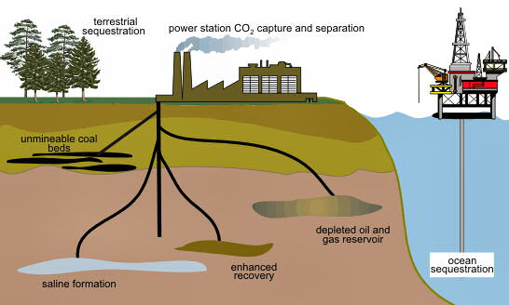
Power Station CO₂ Capture and Separation
terrestrial sequestration
Fossil fuels
Unminable coal beds
depleted oil and gas reservoir
ocean sequestration
enhanced recovery
saline formation
CCS is controversial since permanent storage of CO₂ underground is not guaranteed

Slide 61
Conclusion
It is good to have increased food production which might have helped reducing the number of undernourished people.
The first of the Millennium Development Goals (MDGs) is to
Eradicate Extreme Poverty and Hunger
The seventh of the MDGs is to
Ensure Environmental Sustainability
How to achieve both the goals simultaneously?
Notes:
Over the past 40 years, globally, intensification of cultivated systems has been the primary source (almost 80%) of increased output. But some countries, predominantly found in Sub-Saharan Africa, have had persistently low levels of productivity, and continue to rely on expansion of cultivated area. in sub-Saharan Africa, however, yield increases accounted for only 34% of growth in production

Slide 62

THANK YOU FOR YOUR PATIENT HEARING

Slide 63




