Slide 1
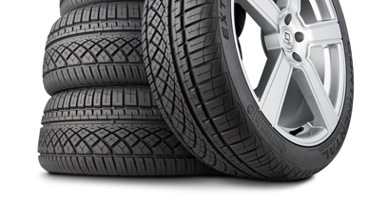
WHEEL
MADE BY-
AKASH DHAYAL (MDM16B002)
GUIDED BY-
JAYACHANDRA BINGI

Slide 2
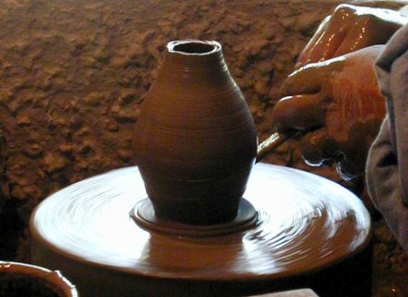

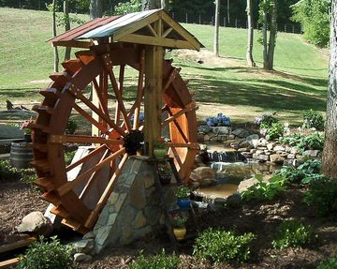
WHEEL
a circular object that revolves on an axle and is fixed below a vehicle or other object to enable it to move over the ground.
It is one of the most important mechanical component which drives heavy machines and creates motion
Potters wheel
Giant wheel
Mill wheel

Slide 3
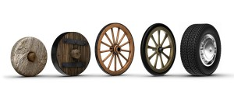
EVOLUTION OF WHEEL

Slide 4
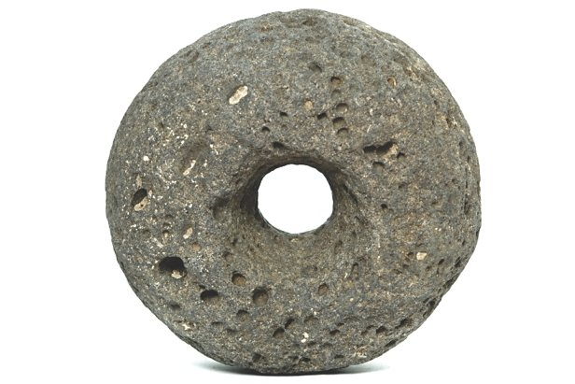
STONE WHEEL
Invented around 3500 b.c in Mesopotamia
Used for transporting heavy objects such as fallen trees and war supplies
Constraint:
It was not completely circular
Was heavy and needed more force to roll

Slide 5
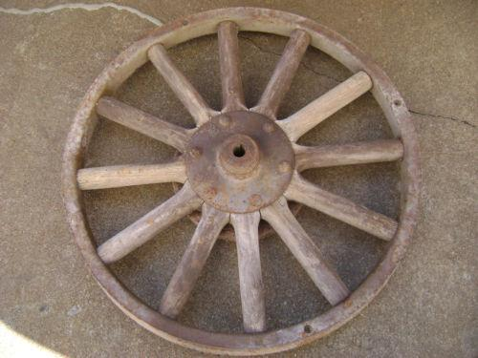
SPOKED WOODEN WHEEL
In 2000 b.c Egyptians created a wheel with spokes to replace the one that was going on their chariots because it looked more appealing and used less resources.
They had an uniform circular shape and the spokes supported the circular frame
Major technical development was introduction of spokes and the weight reduced due to use of wood.
Constraint:
The wheel was not durable and easily breakable
It was not water-resistant

Slide 6
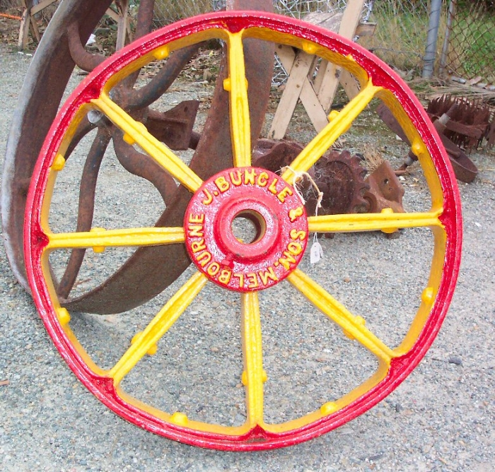
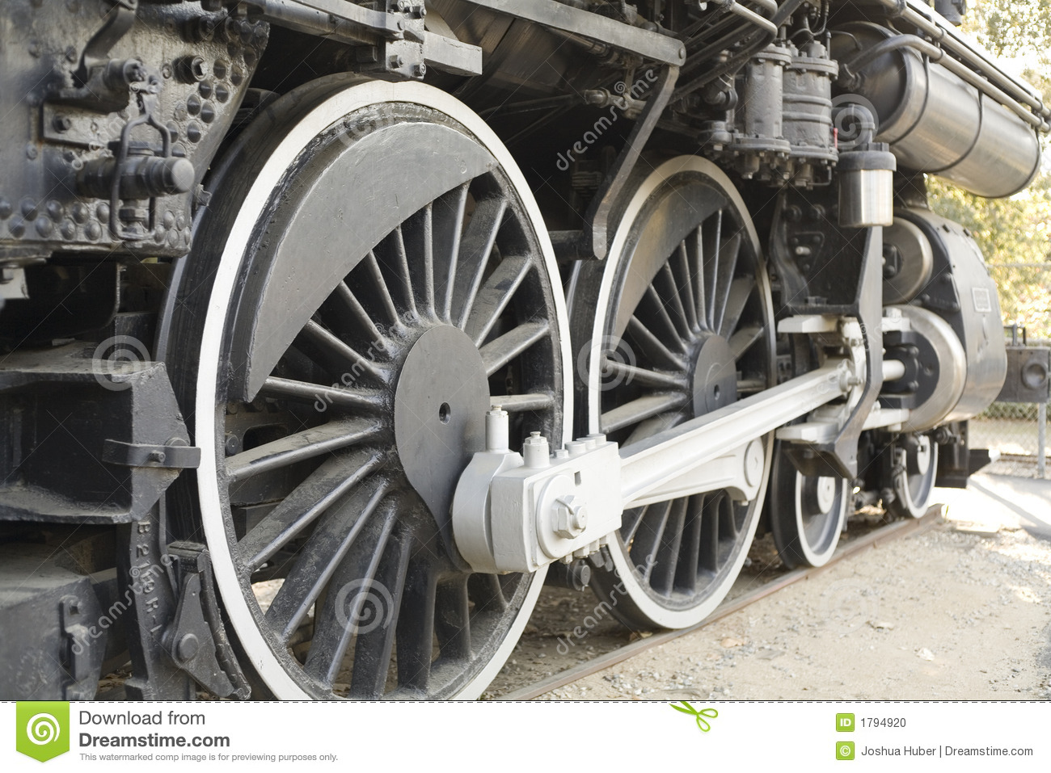
IRON RIMmed wheels
Since they are made of metal they were durable and could carry more weight
The wheels required regular lubrication for smooth functioning and paint on surface to avoid rusting
These wheels are still used today in trains that run on rails
Constraint:
Iron wheels were uncomfortable on uneven rods and pits
Wheel was heavy compared to wooden wheel

Slide 7
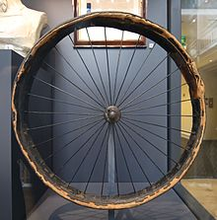
PNEUMATIC WHEELS
John Dunlop in 1887 invented pneumatic tyres
He used inflatable tyres made of rubber which was earlier invented by Charles goodyear
The major technological change was that the wheels were filled with air and rubber was used as covering material
The advantage was that this wheel enabled smooth riding on uneven surface and the wheel was capable of withstanding heavy loads
Constraint:
The air needs to be filled regularly
The problem of puncture

Slide 8
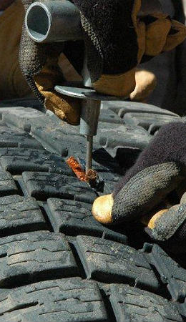
TUBELESS…
Unlike pneumatic tires which use a separate inner tube, tubeless tires have continuous ribs so that they are forced by the pressure of the air inside the tire to seal with the metal rim of the wheel.
Traditional designs of pneumatic tires required a separate inner tube which could fail for a number of reasons, such as incorrect tire fit, friction between the tire wall and inner tube generating excess heat, or a puncture. Tubeless tire technology does away with the need for an inner tube thereby increasing safety.

Slide 9
Advantages of tubeless tyres
Liquid sealant
Tubeless tyres have the advantage to be filled with liquid sealants. If a sharp object does put a hole in a tubeless tyre, the liquid sealant immediately oozes out and dries up, sealing the hole. This enables you to travel longer, without having to stop to fix a puncture.
2. Ability to run at lower pressure
Air does change its pressure inside the tube or the tyre, and it is common for tyres to run at lower pressures. Again, a tube will get pinched when the pressure is low, leading to a puncture. This is not the case with tubeless tyres.
3. No unwanted friction
While driving at high speeds, a tube type tyre will have friction with the tyre, which increases the temperature of the tube and there are chances of the tube exploding. A tyre/ tube explosion at high speeds calls for disaster. Tubeless tyres do not have this risk.

Slide 10
disadvantages
Difficult to fit
Tubeless tyres are difficult to fit on the rim. It takes longer to fit a tubeless tyre since it has to be airtight against the rim or it will not hold air. Tubeless tyres have to be fit by an expert so that the rims do not get damaged.
2. Punctures
If at all you have had a puncture and the tyre is flat, not everybody will fix it. Fixing punctures in a tubeless tyre needs special equipment, which not many will have.
3. Sidewall puncture
The sidewall of the tyre is a dangerous place to have a puncture. In a tube type tyre, you can change the tube and carry on, but a tubeless tyre will need to be changed if damaged or even discarded depending on situations.

Slide 11
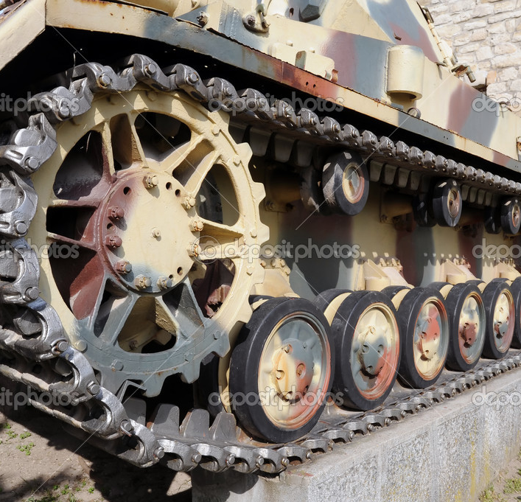
CATERPILLAR WHEELS
Continuous track, also called tank tread or caterpillar track, is a system of vehicle propulsion in which a continuous band of treads or track plates is driven by two or more wheels. This band is typically made of modular steel plates in the case of military vehicles and heavy equipment, or synthetic rubber reinforced with steel wires in the case of lighter agricultural or construction vehicles.

Slide 12
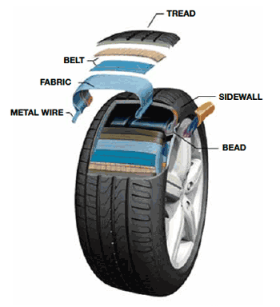
DISSECTION OF A WHEEL

Slide 13
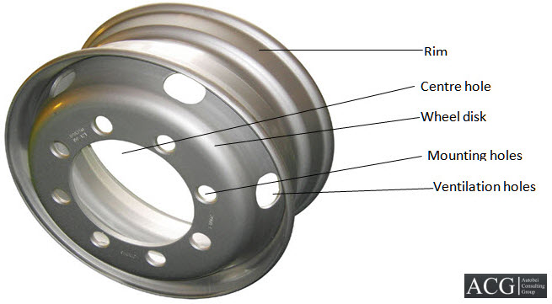
RIM
The rim is the "outer edge of a wheel, holding the tire". It makes up the outer circular design of the wheel on which the inside edge of the tire is mounted on vehicles
Because the rim is where the tire resides on the wheel and the rim supports the tire shape, the dimensions of the rims are a factor in the handling characteristics of an automobile

Slide 14
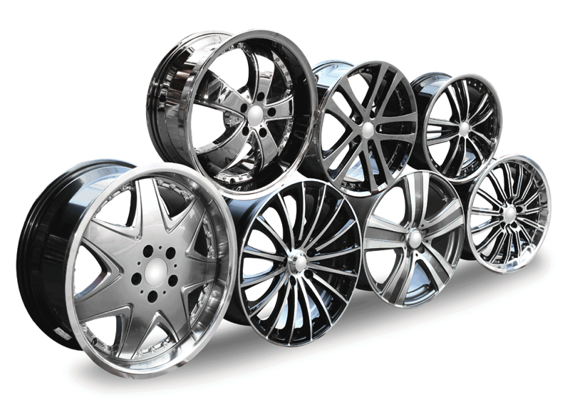
Designer alloy wheels
Alloy wheels are nothing but simple wheels fitted with different cases to look attractive.
It is alloy of aluminium and magnesium

Slide 15
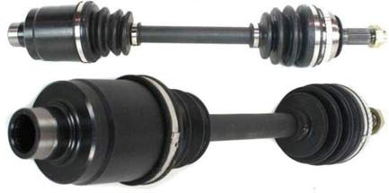
AXEL
It is the most important component of a wheel
Can be referred as heart of wheel
It is the component that converts energy delivered by engine to motion of wheel
There are different types of axel:
1. tag axel
2.rear axel
3.stub axel
4.live axel
Depending on the type of vehicle the appropriate axel is selected

Slide 16
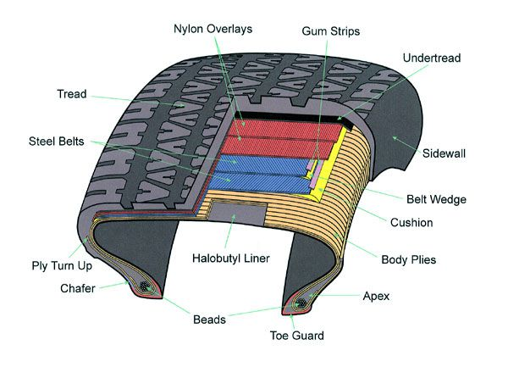
a rubber covering, typically inflated or surrounding an inflated inner tube, placed round a wheel to form a soft contact with the road.
They are inflated with either air or water. in case of an aircraft nitrogen is filled in tyres to avoid fire accidents because unlike oxgen, nitrogen is not flammable.
Different threads are printed on the outer surface of tyre depending on the amount of friction required
TYRE

Slide 17
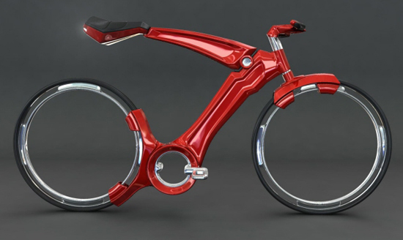
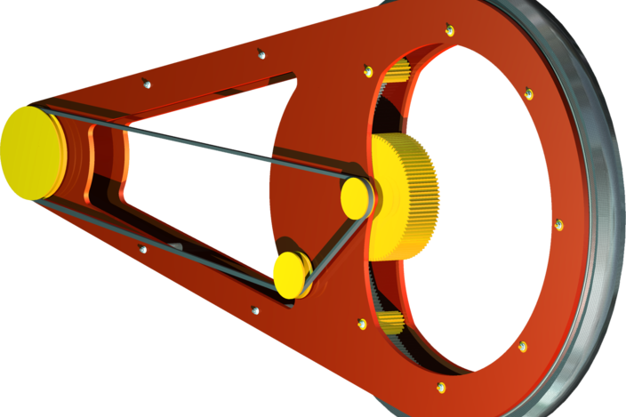
Future…
RIMLESS WHEEL
They are popularly known as hubless wheels
Advantages?
Decreased weight - obviously without spokes and central solid hub, weight has to decrease.
2. Lower center of gravity - you can lower the transmission systems
3. Better braking leverage
4.Better accuracy in steering
MECHANISM
A simple mechanism with use of internal gears and belts/chains.

Slide 18
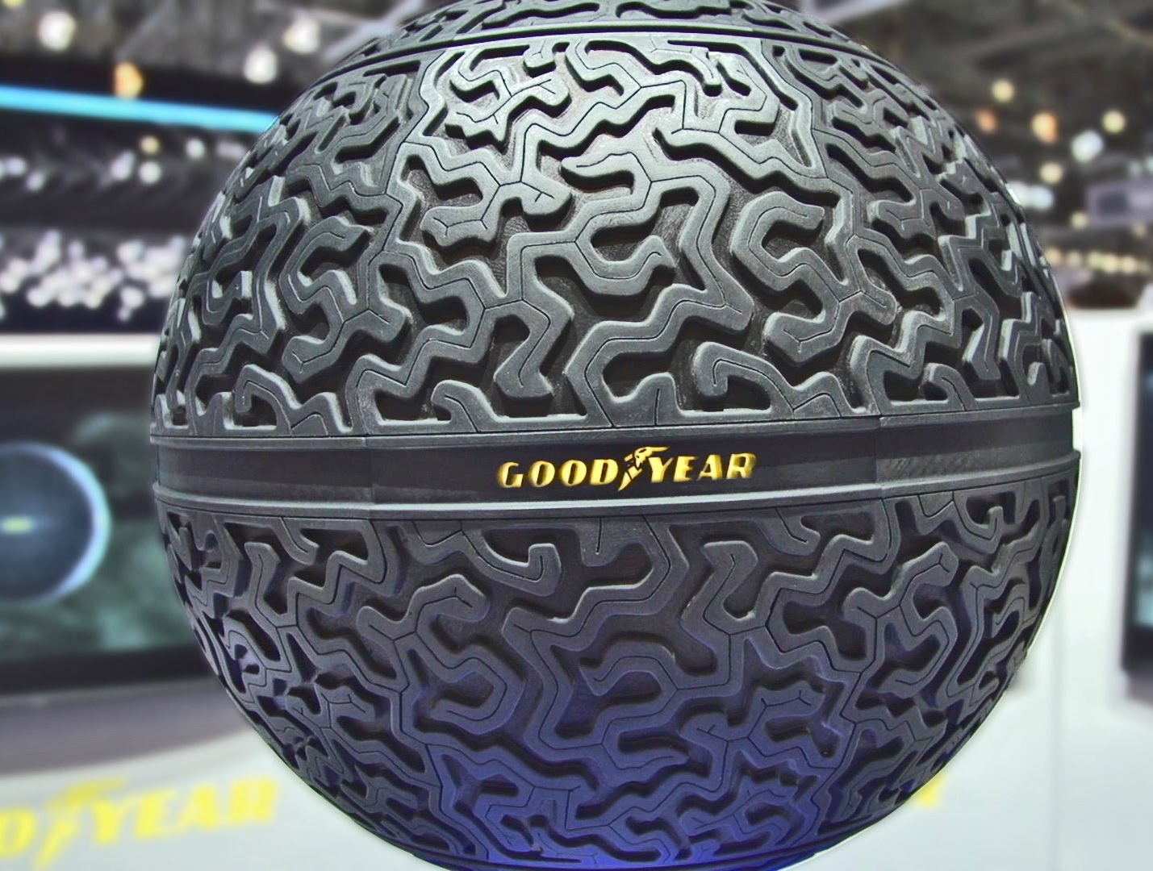
FUTURE…
EAGLE 360
This concept is given by goodyear company and it is not yet in market.
It is multi-orientation wheel
it is designed to give maximum performance in all weather conditions
it will have 360 degree motion

Slide 19
THANK YOU!!!
ANY SUGGESTIONS OR COMMENTS ???

