Slide 1
Solid and Hazardous Waste
Chapter 13

Slide 2
Key Concepts
Types and amounts of wastes
Preventing waste
Methods of dealing with wastes
Hazardous waste regulation in the US

Slide 3
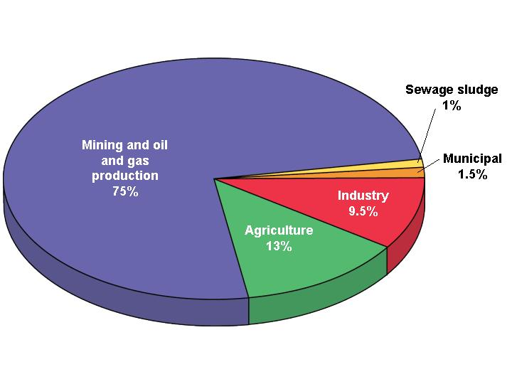
Wasting Resources
US waste: 11 billion metric tons/year
Mining waste
Agricultural waste
Industrial waste
Municipal solid waste (MSW)
Sewage sludge

Slide 4
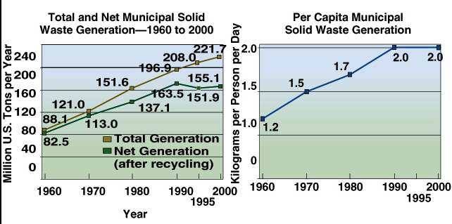
US Solid Waste since 1960

Slide 5
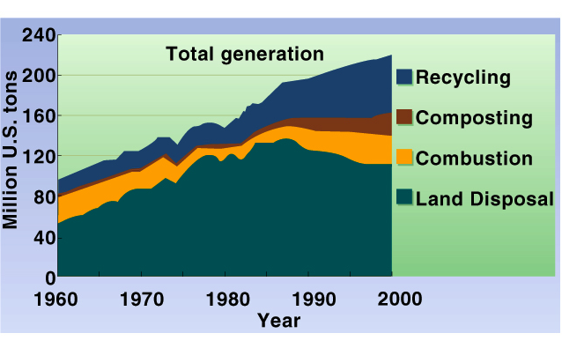
Waste Disposal Methods

Slide 6
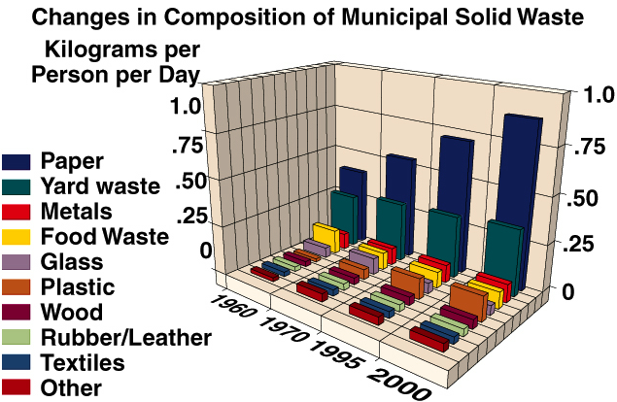
What’s in our trash?

Slide 7
US consumers toss every year:
aluminum cans to rebuild commercial airline fleet 4 times
e-waste by the millions
tires to circle planet 3x
diapers to moon and back 7x
carpet to cover Delaware
670,000 metric tons of food
and much, much more…

Slide 8
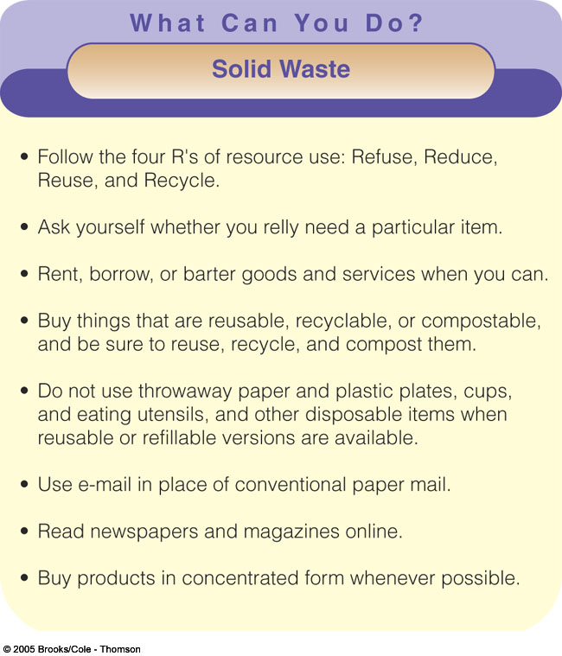

Slide 9
Producing Less Waste
Waste management
  high waste approach
  Burying, burning, shipping
Waste prevention
  low waste approach
Reduce, reuse, recycle

Slide 10
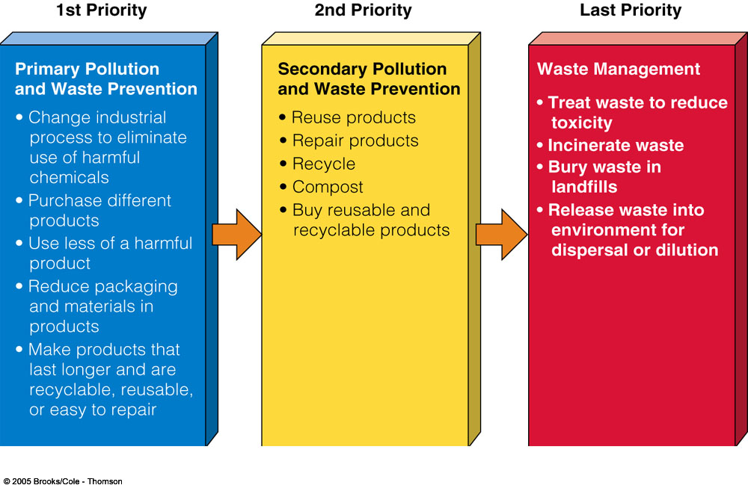
Dealing with Material Use and Wastes

Slide 11
Solutions: Cleaner Production
Ecoindustrial revolution
Resource exchange webs
  waste from one industry is raw material for another – see figure
Biomimicry (mimic nature)
  no waste in nature
Service-flow economy
  more in a moment

Slide 12
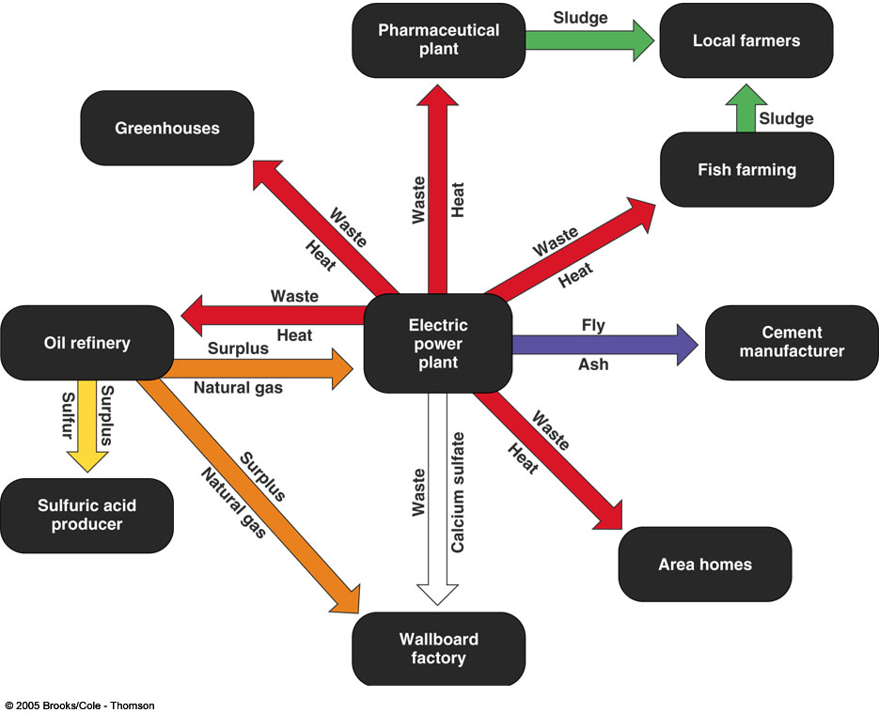
Industrial Ecosystem in Denmark

Slide 13
Solutions: Selling Services Instead of Things
Service-flow economy
  Dow Chemical - solvents
Uses a minimum amount of material
  Xerox copy services
Products last longer
Products are easier to maintain, repair, and recycle
  Carpet tiles
Eco-leasing

Slide 14
Reuse
Extends resource supplies
Saves energy and money
Reduces pollution
Creates jobs
Reusable products

Slide 15
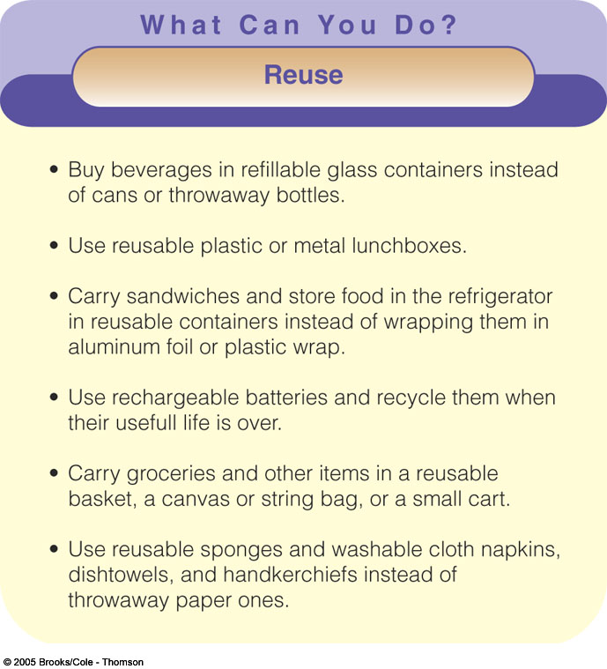

Slide 16
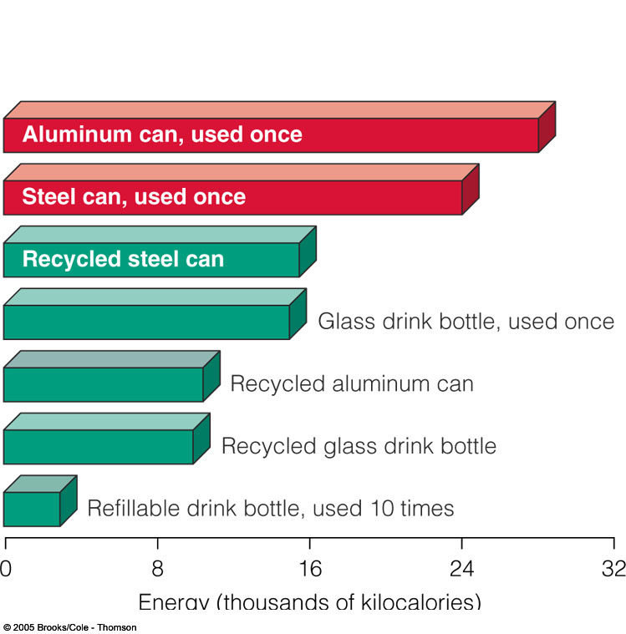
Recycling
Primary (closed-loop)
Secondary (open loop)
Pre-consumer waste
Post-consumer waste

Slide 17
Characteristics of Recyclable Materials
Easily isolated from other waste
Available in large quantities
Valuable

Slide 18
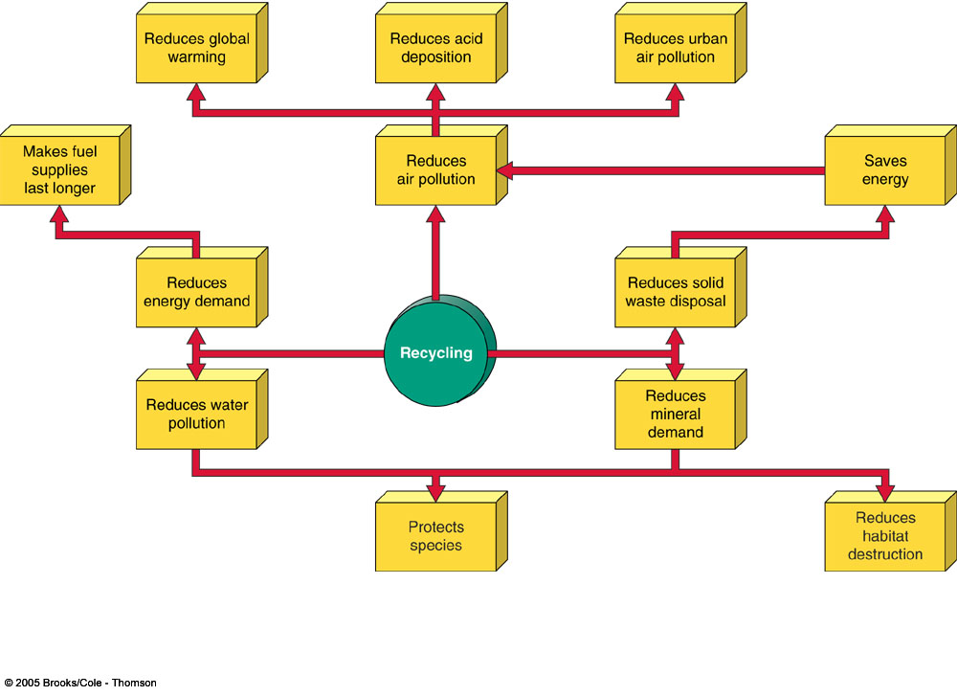
Benefits of Recycling

Slide 19
Case Studies: Wastepaper and Plastics
49% of wastepaper recycled in US
Chlorine-based compound in paper production
10% or less of plastic recycled in US
Plastics can be very difficult to recycle

Slide 20
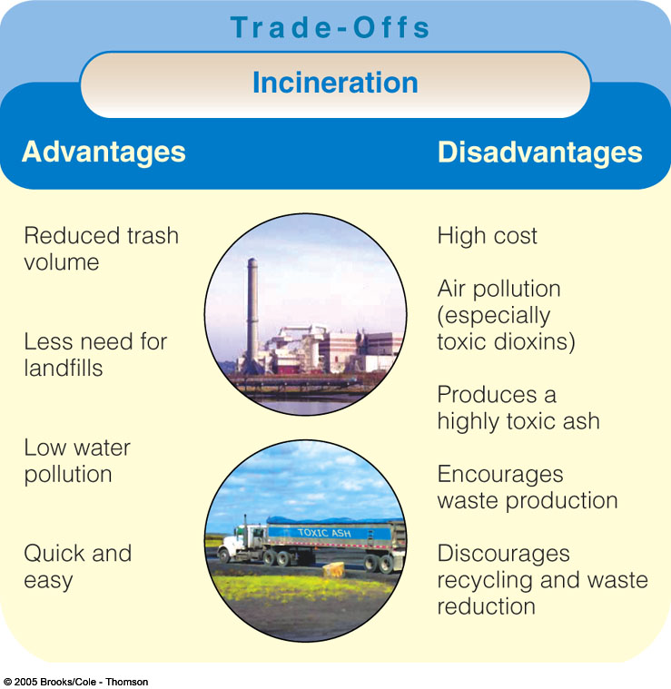
Burning Wastes
Mass burn incineration
Air pollution
Waste to energy

Slide 21
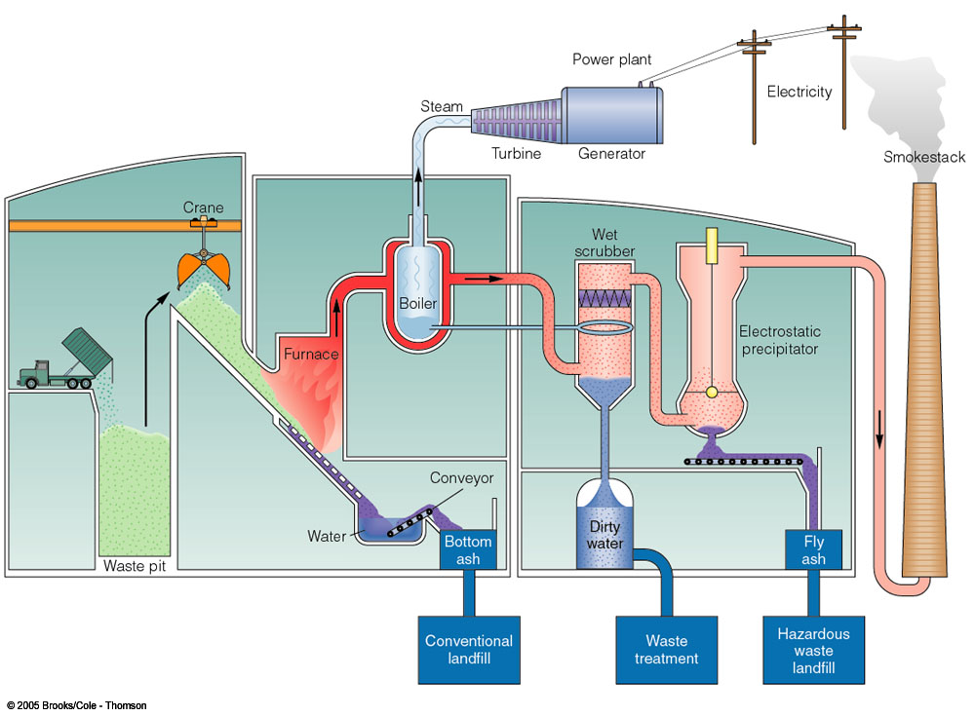

Slide 22
Burying Wastes
Landfills most common method of waste disposal - cheap and convenient.
Open pits no longer acceptable.
Complex impermeable bottom layers to trap contaminants
Daily deposits are covered by layer of dirt.
Methane gas and leachate monitoring wells

Slide 23
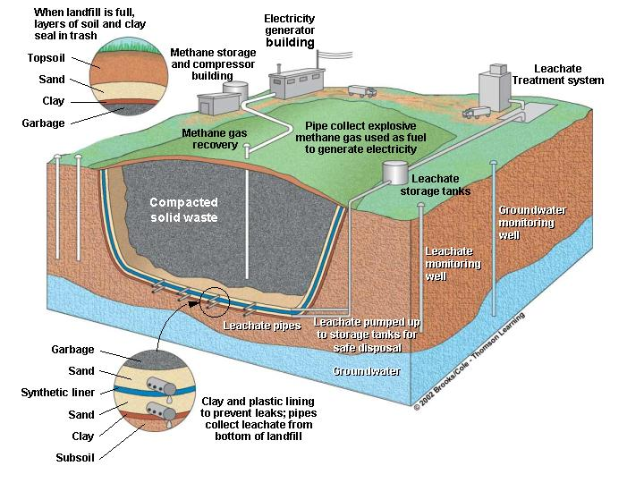
Sanitary Landfill

Slide 24
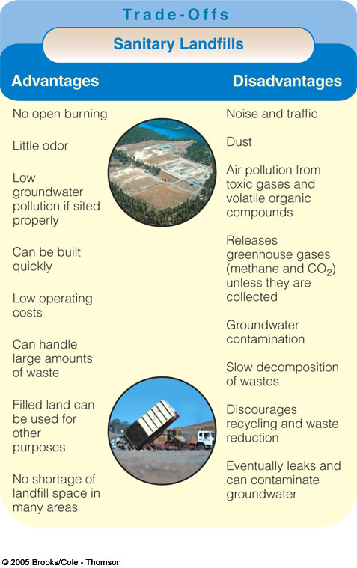
Sanitary Landfills: Trade-offs

Slide 25
The Love Canal Story
Love Canal was a waterway built in the 1800s next to Niagara Falls, NY.
Hooker Chemical Company purchased the site and used it for a chemical dump 1942-53.
Site was sold to local gov’t for $1. A housing development and school were constructed on the site in the 70s.
Chemicals began seeping into basements.
Housewife and resident Lois Gibbs brought problems to national attention in 1977.
Some families moved right away, some cleanup done.

Slide 26
The Love Canal Story
Of remaining families, miscarriage rate 50% higher than normal.
Of 17 pregnancies in 1979, 2 normal, 9 had birth defects, 2 still born, 4 miscarriages.
In adults tested, nerve impulses slower, 30% had broken chromosomes.
1980, gov’t relocated everybody, started massive cleanup.
1990 cleanup done, new development called Black Creek Village opened. Houses cheap.

Slide 27
Hazardous Waste Regulation in the United States
Resource Conservation and Recovery Act (RCRA)
Comprehensive Environmental Response, Compensation, and Liability Act (Superfund)
National Priority List
Polluter-pays principle

Slide 28
Hazardous Wastes: Types
Contains at least one toxic compound
Catches fire easily
Reactive or explosive
Corrodes metal containers

Slide 29
Not Hazardous Wastes under RCRA
Radioactive wastes
Household wastes
Mining wastes
Oil and gas drilling wastes
Liquids containing organic hydrocarbons
Cement kiln dust
<100 kg (220 lb) per month

Slide 30
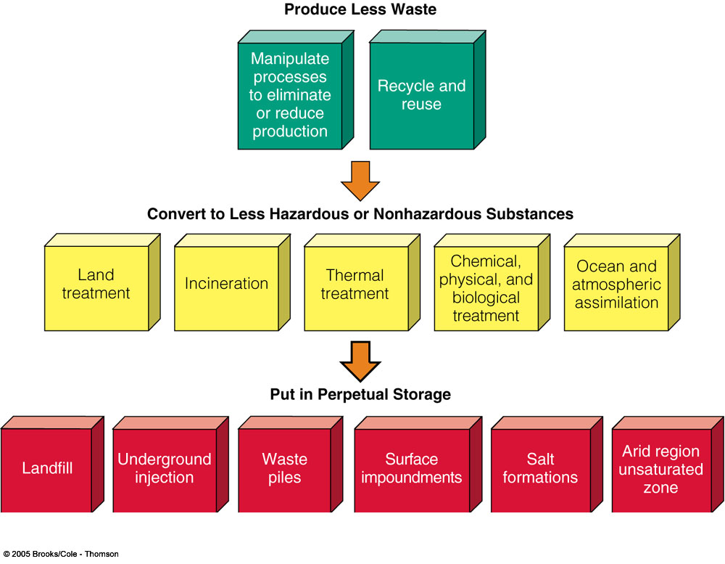
Dealing with Hazardous Wastes

Slide 31
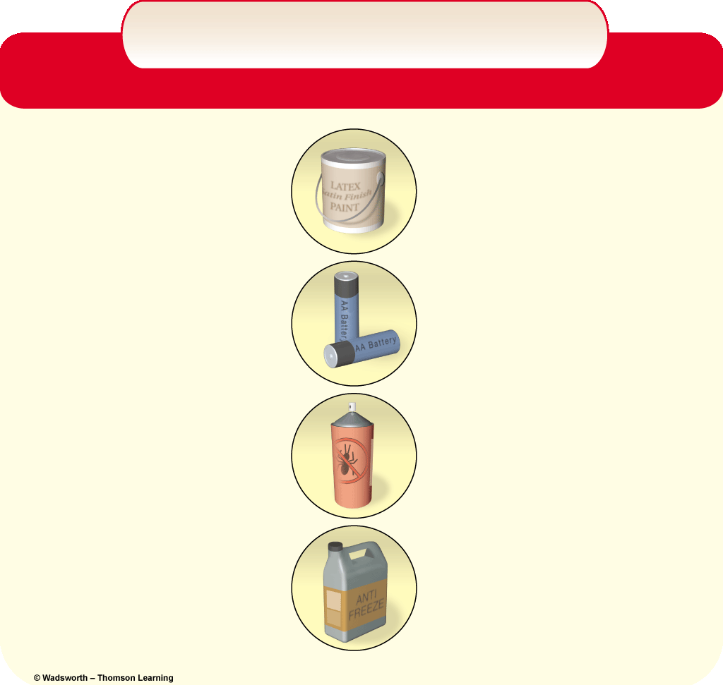
What Harmful Chemicals Are in Your Home?
What Harmful Chemicals Are in Your Home?
Cleaning
• Disinfectants
• Drain, toilet, and
window cleaners
• Spot removers
• Septic tank, cleaners
Gardening
• Pesticides
• Weed killers
• Ant and rodent killers
• Flea powders
Paint
• Latex and oil-based paints
• Paint thinners, solvents,
and strippers
• Stains, varnishes,
and lacquers
• Wood preservatives
• Artist paints and inks
Automotive
• Gasoline
• Used motor oil
• Antifreeze
• Battery acid
• Solvents
• Brake and transmission
fluid
• Rust inhibitor and
rust remover
General
• Dry cell batteries
(mercury and cadmium)
• Glues and cements

Slide 32
Detoxifying and Removing Wastes
Physical methods
Chemical methods
Bioremediation
Phytoremediation
Plasma incineration

Slide 33
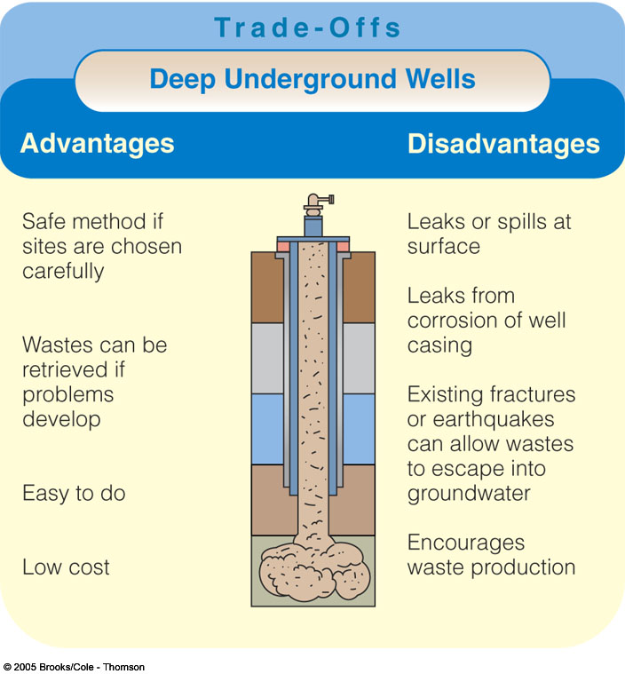
Deep-well Disposal

Slide 34
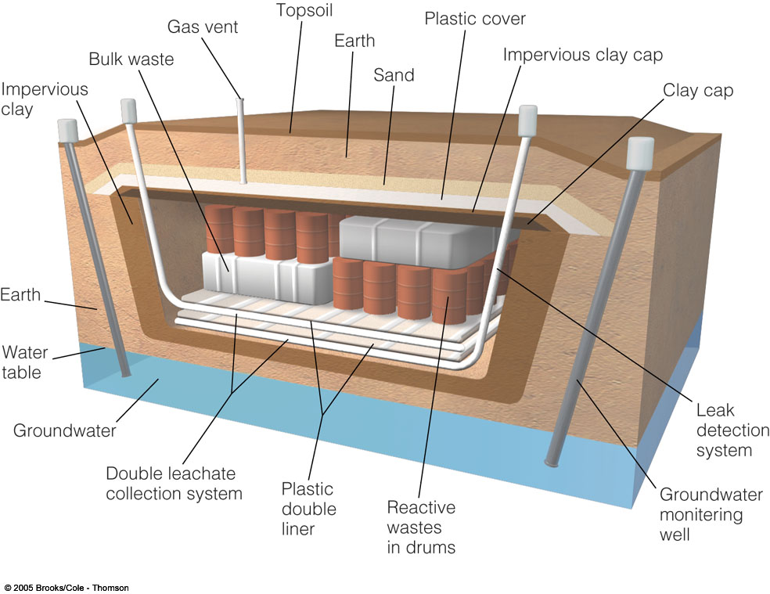
Hazardous Waste Landfill

Slide 35
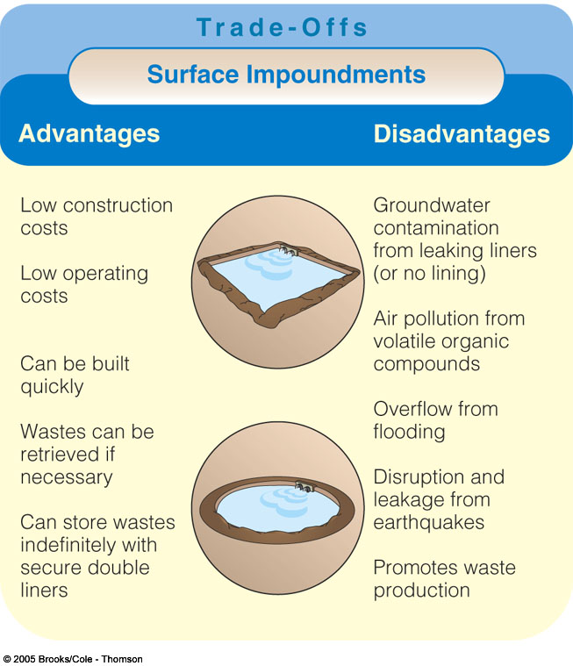
Surface Impoundments: Trade-offs

Slide 36
Some common hazardous chemicals
Lead
  paint, gasoline, pipes, accumulates in soil and water
  neurological damage, slows brain development, kidney disorders; children especially vulnerable
Mercury
  paint, batteries, old thermometers, industrial processes, combustion of coal, dental fillings, contaminated historical mining sites
  damages brain, kidneys, developing fetus, learning disabilities, death with high doses

Slide 37
Some common hazardous chemicals
Arsenic
  treated wood, industrial processes, contaminated soil and water
  impairs organ, heart, and blood functions; damages nervous system
PCBs (Ploycholorinated biphenyls)
  industrial chemical (used in fire retartands, lubricants, insulation for electrical transformers, some printing inks)
  carcinogenic, birth defects, lower IQ, learning disabilities, impairs neurological development

Slide 38
ASARCO of Tacoma
Commencement Bay home to smelting, shipbuilding, sawmills, refineries
Lead and Copper smelter
Operated 1890-1986
Released arsenic and lead into atmosphere
Now contaminated soil present throughout Puget Sound region
Largest Superfund site in Washington

Slide 39
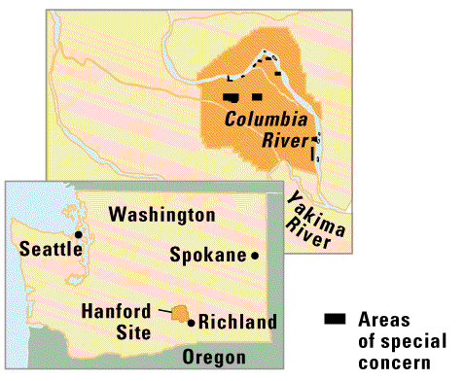
Hanford Nuclear Reservation : a complicated cleanup
1377 waste sites: trenches, pits, tanks, ponds, underground cribs
Both radioactive and toxic materials present
Example: Two pools store 100,000 spent fuel rods. Radioactive uranium, plutonium, cesium, and strontium released into water. The pools leak and soil and groundwater have become contaminated. The Columbia River is threatened.
Tanks of toxic and/or radioactive liquids have boiled for years by their own reactivity. Crusts of hazardous material forms on outside of tanks.

Slide 40
Solutions: Achieving a Low-Waste Society
Local grassroots action
International ban on 12 persistent organic pollutants (POPs)
  (the dirty dozen)
Precautionary Principle

