Slide 1
Introduction to Big Data and Data Mining

Slide 2
Importance of Data
Data provides the basis for generating information required in business operations/ any activity.

Slide 3
Data, Information and Knowledge
Data
Facts of the world
Information
Refers to the meaning of the data as understood by the user
Provides answers to "who", "what", "where", and "when" questions
Data that has been interpreted and then presented in a more meaningful context that allows a business to make decisions from.
Knowledge
It is the appropriate collection of information
Answers "how" / “why” questions

Slide 4
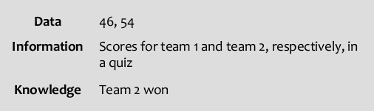
Example 1

Slide 5
Example 2
Data: crude oil, 70, 80
Information: The price of crude oil has risen from $70 to $80 per barrel"
Knowledge: is a combination of information, experience and insight that may benefit the individual or the organisation.
"When crude oil prices go up by $10 per barrel, it's likely that petrol prices will rise by 2p per litre" is knowledge.

Slide 6
Introduction to Big Data
Large amount of data is getting generated from various sources at a faster rate
Volume – How much data?
Velocity – How fast the data is generated/processed?
Variety - The various types of data.
Example: Mobile phone data, Sensor Data, Credit card data, Weather data, Data generated in social media sites (eg. Facebook, Twitter), Video surveillance data, medical data, etc.
Structured data (DBMS), Unstructured data (Text, Image, Audio and Video) , Semi structured data (XML)

Slide 7
Big Data
Uses of large data
Knowledge (meaningful pattern) obtained by analyzing data, can improve the business
Analyzing super market data
What kind of items sold?
Analyzing weather data
Precautionary measures can be taken against floods, Tsunami , etc.
Analyzing Medical data
Reasons for epidemic diseases, Cancer cells identification, etc.

Slide 8
Big Data
Limitations of Centralized systems
Storage is limited to terabytes
Uni-processor systems: Multi programming, Time sharing, Threads - improves throughput
Multi processor systems: Parallel processing using multiple CPUs - improves throughput.
Disadvantage: Scalability – Resources cannot be added to handle increase in load.

Slide 9
Big Data
Centralized systems
Do not have
Enough storage
Required computing power to process large data
Data has to be transferred to the system where application program is getting executed

Slide 10
Big Data
Multi computer systems
Scalable: Storage, Computing power can be increased according to the requirement
Data intensive computing : Type of parallel computing – Tasks are executed by transferring them to the systems where the data is available and executing these tasks in parallel.

Slide 11
Fastest Super Computer
Sunway TaihuLight, a system developed by China’s National Research Center of Parallel Computer Engineering & Technology (NRCPC) and installed at the National Supercomputing Center in Wuxi, maintains its top position.
With a Linpack performance of 93 petaflops, TaihuLight is far and away the most powerful number-cruncher on the planet.
The Sunway TaihuLight uses a total of 40,960 Chinese-designed SW26010 many core 64-bit RISC processors.
Each processor chip contains 260 processing cores for a total of 10,649,600 CPU cores across the entire system

Slide 12
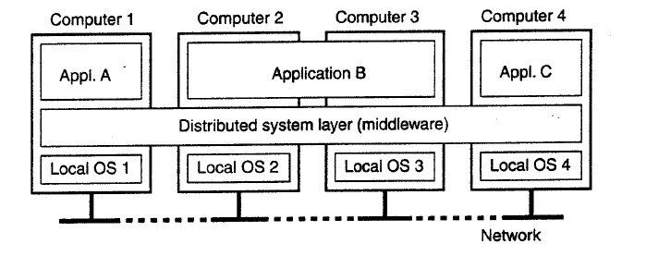
Distributed System (DS)
A distributed system is a collection of independent computers that appears to its users as a single coherent system (Single System Image) - Loosely coupled systems
Computing power and storage are shared among the users.

Slide 13
Advantages of DS
Scalability
Reliability
Availability
Communication
Building pure DS is not practically possible!
-due to heterogeneous systems

Slide 14
Cluster Systems
Collection of similar computers (nodes) connected by high speed LAN
Master node, Computational nodes
Nodes run similar OS
Master node controls storage allocation and job scheduling
Provides single system image
Computing power and storage are shared among the users.

Slide 15
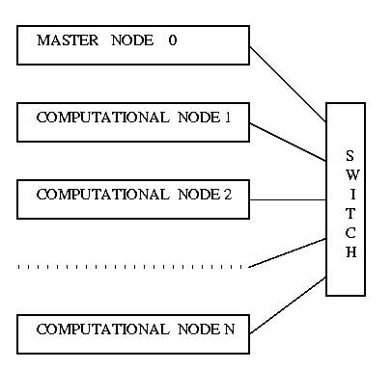
Cluster Computing .. Contd

Slide 16
Hadoop
How to store and process large data ?
Hadoop provides
Storage facility through HDFS (Hadoop Distributed File System)
Computing framework in the form of MapReduce for performing distributed and parallel processing
(Cluster is formed using commodity hardware)

Slide 17
Big Data Analytics
Statistical Methods
Sales of plastic items in Hyderabad (for Vijetha super market )
R Programming language – Stand alone - or with Hadoop
Machine Learning : focuses on the development of computer programs that can access data and use it for learning themselves.
Applications: Image and Speech recognition, Stock Market prediction
Google’s automatic car project (Waymo)
Data Mining
(Current research trend: Converting DM algorithms into parallel algorithms and run them in distributed computing environment – for improving the performance- Hadoop MapReduce )

Slide 18
What is Data Mining?
Data Mining is:
Finding hidden information (interesting) in a database
Extracting knowledge from large amounts of data
the process of automatically discovering novel and useful patterns from large date set
The efficient discovery of previously unknown, valid, potentially useful, understandable patterns in large datasets
The analysis of (often large) observational data sets to find unsuspected relationships and to summarize the data in novel ways that are both understandable and useful to the data owner

Slide 19
Data Mining
Data Mining – major knowledge patterns
Association rules
Clustering
Classification

Slide 20
Data Mining
Similar terms
Exploratory data analysis
Data driven discovery
Deductive learning
DM algorithms
Attempt to fit a model to the data
examine the data and determine a model that is closest to the characteristics of the data being examined
Some criteria must be used to fit one model over another

Slide 21
Query Examples
Database
Find all credit applicants with last name of Suman
Identify customers who have purchased more than $10,000 in the last month.
Find all customers who have purchased honey.
Data Mining
Find all credit applicants who are poor credit risks.
Identify customers with similar buying habits.
Find all items which are frequently purchased with honey

Slide 22
Results of DM
Data Mining
70% of students who scored high in mathematics also scored high in C programming
80% of students who scored high in mathematics and low in C programming became Professors

Slide 23
Predictive Tasks and Modeling
Predictive tasks predict the value of a particular attribute (target or dependent variable) based on the values of other attributes (explanatory or independent variables)
Predictive modeling refers to the task of building a model for the target variable as a function of explanatory variables.
Classification
Predicting a web user will make a purchase or not is a classification task
Regression
Forecasting the future price of the stock

Slide 24
Predictive Tasks and Modeling
The goal of both classification and regression is to learn a model that minimizes the error between the predicted and true values of the target variables.
Predictive modeling can be used
to identify customers that will respond to marketing campaign
predict disturbances in the earth’s eco system
judge whether a patient has a particular disease based on the medical tests

Slide 25
Descriptive Tasks and Modeling
Descriptive tasks derive patterns that summarize the underlying relationships in data.
Descriptive tasks frequently require post processing techniques to validate and explain the results
Clustering
grouping employees with similar behavior pattern accordingly allocating work
Association rules
bread, butter, jam → pillow

Slide 26
Association Analysis
It is used to discover patterns that describe strongly associated features in the data
Discovered patterns are typically represented in the form of implication rules or feature subsets
It has to extract most interesting patterns in an efficient manner (exponential search space size)
Examples:
Finding groups of genes that have related functionality
identifying web pages that are accessed together
understanding the relationships between different elements of earth’s climate subsystem
Open problem: Stacking items in a Super market

Slide 27
Classification
Classification maps data into predefined groups or classes
Test cricket between India, SA at Newlands
Records of Indian team players (in SA and in fast and bouncy and swinging pitches) , nature of pitch and climate at Newlands , Records of SA players – attributes.
India – win, lose, draw (classes)
Classes are predetermined (classes are determined before examining data ) based on the already existing data and this is referred to as supervised learning

Slide 28
Classification
Pattern recognition is a type of classification where an input pattern is classified into one of several classes based on its similarity to these predefined classes
Airport security scans face of passenger to check whether they are potential terrorists or criminals
Distance between eyes, size and shape of mouth, shape of head etc .. are compared with entries in a database to see if it matches any patterns that are associated with known offenders

Slide 29
Regression
Target variable is estimated in terms of independent variables
Target variables – continuous valued attribute
Examples:
Predicting a stock market index using economic indicators
Projecting the total sales of a company based on the amount spend for advertising

Slide 30
Clustering
Partitioning or segmenting the data into groups that might or might not be disjointed
Clustering is accomplished by determining the similarity among the data on predefined attributes
the most similar data are grouped into cluster
Since the clusters are not predefined, a domain expert is often required to interpret the meaning of created clusters (Unsupervised learning)

Slide 31
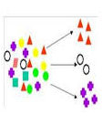
Clustering (2)
Examples:
Areas of the ocean that have a significant impact on the earth’s climate
Amazon – target customers – grouping – for sales advertisements

Slide 32
Anomaly Detection
It is the task of identifying observations whose characteristics are significantly different from the rest of the data (anomalies or outliers)
Grouping Cancer cells
A good anomaly detector must have a high detection rate and low false alarm rate
Applications: Detection of fraud, network intrusions, ecosystem disturbances, unusual pattern of diseases
Credit card fraud detection
Build a profile of legitimate transactions made by the user
If the characteristics of the current transaction of the user are very different from the previously created profile – transaction is flagged as potentially fraudulent

Slide 33
Summarization
Derives representative information about data
Summary type of information can be derived from the data (mean of numeric data)
Ranking the Institutes based on
Average IIT JEE marks of the students - UG Institutes
Average GATE score of students - PG Institutes

Slide 34
Sequential Discovery or Sequential Analysis
Sequential Analysis
Based on time sequence of actions
used to determine sequential patterns in data
Applications
Items are purchased over time in some order
Most people who purchased CD players may be forced to purchase CDs within one week
Website visits – Frequent patterns - <A, B, C>
<A, D, B, C> <A,E,B,C> - Decision: Add a link to C from A

Slide 35
File System Example – for Frequent Sequence Access Pattern
Example:
F1 1,5,7,9,11
F2 – 2,9,14,17
When an application accesses block 1 of F1, the system can pre fetch the blocks 5, 7, 9, and 11 into memory
Read access time can be reduced

Slide 36
Time Series Analysis
The input data consists of values of attributes that change over time
Examples:
Stock market data
Traces of scientific experiments
Medical treatment details
Goals of TSA
To form a model that can be used to predict the time series for future values of time
Stock market: Future values of stock

Slide 37
Time Series Analysis (2)
Take a sequence as a query and retrieve similar sequences or sub-sequences from a large database of sequences
Figure shows stock market values of X, Y and Z companies for 30 days

Slide 38
Time Series Analysis (3)
Y, Z – exhibit similar behavior (The behavior of Y between days 6 and 20 is identical to that for Z between days 13 and 27)
X appears to have less volatility
X- overall showing a slightly larger relative amount of growth than either of the other stocks

Slide 39
Time Series Analysis (4)
Predict future values
Determine similar patterns over time
Classify behavior

Slide 40
Development of Data Mining
Data mining algorithms adopt ideas from other areas also
Artificial Intelligence
Machine Learning
Pattern Recognition
Database Systems
Parallel and distributed computing
Statistics
Information Retrieval

Slide 41
Development of Data Mining (2)
DBMS
Relational Data Model
SQL
Association Rule Algorithms
Data Warehousing
Scalability Techniques
Information Retrieval
Similarity Measures
Hierarchical Clustering
IR Systems
Imprecise Queries
Textual Data
Web Search Engines

Slide 42
Development of Data Mining (3)
Algorithms
Algorithm Design Techniques
Algorithm Analysis
Data Structures
Machine Learning
Neural Networks
Decision Tree Algorithms
Statistics
Bayes Theorem
Regression Analysis
K-Means Clustering
Time Series Analysis

Slide 43
Data Mining Metrics
DM metrics are used for measuring the effectiveness or usefulness of a DM approach
Interestingness of discovered pattern
Novelty: A pattern is novel if it was not known previously
Actionability: A pattern is actionable if its existence leads to some profitable decision
Return on Investment (ROI) (business perspective)
ROI examines the difference between what DM technique costs and what the savings or benefits from its use are
eg. increased sales, reduced advertising expenditure

Slide 44
DM Algorithms – Implementations issues
Scalability: DM algorithms should work regardless of the size of the dataset and amount of available main memory
Real-world data:
are noisy and have many missing attribute values
Algorithms should be able to work even in the presence of these problems

Slide 45
DM Algorithms – Implementations issues (2)
Update: Many DM algorithms work with static datasets
Ease of use: Although some algorithms may work well , they may not be well received by users if they are difficult to use and understand

Slide 46
Challenges for DM algorithms
High Dimensionality
Data sets with hundreds or thousands of attributes are common
Gene expression data involves thousands of features
Datasets with temporal or spatial components tend to have high dimensionality
Computational complexity increases as the dimensionality (the number of features) increases
Dimensionality reduction
Determining which attributes are not needed is a challenge

Slide 47
Challenges for DM algorithms (2)
Multimedia data
Most previous DM algorithms are developed for handling traditional data types (numeric, character, text, etc.)
The use of multimedia data (found in Geographic Information System (GIS), etc ..) complicates or invalidates many proposed algorithms

Slide 48
Challenges for DM algorithms (3)
Data ownership and Distribution:
Data is geographically distributed among resources belonging to multiple entities and requires the development of distributed data mining (DDM) techniques
Key challenges for DDM techniques:
How to reduce the amount of communication needed to perform the distributed computation?
How to effectively consolidate the DM results obtained from multiple resources?
How to address data security issues?

Slide 49
Challenges for DM algorithms (4)
Non-traditional Analysis:
In statistics-based approach a hypothesis is proposed, an experiment is designed to gather data and then the data is analyzed with respect to hypothesis.
Current data analysis tasks often require the generation and evaluation of thousands of hypotheses
laborious to do it manually and automatic techniques are needed

Slide 50
Knowledge Discovery in Databases (KDD)
KDD is the process of finding useful information and patterns in data.
Data mining is the integral part of KDD process.
KDD involves the following steps: (i) Selection (ii) Preprocessing (iii) Transformation (iv) Data mining (v) Interpretation and evaluation

Slide 51
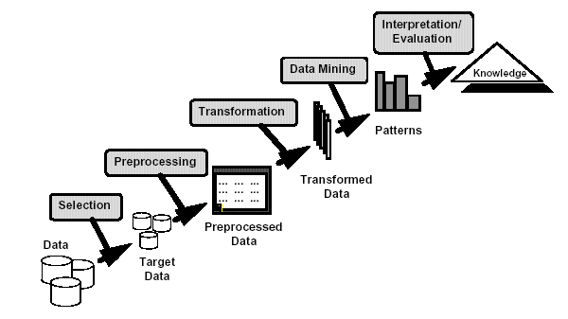
KDD
Selection: Data needed for the DM
process may be obtained from many
different and heterogeneous
data sources (DBMS, files, non electronic sources)
Preprocessing:
Incorrect data may be corrected or removed
Missing data must be supplied or predicted
Transformation:
Data from different sources must be
converted into a common format for
processing
Data reduction may be used to reduce
number of possible data values
Data mining: algorithms are applied to the transformed data to generate the
Desired results.
Interpretation/evaluation:
Visualization: Visual presentation of data bar, pie, histograms and line graphs, icon-based or pixel-based approaches can be used
Data mining as a step in the process of knowledge discovery

Slide 52
Introduction to Data Warehousing and OLAP

Slide 53
Data warehouse
An infrastructure to store and manage historical (archival data) data
Data warehousing is a repository collected from multiple data sources and integrated for human exploration (Data pertaining to some aspect of day-to-day operations in an enterprise are available in a data source)
Data collection involves data cleaning (removing noise and inconsistent data) and data integration (bringing data from multiple sources to a single location and into a common format)

Slide 54
Data warehouse
Online analytical processing (OLAP) tools enable the users to explore the stored data along multiple dimensions, at any level of granularity and manually discover patterns
Data warehouse users are analysts who explore data to find useful patterns using which some business decisions can be taken.
DW: is a subject oriented, integrated, time variant and non-volatile collection of data to support the decision making process. (by W. H. Inmon, 1990, Founder of DW)

Slide 55
OLTP Applications
Use operational data stored in the database
Frequent update and queries
Normalized for efficient search and updates ( minimize update anomalies)

Slide 56
OLAP Applications
Use aggregated/summarized data stored in the DW
DW stores materialized views
Very infrequent updates
Analytical queries are issued to DW
Require huge amounts of aggregation
eg. Average age of Engineering Students who are purchasing Apple cell phone and do iOs programming
Average salary of passengers traveling in First class AC
Average gain to the Govt. due to cancellation of confirmed tatkal tickets
Performance issues mainly in query response time (not in updates as updates are infrequent)

Slide 57
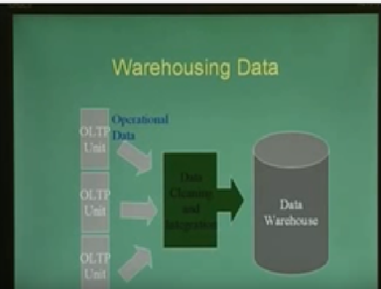
Warehousing Data

Slide 58
Hadoop
Hive
DW
Store data in HDFS
Use MapReduce for parallelexecution
Hbase
column oriented DB
CAP
NO SQL

Slide 59
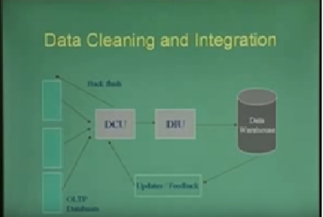
Data Cleaning and Integration

Slide 60
Dirty data
Lack of Standardization
Spurious abbreviations
BV street – Bakthavatchalam street
Semantic equivalence
Bombay, Mumbai
Coimbatore, Covai
Different encoding schemes
Multiple standards , using KM, Miles (1.6 KM = 1 mile)

Slide 61
Dirty Data (2)
Missing, spurious and duplicate data
Missing ‘age’ field for employees
Spurious values – (incorrectly entered sales values)
Duplication of data across OLTP units
Semantic duplication
Sachin Ramesh Tendulkar, Sachin Tendulkar

Slide 62
Dirty Data (3)
Inconsistencies
incorrect use of codes (use of M/F in addition to 0/1 for gender)
Codes with inconsistent or outdated meaning
Travel eligibility ‘C’ denoting to travel only in III class sleeper which no longer exists
Inconsistent duplicate data (two data sets are found to belong to the same person, but have two different address information)

Slide 63
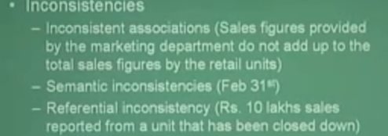
Dirty Data (4)

Slide 64
Issues in Data Cleaning
Cannot be fully automated
Requires considerable knowledge beyond the purview of DW (metrics, geography, govt. policies, etc ..)
Complexity increases with increase in data sources
Complexity increases with the history span that is taken up for cleaning

Slide 65
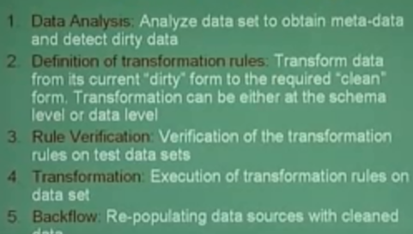
Steps in Data Cleaning

Slide 66
Example: Transformation Algorithm
Hash-Merge for duplicate elimination
Hash tuples based on given column into buckets
(Tuples with duplicate values are hashed onto same bucket)
Merge tuples within each bucket separately

Slide 67
Integration
Schema integration: Forming integrated schema structure
Data integration: Cleaning and merging data from different sources

Slide 68
Schema Integration
Challenges
Naming differences
Structural differences
Data type differences
Missing Fields
Semantic differences
Health Informatics …
Integrating patient details from multiple hospitals

Slide 69
Data warehouse .. Multidimensional Model
DW users study how certain attributes of data elements (called measures) are related to other attributes (called dimensions)
Users have to specify which attributes will be treated as measures and dimensions.
DW is structured in terms of these subjects (measures and dimensions) to facilitate exploration.

Slide 70
Data warehouse .. Multidimensional Model (2)
The data is conceptually organized as a multi dimensional array
each dimension corresponds to a dimension of the warehouse
values stored in each cell of the array correspond to the measures of the DW
This way of organizing data is referred to as a multidimensional model and the data repository is said to be subject oriented

Slide 71
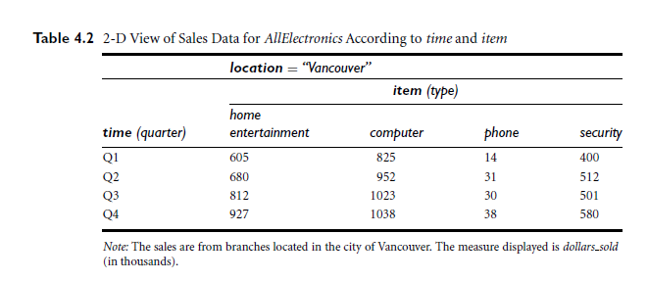
Data Warehouse .. Multidimensional Model (3)

Slide 72
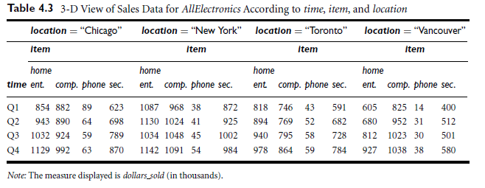
Data Warehouse .. Multidimensional Model (4)

Slide 73
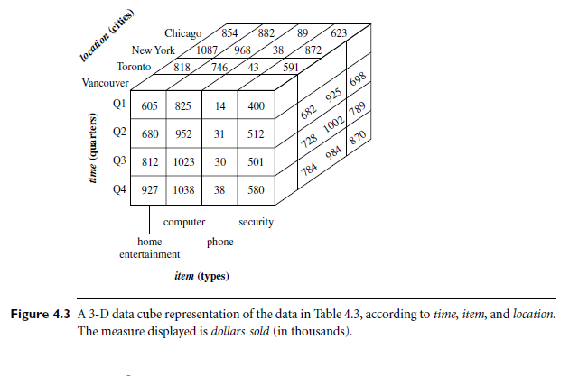
Multi dimensional model … (Data cube / cuboid)

Slide 74
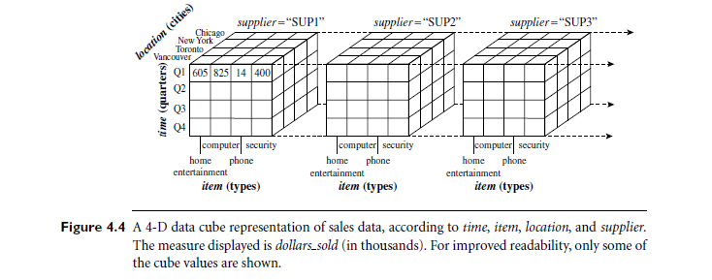
Multi dimensional model … (Data cube / cuboid) - 2
Data cubes are n dimensional and do not confine to 3-D

Slide 75
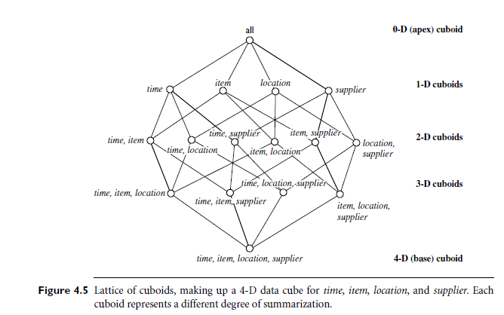
Multi dimensional model … (Data cube / cuboid) - 6
Given a set of dimensions, we can generate a cuboid for each of the possible subsets of the dimensions and the result would form a lattice of cuboids each showing data at a different level of summarization.

Slide 76
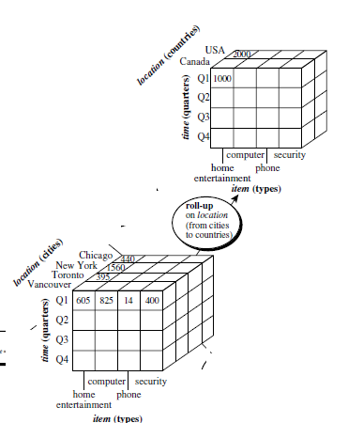
OLAP Operations
Roll-up operation performs
Aggregation on the data cube

Slide 77
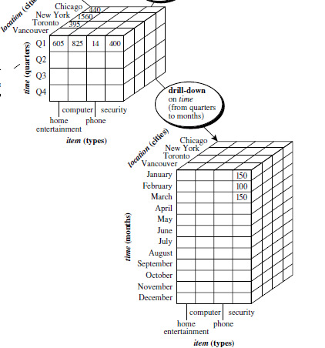
OLAP Operations (2)
Drill down navigates from less detailed data to more detailed data

Slide 78
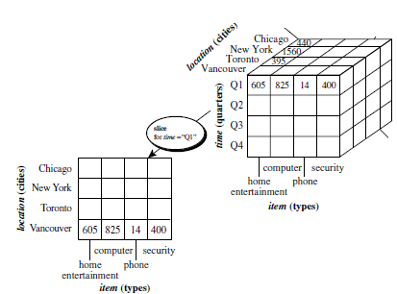
OLAP Operations (3)
Slice operation performs a selection on one dimension of the given cube resulting in a sub cube.

Slide 79
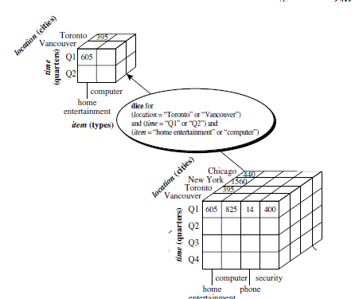
OLAP Operations (4)
The dice operation defines a sub cube by performing a selection on two or more dimensions

Slide 80
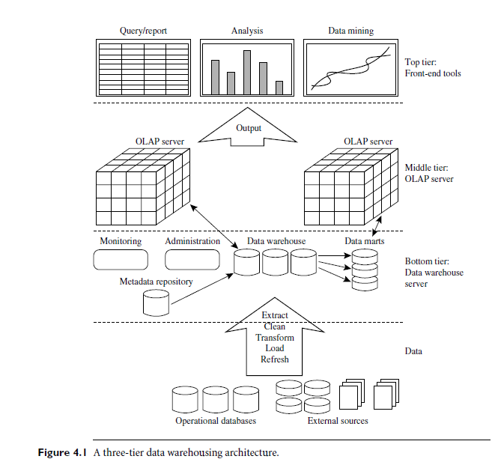

Slide 81
Discrete traget variable – classification
Continuous target variable - regression

