Slide 1
Introduction to Big Data and Data Mining

Slide 2
Importance of Data
Data provides the basis for generating information required in business operations/ any activity.

Slide 3
Data, Information and Knowledge
Data
Facts of the world
Information
Refers to the meaning of the data as understood by the user
Provides answers to "who", "what", "where", and "when" questions
Data that has been interpreted and then presented in a more meaningful context that allows a business to make decisions from.
Knowledge
It is the appropriate collection of information
Answers "how" / “why” questions

Slide 4
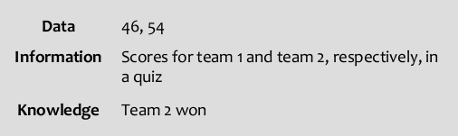
Example 1

Slide 5
Example 2
Data: crude oil, 70, 80
Information: The price of crude oil has risen from $70 to $80 per barrel"
Knowledge: is a combination of information, experience and insight that may benefit the individual or the organisation.
"When crude oil prices go up by $10 per barrel, it's likely that petrol prices will rise by 2p per litre" is knowledge.

Slide 6
Introduction to Big Data
Large amount of data is getting generated from various sources at a faster rate
Volume – How much data?
Velocity – How fast the data is generated/processed?
Variety - The various types of data.
Example: Mobile phone data, Sensor Data, Credit card data, Weather data, Data generated in social media sites (eg. Facebook, Twitter), Video surveillance data, medical data, etc.
Structured data (DBMS), Unstructured data (Text, Image, Audio and Video) , Semi structured data (XML)

Slide 7
Big Data
Uses of large data
Knowledge (meaningful pattern) obtained by analyzing data, can improve the business
Analyzing super market data
What kind of items sold?
Analyzing weather data
Precautionary measures can be taken against floods, Tsunami , etc.
Analyzing Medical data
Reasons for epidemic diseases, Cancer cells identification, etc.

Slide 8
Big Data
Limitations of Centralized systems
Storage is limited to terabytes
Uni-processor systems: Multi programming, Time sharing, Threads - improves throughput
Multi processor systems: Parallel processing using multiple CPUs - improves throughput.
Disadvantage: Scalability – Resources cannot be added to handle increase in load.

Slide 9
Big Data
Centralized systems
Do not have
Enough storage
Required computing power to process large data
Data has to be transferred to the system where application program is getting executed

Slide 10
Big Data
Multi computer systems
Scalable: Storage, Computing power can be increased according to the requirement
Data intensive computing : Type of parallel computing – Tasks are executed by transferring them to the systems where the data is available and executing these tasks in parallel.

Slide 11
Fastest Super Computer
Sunway TaihuLight, a system developed by China’s National Research Center of Parallel Computer Engineering & Technology (NRCPC) and installed at the National Supercomputing Center in Wuxi, maintains its top position.
With a Linpack performance of 93 petaflops, TaihuLight is far and away the most powerful number-cruncher on the planet.
The Sunway TaihuLight uses a total of 40,960 Chinese-designed SW26010 many core 64-bit RISC processors.
Each processor chip contains 260 processing cores for a total of 10,649,600 CPU cores across the entire system

Slide 12
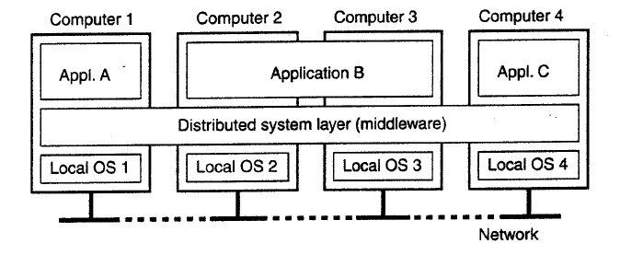
Distributed System (DS)
A distributed system is a collection of independent computers that appears to its users as a single coherent system (Single System Image) - Loosely coupled systems
Computing power and storage are shared among the users.

Slide 13
Advantages of DS
Scalability
Reliability
Availability
Communication
Building pure DS is not practically possible!
-due to heterogeneous systems

Slide 14
Cluster Systems
Collection of similar computers (nodes) connected by high speed LAN
Master node, Computational nodes
Nodes run similar OS
Master node controls storage allocation and job scheduling
Provides single system image
Computing power and storage are shared among the users.

Slide 15
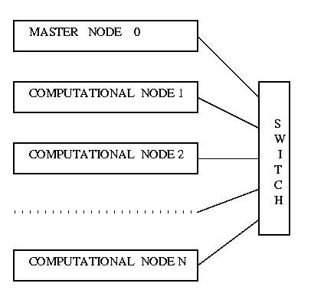
Cluster Computing .. Contd

Slide 16
Hadoop
How to store and process large data ?
Hadoop provides
Storage facility through HDFS (Hadoop Distributed File System)
Computing framework in the form of MapReduce for performing distributed and parallel processing
(Cluster is formed using commodity hardware)

Slide 17
Big Data Analytics
Statistical Methods
Sales of plastic items in Chandanagar region in Hyderabad (for Vijetha super market )
R Programming language
Machine Learning : focuses on the development of computer programs that can access data and use it for learning themselves.
Applications: Image and Speech recognition, Market prediction
Data Mining

Slide 18
What is Data Mining?
Data Mining is:
Finding hidden information (interesting) in a database
Extracting knowledge from large amounts of data
The efficient discovery of previously unknown, valid, potentially useful, understandable patterns in large datasets
The analysis of (often large) observational data sets to find unsuspected relationships and to summarize the data in novel ways that are both understandable and useful to the data owner

Slide 19
Data Mining
Data Mining
Association rules
eg. Bread, butter, jam → pillow
Clustering
grouping customers with similar behavior pattern
Classification
Predicting whether the new customer will pay the housing loan or not
Open problem: Stacking items in a Super market

Slide 20
Knowledge Discovery in Databases (KDD)
KDD is the process of finding useful information and patterns in data.
Data mining is the integral part of KDD process.
KDD involves the following steps: (i) Selection (ii) Preprocessing (iii) Transformation (iv) Data mining (v) Interpretation and evaluation

Slide 21
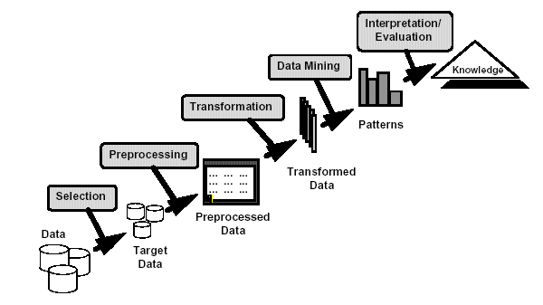
KDD
Selection: Data needed for the DM
process may be obtained from many
different and heterogeneous
data sources (DBMS, files, non electronic sources)
Preprocessing:
Incorrect data may be corrected or removed
Missing data must be supplied or predicted
Transformation:
Data from different sources must be
converted into a common format for
processing
Data reduction may be used to reduce
number of possible data values
Data mining: algorithms are applied to the transformed data to generate the
Desired results.
Interpretation/evaluation:
Visualization: Visual presentation of data bar, pie, histograms and line graphs, icon-based or pixel-based approaches can be used
Data mining as a step in the process of knowledge discovery

Slide 22
Grading Policy Data Mining
Quiz I (test) – 1 hr duration – 10 marks
Quiz II (test) – 1 hr duration – 10 marks
Final Examination – 3 hrs duration - 50 marks
Project - 20 marks
Seminar / Assignments - 10 marks
Total : 100 marks

