Slide 1

Public Participation in Environmental Decision-making
Making Space for a Sustainable Future
Michael Ewing
Coordinator of the Environmental Pillar, Ireland

Slide 2
Public Participation in Environmental Decision-Making
Who are the Public?
What is Participation?
What is Environmental Decision-Making (EDM)?
What are the Tools we can use?
Michael Ewing, Environmental Pillar of Social Parnership, Ireland

Slide 3
Who are the Public?
2.4. “The public” means one or more natural or legal persons”- a collection of numerous continually shifting interests and alliances, which may be in conflict with each other
a catch-all to describe those with an interest in a decision, other than a proponent, operator, or responsible authority. The individuals making up a public may be involved as individuals or as members of organisations. They may become involved due to their proximity, economics, social or environmental issues, values, etc.
A person doesn’t have to be a citizen to be a member of the public
Michael Ewing, Environmental Pillar of Social Parnership, Ireland

Slide 4
Identifying the Public.
In practice there are as many publics as there are different people who care, positively or negatively, about a project. Who they are may depend on their ethical, moral, interest, welfare etc. viewpoints.
Other reasons the public may be affected include:
Proximity – Pollution, Property values, Employment.
Economics – Landowners, House-owners.
Use – Amenity value, rights of way, vista.
Social and Environmental Issues – Justice and Risk.
Values – Animal Rights, Ecology, Religion.
Michael Ewing, Environmental Pillar of Social Parnership, Ireland

Slide 5
Stakeholders
Stakeholders, of which the public is one, are literally those with a stake in an issue and may include non-governmental organizations (NGO’s), government or its agents, industry, individuals, communities etc.
Stakeholders do not always want to be involved in an environmental decision-making process, but they have the right to know, if their interests are affected.
They may also want to become involved at different stages of the process
Michael Ewing, Environmental Pillar of Social Parnership, Ireland

Slide 6

A common understanding of the meaning of Public Participation
Michael Ewing, Environmental Pillar of Social Parnership, Ireland

Slide 7
What is Participation?
Public participation or Public Involvement, means different things to different people.
The level at which the public is involved varies with the relevant legislation, and the attitudes of the other stakeholders.
Simply stated, to participate is to take part, to share and act together.
Participation is an essential part of developing a sustainable future.
Michael Ewing, Environmental Pillar of Social Parnership, Ireland

Slide 8
What is Environmental Decision-Making?
any process of decision-making where consequent significant environmental impacts are a possibility.
includes law making, policy making, spatial planning, strategic planning, resource management planning, licensing of industry e.g. IPPC, environmental assessment (EIA), budgetary decisions etc.
Michael Ewing, Environmental Pillar of Social Parnership, Ireland

Slide 9
DAD or DEAD
Studies indicate a serious gap in understanding and trust between stakeholders
Existing decision-making structures are often based on either the traditional DAD (Decide, Announce and Defend) or DEAD (Decide, Educate, Announce and Defend) methods, and this can be seen as one source of this gap in trust.
Michael Ewing, Environmental Pillar of Social Parnership, Ireland

Slide 10
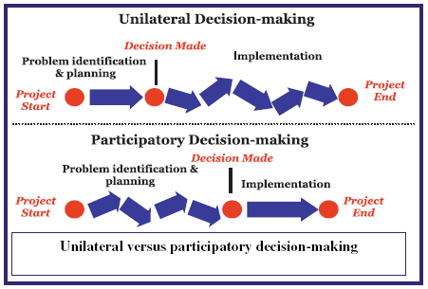
Michael Ewing, Environmental Pillar of Social Parnership, Ireland

Slide 11
Degrees of Citizen Power
Arnstein’s Ladder
Increasing
Public
Power
8 | Citizen Control
7 | Delegated Power
6 | Partnership
5 | Placation
4 | Consultation
3 | Informing
2 | Therapy
1 | Manipulation
Degrees of Citizen Power
Degrees of Tokenism
Non-Participation.
Michael Ewing,
Environmental Pillar of Social Partnership, Ireland

Slide 12
Guiding Principles for Participation
Plan early for public participation - resources needed to support the process, and identify the limitations of finances.
Identify stakeholders and their legitimacy and/or representativeness.
Make it clear at the outset just how much influence the public can have
Identify the appropriate techniques to be used for each stage of the process
Provide information in a form that the recipients can understand
Hold events at a time and venue to suit all participants.
Allow sufficient time for assimilation and response to information.
Ensure inputs of stakeholders are integrated into any decisions made as well as feedback on all issues raised.
Michael Ewing, Environmental Pillar of Social Parnership, Ireland

Slide 13
EIA
Project Concept
Annex I Project
Annex II Project
No EIS Required
Application of Thresholds
Sub-Threshold
Under Articles 103,109 & 120
of SI 600 of 2001.
SCREENING
Public Involvement
EIS Required
Public
Involvement
In the phases of
The EIA process
SCOPING
Public Involvement
Establish TOR and Significance of Impacts
ALTERNATIVES
Public Involvement
Examination of Alternatives
BASELINE STUDY
Assess environmental setting
MITIGATION
Measures to Avoid, Reduce or Offset impacts
WRITING EIS
Proponent Prepares EIS
REVIEW
Public Involvement
Public Review
EIS &Submissions Reviewed by Competent Authority
DECISION MAKING
Decision Made By Competent Authority
FOLLOW UP & MONITORING Public Involvement
Michael Ewing, Environmental Pillar of Social Parnership, Ireland

Slide 14
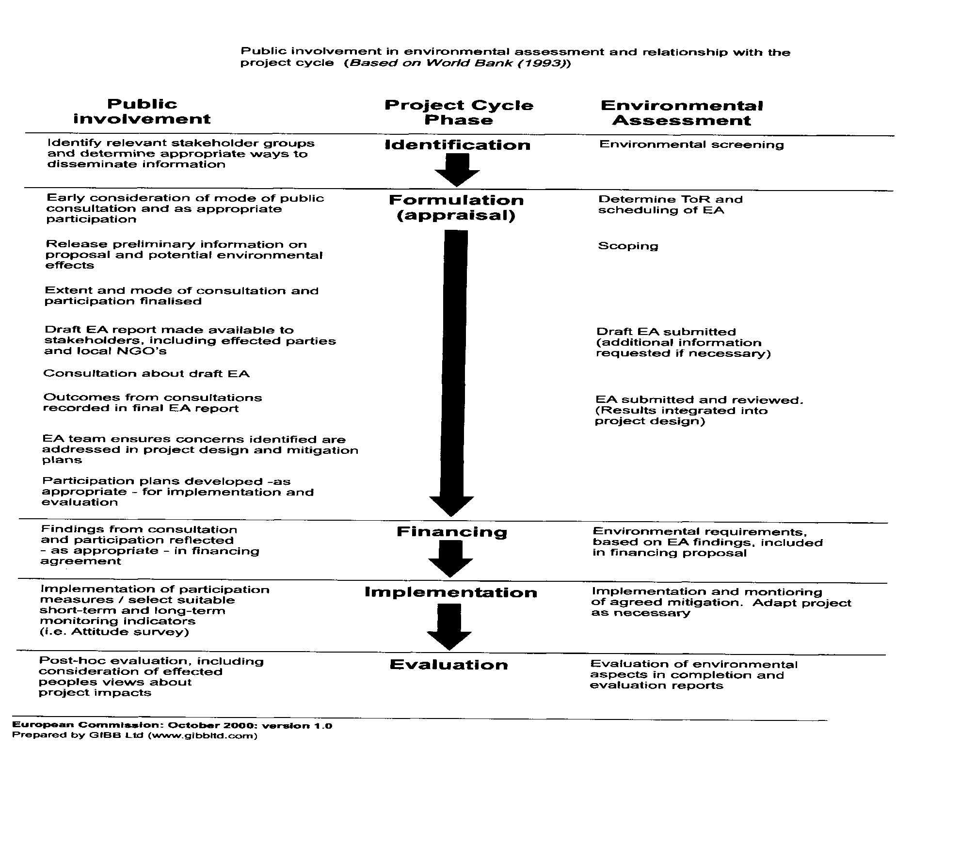
Michael Ewing, Environmental Pillar of Social Parnership, Ireland

Slide 15

The bread has to be good, but the filling is what makes it a sandwich !
Michael Ewing, Environmental Pillar of Social Parnership, Ireland

Slide 16
Planning for Participation
Objectives of the Process
  Set by discussion with stakeholders
  Clear understanding of the limitations
  Objectives change during the stages of a process
  Select techniques for each stage to achieve the objectives
Michael Ewing, Environmental Pillar of Social Parnership, Ireland

Slide 17
Important Factors in Objective Setting.
Environmental Protection
Legal Requirements
Proponent Objectives vs Public Objectives
Two Way Communication
Experts vs. Public
Levels of Participation
Michael Ewing, Environmental Pillar of Social Parnership, Ireland

Slide 18
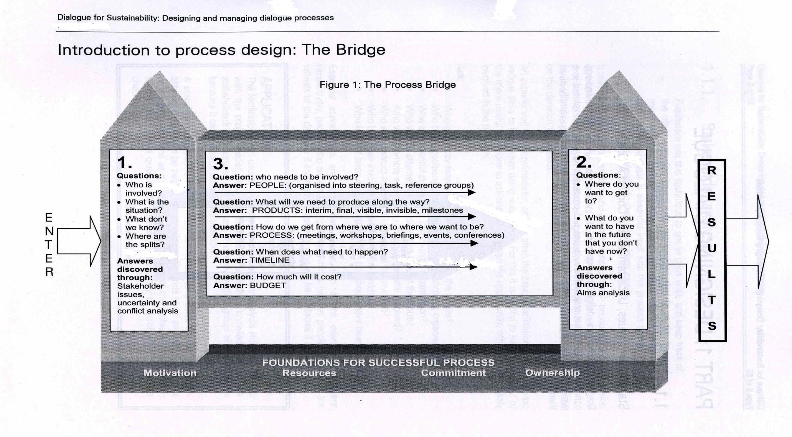
Dialogue Planning
Michael Ewing, Environmental Pillar of Social Parnership, Ireland

Slide 19
Which method to use?
How complex is the issue to be discussed?
What processes are already in place for resolving the issue and how well are they working?
What processes have been tried previously and how well did they work?
What is the geographical scale of the issue?
At what levels of societal structure is the process to operate?
What resources are available in time, money and in-house skills?
Will external professional facilitators or consultants need to be employed?
What is the Timescale?
Michael Ewing, Environmental Pillar of Social Parnership, Ireland

Slide 20
Human Beings are Messy
“Most important of all, it should be remembered that, stakeholder dialogue is often messy, disjointed and even chaotic at times. This is just how it should be – reflecting the real world in which we all have to operate (Acland, A. 2002, 3-2).” So events should be made enjoyable. Having regular breaks for stretching, food and refreshments.
Michael Ewing, Environmental Pillar of Social Parnership, Ireland

Slide 21
Choosing the Tools for the Job
Level 1 Education and Information Provision.
Printed Materials
  Advertisements
  Press Releases.
  Newspaper Inserts.
  Newsletters.
  Bill Stuffers.
Public Displays
Information Repositories.
Site Visits.
Video.
Independent Technical Documents and Expertise.
Michael Ewing, Environmental Pillar of Social Parnership, Ireland

Slide 22
Level 2. Information Feedback
Public Meetings.
Public Hearings.
The Internet.
Free-phone Telephone Lines
Interviews.
Surveys.
Response Sheets.
Random Postal/Telephone/Web Surveys.
Michael Ewing, Environmental Pillar of Social Parnership, Ireland

Slide 23
Level 2. Information Feedback continued
Deliberative Polling.
Teleconferencing.
Presentations to Community Groups.
Expert Panels.
Field Offices.
Informal Small Group Meetings.
Michael Ewing, Environmental Pillar of Social Parnership, Ireland

Slide 24
Level 3. Involvement and Consultation
Workshops.
Focus Groups.
Open House.
The Delphi Method.
Michael Ewing, Environmental Pillar of Social Parnership, Ireland

Slide 25
Level 4. Extended Involvement.
Citizen Juries.
Advisory Groups.
Task Forces.
Planning for Real
Community Visioning.
Michael Ewing, Environmental Pillar of Social Parnership, Ireland

Slide 26
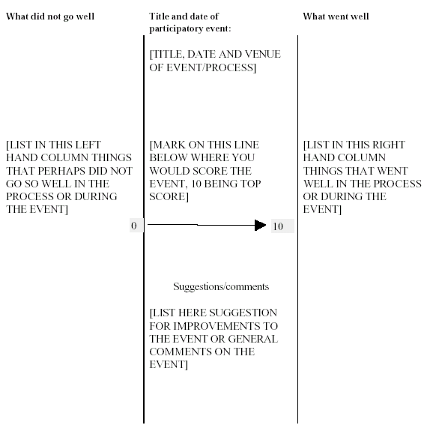
Evaluation of a Participatory Event
Michael Ewing, Environmental Pillar of Social Parnership, Ireland

Slide 27
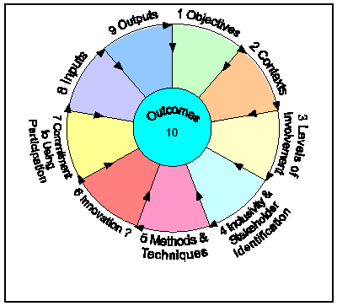
Evaluation of the Process
Michael Ewing, Environmental Pillar of Social Parnership, Ireland

Slide 28
The AC Roadmap
Step 1
Assess Implementation of the Convention
  The Access Initiative
    Law
    Effort
    Effectiveness
Identify the Barriers to Participation
Financial-Legal-Cultural-Language Literacy-Geographic-Awareness of the Right to participate
Michael Ewing, Environmental Pillar of Social Parnership, Ireland

Slide 29
The AC Roadmap
Step 2
Public Participation cannot take place in any meaningful way unless the legislation is in place to provide for it.
Step 3
For effective Participation all stakeholders need to learn how to have open, constructive and creative conversations.
  Training in Facilitation Skills
  Training in Dialogue Planning
Michael Ewing, Environmental Pillar of Social Parnership, Ireland

Slide 30
Resources for Public Participation I
Dialogue Designer. Online engagement design system – which can be found at http://designer.dialoguebydesign.net
Dialogue by Design - A Handbook of Public & Stakeholder Engagement (2007) Acland, A et al
http://www.dialoguebydesign.net/consultation/resources_handbook.htm
Designing and Managing Electronic Consultation Processes (2003)
http://www.dialoguebydesign.net/docs/articles/DesigningandManagingElectronicConsultationProcesses.pdf
Environment Council (UK) focuses us on seeking new ways to resolve and build truly sustainable solutions http://www.the-environment-council.org.uk/
Involve. (2005). People and Participation- How to put citizens at the heart of decision-making.
http://www.involve.org.uk/mt/archives/blog_37/People%20and%20Participation%20final.pdf
Michael Ewing, Environmental Pillar of Social Parnership, Ireland

Slide 31
Resources for Public Participation II
Process Planner. This is an easy to use search engine for participatory methods. It is designed for users who are in the stage of planning for participation.http://www.peopleandparticipation.net/pages/viewpage.action?pageId=24215596
“Public Participation In Environmental Decision-Making” Michael Ewing www.gdrc.org/decision/participation-edm.html .
The Facilitator’s Handbook, Centre for Management and Organisation Development. http://www.finance.gov.ie/cstc/cstdcdocs/facilitators_handbook.pdf
The Community Planning Handbook. Wates, Nick (ed) 2000. Earthscan Publications, London.
The Guide to Effective Participation by David Wilcox
http://www.partnerships.org.uk/guide/time.htm#Init
http://www.environmentaldemocracy.ie/
Michael Ewing, Environmental Pillar of Social Parnership, Ireland

Slide 32
Assessing Access to Participation
There are a number of tools that will enable to make an assessment of the effectiveness of Public Participation in your country, and the need for capacity building in all levels of society.
As an internationally recognised tool for this purpose is The Access Initiative, which now has a Russian Language version of this well tested online tool.
http://www.accessinitiative.org/ru/about-tai
Michael Ewing, Environmental Pillar of Social Parnership, Ireland

Slide 33
Thank You
Go raibh maith agat
Michael Ewing, Environmental Pillar of Social Parnership, Ireland

