Slide 1
PATTERN RECOGNITION LECTURE 1 introduction
LECTURE NOTES
02-01-2020

Slide 2
Text books
Pattern Classification (2nd. Edition) by R. O. Duda, P. E. Hart and D. Stork, Wiley 2002
Pattern Recognition and Machine Learning by C. Bishop, Springer 2006

Slide 3
Evaluation
Quiz 1 :15
Quiz 2 :15
End Sem : 40
Assignment/project : 30

Slide 4
Pattern
A pattern is an abstract object, such as a set of measurements (known as feature extraction) describing a physical object.
Feature extraction measures object properties that are useful for classification.
A pattern could be an object, an event or a process.
Biometric pattern corresponds to an object.
Hand gesture pattern corresponds to an event.

Slide 5
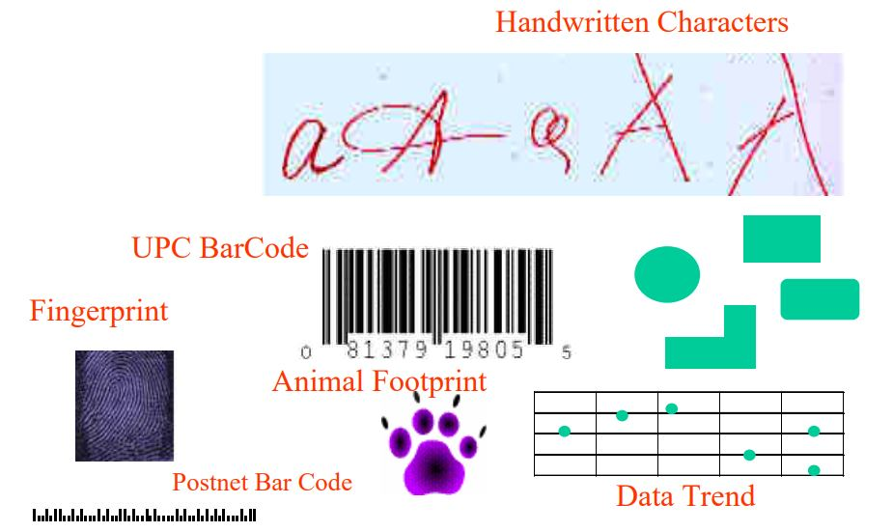
Examples of patterns

Slide 6
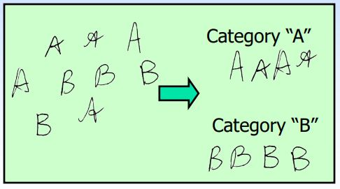
Recognition
Identification of a pattern as a member of a category (class) we already know or we are familiar with.
Classification (known categories)

Slide 7
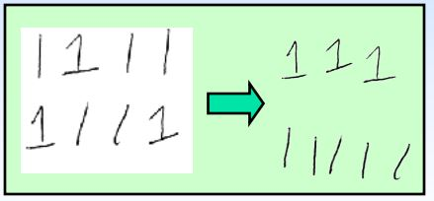
Clustering (learning categories)

Slide 8
Pattern Recognition : Definition
The act of taking as input sensed data (measurements) and taking an action based on the “category” or “class” of the pattern.
Theory, algorithms, systems to put patterns into categories.
Classification of noisy or complex data.
Relate perceived pattern to previously perceived patterns.
Assign an unknown pattern to one of the several known categories(or classes).

Slide 9
The real power of human thinking is based on recognizing patterns. The better computers get at ‘pattern recognition’, the more human like they will come.

Slide 10
Outline of the course
Distance measures
Baye’s decision theory
Minimum error rate classification
Parametric and non parametric estimation
MLE
Dimensionality reduction
PCA, LDA
Linear Discriminant Function
Perceptorn, SVM
Artificial Neural networks
Multilayer Perceptorn, feed forward NN

Slide 11
Thank you

