Slide 1
PATTERN RECOGNITION LECTURE 2 Paradigms of pr
LECTURE NOTES
03-01-2020

Slide 2
Different Paradigms (Models) for Pattern Recognition
Statistical Pattern Recognition
Syntactic Pattern Recognition/Structural Pattern Recognition
Template Matching
Neural Networks

Slide 3
1. Statistical Pattern Recognition
Statistical PR is more popular and has received the majority of attention in literature.
The main reason for this is that most practical problems in this area deals with noisy data and uncertainty.
Statistics and probability are good tools to deal with such problems.
In statistical PR, we focus on the statistical properties of the pattern (generally expressed in probability densities) and this will be used in most of the real time applications.
Here, we use vector spaces to represent patterns and classes.

Slide 4
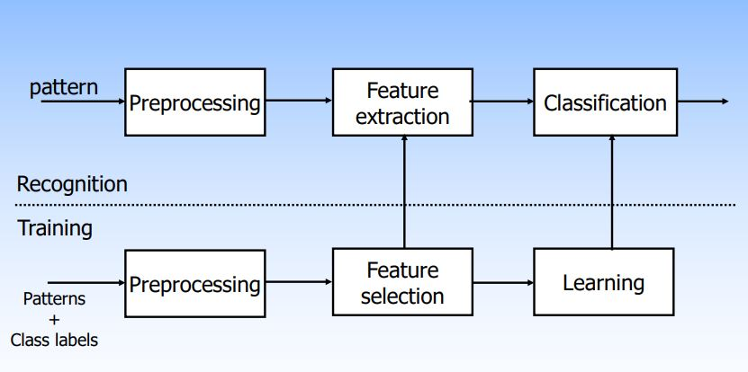
Statistical PR (cont) Schematic Diagram :

Slide 5
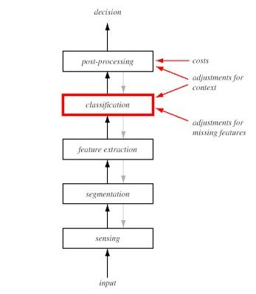
Statistical PR (cont) Schematic Diagram

Slide 6
Statistical PR (cont)
Sensor converts images/sounds/physical inputs into signal data.
Segmentation isolates sensed object from the background.
Feature extraction measures object properties that are useful for classification.
Classification assigns sensed object to a category.
Post processing take into account other considerations, such as effects of context and the cost of errors to decide on the appropriate action.

Slide 7
Statistical PR (cont)
The abstractions typically deal with probability density or distributions of points in multi dimensional spaces/ vector space.
Because of the vector space representation, it is meaningful to talk of sub-spaces /projections and similarity between points in terms of distance measures.

Slide 8
Statistical PR (cont)- Examples
The Baye’s Classifier characterises optimality in terms of minimum error rate classification.
The use of HMM (Hidden Markov Model) is popular in fields like speech recognition.
A Decision Tree is a transparent data structure which can deal with classification of patterns employing both numerical and categorical features.
Nearest Neighbour Rule: It is the most popular and simple classifier. A new pattern is classified based on the class label of its nearest neighbour. In such a classification, we do not have a training phase.

Slide 9
2. Syntactic Pattern Recognition/ Structural Pattern Recognition
If the model consists of some set of crisp logical rules, then we employ the method of syntactic pattern recognition, where the rules or grammar describe our decision.
Example : To classify an English sentence as grammatical or not, crisp rules are appropriate rather than statistical descriptions such as word frequencies or correlations.

Slide 10
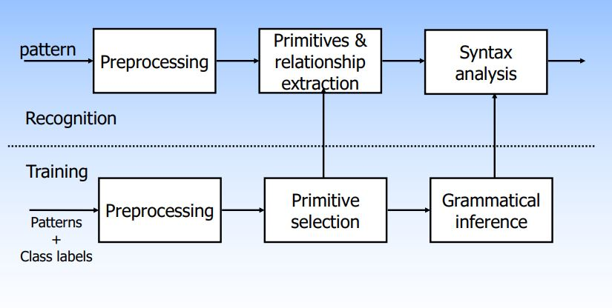
Syntactic PR (cont): Schematic Diagram

Slide 11
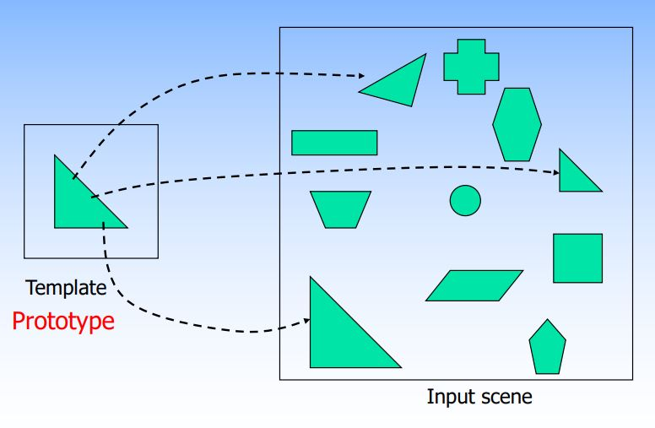
3. Template Matching

Slide 12
4. Neural Networks
Neural networks are a set of algorithms, modeled loosely after the human brain, that are designed to recognize patterns.
A neural network is a series of algorithms that try to recognize underlying relationships in a set of data through a process that mimics the way the human brain operates.

