Slide 1
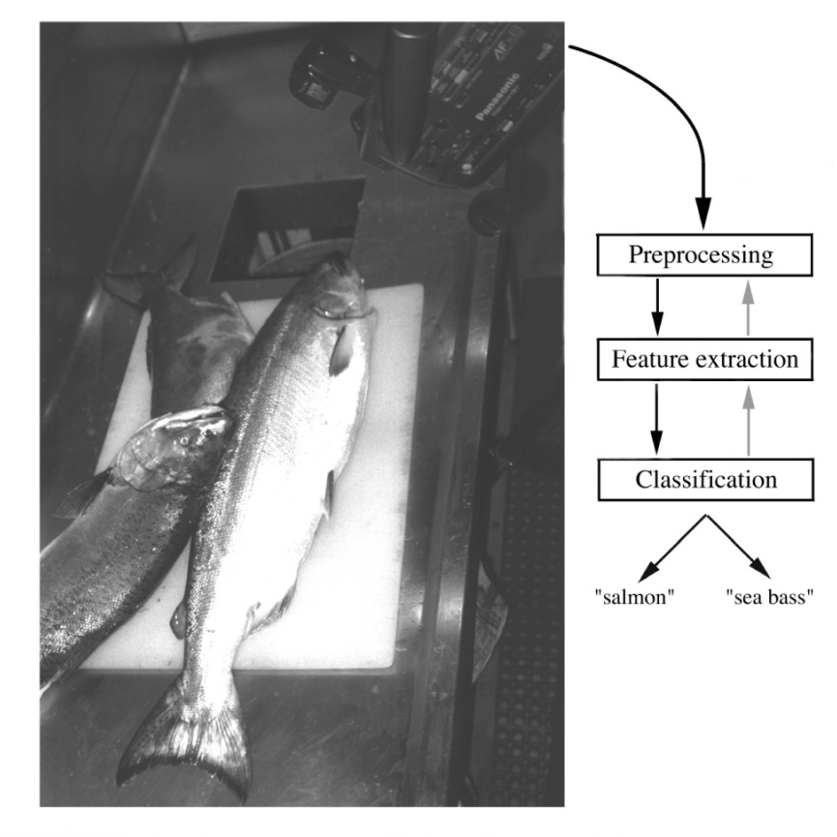
Complexity of PR – An Example
Problem: Sorting incoming fish on a conveyor belt.
Assumption: Two kind of fish:
(1) sea bass
(2) salmon

Slide 2

1. Pre-processing Step
Example
(1) Image enhancement
(2) Separate touching
or occluding fish
(3) Find the boundary of each fish

Slide 3
2. Feature Extraction
Assume a fisherman told us that a sea bass is generally longer than a salmon.
We can use length as a feature and decide between sea bass and salmon according to a threshold on length.
How should we choose the threshold?

Slide 4
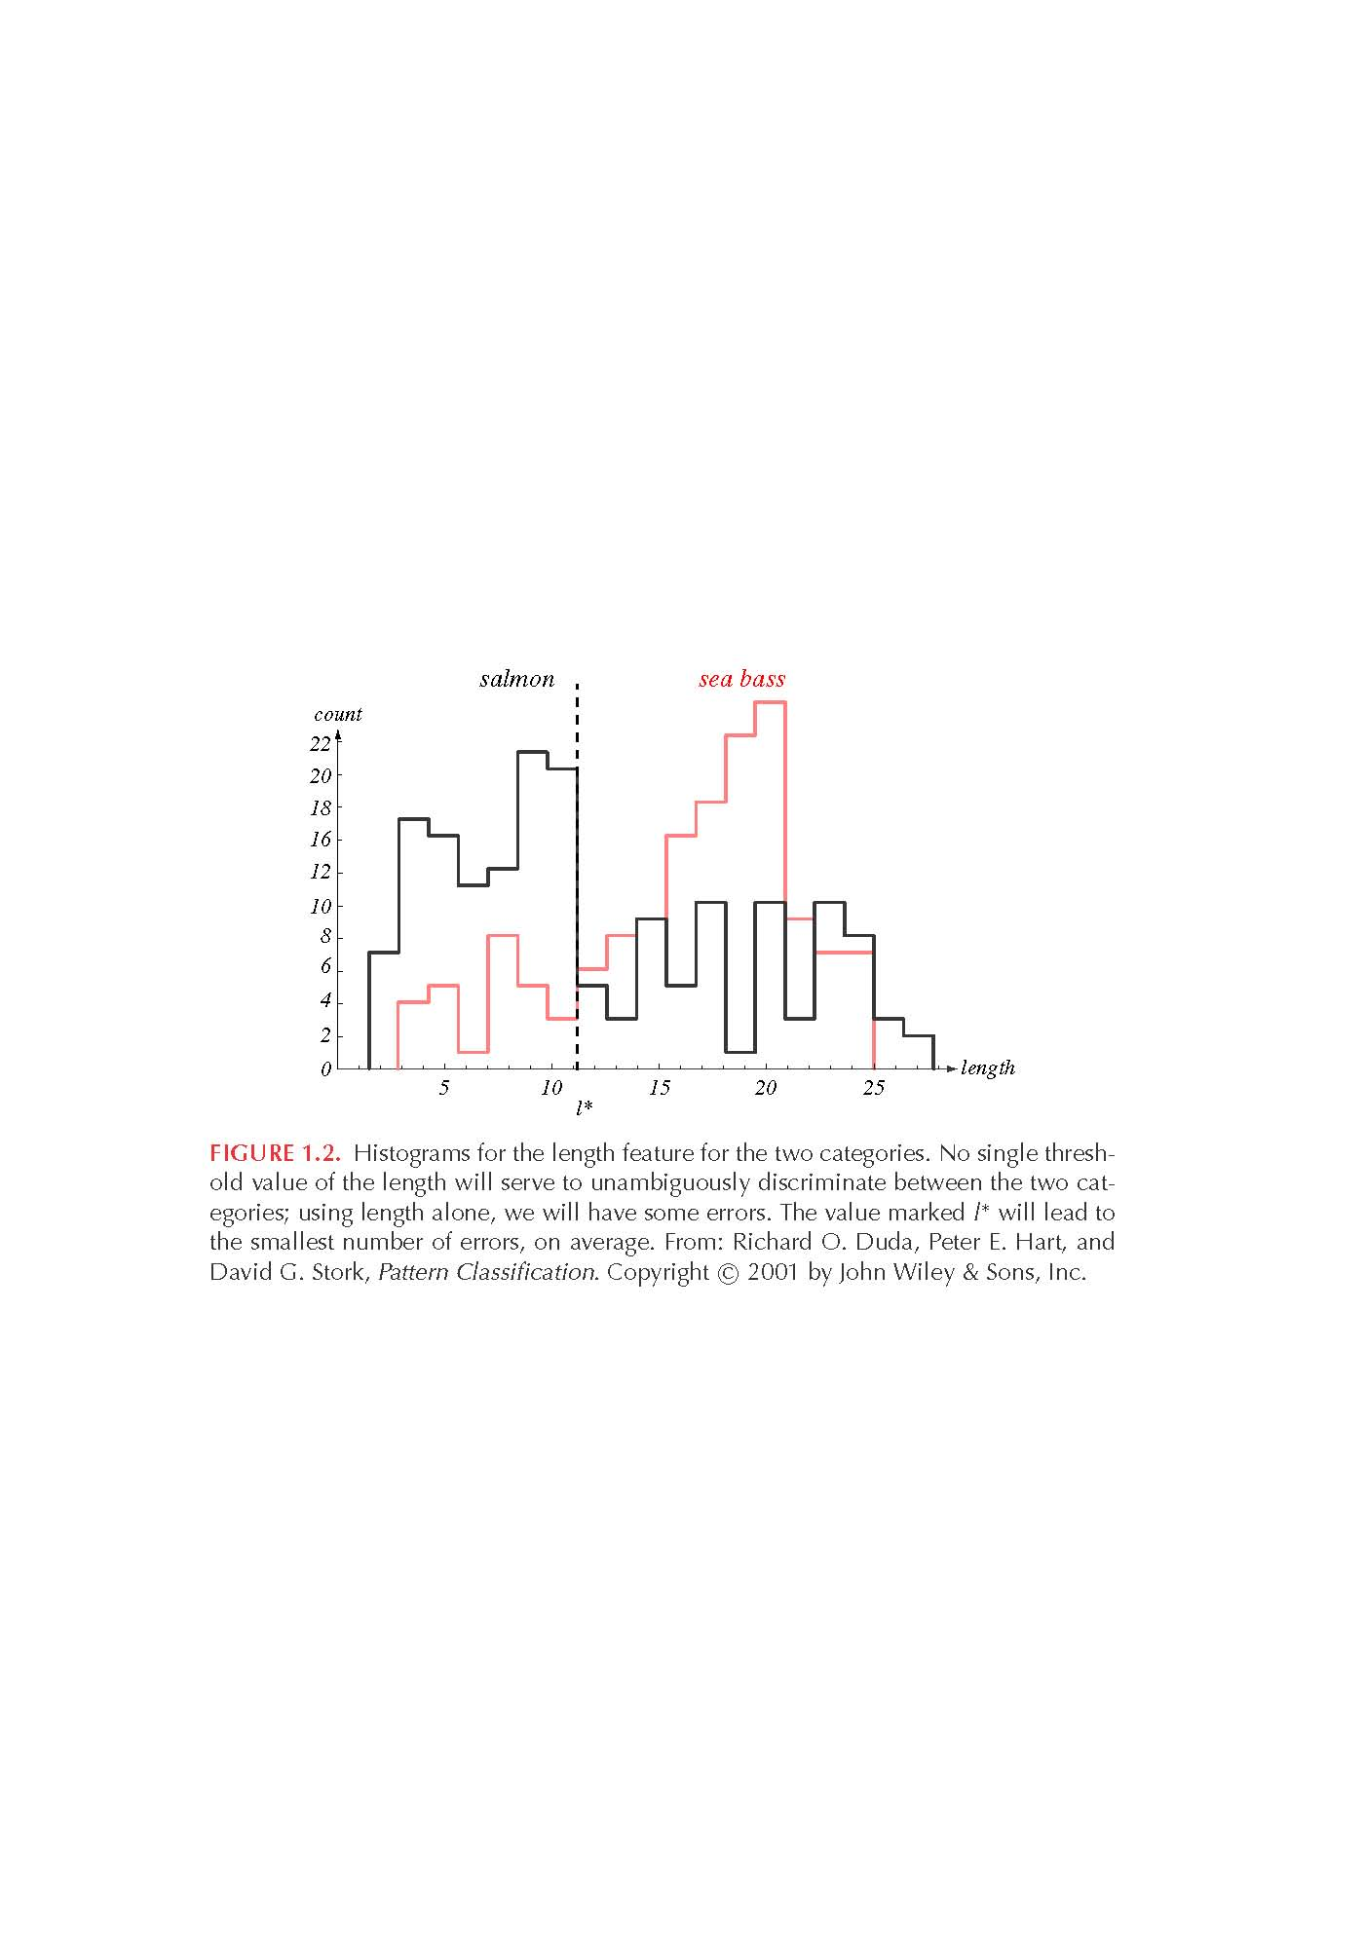
“Length” Histograms
Even though sea bass is longer than salmon on the average, there are many examples of fish where this observation does not hold.
threshold l*

Slide 5
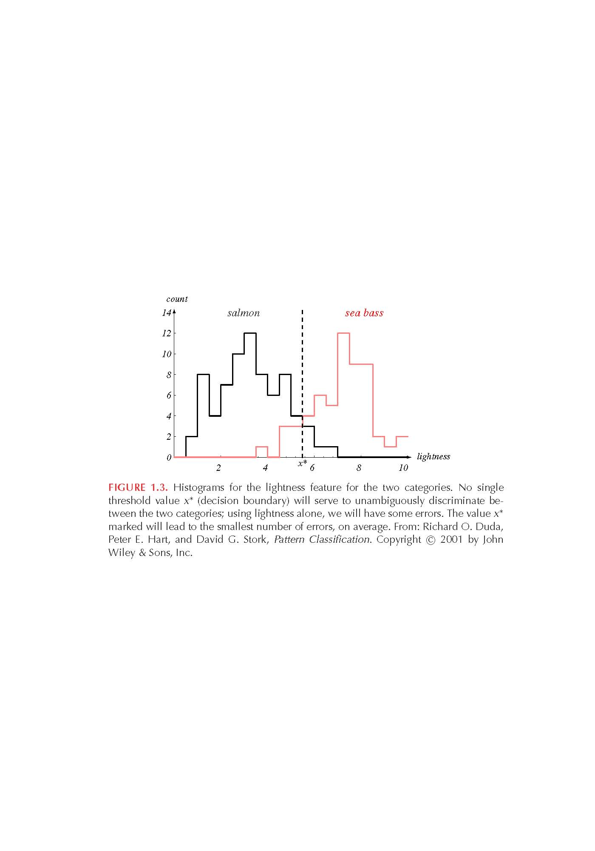
“Average Lightness” Histograms
Consider a different feature such as “average lightness”
It seems easier to choose the threshold x* but we still cannot make a perfect decision.
threshold x*

Slide 6
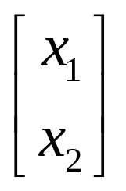
Multiple Features
To improve recognition accuracy, we might have to use more than one features at a time.
  Single features might not yield the best performance.
  Using combinations of features might yield better performance.
How many features should we choose?
x₁: length
x₂: lightness

Slide 7
Feature Extraction
    It might be difficult and computationally expensive to extract certain features.
    Challenges in Feature Extraction
      How many features?
      How to choose a good set of features?
      How to handle the missing features?

Slide 8
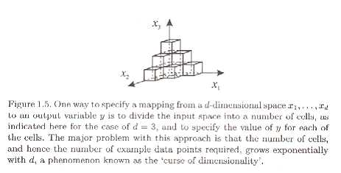
i) How Many Features?
Adding too many features can, paradoxically, lead to a worsening of performance.
  Divide each of the input features into a number of intervals, so that the value of a feature can be specified approximately by saying in which interval it lies.
  If each input feature is divided into M divisions, then the total number of cells is M^{d} (d: # of features).
  Since each cell must contain at least one point, the number of training data grows exponentially with d also known as curse of dimensionality.

Slide 9
Curse of Dimensionality- definition
As the number of features or dimensions grows, the amount of data we need to generalize accurately grows exponentially."
In applied maths, COD refers to the problem caused by the exponential increase in volume associated with adding extra dimensions to a mathematical space.

Slide 10
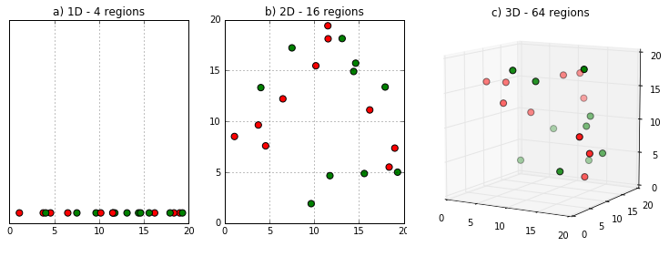
Curse of Dimensionality-(contd)
Fig. 1 (a) shows 10 data points in one dimension i.e. there is only one feature in the data set. It can be easily represented on a line with only 10 values, x=1, 2, 3... 10.

Slide 11
Curse of Dimensionality-(contd)
But if we add one more feature, same data will be represented in 2 dimensions (Fig.1 (b)) causing increase in dimension space to 10*10 =100.
And again if we add 3rd feature, dimension space will increase to 10*10*10 = 1000. As dimensions grows, dimensions space increases exponentially.
10^1 = 10
10^2 = 100
10^3 = 1000 and so on...

Slide 12
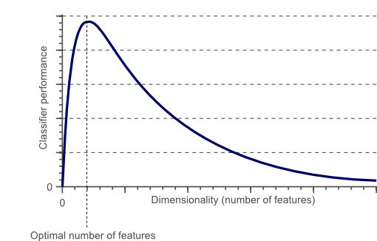
Does adding more features always improve performance?
No.

Slide 13

ii) How to choose a good set of features?
How to choose a good set of features?
  Discriminative features
  Invariant features (e.g., translation, rotation and scale)
Correlated features might not improve performance.
Are there ways to automatically learn which features are best ?

Slide 14
iii) Missing Features
Certain features might be missing (e.g., due to occlusion).
How should we train the classifier with missing features ?
How should the classifier make the best decision with missing features ?

Slide 15
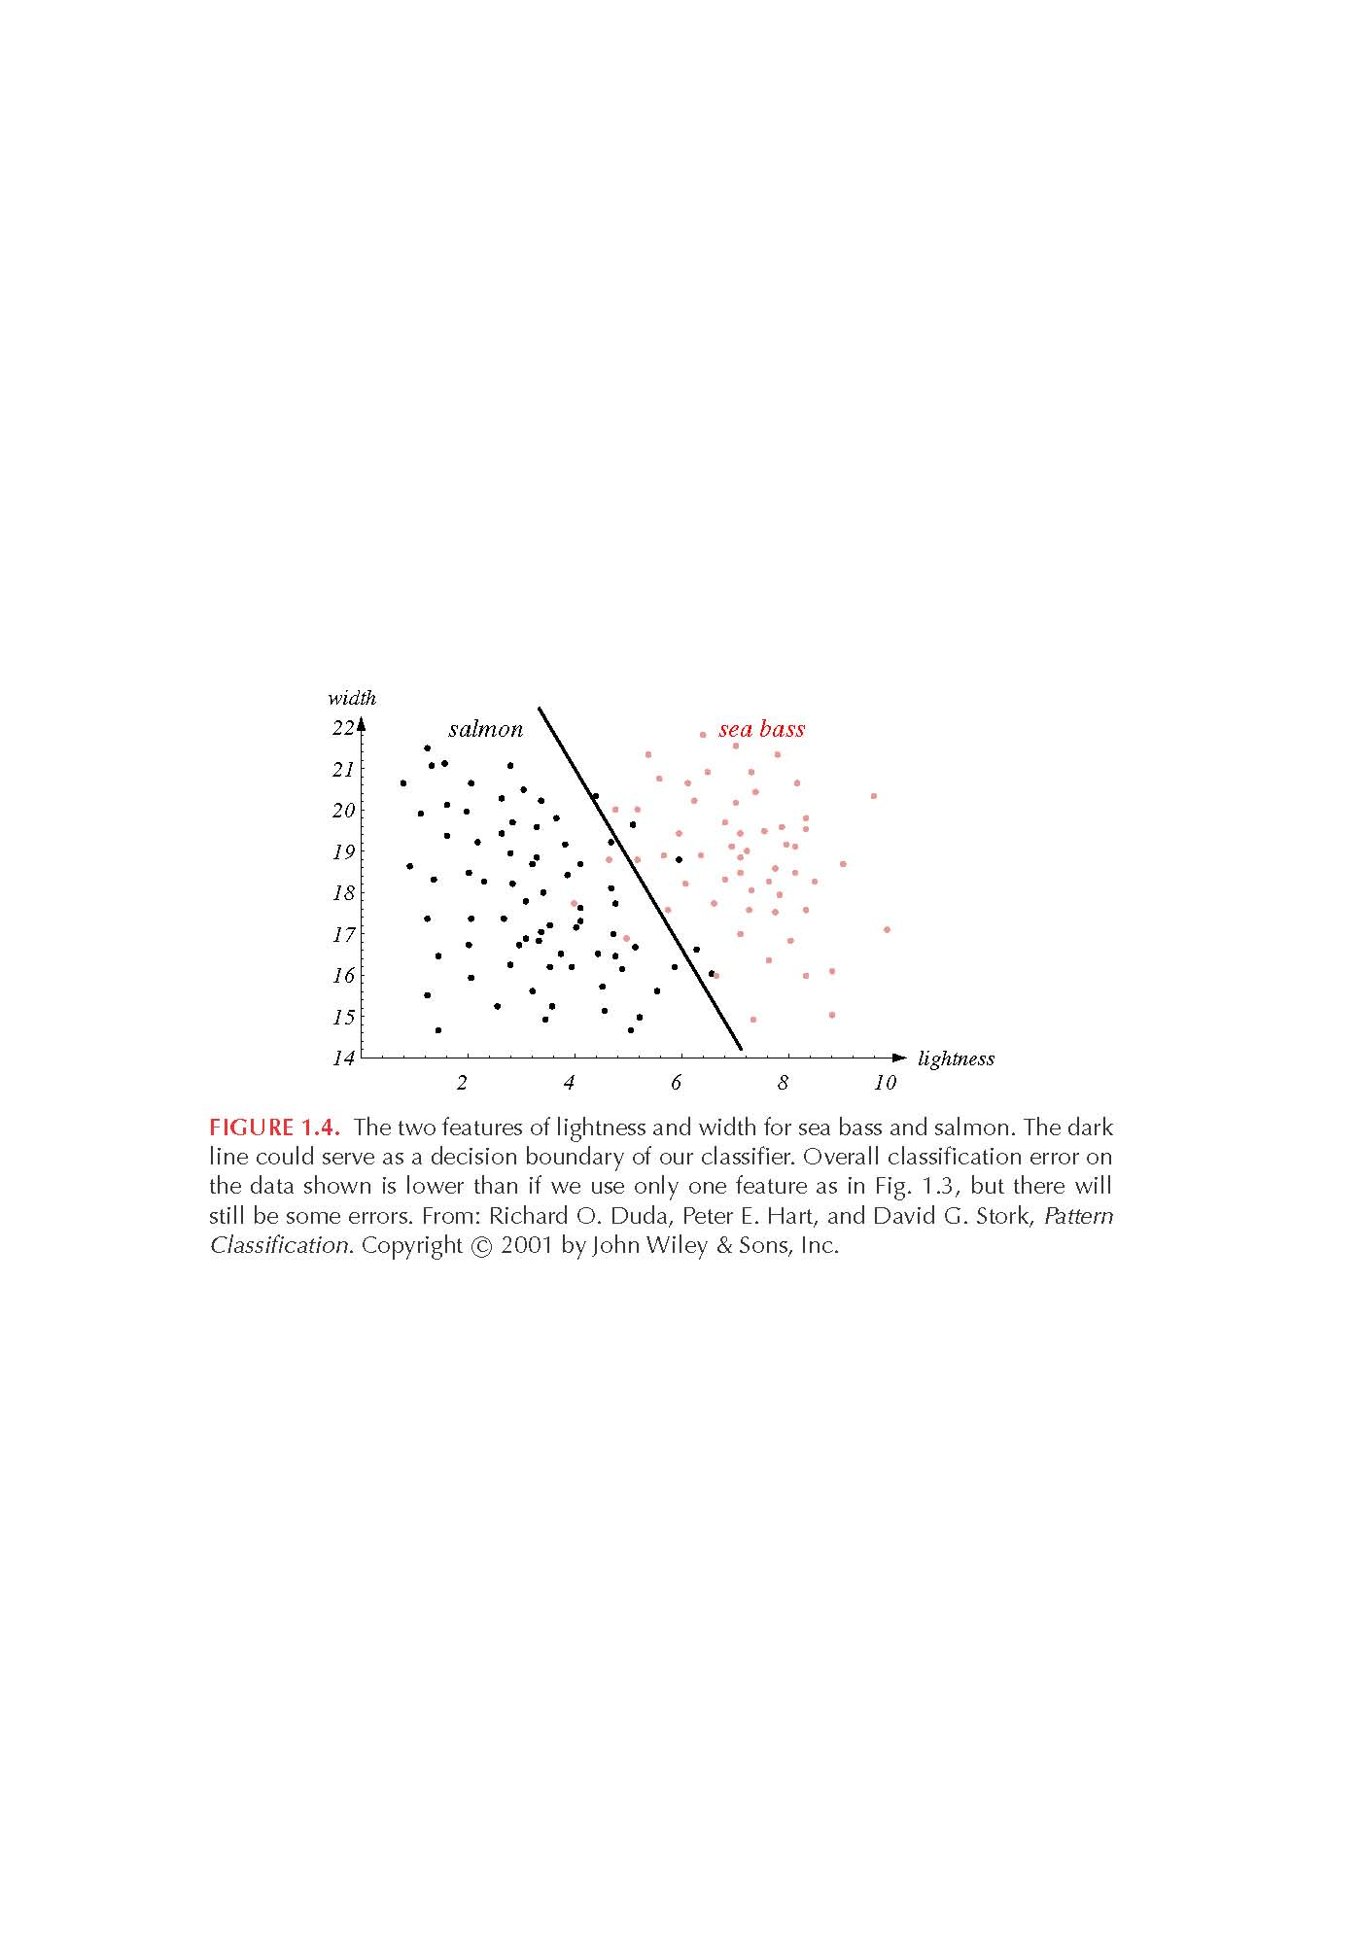
3. Classification
Partition the feature space into two regions by finding the decision boundary that minimizes the error.
How should we find the optimal decision boundary?

Slide 16
Main Classification Approaches
x: input vector (pattern)
y: class label (class)
Generative
  Model the joint probability, p(x, y)
  Make predictions by using Bayes rules to calculate p(ylx)
  Pick the most likely label y
  Eg: Gaussian, Naïve Bayes, Bayesian networks, HMM
Discriminative
  Estimate p(ylx) directly (e.g., learn a direct map from inputs x to the class labels y)
  Pick the most likely label y
  Eg: logistic regression, SVM, neural networks, nearest neighbor

Slide 17
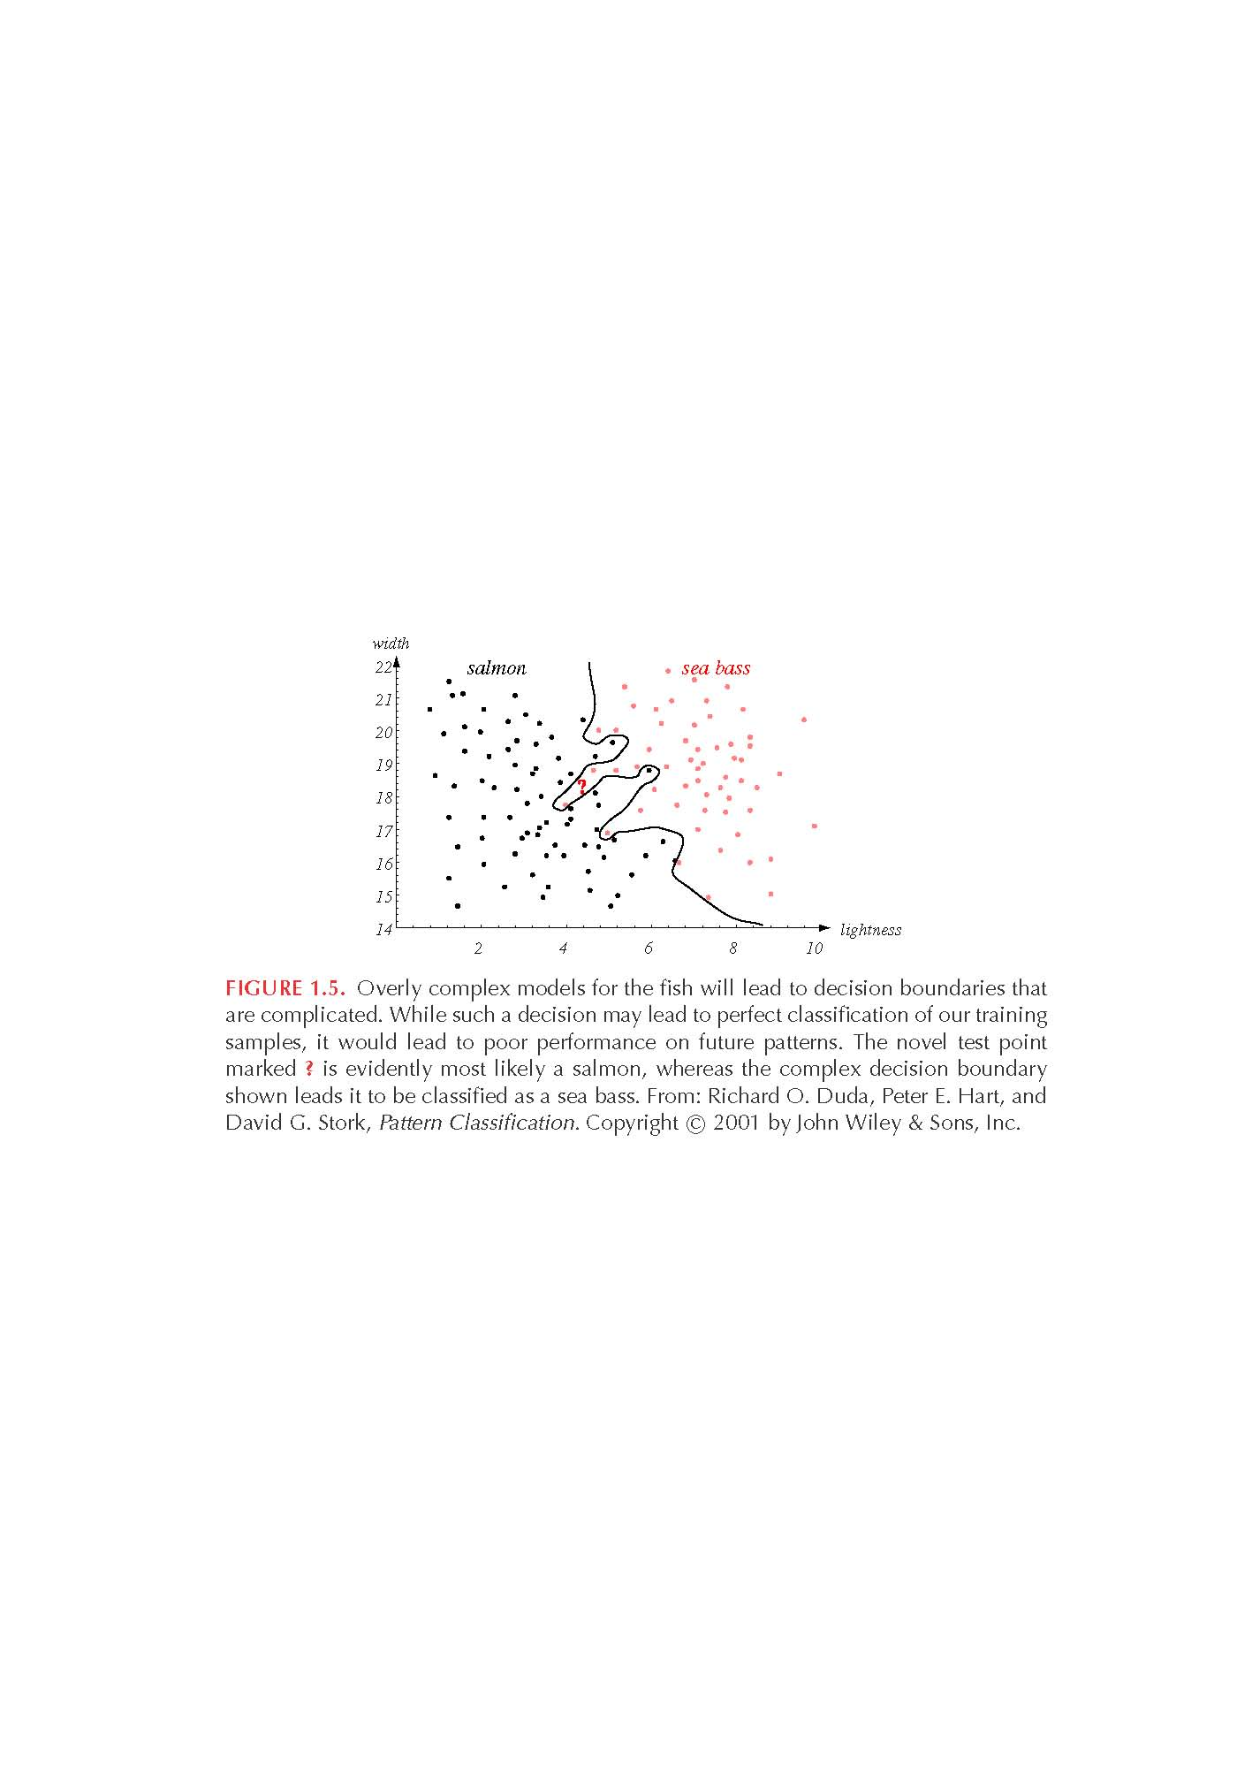
Complexity
We can get perfect classification performance on the training data by choosing complex models.
Complex models are tuned to the particular training samples, rather than on the characteristics of the true model.
overfitting
How well can the model generalize to unknown samples?

Slide 18
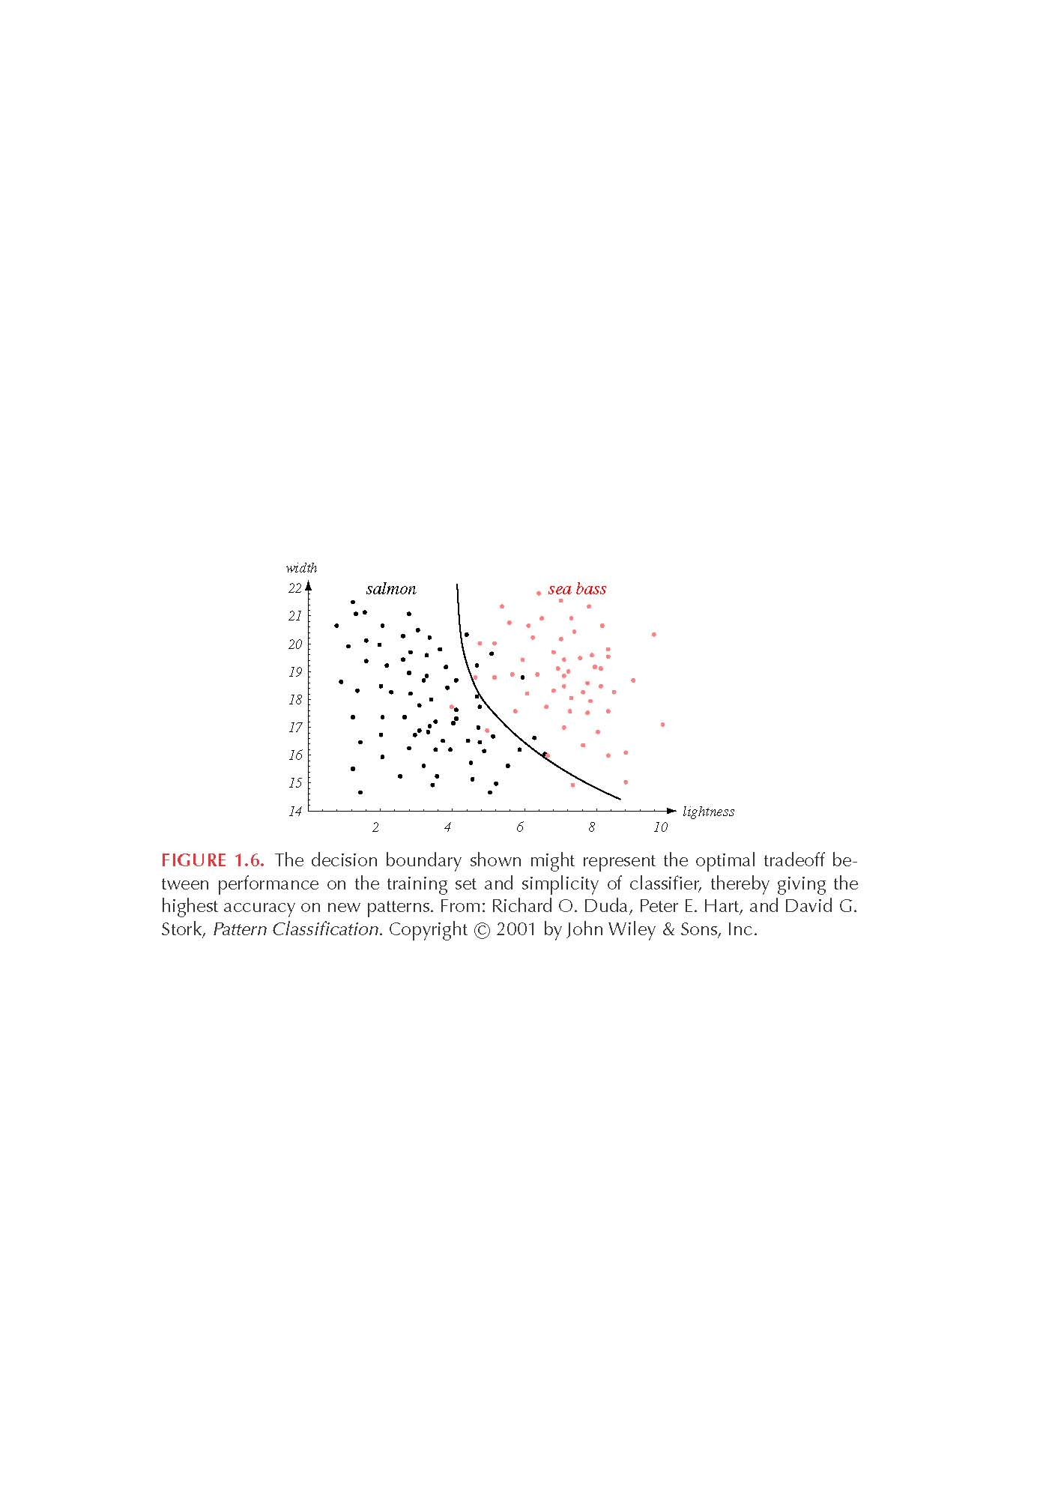
Generalization
Generalization is defined as the ability of a classifier to produce correct results on novel patterns.
How can we improve generalization performance ?
  More training examples (i.e., better model estimates).
  Simpler models usually yield better performance.
complex model
simpler model

Slide 19
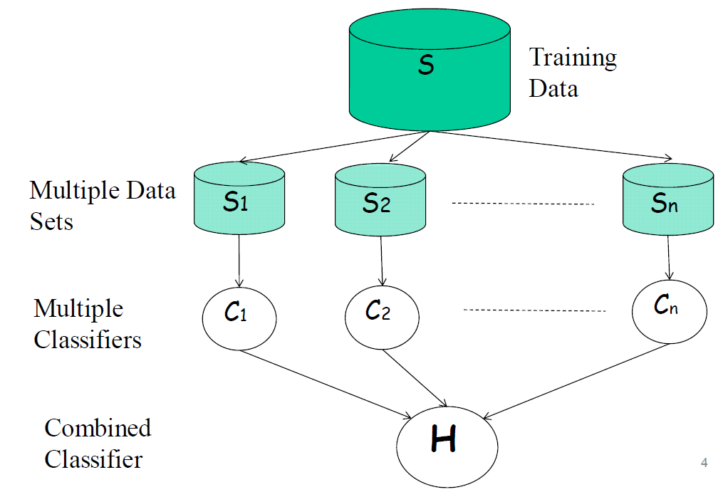
Ensembles of Classifiers
Performance can be improved using a "pool" of classifiers.
How should we build and combine different classifiers ?

Slide 20
Would it be possible to build a “general purpose” PR system?
No. Humans have the ability to switch rapidly and seamlessly between different pattern recognition tasks.
It is very difficult to design a system that is capable of performing a variety of classification tasks.
  Different decision tasks may require different features.
  Different features might yield different solutions.
  Different tradeoffs exist for different tasks.

Slide 21
Thank you

Slide 22
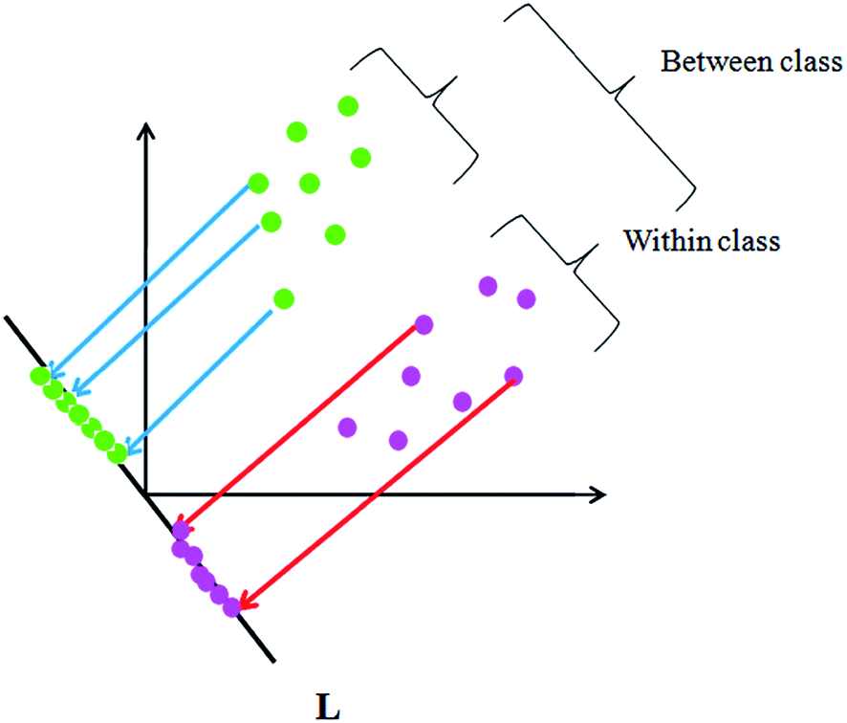


Slide 23
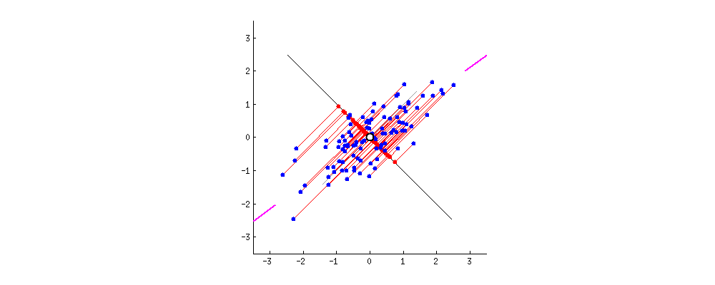

Slide 24
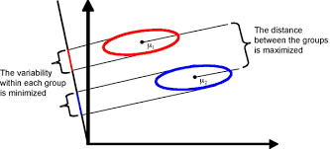

Slide 25
