Slide 1

Professional Ethics
Professionalism In The Workplace

Slide 2
Єθοσ [ethos]
Greek word for custom or habit, the characteristic conduct of an individual human life.
A Dictionary of Philosophical Terms and Names
Why is Ethics important?
Ethics is a requirement for human life. It is our means of deciding a course of action.

Slide 3
“Ethics is studying and talking about what is right and wrong, good and bad. It is also studying what makes something good or bad. This helps decide whether other things are good or bad.

Slide 4
Professional ethics concerns one's conduct of behavior and practice when carrying out professional work
Practically every professional organization has an official code of ethics

Slide 5



Professional
A person who is expert at his or her work.

Slide 6
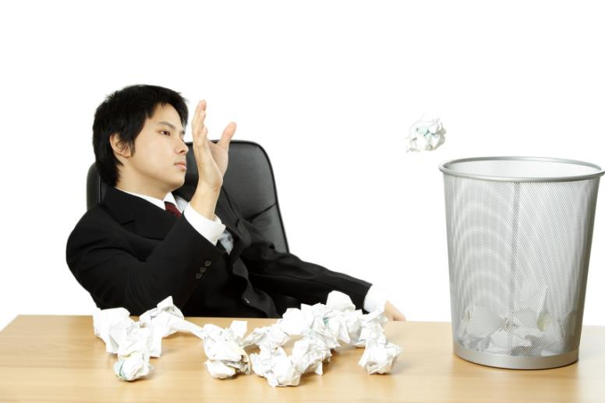
Professionalism
A specific style of behavior in the workplace.

Slide 7

Values
The social principles, goals, or standards held or accepted by an individual, a class, a society, culture, etc.

Slide 8

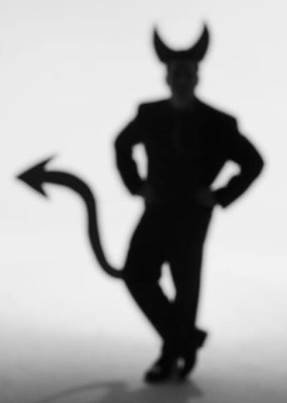
Morals
Relating to, dealing with, or capable of making the distinction between right or wrong conduct.
principles
standards
beliefs with respect to right or wrong behavior

Slide 9

Right
In accordance with fact, reason, justice, law, and morality.

Slide 10
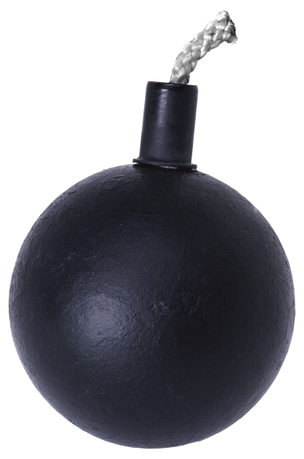
Wrong
Contrary to fact or reason, unlawful, crooked, twisted, immoral, improper.

Slide 11
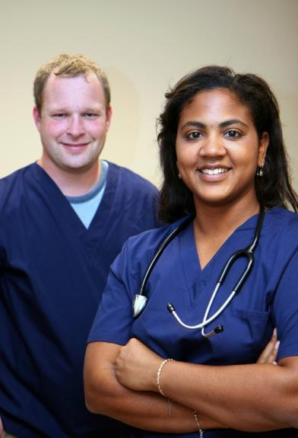
Code of Conduct
A set of conventional principles and expectations that are considered binding on any person who is a member of a particular group.

Slide 12
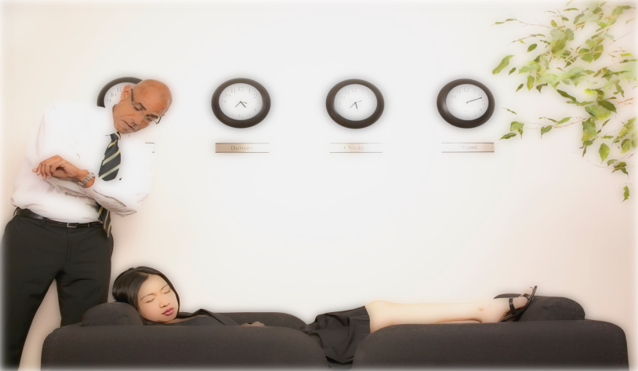
Employee Expectations
What is expected of the employee to get the job done.

Slide 13
Why People Act Unethically
The person’s ethical standards are different
from those of society as a whole.
The person chooses to act selfishly.

Slide 14
Ethical Dilemmas
An ethical dilemma is a situation a person
faces in which a decision must be made
about appropriate behavior.

Slide 15
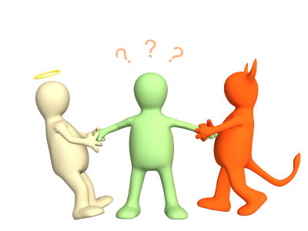
Ethics is two- way!
15

Slide 16
WHY BE ETHICAL?
It’s just good business
It’s the smart thing to do
Notes:
People have a lot of reasons for being ethical:
Inner benefit. Virtue is its own reward.
It gives us a personal advantage.
It leads to approval, self-esteem, admiration and respect of peers.
Good behavior can please or help you serve your GOD.
Some people are ethical out of habit, they were trained as children.

Slide 17
Need for Ethics
Ethical behavior is necessary for a society
to function in an orderly manner.
The need for ethics in society is sufficiently
important that many commonly held
ethical values are incorporated into laws.

Slide 18
A Person Chooses to Act Selfishly – Example
Person A finds a briefcase containing
important papers and $1,000.
He tosses the briefcase and keeps the money.
He brags to his friends about his good fortune.
This action probably differs from most of society.

Slide 19
A Person Chooses to Act Selfishly – Example
Person B faces the same situation but
responds differently.
He keeps the money but leaves the briefcase.
He tells nobody and spends the money.
He has violated his own ethical standards
and chose to act selfishly.

Slide 20

Unprofessional Ethics
Not conforming to the standards of a profession; contrary to the accepted code of conduct of a profession.

Slide 21


Characteristics of Professional Ethics
Honest
Skilled
Courteous
Reliable
Considerate
Dependable
Cooperative
Committed

Slide 22
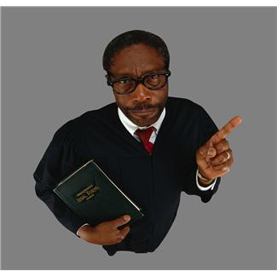
Professional Ethics is judged by:
Unwritten rules
Code of conduct
Culture
Expectations and standards
One’s personal values

Slide 23
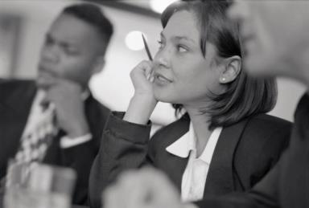
How Are You Judged As an Ethically Sound Professional?
Your Communication
Your Image
Your Competence
Your Demeanor
Your Appearance
Your Behavior
Your Attitude

Slide 24
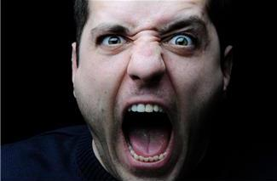
Unethical Behavior
Conduct that could be characterized as harassment or discrimination.
Verbal threats of violence, retribution, or lawsuits.
Verbal outbursts.
Inappropriate physical touching or contact.
Arguing in front of customers, clients and families.
Physical actions that threaten others such as throwing or knocking down objects.
Insults, verbal comments, or criticism intended to belittle or berate others.

Slide 25
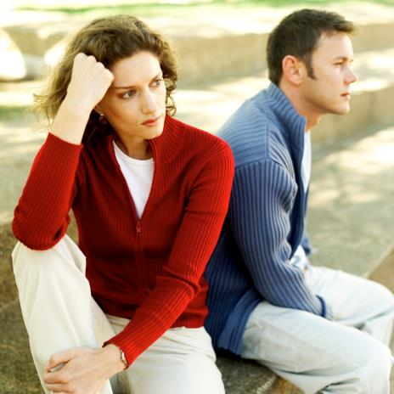
Always Remember!
Keep personal issues separated from the workplace!

