Slide 1
Intrinsic Good, Instrumental Good, and
Universally Good

Slide 2
One thing nearly everyone values to some extent is money. But it is usually valued purely as a means to an end. It provides security, and it can be used to purchase things you want. Detached from its purchasing power, it is just a pile of printed paper or scrap metal. Money has instrumental value only.

Slide 3


It’s Excellent, but is it Good?
Good – something or someone with value
Even a reprehensible act can represent a “good” for someone involved
Some people routinely value “bad” things, but they consider them “good”.

Slide 4
Definitions
What is Instrumental Good?
What is Intrinsic Good?

Slide 5
Intrinsic Good
A thing is said to be intrinsically good if it is good by itself.
An intrinsic good is not required to lead to anything else, create a certain result, or produce a reward.
Some things that may be considered intrinsic goods are happiness, truth, and life.

Slide 6

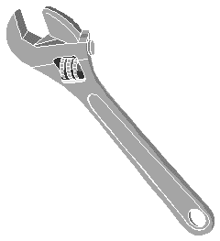
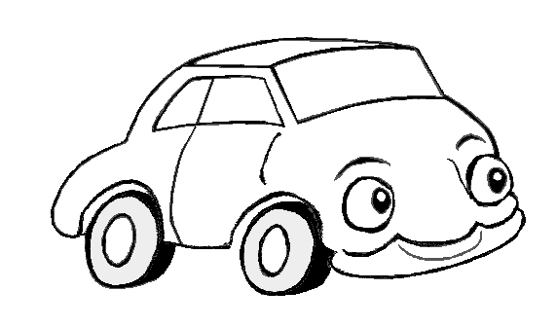
Instrumental Good
A good is instrumental if it only has value as a means to another good.

Slide 7
Instrumental Good
You value most things instrumentally, that is, as a means to some end. Usually, this is obvious.
For instance, you value a washing machine that works, but purely for its useful function.
If there was a very cheap cleaning service next door that picked up and dropped off your laundry, you might use it and sell your washing machine.

Slide 8
Do you think these things are intrinsically good, instrumentally good, both, or neither?
Friendship
Health
Beauty
Romantic
Wisdom

Slide 9
Combinations
Can something be intrinsically bad, but instrumentally good?

Slide 10
Combinations
Can something be intrinsically bad, but instrumentally good?
Definitely! Here are some examples:
  Cheating to win a contest
  Killing in self-defense
  Lying about your qualifications to get a job

Slide 11

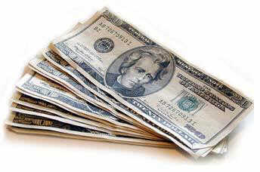
Complications
Instrumental goods only have value because they eventually lead to an intrinsic good.
Without the final good in the chain, no series of instrumental goods will ever be satisfactory.

Slide 12
More Combinations
Can you have something that is both intrinsically good, but instrumentally bad?

Slide 13
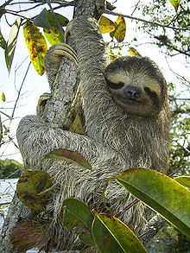
More Combinations
Can you have something that is both intrinsically good, but instrumentally bad?
Certainly! Here are some examples:
  Using heroin or other drugs
  Gluttony and sloth

Slide 14
More Combinations
Can you have something that is both intrinsically good, but instrumentally bad?
Certainly! Here are some examples:
  Using heroin or other drugs
  Gluttony and sloth
But are these examples truly intrinsically good? Can they be intrinsically good if they have some other result?

Slide 15
The End of the Combinations
We can all think of things which are both intrinsically bad and instrumentally bad, but are there things which are intrinsically good and instrumentally good?

Slide 16
The End of the Combinations
We can all think of things which are both intrinsically bad and instrumentally bad, but are there things which are intrinsically good and instrumentally good?
I’m actually asking you this time. Are there any ideas? Is it even possible for something to be good in and of itself, and to also have a reward or desired result attached?

