Slide 2

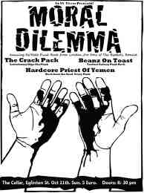
An ambiguous situation that requires a person to make a moral decision.

Slide 3

Conflicts causing subjects to justify the morality of their choices.

Slide 4
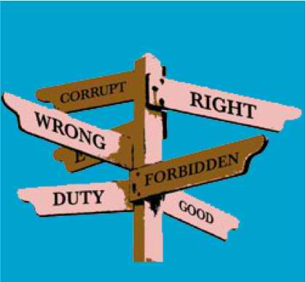

MORAL
relating to principles of right and wrong in behavior.
Conforming to a standard of right behavior.

Slide 5

Agree or disagree?
Cheating is a persistent problem in classrooms. How students think about this problem and how teachers should respond to it depend on students’ levels of moral development.

Slide 6
Scenario 1
The Heinz Dilemma
A woman was near death from a unique kind of cancer. There is a drug that might save her. The drug costs $4,000 per dosage. The sick woman's husband, Heinz, went to everyone he knew to borrow the money and tried every legal means, but he could only get together about $2,000. He asked the doctor scientist who discovered the drug for a discount or let him pay later. But the doctor scientist refused.
Should Heinz break into the laboratory to steal the drug for his wife? Why or why not?

Slide 7
Scenario 2
The Heinz Dilemma
Heinz broke into the laboratory and stole the drug. The next day, the newspapers reported the break-in and theft. Brown, a police officer and a friend of Heinz remembered seeing Heinz last evening, behaving suspiciously near the laboratory. Later that night, he saw Heinz running away from the laboratory.
Should Brown report what he saw? Why or why not?

Slide 8
Scenario 3
The Heinz Dilemma
Officer Brown reported what he saw. Heinz was arrested and brought to court. If convicted, he faces up to two years' jail. Heinz was found guilty.
Should the judge sentence Heinz to prison? Why or why not?

Slide 9
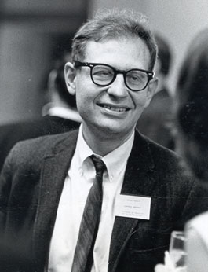
Lawrence Kohlberg (1927-1987
Born into a wealthy family in New York in 1927.
Kohlberg began studying psychology as an undergraduate at the University of Chicago. In one year, Kohlberg had earned his B.A. in psychology and continued his education as a graduate student at the University of Chicago. In 1958, Kohlberg earned his Ph.D.

Slide 10
Lawrence Kohlberg (1927-1987
Kohlberg studied moral reasoning & development with much of his work based on that of Jean Piaget and John Dewey. He had a brief teaching position at Yale University before moving onto Harvard in 1967.
While in Central America in 1973, Kohlberg developed a rare and unknown tropical disease which disabled him in many ways and caused him to be severely depressed. In January of 1987, Kohlberg disappeared, his body was later found in a swamp area. There is some suspicion that Kohlberg took his own life.

Slide 11
Kohlberg’s
Stages of Moral Development
LEVEL I
Stage 1 – Punishment-Obedience Orientation
Stage 2 – Instrumental Relativist Orientation
LEVEL II
Stage 3 – Good Boy – Nice Girl Orientation
Stage 4 – Law and Order Orientation
LEVEL III
Stage 5 – Social Contract Orientation
Stage 6 – Universal Ethical Principle Orientation

Slide 12

LEVEL I
Pre-conventional Morality
4 – 10 yrs. old
people at this stage do not really understand the conventions / rules of a society.

Slide 13

STAGE 1
Punishment – Obedience Orientation
Consequences of acts determine whether they’re good or bad.

Slide 14

Possible Stage 1 responses
to Heinz Dilemma:
Heinz should not steal the drug because he might be caught and sent to jail.
Heinz should steal the drug because if he doesn't then his wife might die.

Slide 15

STAGE 2
Instrumental Relativist Orientation
The ethics of “What’s in it for me?” Obeying rules and exchanging favors are judged in terms of the benefit to the individual.

Slide 16
Possible Stage 2 responses
to Heinz Dilemma:
It is right for Heinz to steal the drug because it can cure his wife and then she can cook for him.
The doctor scientist had spent lots of money and many years of his life to develop the cure so it's not fair to him if Heinz stole the drug.

Slide 17

LEVEL II
10 – 13 yrs. old
Conventional Morality
People at this stage conform to the conventions / rules of a society.

Slide 18

STAGE 3
Good Boy – Nice Girl Orientation
Ethical decisions are based on concern for or the opinions of others.

Slide 19

Possible Stage 3 responses
to Heinz Dilemma:
Yes, Heinz should steal the drug. He probably will go to jail for a short time for stealing but his in-laws will think he is a good husband.
Brown, the police officer should report that he saw Heinz behaving suspiciously and running away from the laboratory because his boss would be pleased.

Slide 20
Officer Brown should not report what he saw because his friend Heinz would be pleased.
The judge should not sentence Heinz to jail for stealing the drug because he meant well ... he stole it to cure his wife.

Slide 21

STAGE 4
Law and Order Orientation
Right behavior consists in doing one's duty, showing respect for authority and maintaining the given social order for its own sake.

Slide 22
Possible Stage 4 responses
to Heinz Dilemma:
As her husband, Heinz has a duty to save his wife's life so he should steal the drug. But it's wrong to steal, so Heinz should be prepared to accept the penalty for breaking the law.
The judge should sentence Heinz to jail. Stealing is against the law! He should not make any exceptions even though Heinz' wife is dying. If the judge does not sentence Heinz to jail then others may think it's right to steal and there will be chaos in the society.

Slide 23

LEVEL III
Post-Conventional Morality
The moral principles that underline the conventions of a society are understood.

Slide 24

STAGE 5
Social Contract Orientation
Rules and laws represent agreements among people about behavior that benefits society. Rules can be changed when they no longer meet society’s needs.

Slide 25
Possible Stage 5 responses
to Heinz Dilemma:
Heinz should steal the drug because everyone has the right to life regardless of the law against stealing. Should Heinz be caught and prosecuted for stealing then the law (against stealing) needs to be reinterpreted because a person's life is at stake.
The doctor scientist's decision is despicable but his right to fair compensation (for his discovery) must be maintained. Therefore, Heinz should not steal the drug.

Slide 26
STAGE 6
Universal Ethical Principle Orientation
Right is defined by the decision of conscience in accord with self-chosen ethical principles appealing to logical comprehensiveness, universality and consistency.

Slide 27


Slide 28

Possible Stage 6
response
to Heinz Dilemma:
Heinz should steal the drug to save his wife because preserving human life is a higher moral obligation than preserving property.

Slide 29
conclusion:
Every person’s moral reasoning develops through the same stages in the same order.
People pass through the same stages at different rates.
Development is gradual and continuous, rather than sudden and discrete.
Once a stage is attained, a person continues to reason at that stage and rarely regress to a lower stage.
Intervention usually results in moving only to the next higher stage of moral reasoning.

Slide 30

Florabel M. Biasong
Abuyod National High School
Teresa, Rizal

