Slide 1
Group Meeting (06/13/2023)
Test Measurements
Amar Maksumić

Slide 2
General Updates
Completed lab safety quizzes on percipio
Completed lab tour with Amir
Did some test measurements with JDS4500 Band Pass Filter

Slide 3
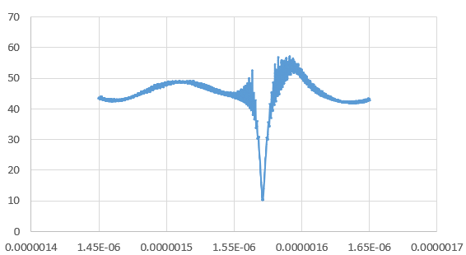
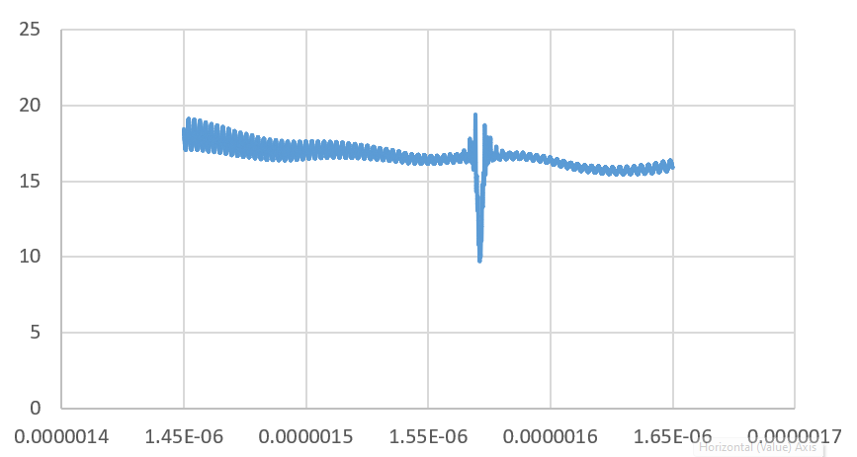
JDS4500 Band Pass Filter
Middle setting
Max setting

Slide 4
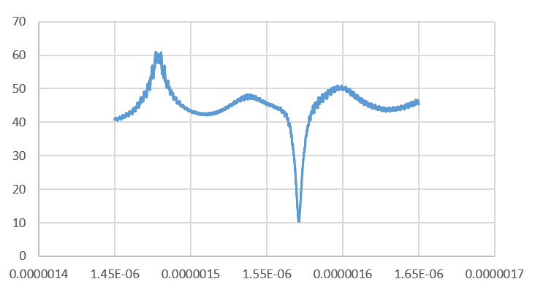
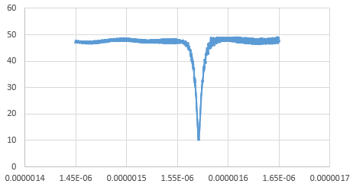
JDS4500 Band Pass Filter
Min setting
Another middle setting

