Slide 1
Group Meeting (06/19/2023)
Amar Maksumic

Slide 2
Updates
I worked on learning how to align the fibers to the chip
Took some sample measurements

Slide 3
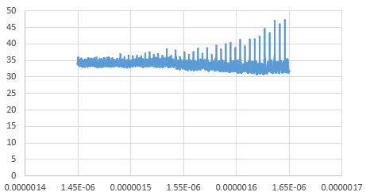
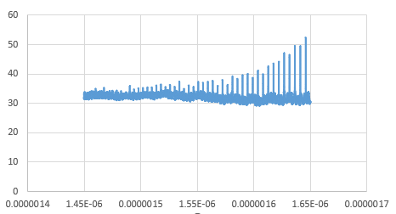
Ring Trials

