Slide 1
Group Meeting (06/26/2023)
Amar Maksumić

Slide 2
Updates
Almost measured all 16 structures on one chip
14/16
Still getting a grip on aligning the fibers
My alignment time is faster than what it was before, but is still slow.
Develop a python script to take in batches of excel data and turn them into graphs

Slide 3
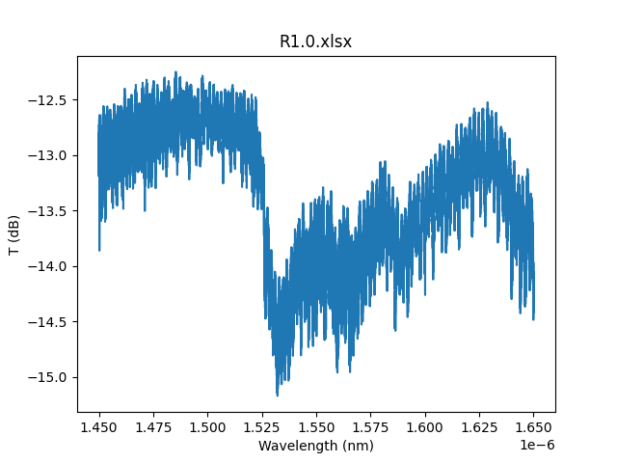
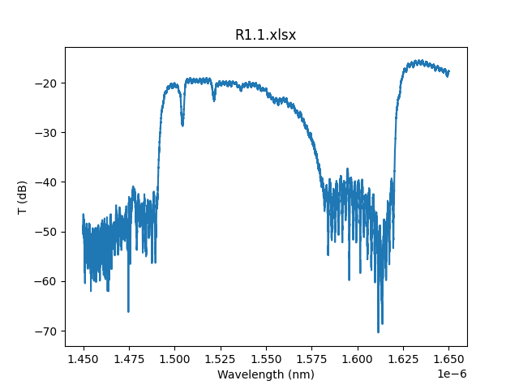
Chip 1 Graphs

Slide 4
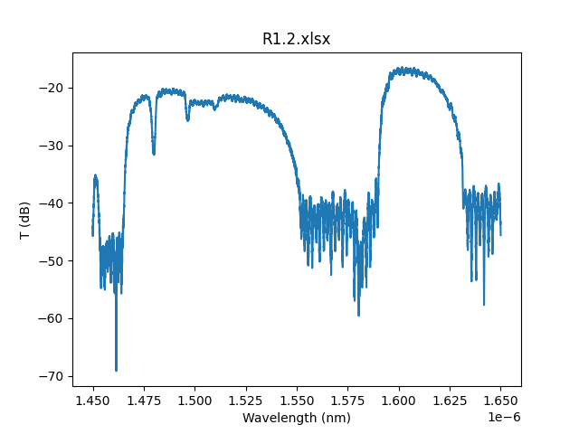
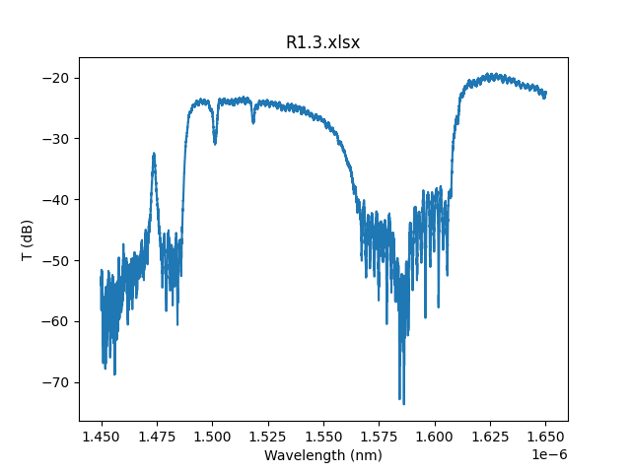
Chip 1 Graphs

Slide 5
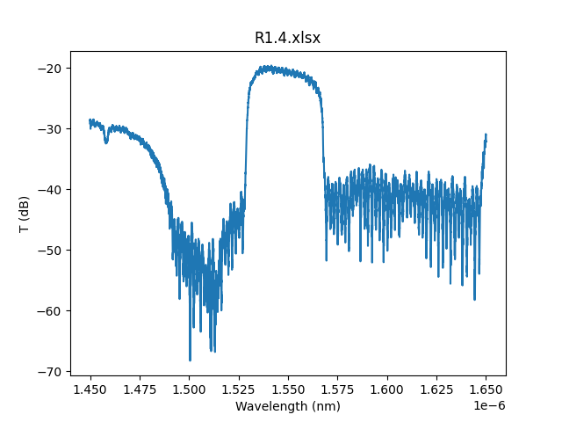
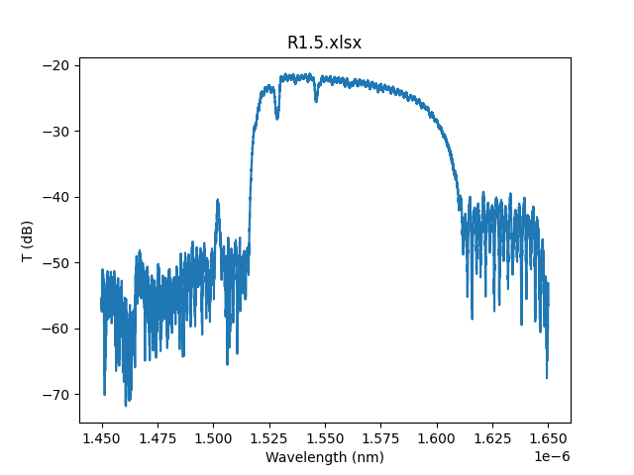
Chip 1 Graphs

Slide 6
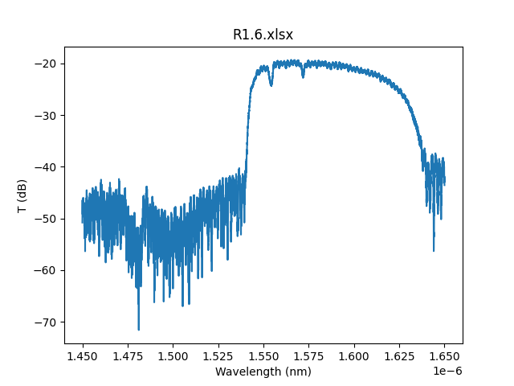
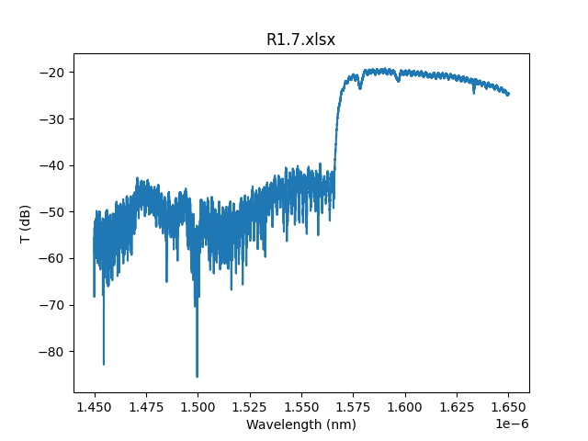
Chip 1 Graphs

Slide 7
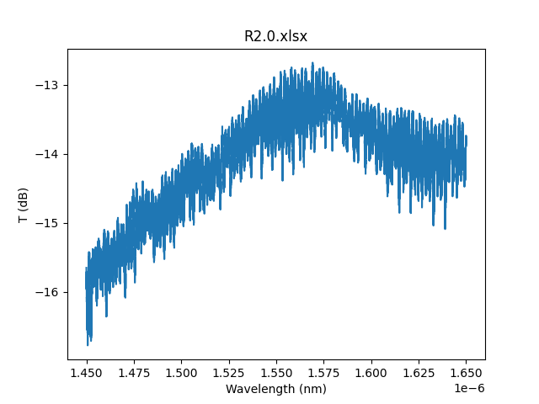
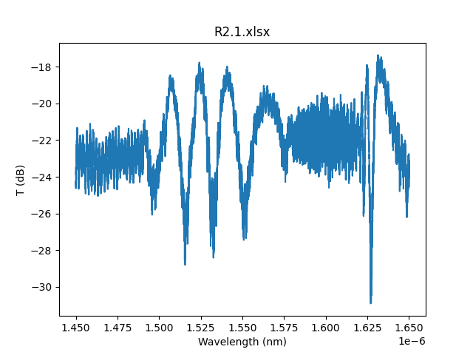
Chip 1 Graphs

Slide 8
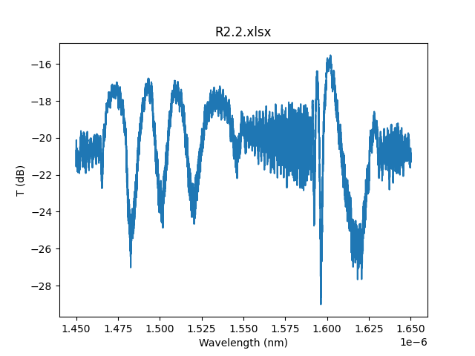
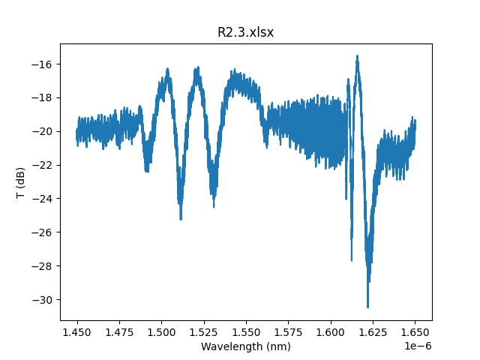
Chip 1 Graphs

Slide 9
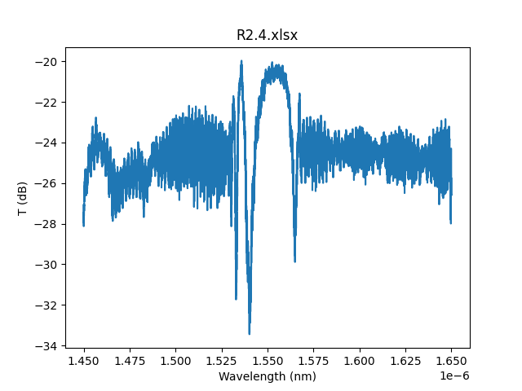
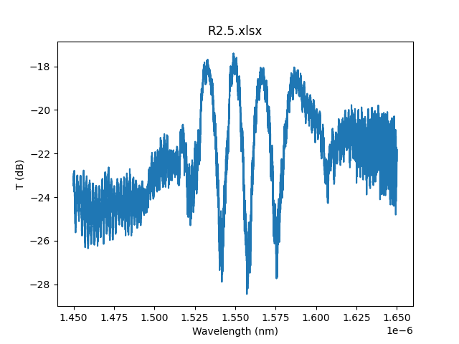
Chip 1 Graphs

Slide 10
Next Week (This Week?)
Finish last 2 structures on Chip 1
Measure Chip 2
Maybe get to Chip 3?
Start work on a python script to find the mean and variance of measurements in each structure across the chips

