Slide 1



Single Page Applications
Introduction

Slide 2
Single Page Applications
Introduction
Instead of the default method of the browser loading entire new pages, a single-page application (SPA) interacts with the web browser by dynamically rewriting the current web page with new data from the web server
Resources are dynamically loaded and added to the page as necessary, usually in response to user actions
The page does not reload at any point in the process, nor does it transfer control to another page
Can be built using
AJAX
Frameworks like ReactJS, AngularJS

Slide 3
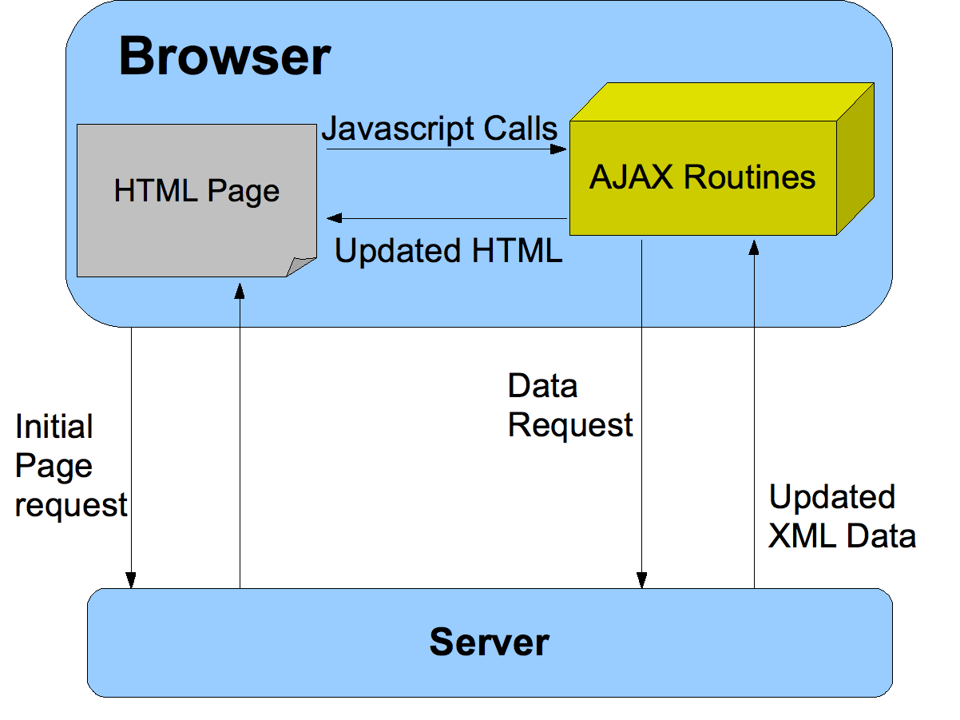

Slide 4
Asynchronous Communication
AJAX
Traditional web applications, upon request from user like clicking a link or submitting a form, a new page is loaded with requested resources
Asynchronous applications, upon user action, updates a part of the page without reloading the entire page
Approaches include
Setting src property of iFrame or img element
A more elegant and complete approach is use of XHR or XMLHttpRequest object
First create an XHR object using
var xhr = new XMLHttpRequest();

Slide 5
XMLHttpRequest - XHR
XMLHttpRequest (XHR) is an API that can be used by JavaScript, JScript, VBScript, and other web browser scripting languages to transfer and manipulate XML data to and from a webserver using HTTP, establishing an independent connection channel between a webpage's Client-Side and Server-Side.

Slide 6
XMLHttpRequest Methods
open( method, URL )
open( method, URL, async )
open( method, URL, async, userName )
open( method, URL, async, userName, password )
Specifies the method, URL, and other optional attributes of a request.
The method parameter can have a value of "GET", "POST", or "HEAD
The "async" parameter specifies whether the request should be handled asynchronously or not. "true" means that the script processing carries on after the send() method without waiting for a response, and "false" means that the script waits for a response before continuing script processing.
send( content ) - Sends the request.

Slide 7
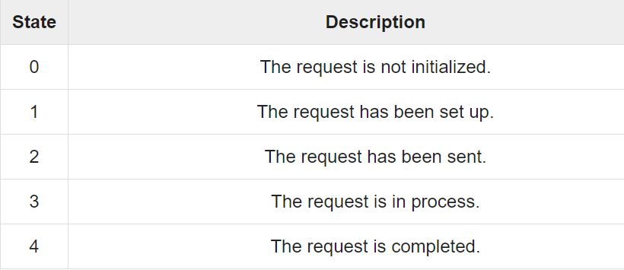
XMLHttpRequest Properties
Onreadystatechange - An event handler for an event that fires at every state change.
readyState - The readyState property defines the current state of the XMLHttpRequest object.
The following table provides a list of the possible values for the readyState property −

Slide 8
XMLHttpRequest Properties
readyState = 0 After you have created the XMLHttpRequest object, but before you have called the open() method.
readyState = 1 After you have called the open() method, but before you have called send().
readyState = 2 After you have called send().
readyState = 3 After the browser has established a communication with the server, but before the server has completed the response.
readyState = 4 After the request has been completed, and the response data has been completely received from the server.

Slide 9
XMLHttpRequest Properties
responseText - Returns the response as a string.
responseXML - Returns the response as XML. This property returns an XML document object.
Status - Returns the status as a number (HTTP status message (a string): usually OK for 200, Not Found for 404, Forbidden for 403 and so on.)
statusText - Returns the status as a string (e.g., "Not Found" or "OK").

Slide 10
Asynchronous Communication
XHR object properties and methods
Properties / Description Methods
readyState | Integer indicating the state of the request, either: 0 (uninitialized) (loading) (response headers received) (some response body received) 4 (request complete)
status | HTTP status code returned by the server (e.g., 200, 404, etc.)
responseText | Full response from the server as a string (responseType property is set to “text” – default)
responseXML | A Document object representing the server’s response parsed as an XML document (responseType property is set to “document”)
response | Any other type of response received ((responseType property is set to “blob” or “json”)

