Slide 1
ASYNCHRONOUS OPERATION IN JAVASCRIPT
Many Web API features now use asynchronous code to run, especially those that access or fetch some kind of resource from an external device, such as fetching a file from the network, accessing a database and returning data from it, accessing a video stream from a web cam, or broadcasting the display to a VR headset.
Why is this difficult to get to work using synchronous code?
Example: Download an image from the server.
That's because you don't know how long the image will take to download, so when you come to run the second line it will throw an error (possibly intermittently, possibly every time) because the response is not yet available. Instead, you need your code to wait until the response is returned before it tries to do anything else to it.
There are two main types of asynchronous code style you'll come across in JavaScript code, old-style callbacks and newer promise-style code.

Slide 2

Callbacks
Introduction
As seen in setInterval, setTimeout and addEventListener, a function accepts a function reference as an argument
They will be called asynchronously based on timer or other events
These function references are called Callback functions
Example:
div.addEventListener(“keypress”, function(){ … });

Slide 3
Promises
Introduction
A promise is used to handle the asynchronous result of an operation.
With Promises, we can defer execution of a code block until an async
request is completed.
The Promise object is created using the new keyword and contains the promise; this is an executor function which has a resolve and a reject callback
Essentially, a promise is a returned object to which you attach callbacks, instead of passing callbacks into a function.
const promise = new Promise(function(resolve, reject) {
// promise description
});

Slide 4
A promise status can be:
fulfilled - The action relating to the promise succeeded
rejected - The action relating to the promise failed
pending - Hasn't fulfilled or rejected yet
settled - Has fulfilled or rejected
.catch(onRejected) -- Rejected
.then(onFulfilled, onRejected) - Fulfilled, Rejected
.finally(onFinally) -- Will be executed anyways

Slide 5
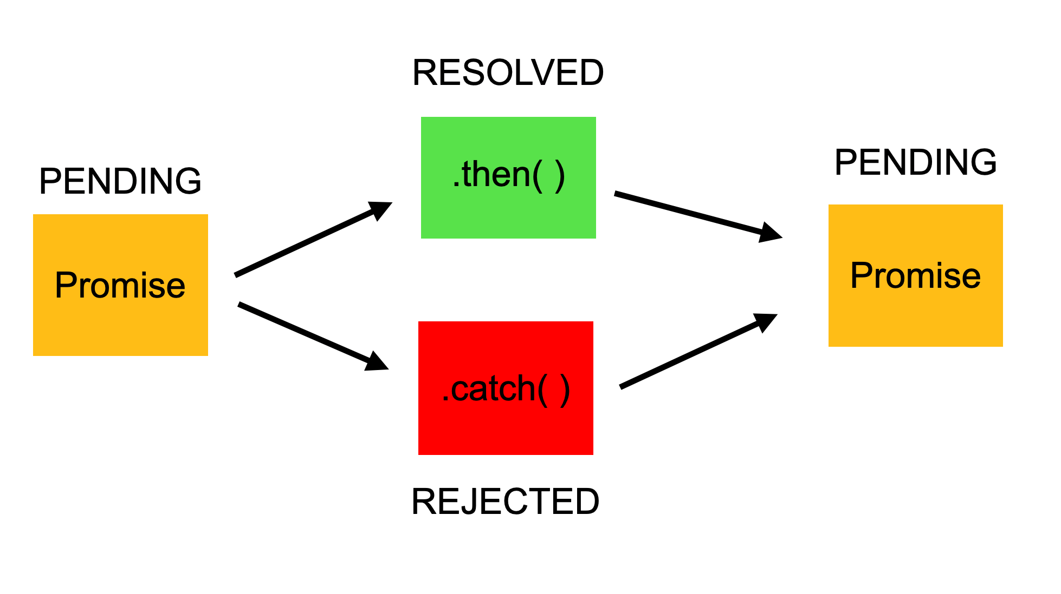

Slide 6
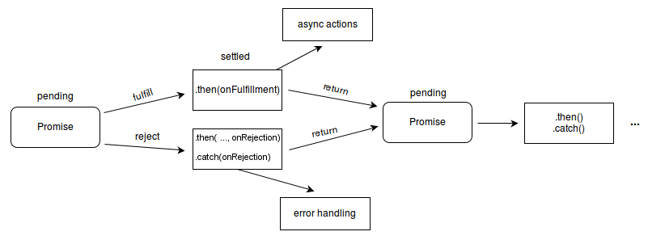

Slide 7
Promises
Example
var weather;
const date = new Promise( function(resolve, reject) {
weather = true; //usually a API call
if (weather) {
const dateDetails = {
name: 'Cubana Restaurant', location: '55th Street', table: 5
};
resolve(dateDetails)
} else {
reject(new Error('Bad weather'))
}
}
);
date
.then(function(done) {
console.log('We are going on a date!') console.log(done)
})
.catch(function(error) { console.log(error.message)
})

Slide 8
Callback and Promises
Comparison
Callbacks and Promises are not the same
Callbacks are function passed to another function as a reference
Chaining of Callbacks can be clumsy and lead to Callback Hell
Promises use Callbacks and more elegant than Callbacks
Chaining of Promises is supported

