Slide 1
Advanced Statistics Project:
“Demographic and Clinical Predictors of OCD Severity .”
INSTRUCTED By : Dr. Syed Faisal Bukhari Associate Professor Department of Data Science
Group Members:
1. Amara Tariq 2. Khansa Azeem
3. Ayesha Akbar 4. Zeenat Fatima

Slide 2

What is OCD? OCD is a mental health cycle where distressing, intrusive thoughts (obsessions) trigger intense anxiety, forcing a person to perform repetitive rituals (compulsions) for temporary relief.
Project Motivation To move beyond clinical theory by using data science to pinpoint which specific treatments and lifestyle habits (like sleep and stress management) most effectively reduce symptom severity.
The Dataset (Kaggle) • Source: Clinical OCD Dataset (500 patient records)

Slide 3
• Key Variables: – Demographic data (Age, Gender) – Therapy types (ERP, CBT, Combined) – Lifestyle metrics (Sleep quality, Stress levels, Exercise, Screen time) – Clinical measures (Y-BOCS severity scores, Obsessions/Compulsions subscales, Depression diagnosis, Duration of symptoms)
Challenges in Analysis • Data Distribution: OCD severity scores (Y-BOCS) are non-normal and heavily skewed → required robust non-parametric statistical testing throughout. • Complex Predictors: High rates of comorbidities (especially Depression) create significant “noise,” complicating efforts to isolate standalone drivers of OCD severity.

Slide 4
Impact of Depression on OCD Severity Statistical Test Mann-Whitney U Test (Non-Parametric)
Hypotheses & Results
Statistical Components:
H₀: There is no difference in OCD severity between depressed and non-depressed patients.
H₁: Patients with depression have higher OCD severity.
Result: U = 20285.5, p = 0.0003
Decision: Reject H₀ (Significant difference found).

Slide 5
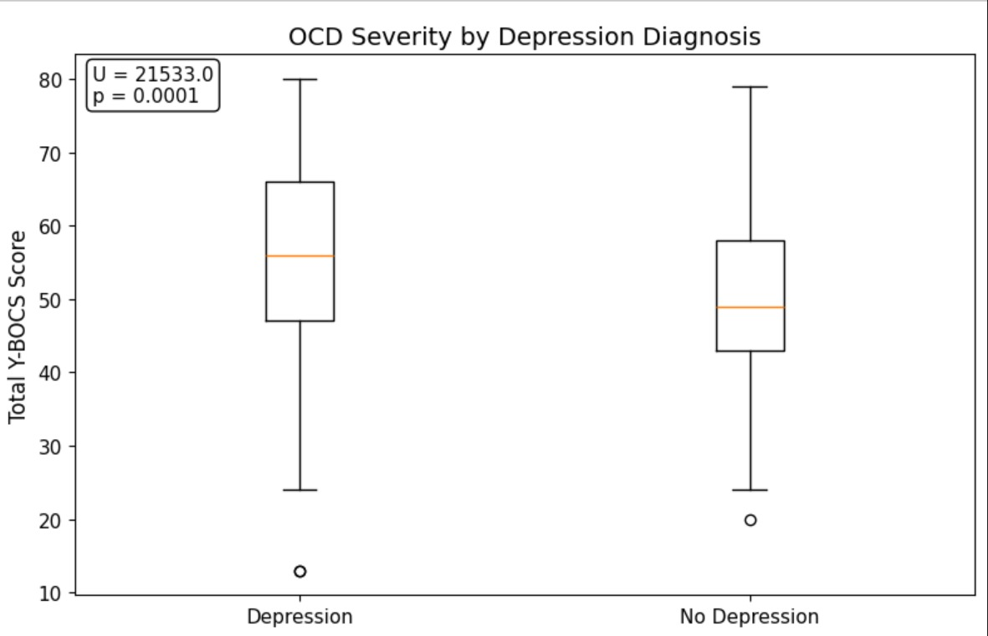

Slide 6
Predictive Modeling (What drives OCD?)
Test Name: Multiple Linear Regression
Why applied: To see which factor has the most power to predict a patient's Y-BOCS score when all factors (Stress, Sleep, Exercise, Depression) are considered at once.
Mathematical Results:
• Model Fit (R²): 0.063
• Top Predictor (Depression): Coeff = 5.51 (p < 0.001)
• Second Predictor (Sleep): Coeff = -1.03 (p < 0.001)
• Third Predictor (Stress): Coeff = 0.62 (p = 0.026)

Slide 7
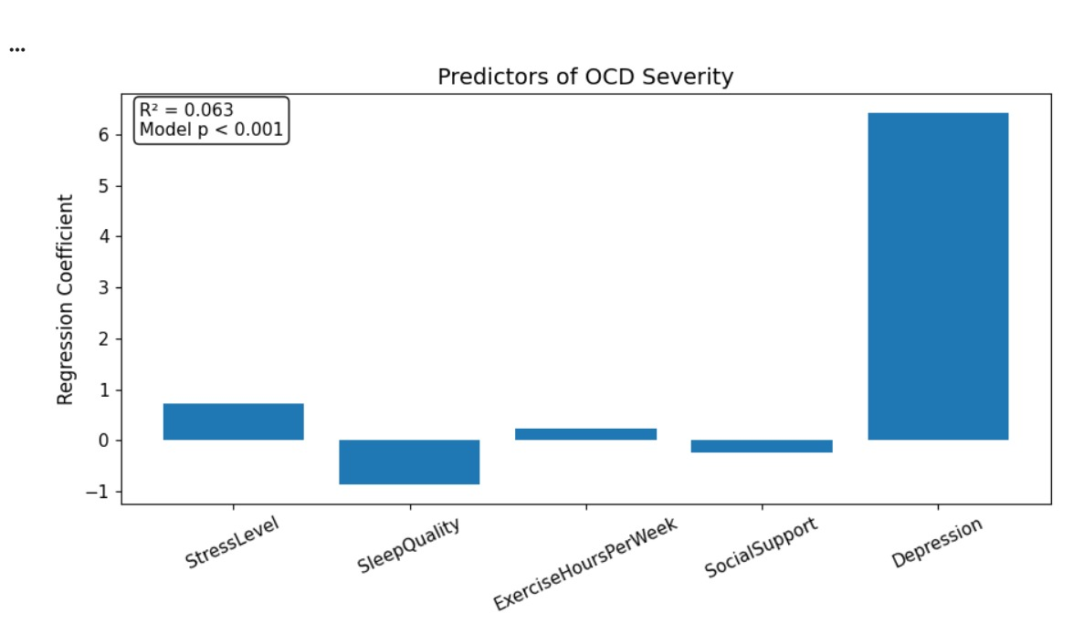

Slide 8
Correlation of Behavioral Factors
Test Name: Kendall’s Tau Correlation
Why applied: To measure the strength and direction of the relationship between behavioral habits (Stress, Sleep, Exercise) and OCD Severity. We use Kendall’s Tau because it is best for non-normal, ordinal data.
Statistical Results:
• Sleep Quality: τ = -0.11 | p < 0.001 (Highly Significant)
• Stress Level: τ = 0.088| p = 0.015 (Significant)
• Exercise: τ = 0.046 | p = 0.131 (Not Significant)
• Social Support: τ = -0.04| p = 0.227 (Not Significant)

Slide 9
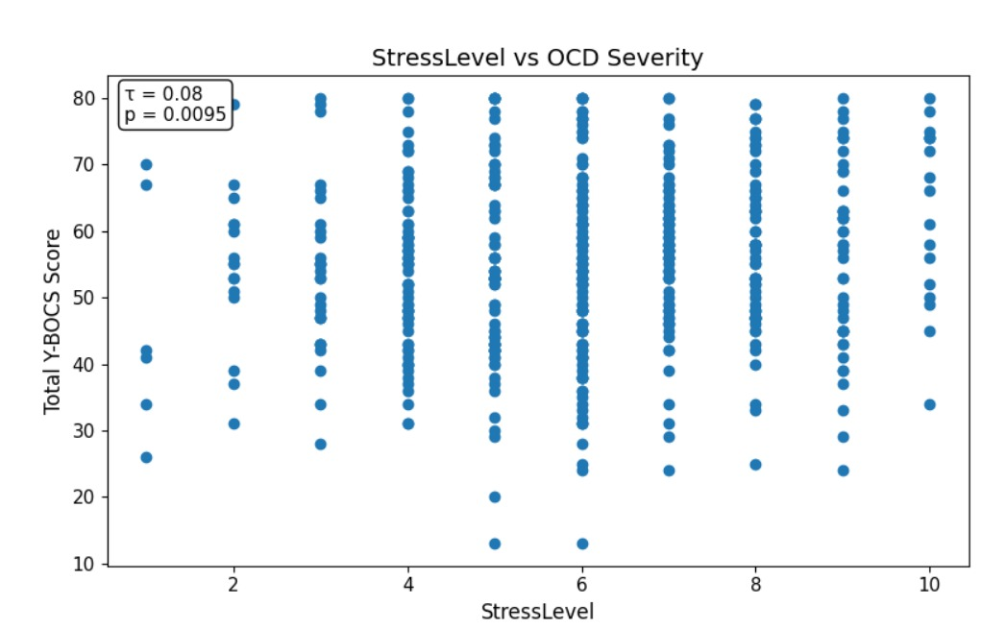
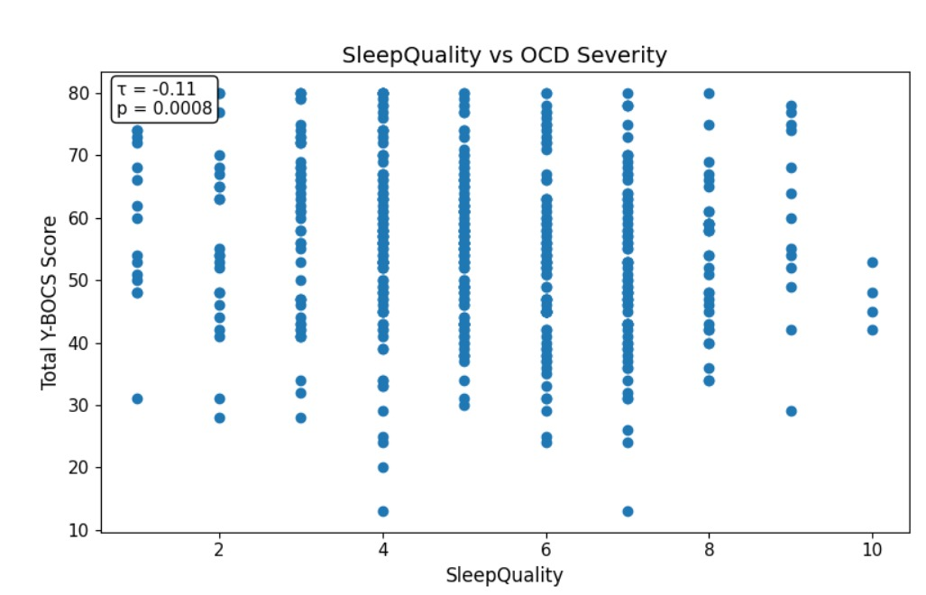
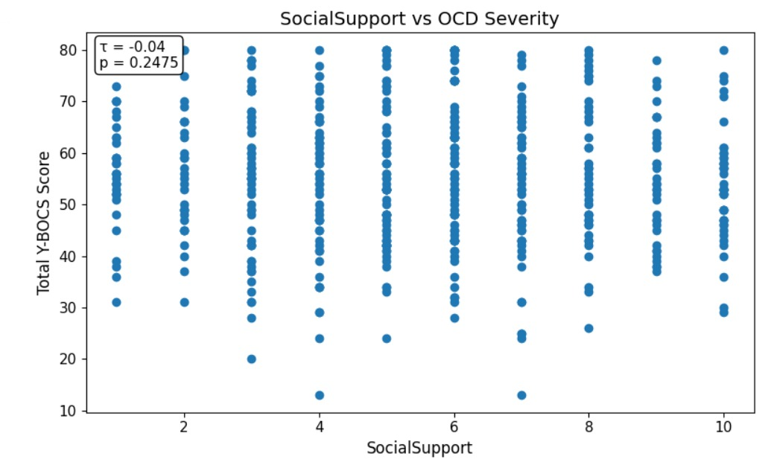
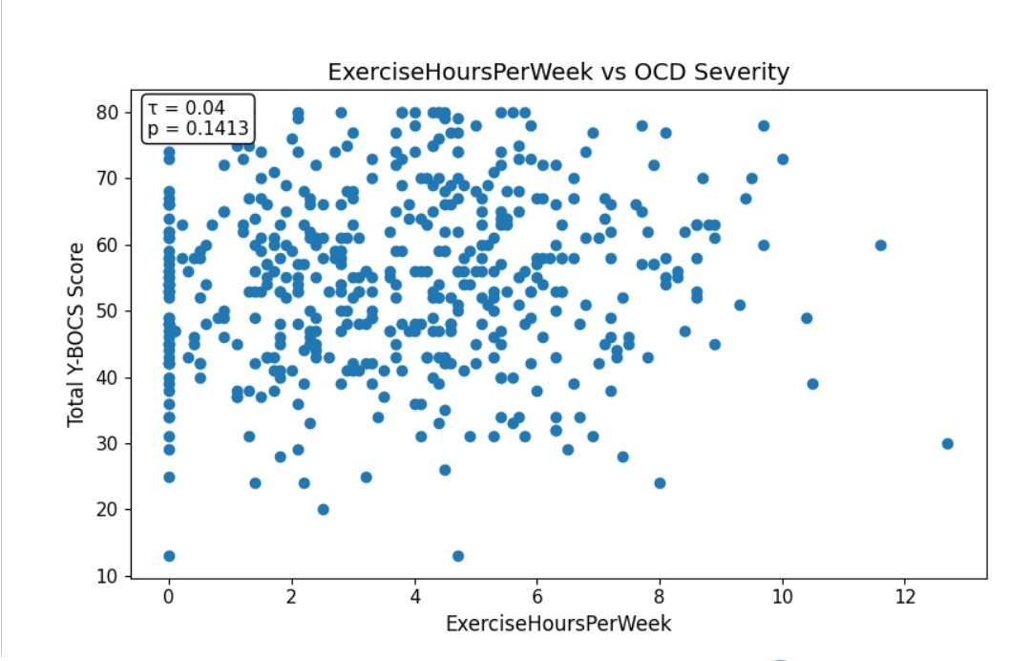

Slide 10
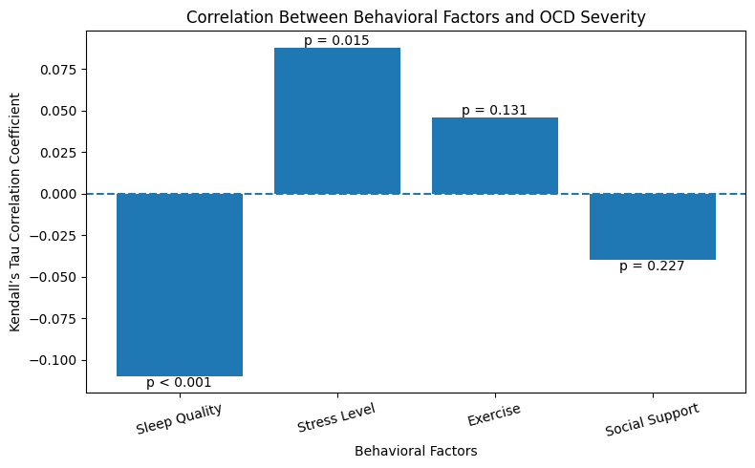

Slide 11
Categorical Analysis (Gender vs. Depression)
Test Name:
Chi-Square Test of Independence
Why applied:
To check if one gender is more likely to suffer from depression than others, or if they are independent.
Calculation Results:
• χ² Statistic: 0.656
• p-value: 0.720
• Decision: Fail to Reject H₀ (No significant association).
Gender | No | Yes
Female | 36 | 183
Male | 40 | 211
Non-Binary | 4 | 26

Slide 12
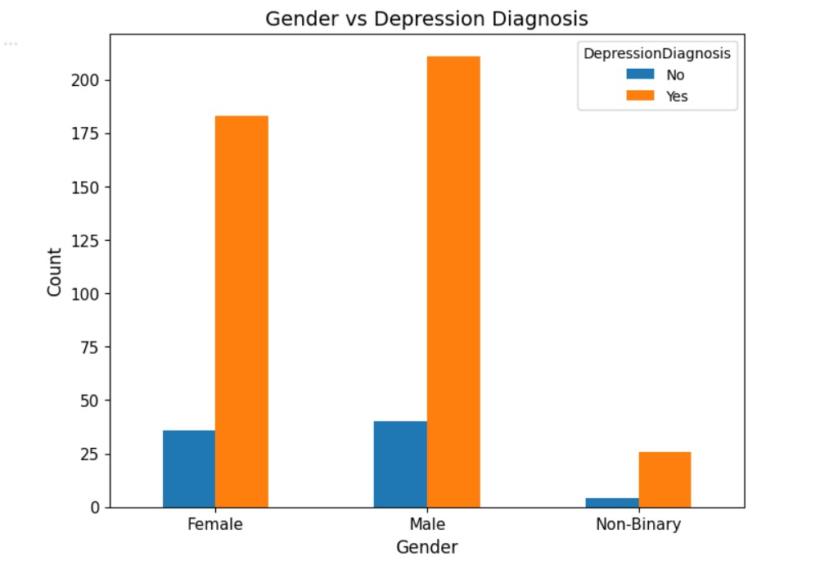

Slide 13
Impact of Therapy Types on OCD Severity
Test Name: Kruskal-Wallis H-Test (Non-Parametric).
Why this is applied: We use this test because we are comparing more than two groups (ERP, CBT, and Combined) and our OCD severity scores are not normally distributed. It helps us see if the type of therapy makes a statistically "accurate" difference in patient outcomes.
Hypotheses & Results: Null Hypothesis (H₀): There is no significant difference in OCD severity scores among patients receiving different types of therapy (The groups are equal).
Alternative Hypothesis (H₁): At least one therapy type results in significantly different OCD severity scores compared to the others.
Calculation Result: H-statistic = 210.00, p < 0.001
Decision: Reject H₀. The difference is highly significant.

Slide 14
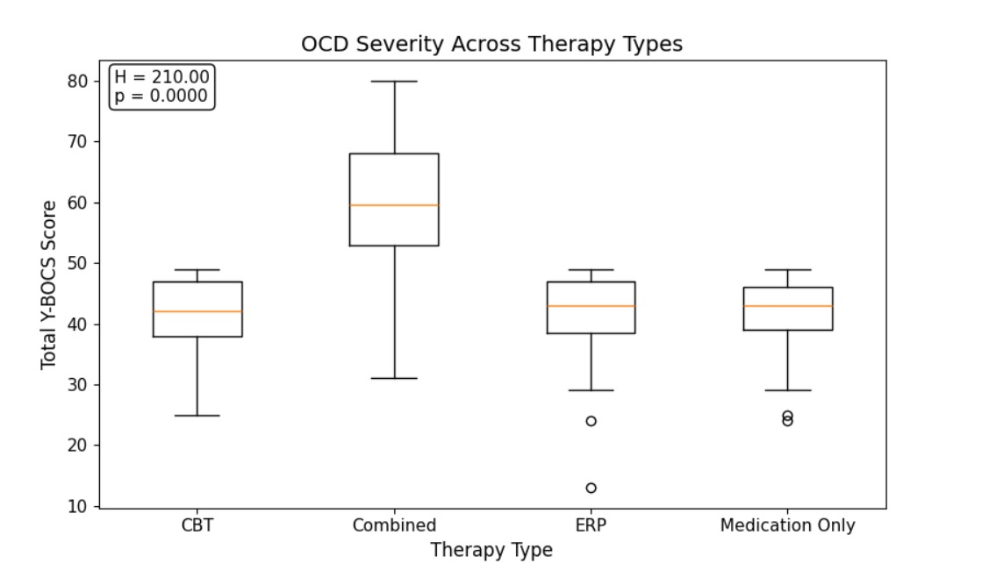

Slide 15
Pearson Correlation Analysis
Test Name: Pearson Correlation Coefficient (r)
Why this is applied: We use this to measure the strength and direction of the linear relationship between numeric clinical variables. It identifies how closely linked components like "Obsessions" and "Compulsions" are to the "Total Severity" and if "Age" or "Duration" play a role.
Test Components: Null Hypothesis (H₀): There is no linear relationship between the numeric variables (r = 0).
Alternative Hypothesis (H₁): There is a significant linear relationship between the variables (r ≠ 0).
5.Key Coefficients:
• Obsessions vs. Total: r = 0.96
• Compulsions vs. Total: r = 0.96
• Duration vs. Total: r = 0.20
Duration of Symptoms" suggests that OCD severity increases slightly the longer a patient remains untreated.Age shows near-zero correlation, indicating that OCD severity is not determined by how old the patient is

Slide 16
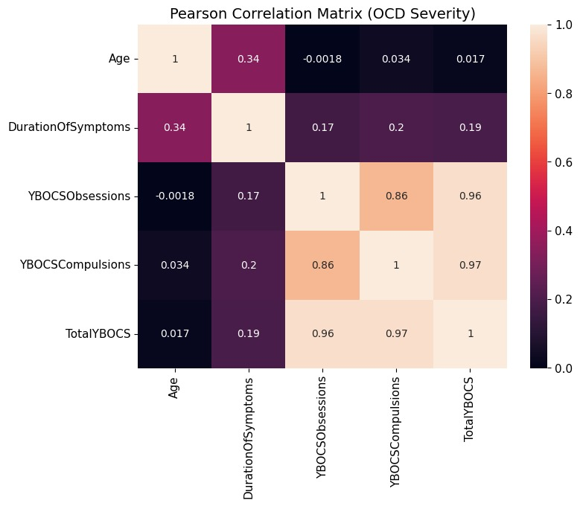

Slide 17
Conclusion
OCD severity is primarily driven by Therapy Type, with Combined Therapy showing the best results. Depression acts as a "severity multiplier," significantly increasing patient scores. Additionally, Sleep and Stress are the most critical lifestyle factors, while Age and Gender have no major impact. For recovery, treatment must focus on integrated therapy, depression management, and better sleep hygiene.

