Slide 1

ST ANN’S COLLEGE OF ENGINEERING & TECHNOLOGY
AUTONOMOUS
DEPARTMENT OF
CSE-ARTIFICIAL INTELLIGENCE & MACHINE LEARNING
Railway Track Fall Detection System Using Region Based Convolutional Neural Networks
For People Safety
A.SATHWIKA (22F01A4202)
D.VISHNU PRIYA (22F01A4213)
K.AVANTHI (22F01A4227)
B.V.L.SAAHITHI (22F01A4207)
PRESENTED BY
UNDER THE GUIDANCE OF
Dr. P. S. NAVEEN KUMAR, Ph. D
ASSOCIATE PROFESSOR

Slide 2
TABLE OF CONTENTS
Abstract
Introduction
Objective
Existing System
Proposed Approach using RCNN
Hardware and Software requirements
Literature review
UML Diagrams
Modules Description
Implementation
Conclusion

Slide 3
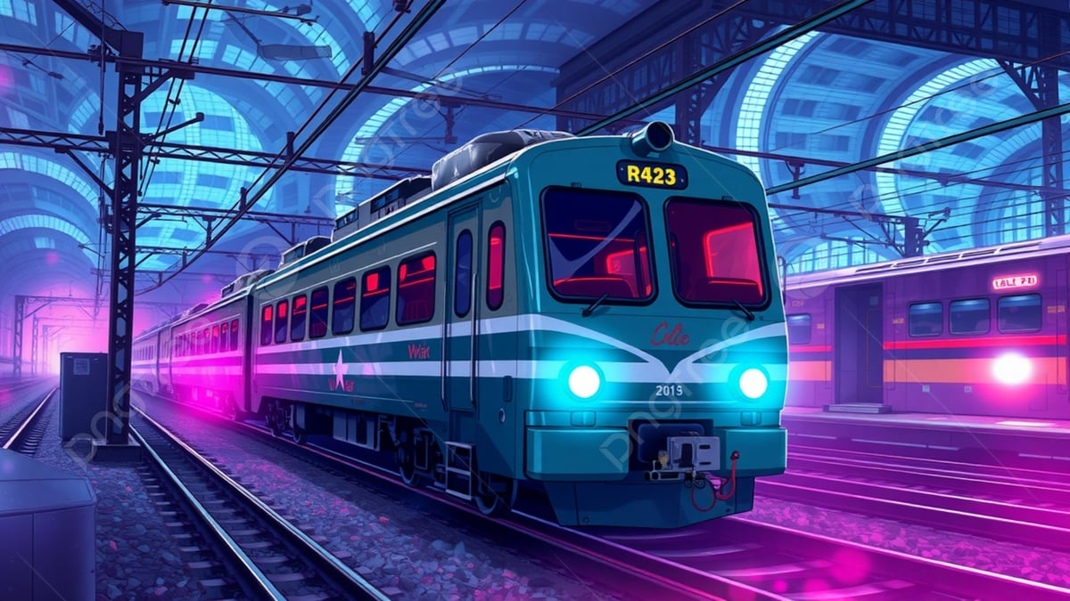
PROJECT TITLE
Railway Track Fall Detection System Using Region Based Convolutional
Neural Networks For people Safety
A real-time, AI-powered system using Region-Based Convolutional Neural Networks (R-CNN) to detect falls, cracks, and obstacles on railway tracks to prevent accidents.

Slide 4
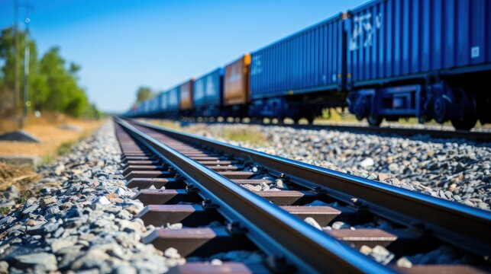
ABSTRACT
Railway track defects can cause serious
accidents if not detected early.
This project uses R-CNN to automatically
identify track falls, cracks, and obstacles.
Detected defects are highlighted with
bounding boxes.
A siren alarm alerts immediately when a
defect is found.
The system improves railway safety through
fast and accurate detection.
Helps reduce manual inspection effort and
supports predictive maintenance.

Slide 5
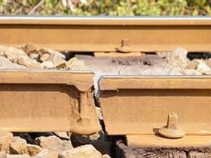
INTRODUCTION
Railway networks are one of the most widely used
transportation systems and require high safety
standards.
Even small defects on the track can lead to major failures if not detected early.
Traditional inspection methods depend on manual checking,
which is time-consuming and cannot cover long
routes efficiently.
With the growth of technology, AI and computer vision offer a modern way to observe track conditions continuously.
Implementing automated detection systems helps railway authorities improve monitoring, reduce human error, and respond quickly to risks.

Slide 6
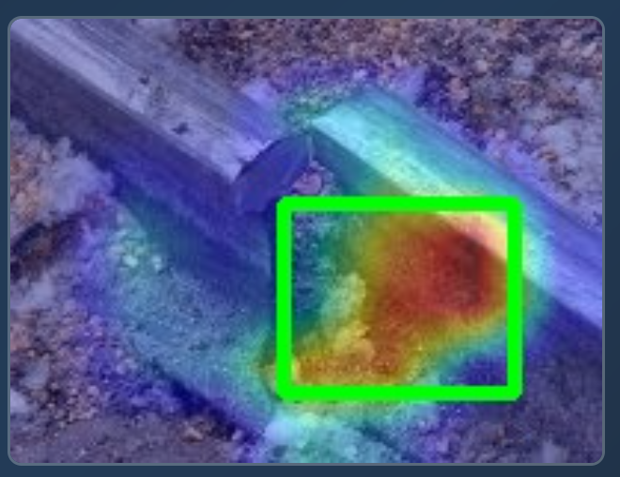
OBJECTIVE
To detect railway track falls, cracks, and
obstacles using R-CNN.
To accurately locate defects with
bounding boxes.
To automate monitoring and reduce manual
inspection effort.
To provide a siren alarm alert when defects are detected.
To improve railway safety through real-time detection.

Slide 7
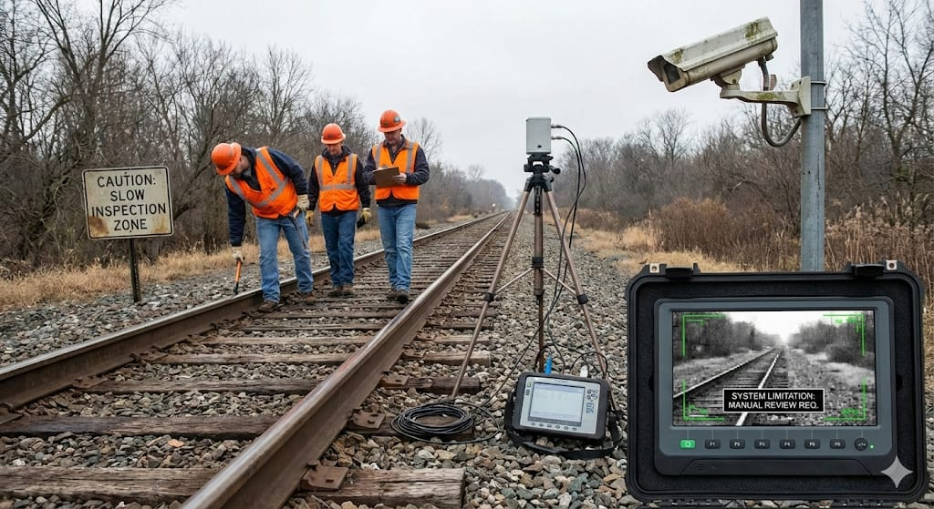
EXISTING SYSTEM
Manual inspection of railway tracks by workers.
Sensor-based methods (ultrasonic, vibration sensors).
CCTV surveillance along railway lines.
Traditional image processing techniques
Limitations of the Existing System:
Slow and not suitable for long railway routes.
Highly dependent on human judgment → errors possible.
Sensors cannot detect all types of external
defects.
CCTV requires manual monitoring, not real-time detection.

Slide 8
PROPOSED APPROACH
⭐ Why R-CNN for Railway Track Fall Detection
Steps Involved:
Capture railway track images/videos using cameras.
Preprocess data (resizing, normalization).
Use R-CNN to generate region proposals.
Extract features using CNN.
Classify regions as normal track or faulty track.
Localize faults such as cracks, breaks, or missing tracks.
Send alerts for maintenance action.

Slide 9
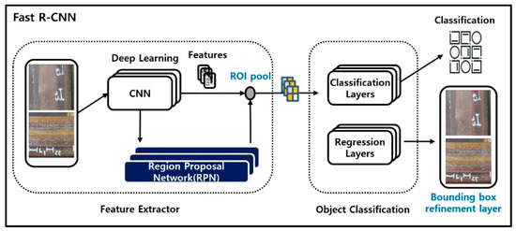
PROPOSED APPROACH

Slide 10
HARDWARE AND SOFTWARE REQUIREMENTS
Hardware Requirements :
Camera / Webcam
Laptop/PC with 8–16 GB RAM
GPU (optional but recommended for training)
Speaker/Buzzer for siren alarm
Software Requirements :
Windows / Linux OS
Python 3.x
TensorFlow, OpenCV
LabelImg (for annotation)
VS Code / Jupyter Notebook

Slide 11
LITERATURE SURVEY
Previous research in railway track safety mainly focused on improving inspection methods to detect cracks and defective track conditions at an early stage. Initial studies relied heavily on manual inspection, where railway staff visually examined tracks. Literature clearly reports that this approach is slow, labor-intensive, and unreliable for detecting small or early-stage cracks.
Later studies explored camera-based inspection systems, where images of railway tracks were analyzed instead of physical checking. These studies showed that visual data can capture surface irregularities better than human observation. However, many researchers reported that simple image processing techniques fail under real outdoor conditions due to changes in lighting, shadows, rust, and surface wear.

Slide 12
LITERATURE SURVEY
As research progressed, learning-based approaches were introduced to improve crack detection accuracy. These methods allowed systems to learn patterns from sample images rather than relying on fixed rules. Literature highlights that such approaches perform better in handling variations in crack shape and track appearance.
Recent studies emphasize automated and intelligent systems for railway inspection. However, many existing solutions are reported to be complex, computationally heavy, or tested only in controlled environments. Literature concludes that there is a strong need for practical, accurate, and adaptable crack detection systems suitable for real-world railway infrastructure.

Slide 13
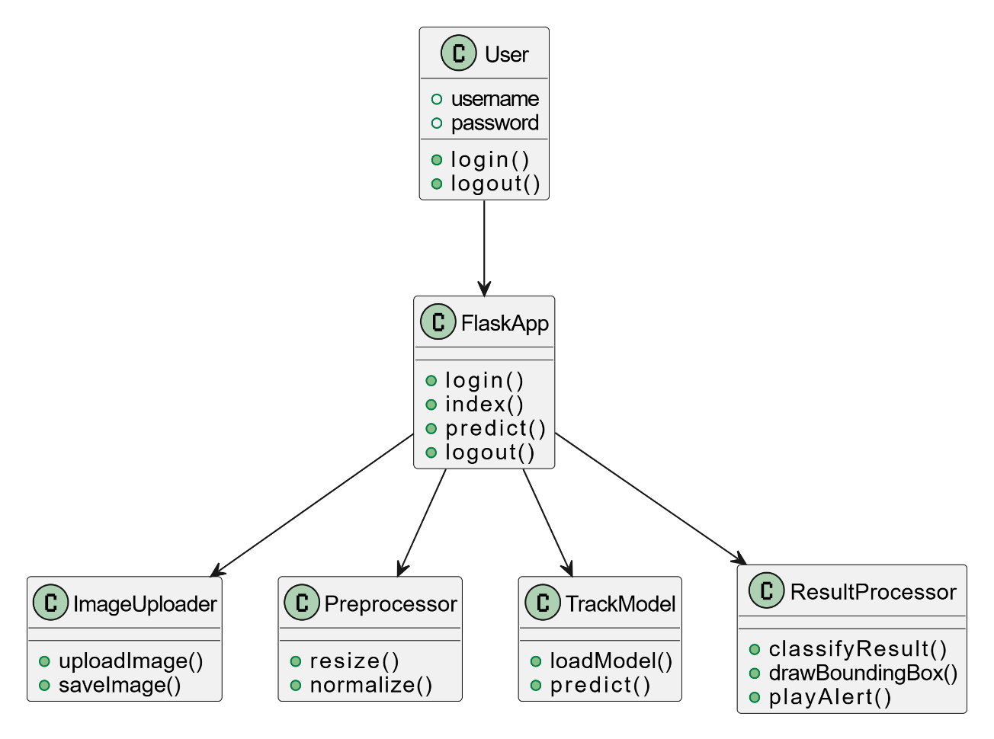
UML DIAGRAMS
CLASS DIAGRAM
The class diagram represents the static structure of the railway track defect detection system.
It shows the main classes such as User, Flask Application, Image Uploader, Preprocessor, AI Model, and Result Processor.
Each class defines its attributes and methods, for example login, image upload, prediction, and alert generation.
The Flask application acts as a central controller that connects all modules.
This diagram helps in understanding the internal organization and responsibilities of the system.

Slide 14
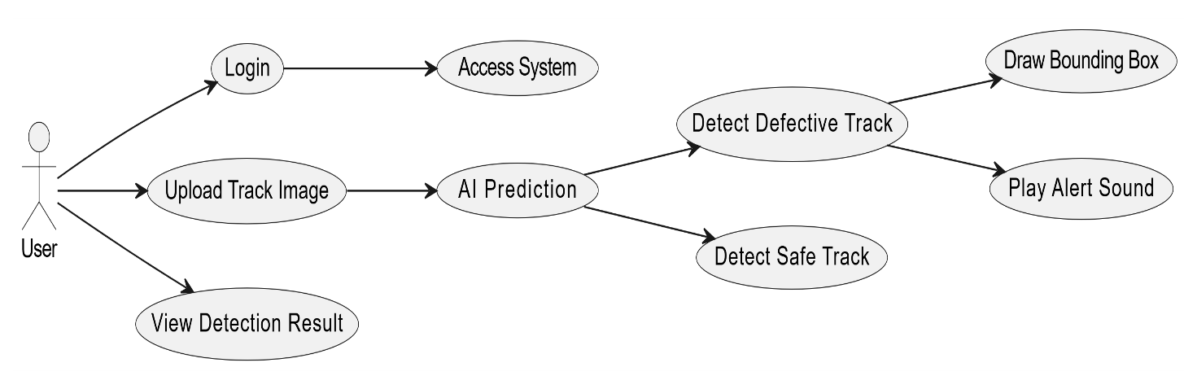
USECASE DIAGRAM
The use case diagram describes the functional requirements of the system.
The User is the primary actor who interacts with the application.
The user must first log in to access the system features.
After login, the user uploads a railway track image for analysis.
The system performs AI-based detection to classify the track as defective or safe.
If a defect is detected, the system draws a bounding box and generates an alert.
Finally, the user can view the detection result.

Slide 15
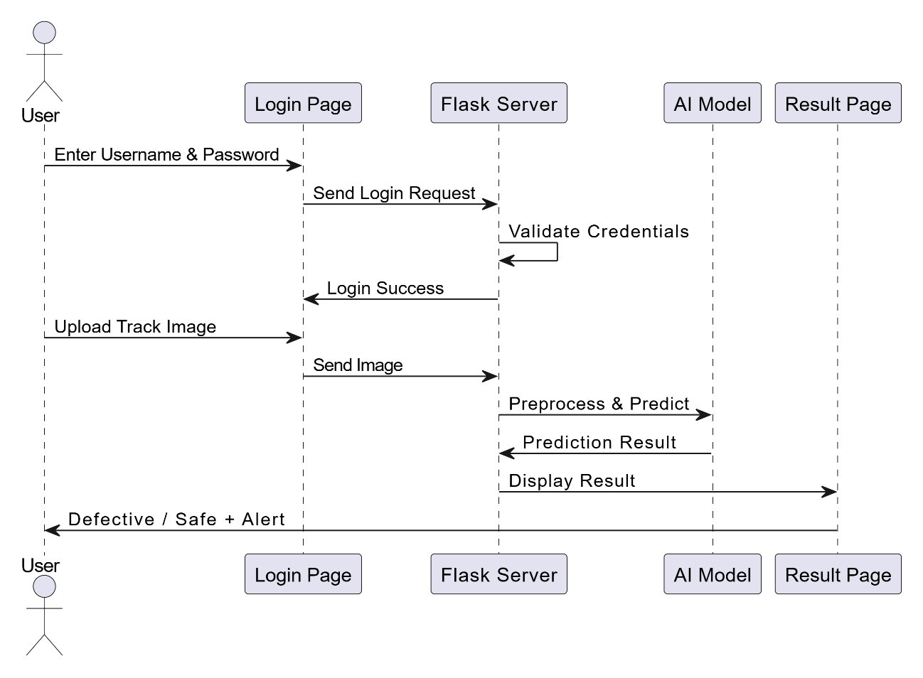
SEQUENCE DIAGRAM
The sequence diagram explains the order of execution of processes in the system.
The user enters credentials which are sent to the Flask server for validation.
After successful login, the user uploads a track image.
The Flask server preprocesses the image and forwards it to the AI model.
The AI model performs prediction and sends the result back to the server.
The server displays the final output and alert message to the user.

Slide 16
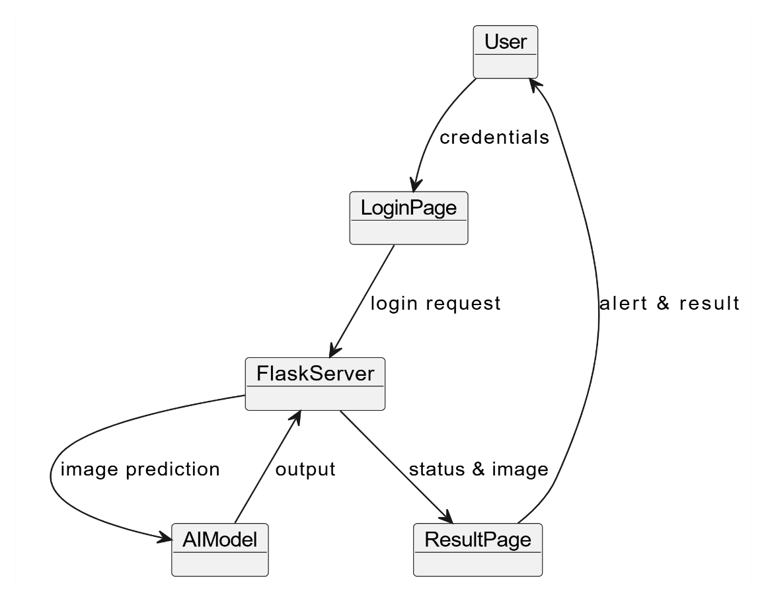
COLLABORATION DIAGRAM
The collaboration diagram shows how objects interact and communicate with each other.
The User communicates with the Login Page to provide credentials.
The Flask server coordinates between image processing and AI prediction modules.
The AI model sends prediction results to the result processing module.
The result page displays the output along with alert information.
This diagram emphasizes the relationships and message flow between objects.

Slide 17
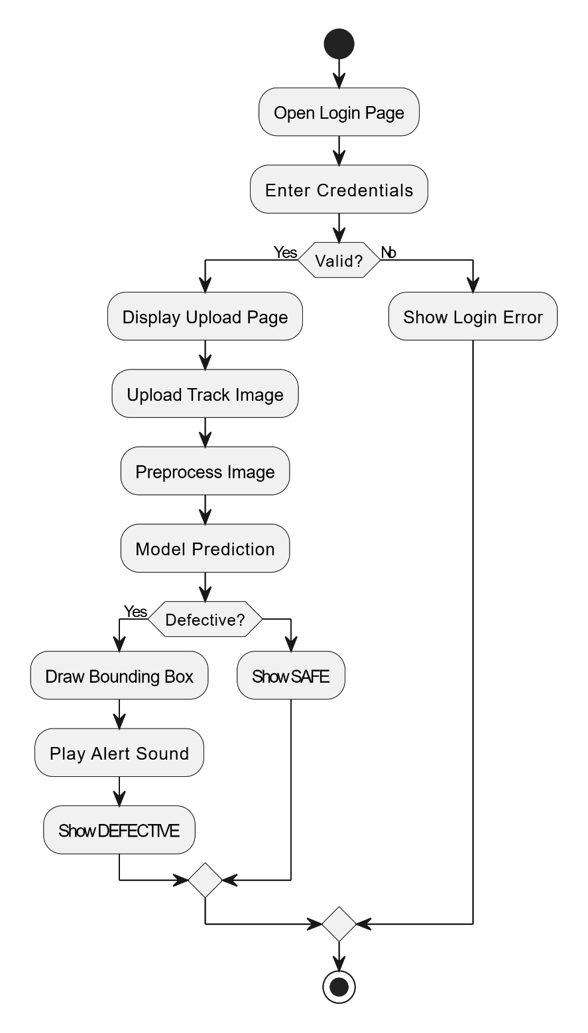
ACTIVITY DIAGRAM
The activity diagram represents the workflow of the system from start to end.
The process begins with the user opening the login page and entering credentials.
If the credentials are invalid, an error message is displayed.
After successful login, the user uploads a railway track image.
The image is preprocessed and sent to the AI model for prediction.
If the track is defective, a bounding box is drawn and an alert is generated.
If the track is safe, the system displays a safe message.
The process ends after showing the result.

Slide 18
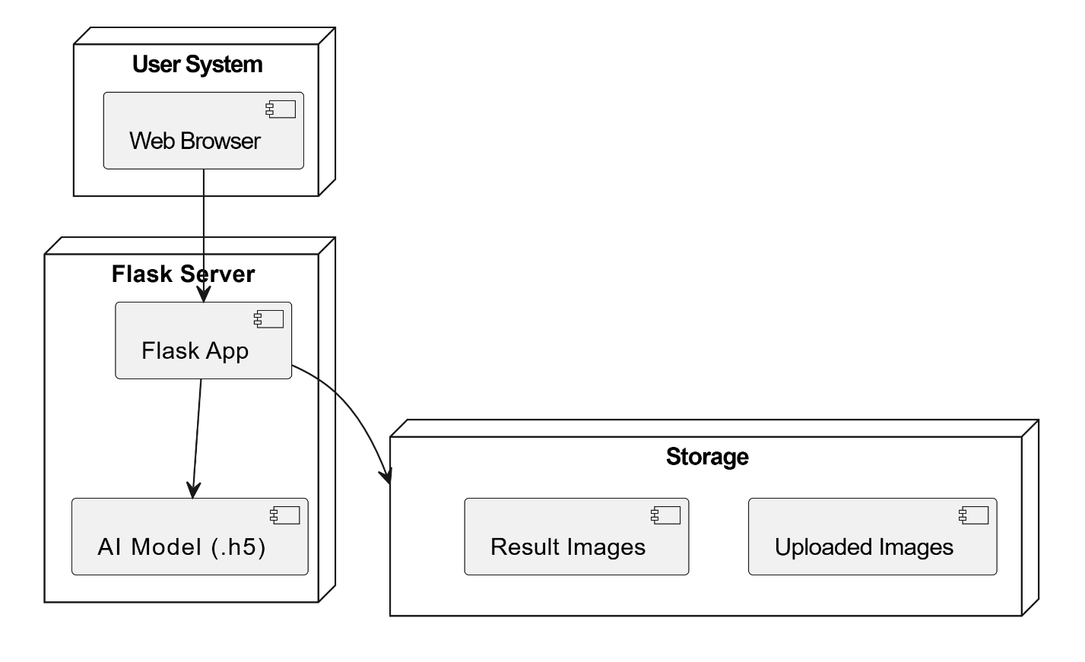
DEPLOYEMENT DIAGRAM
The deployment diagram shows the physical architecture of the system.
The user accesses the application through a web browser.
The Flask server hosts the web application and manages requests.
The trained AI model is deployed within the server environment.
Uploaded images and result images are stored in the storage system.
This diagram explains how software components are deployed and connected.

Slide 19
MODULES DESCRIPTION
Region Proposal Module (RPN): Identifies possible defect regions.
Image Acquisition Module: Captures railway track images/video through a camera.
Preprocessing Module: Enhances and prepares images for detection.
Feature Extraction Module: Uses CNN to extract important track features.
Faster R-CNN Detection Module: Detects cracks, falls, and obstacles with bounding boxes.
Bounding Box Detection Module: Generates bounding boxes around cracks, falls, and obstacles.
Alert Module (Siren Alarm): Triggers alarm when a defect is found.
Output Visualization Module: Displays detected defects on the screen.

Slide 20
IMPLEMENTATION
Detect railway track condition using camera input
the siren rings immediately to alert nearby staff.
The model checks for cracks, track falls, or obstacles.
Notifies staff so they can take quick action to prevent accidents.
Each defect is highlighted, making it easy to identify the exact location.
Shows crack/fall/obstacle along with its location for easy review.

Slide 21
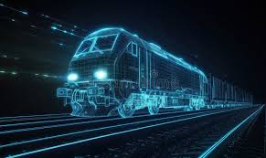
CONCLUSION
The Railway Track Fall Detection System using Faster R-CNN successfully identifies cracks, falls, and obstacles with high accuracy.
The system provides real-time detection with clear bounding boxes, improving the reliability of track monitoring.
The integrated siren alarm gives instant alerts, helping railway staff respond quickly and prevent accidents.
Overall, the project reduces manual inspection, increases safety, and offers an efficient AI-based solution for railway infrastructure monitoring.

