Slide 1
Delphi-lite
Which movies will a user rate on their next active day?
Ragnar Björn and Ólafur Sær · Introduction to Deep Learning · Fall 2026
day 1
day 2
day 9
day 30
day 31
next day?
Notes:
[0:30] Hi, we are Ragnar Björn and Ólafur Sær. Our project applies Delphi, a transformer that was built to read people's health histories, to people's movie-rating histories. The question is in the subtitle: which movies will a user rate on their next active day, and does their own history help?

Slide 2
From health histories to movie histories
Delphi (Shmatko et al., Nature 2025)
Our question
A GPT-2 that reads diagnoses with the age they occurred at and predicts the next event and when it happens.
Given everything a user rated up to the end of an active day, which movies will they rate on their next active day?
Here: MovieLens rating histories
…and does their own history help beyond knowing what is popular right now?
Each rating is an event; its date plays the role of age. Same model family, very different events.
Notes:
[1:00] Delphi, published in Nature last year, is a GPT-2 that reads a person's diagnoses together with the age at which they happened, and predicts what comes next and when. A movie-rating history has the same shape: events with dates. So we ask a focused question: given everything a user rated up to the end of an active day, which movies will they rate on their next active day? And the part that makes it interesting: does the user's own history help beyond simply knowing what is popular at that time? That second part decides which baselines we need.

Slide 3
MovieLens-25M: ratings, not viewings
25,000,095
162,541
59,047
1995–2019
ratings = events (stars ignored)
users, split 80 / 10 / 10
movies rated; we keep the 10,000 most rated
dates the ratings were entered (UTC)
Dates are rating dates
Licence and citation
A timestamp says when a rating was typed in, not when the film was seen. Many users rate dozens of old favourites when they sign up.
GroupLens licence: research use, cite Harper & Konstan (2015), no redistribution. We hand in a download script with an MD5 check, never the files.
Notes:
[0:40] The data is MovieLens 25M from GroupLens: 25 million ratings by 162 thousand users, 1995 to 2019. Every rating is one event, whatever its stars. Two things to keep in mind. First, the timestamp is when the rating was entered, not when the movie was watched. Second, the licence allows research use with a citation but forbids redistribution, so our hand-in has a download script and no data.

Slide 4
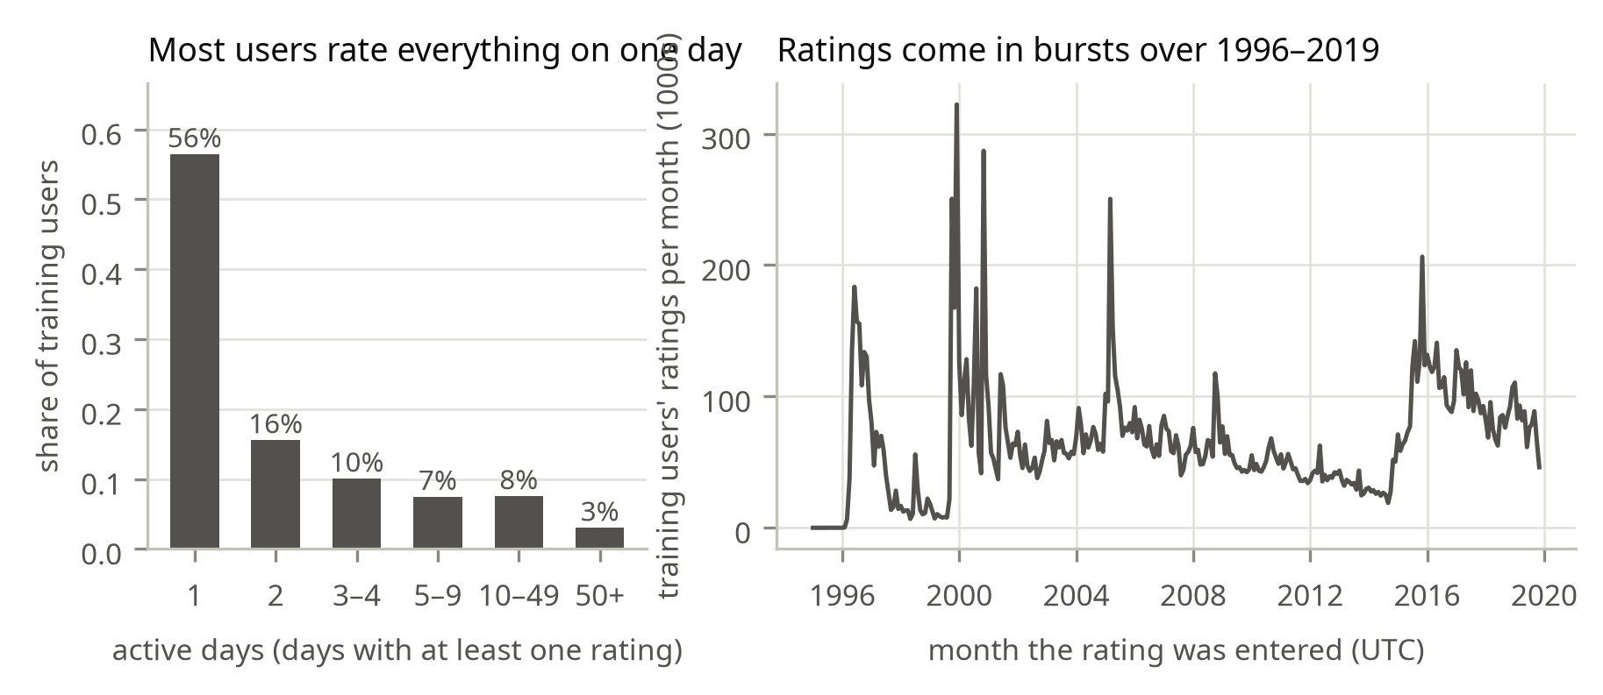
Histories are short, bursty and batched
56% single-day users
No earlier day to predict from: we need ≥ 2 active days.
57% on day one
Most ratings are entered in the sign-up batch.
Ties within a day
Eligible users (≥ 2 active days): 56,650 train · 7,067 validation · 7,129 test
Ratings on one day are unordered; their order is random.
Notes:
[0:55] Looking at the histories changed our task definition. On the left: 56% of users rate everything on a single day, so there is no earlier day to learn from; we keep users with at least two active days. 57% of all ratings are typed in on the user's first day, the sign-up batch. On the right, ratings come in bursts: the busiest day, 2000-11-20, has 78,444 ratings. Same-day ratings have no meaningful order, so we treat them as ties.

Slide 5
The prediction task
day 1
day 2
day 9
day 30
target day T
input: ratings on earlier days only (latest 256)
prediction time: end of the last active day before T
Target
Candidates
Metric: recall@20
The set of movies rated on day T (median 7). T is drawn at random from the user's active days after the first.
All 10,000 movies minus everything the user rated before T. Movies are never rated twice.
Hits in the top 20 ÷ min(20, |target|), averaged over users, with 95% intervals and paired differences.
Notes:
[1:10] Here is the exact task. For every held-out user we pick one target day at random among their active days after the first. The prediction time is the end of the last active day before it. The model sees only ratings from earlier days, at most the latest 256. The target is the set of movies rated on the target day; the median is 7 movies. Candidates are all 10,000 movies except those the user has already rated, because MovieLens users never rate a movie twice. We measure recall at 20: of the top 20 suggestions, how many were rated that day, divided by 20 or by the size of the target set if it is smaller.

Slide 6
Keeping the evaluation honest
1 Split users first
2 Fit on training users
80 / 10 / 10, seed 42, before any other step.
Movie vocabulary, popularity counts and co-occurrences use training users only.
3 Validation decides
4 Strictly earlier days
Every choice was made on 7,067 validation users; test (7,129 users) was scored once.
Inputs stop at the end of the last active day before the target day.
Notes:
[0:40] Four rules keep this honest. We split users before anything else. The movie vocabulary and every baseline are fitted on training users only. Every decision, including the baseline's window, was made on validation users, and the test users were scored once at the end. And the model never sees the target day itself.

Slide 7
Delphi, adapted to movie days
movie token + day
Time unit: the calendar day; same-day ratings are ties.
Ties: Delphi's mask_ties leaks the current same-day token through the residual stream (unit test). We read each prediction for day d from the last position before day d.
Tokens 0 (padding) and 1 (no event) are reserved and never predicted; no generation, so the health-specific stop token (1269, death) is unused.
Tried, not kept: a popularity offset β·log(1 + 30-day count) on every log-rate. It speeds up early training but gives no gain at convergence.
token embedding + sinusoidal day encoding
4 transformer blocks (causal attention)
log-rate for each of 10,000 movies
Two outputs
which movie: softmax over the log-rates
when: an exponential waiting time
Notes:
[1:10] The model is Delphi: GPT-2 where the position embedding is replaced by a sinusoidal encoding of the event time. Each movie has a log-rate; the next event is a competing-risks draw, so the loss is cross-entropy for which movie plus an exponential likelihood for when. We adapted four things. Time is the calendar day. Ties: Delphi's own tie masking hides same-day events from attention, but the current token still reaches its prediction through the residual connection; a unit test shows this leak. So we read every prediction from the last position on an earlier day. Tokens zero and one are reserved and never predicted, and we do not use Delphi's generation, whose stop token is death. Finally, we tried giving every movie a popularity baseline rate; it helped early in training but not at the end, so the final model does not use it.

Slide 8
Three baselines to beat
POP
RECENT-POP
ITEM-KNN
All-time number of training users who rated the movie. The brief's popularity baseline.
Training ratings in the 30 days up to the prediction day. Window chosen on validation among 12 variants.
Cosine co-occurrence with the movies in the visible history. Personal, but blind to time.
Same candidates and the same exclusion of already-rated movies for every method.
Notes:
[0:40] We compare against three baselines, all fitted on training users. POP ranks by all-time popularity. RECENT-POP ranks by what training users rated in the last 30 days up to the prediction day; we chose that window on validation among 12 variants, and it is the strongest baseline. ITEM-KNN is personalised: it suggests movies that co-occur with the user's history, but it ignores time.

Slide 9
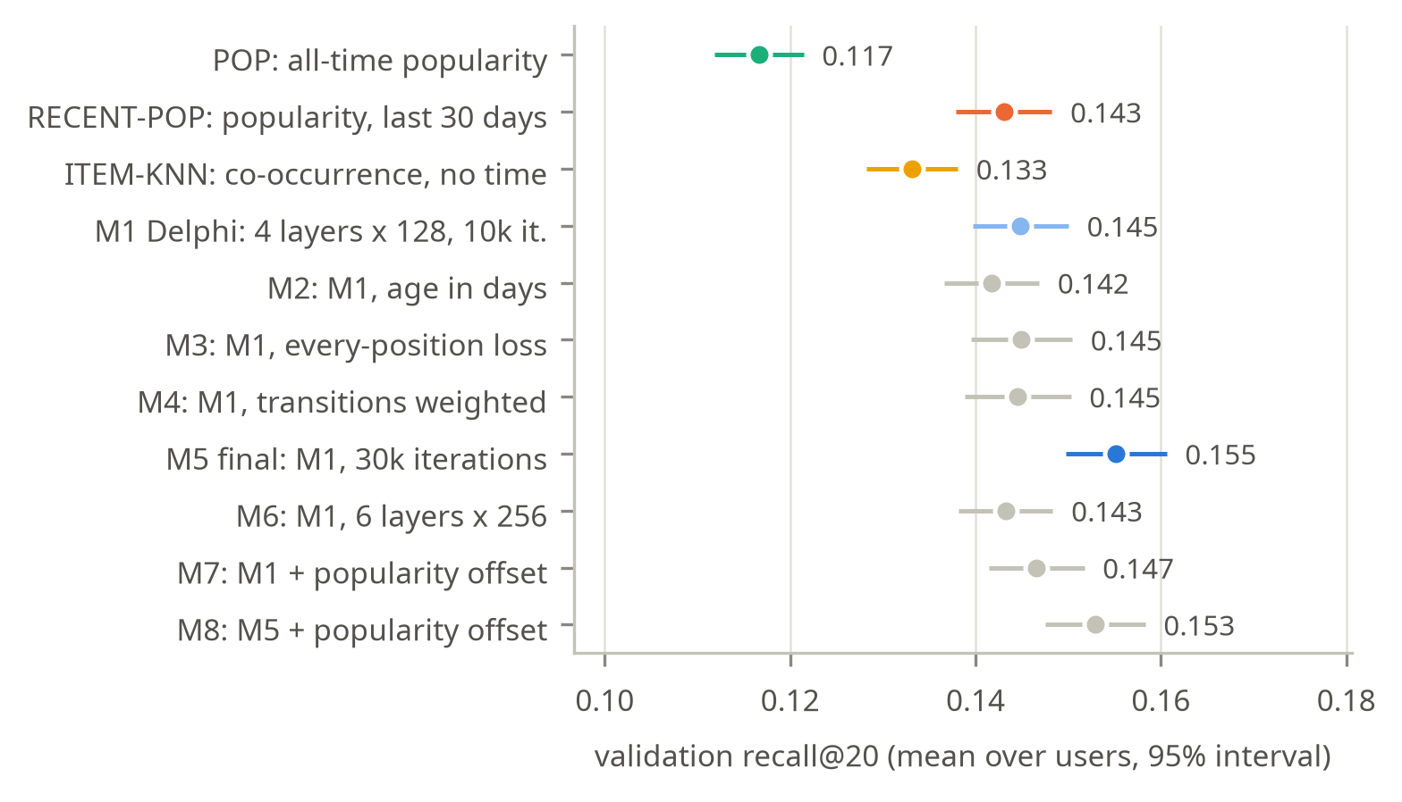
One change at a time, decided on validation
Notes:
[0:55] This is the path from the baselines to the final model, all on validation users, one change per row. M1, a small Delphi with four layers and 128 dimensions, only matches RECENT-POP. Changing the time unit, the objective or the loss weighting did nothing, and a model three and a half times larger did not help either. What helped was training three times longer: that is M5, our final model. The popularity offset, M7 and M8, sped up early training, but its learned weight shrank from 0.49 to 0.31 and it ended below M5, so we dropped it.

Slide 10
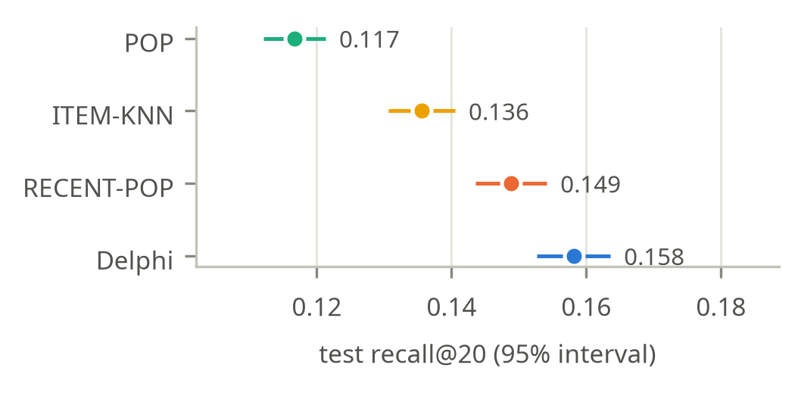
Headline: Delphi beats recent popularity
0.158
Delphi recall@20 on test
0.149
RECENT-POP, the best baseline
Paired difference +0.009 ± 0.005 (95%)
3 seeds: 0.156–0.158, each above RECENT-POP
Notes:
[1:00] On the 7,129 test users, scored once at the end, Delphi reaches recall at 20 of 0.158, against 0.149 for RECENT-POP. The paired difference on the same users is +0.009 plus or minus 0.005, about 6% relative. The three training seeds land between 0.156 and 0.158, and each one beats the baseline on its own. Recall at 10, recall at 50 and NDCG agree. All-time popularity is far behind at 0.117, and the time-blind ITEM-KNN at 0.136.

Slide 11
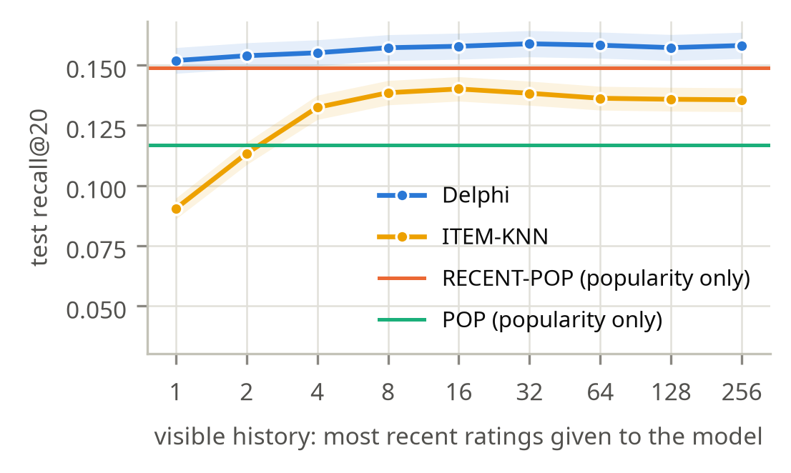
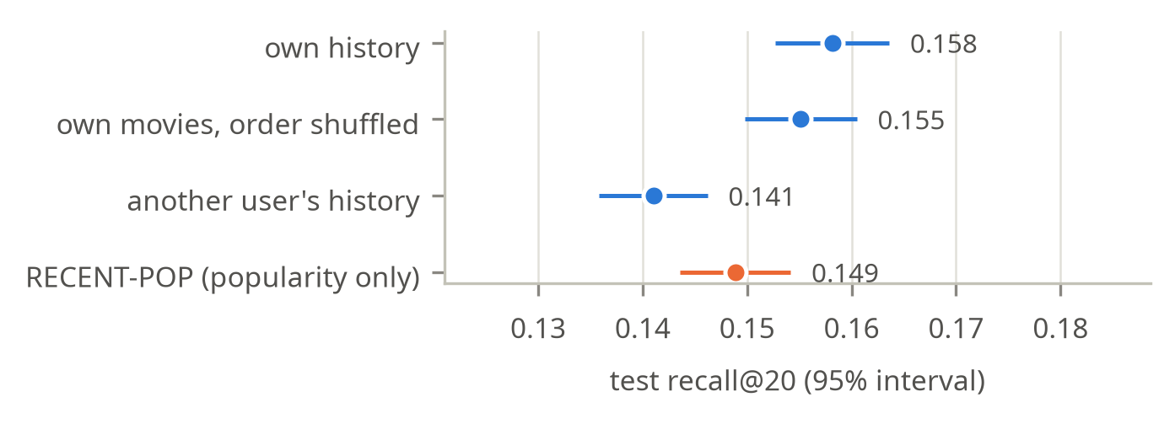
The gain needs the user's own history
Own ratings, order shuffled: -0.003 ± 0.002. The films matter more than their order.
Another user's history: -0.017 ± 0.004, below RECENT-POP. The model personalises to the history it is given.
One rating: 0.152, level with RECENT-POP (0.149). 32 ratings: 0.159, flat after that.
Notes:
[1:00] Where does the gain come from? Left: we give the model only the latest k ratings. With a single rating it already scores 0.152, level with RECENT-POP: from the date and one film it has learned what is popular then. More of the user's history adds the rest, up to 0.159 at 32 ratings, and then it is flat. Right, two controls. Shuffling the order of the user's own ratings costs only 0.003, so which films matter more than their order. Giving the model another user's history, from just before the same date, drops it to 0.141, below the popularity baseline: the model personalises to whatever history it is given.

Slide 12
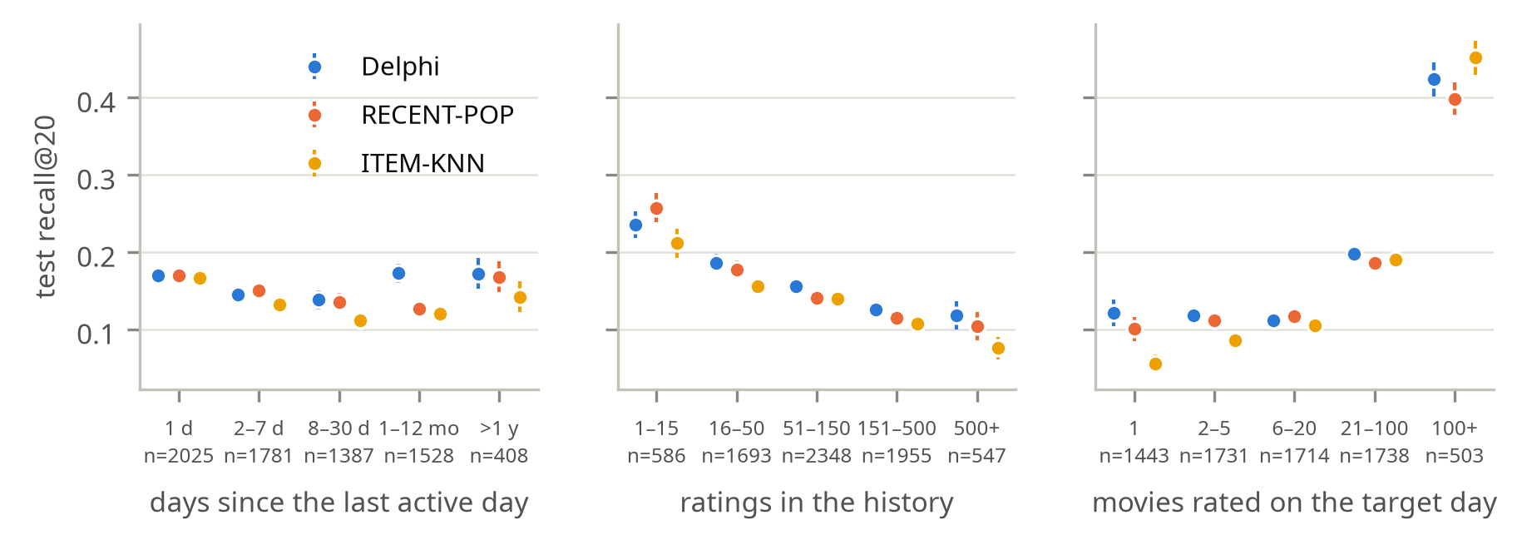
Where it fails
Behind RECENT-POP for histories of 15 ratings or fewer (0.235 vs 0.257) and in 2015–19 (0.123 vs 0.129).
Long tail: 16% of next movies are top-100; neither method finds anything in 42% of cases.
Notes:
[1:10] Where does it fail? Short histories: with fifteen ratings or fewer, RECENT-POP is better; Delphi's lead grows with the history. Gaps: next-day returns are a tie, and the biggest gain is when users come back after one to twelve months. Calendar: in 2015 to 2019, 31% of the test cases, Delphi is slightly behind. And the long tail: only 16% of the movies users rate next are among the 100 most popular, and like every method Delphi almost never finds the rest. In 42% of cases neither Delphi nor RECENT-POP finds a single movie; those are mostly small days of less popular films.

Slide 13
Live demo: held-out users
1
Timeline
Backup plan
Reveal one more active day at a time; recall of Delphi and RECENT-POP for each next day.
notebooks/demo.html is the same notebook, already run. The notebook itself runs offline on a CPU, a few seconds per user.
2
One prediction
History, what the user rated next, and both top-20 lists with hits highlighted.
3
A failure
A next day Delphi misses although popularity finds part of it, and why.
4
Your own movies
Type a few titles and a date; see Delphi's and RECENT-POP's suggestions.
Notes:
[2:40] Now the demo, in the notebook. One: pick a held-out test user and step through their timeline, one day at a time, comparing Delphi with RECENT-POP. Two: open one step and look at what the user rated next, with hits highlighted. Three: a failure, and why. Four: type in a few movies we like and see what Delphi suggests. If the live demo fails, the same notebook is exported as HTML.

Slide 14
Extras: seeds, data size and cost
Repeated seeds
Data size
Cost
3 seeds: recall@20 0.156–0.158 (sd 0.001). Each seed beats RECENT-POP on its own.
M1's budget (10k iterations) on 10% / 30% / 100% of training users: 0.144 / 0.147 / 0.147. More users barely help there; longer training did.
2.1M parameters · about 29 min training (laptop GPU) · 3 ms per user on CPU · 7,230 users/s on GPU.
Notes:
[0:40] Some extras. Three seeds give 0.156 to 0.158, so the gain over the baseline is not seed noise. Data size: with the small ten-thousand-iteration budget, training on 10, 30 and 100 percent of the training users gives 0.144, 0.147 and 0.147: at that budget more users barely help; training longer is what helped. The final model has 2.1 million parameters, trains in about 29 minutes on a laptop GPU and answers one user in about 3 milliseconds on a CPU.

Slide 15
Limitations and next steps
Limitations
Next steps
Rating dates are not viewing dates.
UTC days can split one evening session.
User split: the model saw training users' later ratings. Without films that appeared after the prediction day, the gain stays +0.009.
Only which movie, not when.
Split by time as well as by user.
Evaluate Delphi's waiting-time head.
Generate histories from training users and compare with real ones.
Movie metadata (genres, years) as extra inputs.
Notes:
[0:45] Limitations. Ratings are not viewings, so a good suggestion can count as a miss. A UTC day can cut an evening in two, which makes some next-day targets easy. The split is by user, so the model and the baselines learned from training users' ratings after a test user's prediction day. We checked this: if no method may suggest a film that appeared after the prediction day, Delphi's gain over RECENT-POP stays at +0.009. A time-based split would still be stricter. And we only predict which movies, not when. Next steps: a temporal split, evaluating Delphi's waiting-time head, and generating synthetic histories from training users only.

Slide 16
Summary
Delphi beats recent popularity on held-out users: 0.158 vs 0.149 recall@20 (+0.009 ± 0.005).
The gain is personal: another user's history drops it below the baseline.
Like popularity, it rarely finds less popular films: the long tail is the next problem.
Notes:
[0:30] To sum up: we adapted Delphi to movie-rating histories with a strict whole-day evaluation. Popularity in the last month is a strong baseline; Delphi beats it by a small but repeatable margin on held-out users, the gain depends on the user's own history, and the long tail is still out of reach. Thank you, we are happy to take questions.

