Slide 1
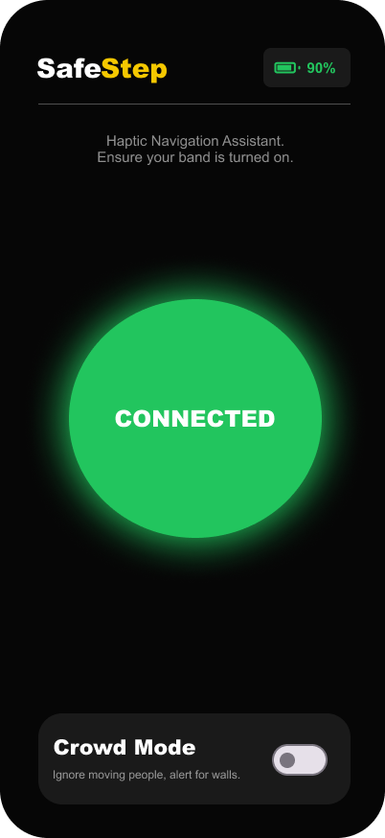
CONCEPT PITCH
Safe Step makes obstacle awareness immediate and multimodal.
A low-fidelity haptic navigation assistant that turns simulated proximity sensing into vibration, voice, and visual guidance.
3
5s
0
feedback channels: haptic, voice, visual
watchdog timeout for lost band signal
dependency vulnerabilities in npm audit
01 Safe Step prototype | local code and design assets

Slide 2
USER PROBLEM
Navigation anxiety is a feedback timing problem.
When a person is moving, a warning that arrives late or through the wrong channel is not just inconvenient. It can break confidence.
Design principle
Delay
Obstacle is detected but not felt quickly enough.
Immediate vibration pattern
Overload
Screen-only feedback competes with the environment.
Eyes-busy voice and haptic cues
Ambiguity
The user knows something is wrong, not where it is.
Directional left, right, center patterns
02 Concept rationale derived from prototype behavior

Slide 3
INTERACTION LOOP
The prototype closes the loop from sensor reading to body feedback.
Sensor
Navigation
Haptic
User response
Distance, direction, object type
Danger and warning-zone decisions
Pattern fired through vibration API
Move, stop, or adjust mode
The same callback updates both the navigation engine and the screen, keeping the demo explainable: one reading becomes one decision and one user-facing cue.
03 Source: backend Sensor, Navigation, Haptic modules and SafeStep.connect callback

Slide 4
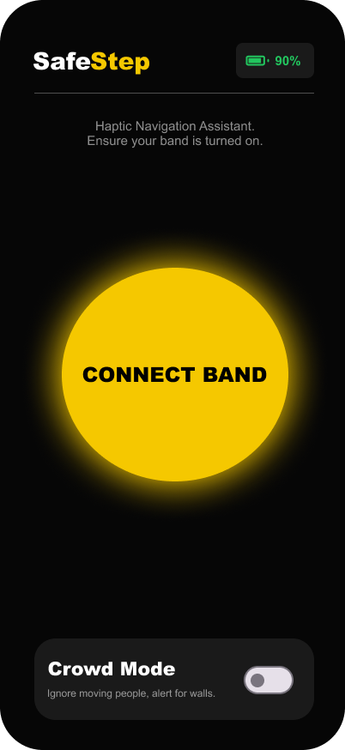
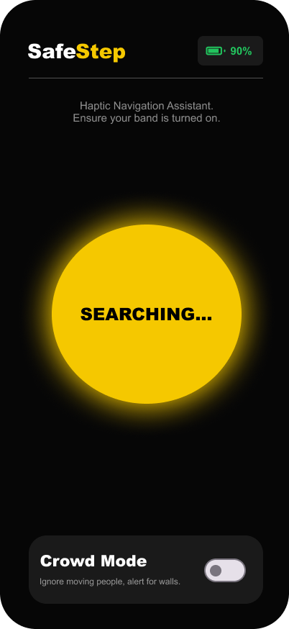
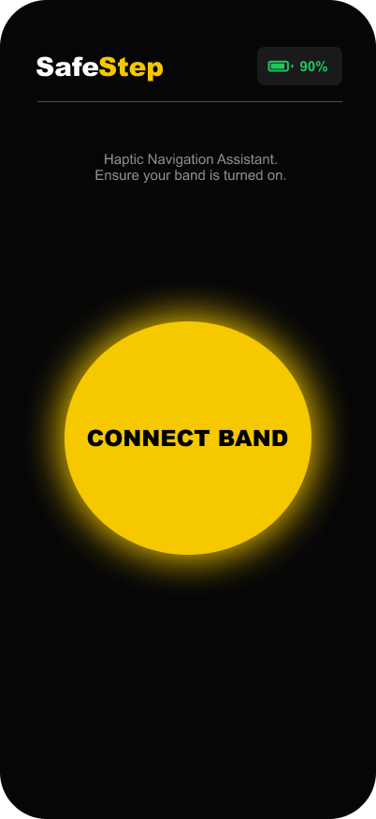
EXPERIENCE
The UI supports the journey without becoming the journey.
Default
Searching
Connected
Crowd mode
Ready state
Connection feedback
Live navigation
Context-aware filtering
04 Source: local design screenshots in /designs

Slide 5
ARCHITECTURE
The code is modular enough to swap simulation for real hardware.
Frontend experience
Backend logic engine
Connect button
callbacks
Sensor simulator
Crowd mode gesture
Navigation rules
Voice guidance
Haptic controller
Battery and status UI
Watchdog and battery
status + sensor updates
05 Source: SafeStep public API plus frontend callback integration

Slide 6
SAFETY CONTROLS
The prototype now handles demo failures before they become confusing.
Risk
Control in code
Why it matters
Bad sensor input
Reject negative, NaN, or unknown direction values
Prevents misleading guidance
Lost heartbeat
5s watchdog fires emergency pattern once
Makes disconnects obvious
Repeated connects
Connection session cancels stale timeouts
Avoids ghost connected states
Battery edge cases
Clamp battery percent to 0-100
Keeps UI and alerts stable
06 Source: validation, watchdog, and connection cleanup changes in backend.ts

Slide 7
ROADMAP
The next milestone is validating the interaction, not overbuilding the hardware.
Now
Next
Pilot
Low-fidelity prototype
Human-in-the-loop test
Hardware bridge
Simulated sensor, haptics, voice, crowd mode
Walkthrough tasks, vibration recognition, failure recovery
Bluetooth band, calibrated sensor, field safety protocol
07 Roadmap based on current code maturity and prototype boundaries

Slide 8
THE ASK
Pitch Safe Step as a focused accessibility interaction, ready for testing.
The concept is not trying to replace a mobility aid. It is testing whether timely multimodal feedback can improve confidence during obstacle navigation.
Why it is credible
Live prototype states already exist.
Code separates UI from navigation logic.
Next action: run a short user test focused on cue recognition, timing, and trust.
Failure states are visible and recoverable.
08 Safe Step prototype | local code and design assets

