Slide 1
Embedded Project:
Remote Distance Measuring Device
Embedded System to control water tap supply automatically
By:-
Sonali Pradhan
Amardeep Kasaudhan
Adarsh Priyaranjan

Slide 2
Project No. 7
Client’s Statement:
We are colour painting company. We need to measure the area of walls to be painted all the time. Measuring tape is not useful as we may not be able to reach the ceiling /rooftop etc. So, we need a distance measuring device that can measure it remotely like standing on floor only we will be able to measure the height of a room.
Project No. 4
Client’s Statement:
Toilets in public places like railway station, airport required automatic control of water resources to reduce wastage of water happens due to negligence of user.
Therefore, develop an embedded system to control the water supply at the tap automatically.

Slide 3
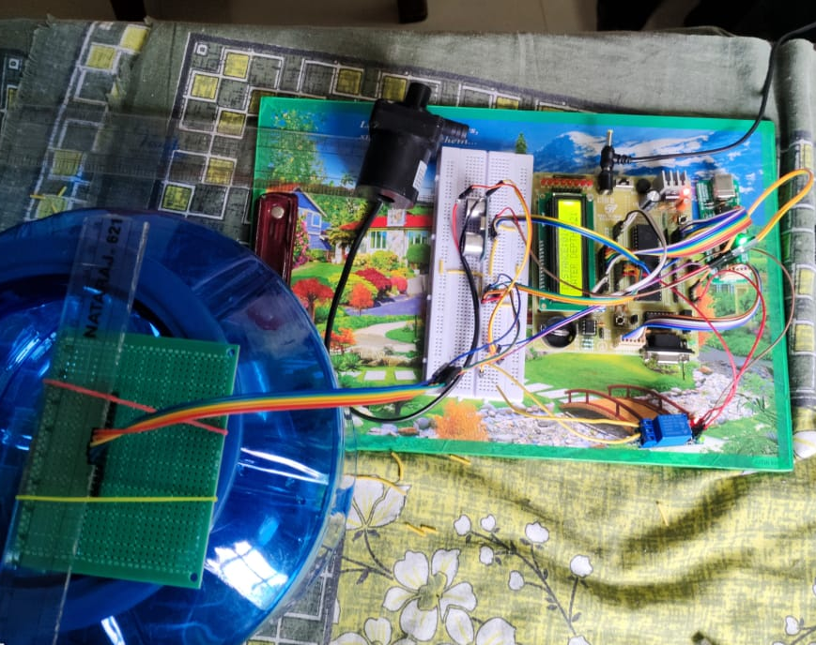
Project 7:

Slide 4

Components For Project 7:
Silicon TechnoLabs ATMEL 8051 Quick Starter Development Board and AVR USB ISP Programmer Kits
HC – SR05
12V DC Adapter
16x2 LCD Display
AT89S52 microcontroller(8051 inbuilt in the dev board)
11.0592 MHz crystal Oscillator(inbuilt in dev board)
2x33pF Capacitor(inbuilt in dev board)

Slide 5
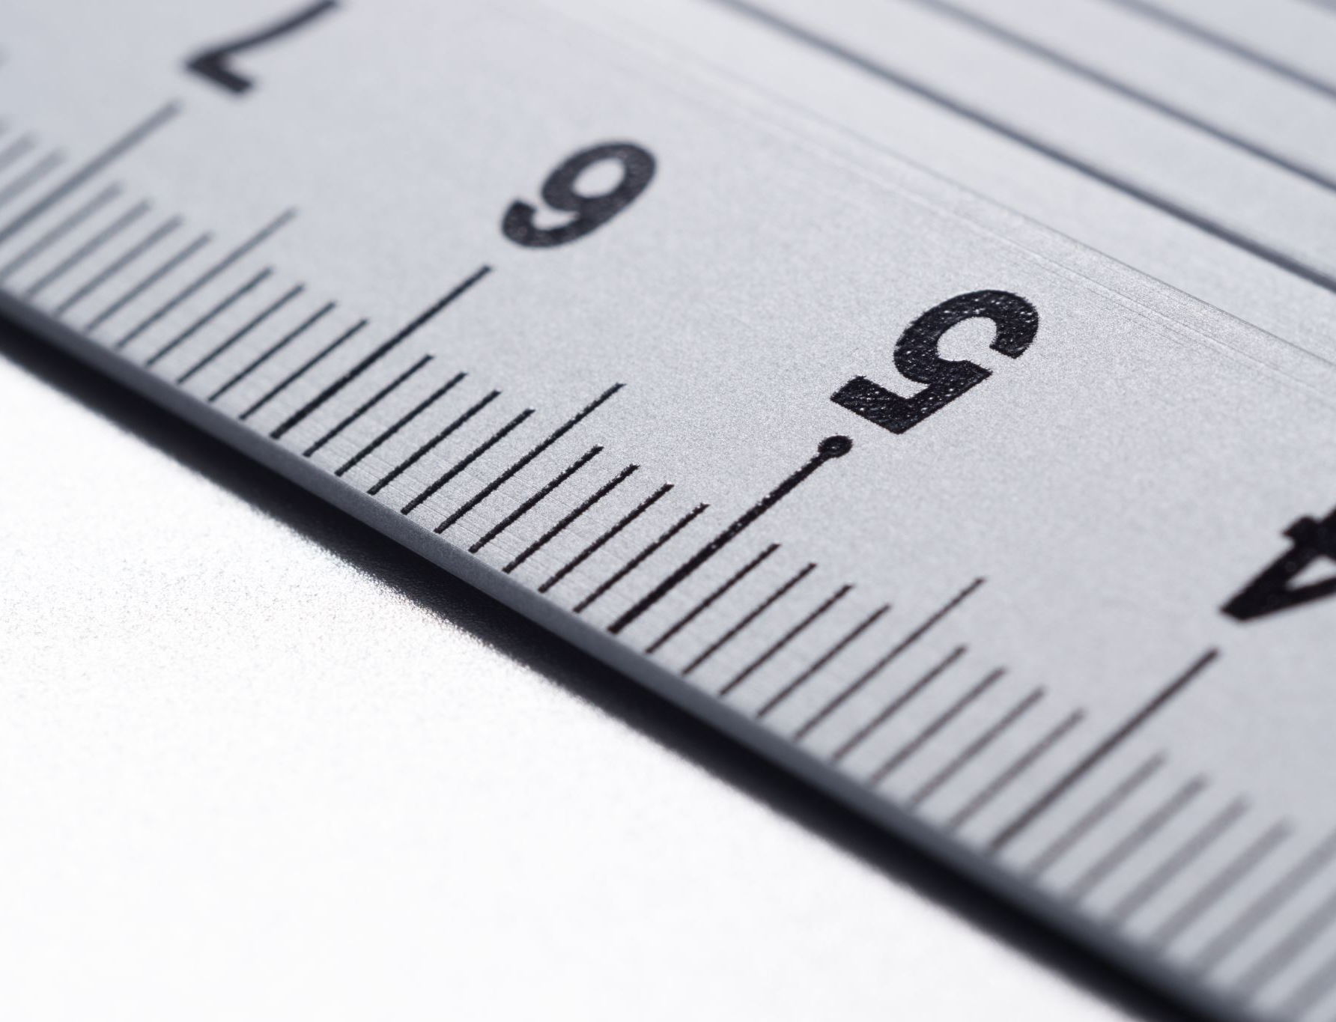
Ultrasonic sensors overcome many of the weaknesses of IR sensors - they provide distance measurement regardless of color and lighting of obstacles. They also provide lower minimum distances and wider angles of detection to gaurantee that obstacles are not missed by a narrow sensor beam.

Slide 6
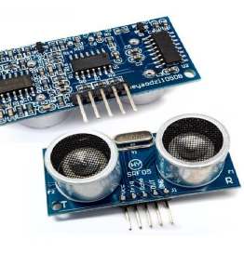
SR05
The SRF05 is an evolutionary step from the SRF04, and has been designed to increase flexibility, increase range, and to reduce costs still further. As such, the SRF05 is fully compatible with the SRF04. Range is increased from 3 meters to 4 meters. A new operating mode (tying the mode pin to ground) allows the SRF05 to use a single pin for both trigger and echo, thereby saving valuable pins on your controller. When the mode pin is left unconnected, the SRF05 operates with separate trigger and echo pins, like the SRF04. The SRF05 includes a small delay before the echo pulse to give slower controllers such as the Basic Stamp and Picaxe time to execute their pulse in commands

Slide 7
Pin
5-Pin, One each for VCC, Trigger, Echo, Out and Ground.
Trig : Pulsing a HIGH on this pin will send a Pulse
Echo : The pulse length is proportional to the distance from the obstacle ( 100usec to 25ms, times out if 30ms)
Highlights
Trigger Pin Format: 10 uS digital pulse
Sound Frequency: 40 kHz
Echo Pin Output: 0-Vcc
Echo Pin Format: output is DIGITAL and directly proportional with range. See our conversion formula above.
Measurement Range: 2cm to ~4.5m
Measurement Resolution: 0.3cm
Measurement Angle: up to 15 deg
Measurement Rate: 40 Hz
Supply Voltage: 4.5V to 5.5V
Supply Current: 10 to 40mA
Connector: standard 5-pin male connector which can plug directly into breadboards. • Static current : less than 2mA
Detection distance: 2cm-450cm

Slide 8
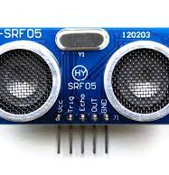
Using I/O trigger for at least 10us high level signal
The module automatically sends eight 40KHz and detect whether there is a pulse signal back •
If the signal back, through high level, time of high output IO duration is the time from sending ultrasonic to returning
Test distance = high level time x velocity of sound (340m/s) / 2
Display Format: 16 Characters x 2 lines

Slide 9
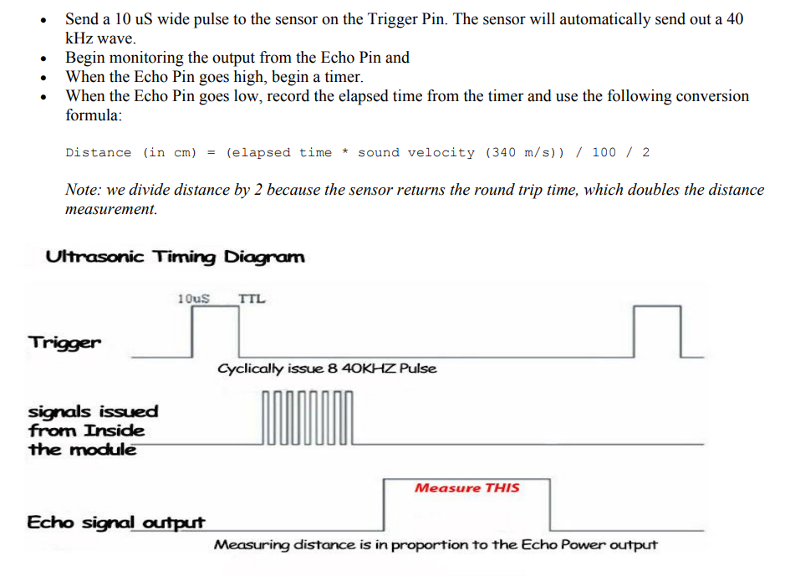

Slide 10
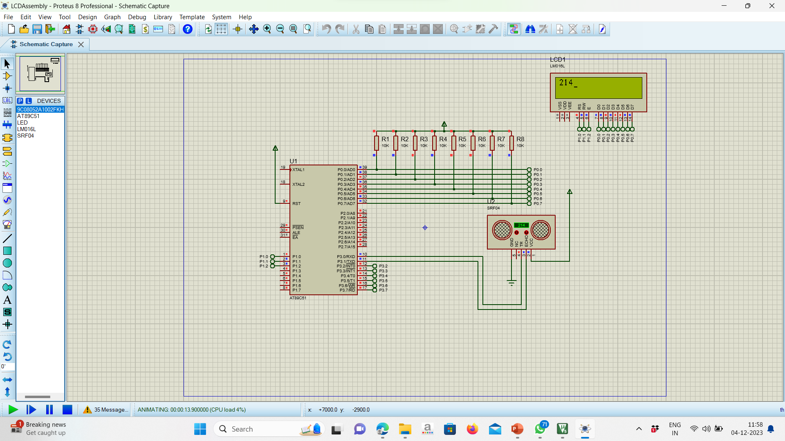
Simulation

Slide 11
ALGORITHM:
TRIGGER FUNCTION:
Set the TMOD register to 11H to use both timer 0 and
Timer 1 as 16bit counter
Initialise the T0 register TH0 to FFH and TL0 to F0H
Initialise the T1 register TH1 and TL1 both to 00H
The idea is that we will use T0 to set a delay of 10uS to
make trigger pin of Ultrasound sensor high for 10us.
We will wait till TF0 overflows and when it does so it marks the end of 10us duration
So at this moment will set trigger pin low
As per data sheet we need to pass a minimum pulse of 10us to convey the sensor to generate a 8 cycle ultrasonic burst of 40kHz
As soon as TF0 overflow
Now wait till echo is high
When Echo pin goes high start timer by issuing TR1=1
Wait till Echo pin goes low while timer1 keeps counting
When ECHO pin goes low stop timer1 by issuing TR1=0
The timer count multiplied by oscillator frequency will give the width of echo signal

Slide 12
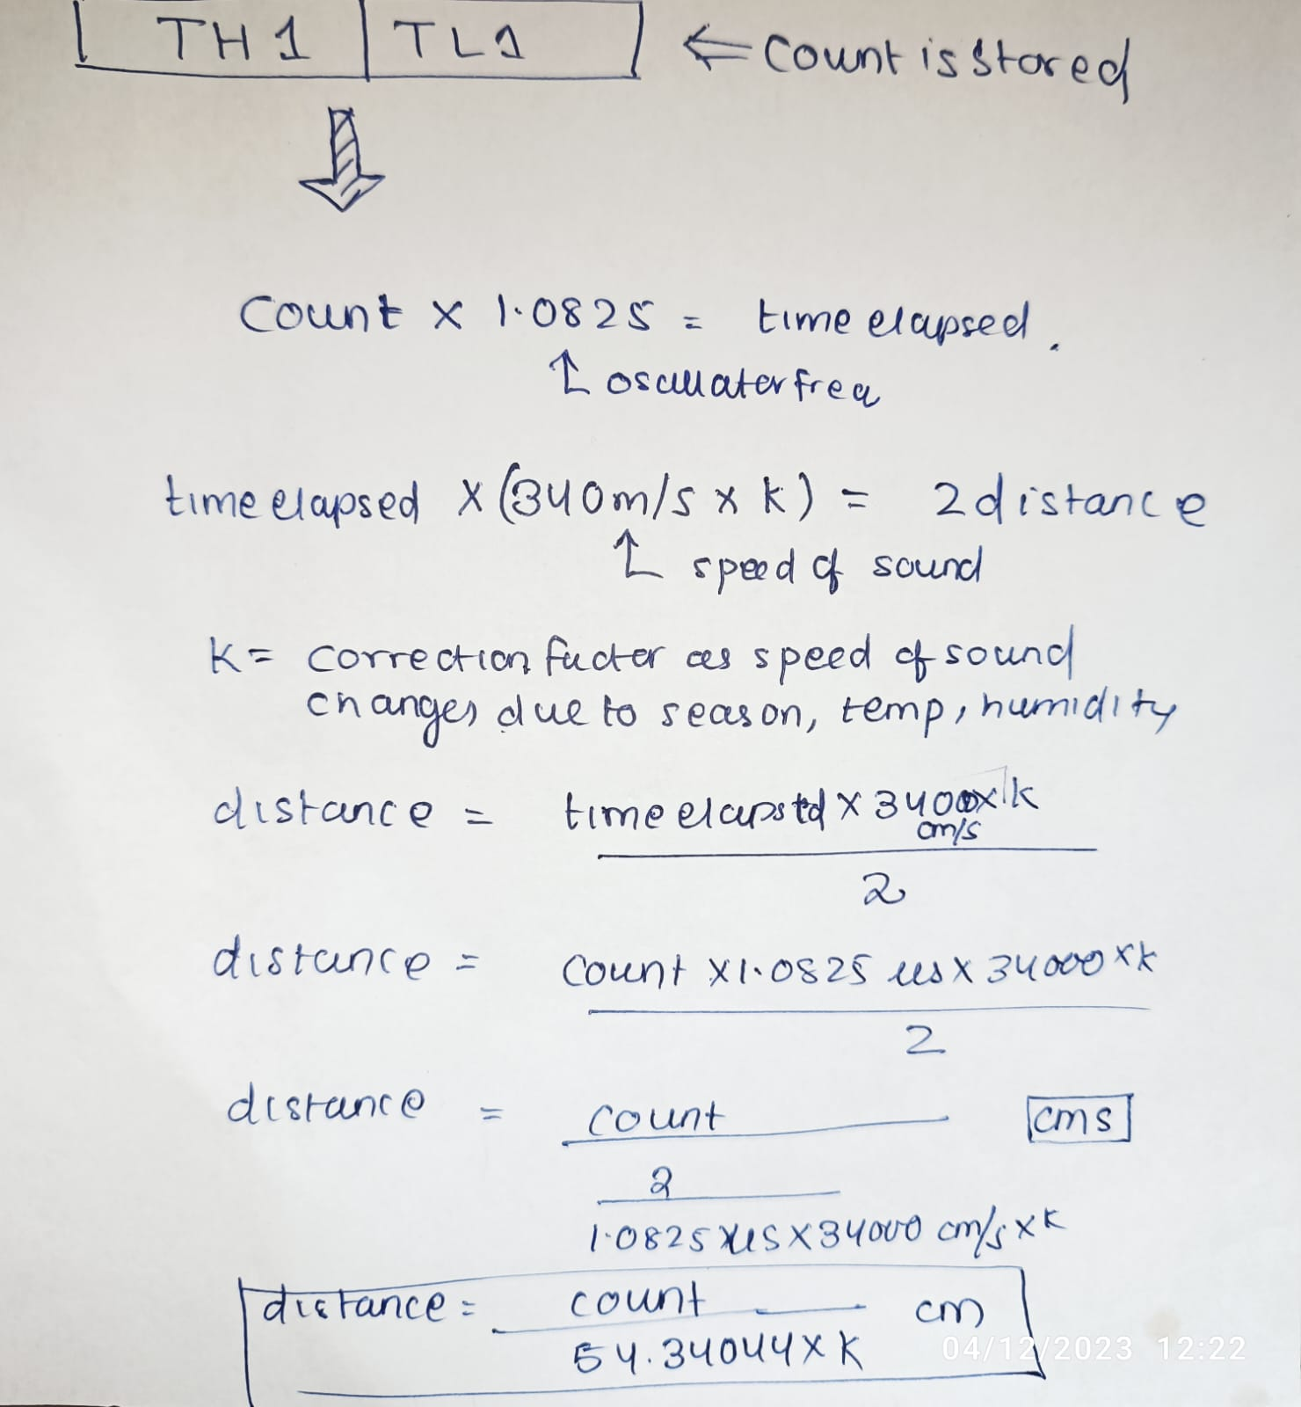
We have put 54k as 58 considering all environment condition (hit and trial)

Slide 13
16 bit division by repeated substraction
Bring TH1 and TH0 that contains the count to register R4 and R3
Now load the number you substract to B register
Now create a loop
In that loop load the R3(lower 8 bits) to accumulator
Set PSW.CY =0
Substract B from Accumulator and increment R5
If borrow is generated i.e CY=1 then decrement R4 and load accumulator contents to R3.
If borrow not generated i.e CY=0 then don’t decrement R4 and load accumulator contents to R3
Do the process 4,5,6,7 till R4 is zero
When R4 becomes 0 then load R3 into accumulator
Set PSW.CY = 0
Substract B from Accumulator and increment R5
Do process 10 till CY is generated.

Slide 14
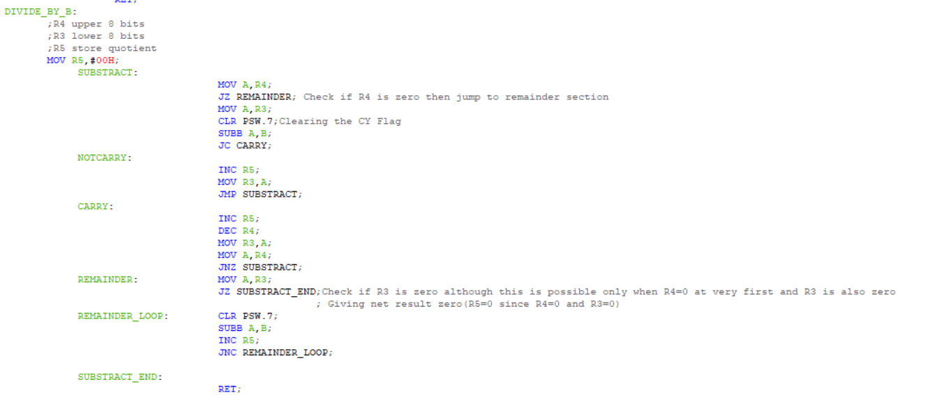
16 bit division by repeated substraction

Slide 15
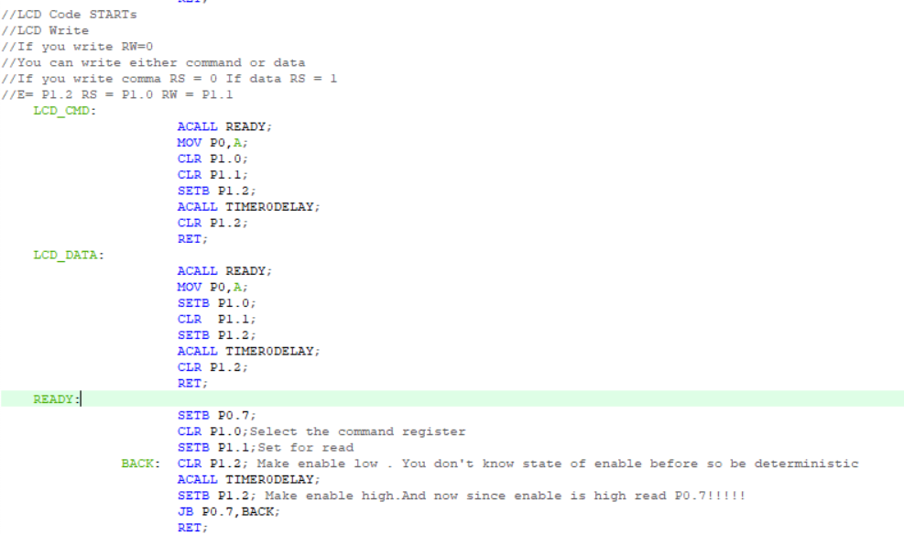

Slide 16
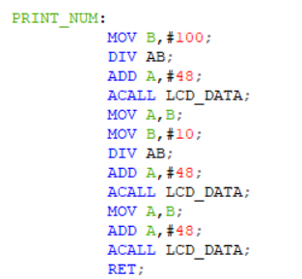

Slide 17
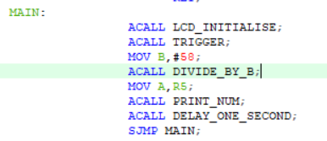

Slide 18
PROJECT 2:-
Toilets in public places like railway station, airport required automatic control of water resources to reduce wastage of water happens due to negligence of user.
Therefore, develop an embedded system to control the water supply at the tap automatically.

Slide 19
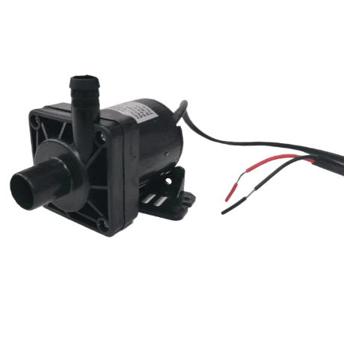
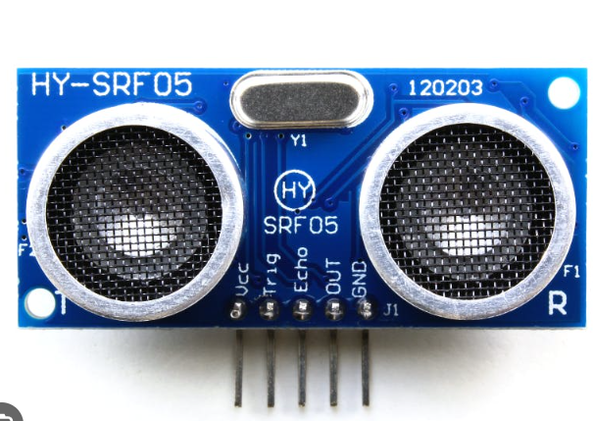
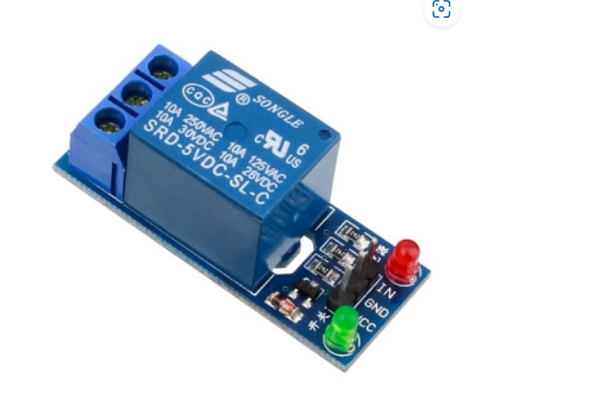
Algorithm:
Measure depth of water using SRF07 (ultrasonic sensor specially meant for water sensing)
If water is more than a particular depth turn on relay else turn off relay.
The relay is connected to water pump

Slide 20
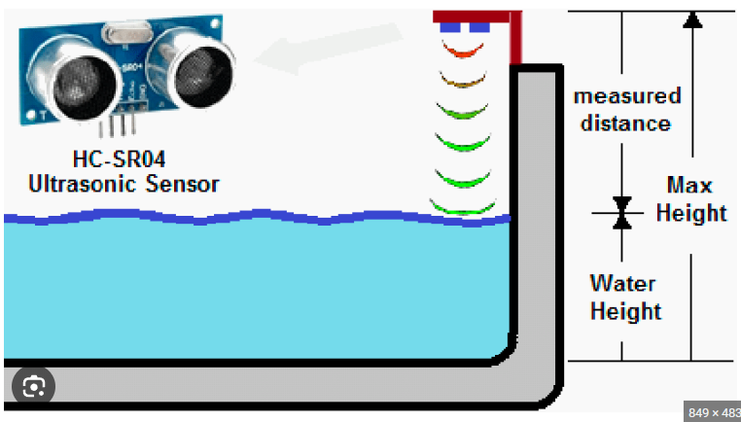

Slide 21
Thanks
Sonali Pradhan
Amardeep Kasaudhan
Adarsh Priyaranjan

