Slide 1
Object-Oriented Programming (OOP)

Slide 2
Course Contents
Object-Orientation
Objects and Classes
Overloading
Inheritance
Polymorphism
Generic Programming
Exception Handling
Introduction to Design Patterns

Slide 3
Object-Orientation (OO)

Slide 4
What is Object-Orientation?
A technique for system modeling
OO model consists of several interacting objects

Slide 5
What is a Model?
A model is an abstraction of something
Purpose is to understand the product before developing it

Slide 6
Examples – Model
Highway maps
Architectural models
Mechanical models

Slide 7



Example – OO Model

Slide 8
…Example – OO Model
lives-in
Ali
House
Objects
Ali
House
Car
Tree
Interactions
Ali lives in the house
Ali drives the car
drives
Car
Tree

Slide 9
Object-Orientation - Advantages
People think in terms of objects
OO models map to reality
Therefore, OO models are
easy to develop
easy to understand

Slide 10
What is an Object?
An object is
Something tangible (Ali, Car)
Something that can be apprehended intellectually (Time, Date)

Slide 11
… What is an Object?
An object has
State (attributes)
Well-defined behaviour (operations)
Unique identity

Slide 12
Example – Ali is a Tangible Object
State (attributes)
Name
Age
behaviour (operations)
Walks
Eats
Identity
His name

Slide 13
Example – Car is a Tangible Object
State (attributes)
- Color
- Model
behaviour (operations)
- Accelerate - Start Car
- Change Gear
Identity
- Its registration number

Slide 14
Encapsulation
Data and behaviour are tightly coupled inside an object
Both the information structure and implementation details of its operations are hidden from the outer world

Slide 15
Example – Encapsulation
Ali stores his personal information and knows how to translate it to the desired language
We don’t know
How the data is stored
How Ali translates this information

Slide 16
Example – Encapsulation
A Phone stores phone numbers in digital format and knows how to convert it into human-readable characters
We don’t know
How the data is stored
How it is converted to human-readable characters

Slide 17
Encapsulation – Advantages
Simplicity and clarity
Low complexity
Better understanding

Slide 18
Object has an Interface
An object encapsulates data and behaviour
So how objects interact with each other?
Each object provides an interface (operations)
Other objects communicate through this interface

Slide 19
Example – Interface of a Car
Steer Wheels
Accelerate
Change Gear
Apply Brakes
Turn Lights On/Off

Slide 20
Example – Interface of a Phone
Input Number
Place Call
Disconnect Call
Add number to address book
Remove number
Update number

Slide 21
Abstraction
Abstraction is a way to cope with complexity.
Principle of abstraction:
“Capture only those details about an object that are relevant to current perspective”

Slide 22
Example – Abstraction
Ali is a PhD student and teaches BS students
Attributes
- Name - Employee ID
- Student Roll No - Designation
- Year of Study - Salary
- CGPA - Age

Slide 23
Example – Abstraction
Ali is a PhD student and teaches BS students
behaviour
- Study - DevelopExam
- GiveExam - TakeExam
- PlaySports - Eat
- DeliverLecture - Walk

Slide 24
Example – Abstraction
Student’s Perspective
Attributes
- Name - Employee ID
- Student Roll No - Designation
- Year of Study - Salary
- CGPA - Age

Slide 25
Example – Abstraction
Student’s Perspective
behaviour
- Study - DevelopExam
- GiveExam - TakeExam
- PlaySports - Eat
- DeliverLecture - Walk

Slide 26
Example – Abstraction
Teacher’s Perspective
Attributes
- Name - Employee ID
- Student Roll No - Designation
- Year of Study - Salary
- CGPA - Age

Slide 27
Example – Abstraction
Teacher’s Perspective
behaviour
- Study - DevelopExam
- GiveExam - TakeExam
- PlaySports - Eat
- DeliverLecture - Walk

Slide 28
Example – Abstraction
A cat can be viewed with different perspectives
Ordinary Perspective
A pet animal with
Four Legs
A Tail
Two Ears
Sharp Teeth
Surgeon’s Perspective
A being with
A Skeleton
Heart
Kidney
Stomach

Slide 29


Example – Abstraction
Engineer’s View
Driver’s View

Slide 30
Abstraction – Advantages
Simplifies the model by hiding irrelevant details
Abstraction provides the freedom to defer implementation decisions by avoiding commitment to details

Slide 31
Object Oriented Programming
Programmer thinks about and defines the attributes and behavior of objects.
Often the objects are modeled after real-world entities.
Very different approach than function-based programming (like C).

Slide 32
Class: Object Types
A C++ class is an object type.
When you create the definition of a class you are defining the attributes and behavior of a new type.
Attributes are data members.
Behavior is defined by methods.

Slide 33
Creating an object
Defining a class does not result in creation of an object.
Declaring a variable of a class type creates an object. You can have many variables of the same type (class).
Instantiation

Slide 34
Information Hiding
The interface to a class is the list of public data members and methods.
The interface defines the behavior of the class to the outside world (to other classes and functions that may access variables of your class type).
The implementation of your class doesn't matter outside the class – only the interface.

Slide 35
Information Hiding (cont.)
You can change the implementation and nobody cares! (as long as the interface is the same).
You can use other peoples classes without fear!
Wars will end, poverty and illness will be vanquished from earth!

Slide 36
Classes
In an OO model, some of the objects exhibit identical characteristics (information structure and behaviour)
We say that they belong to the same class

Slide 37
Graphical Representation of Classes
(Class Name)
(Class Name)
(attributes)
(operations)
Suppressed Form
Normal Form

Slide 38
Example – Graphical Representation of Classes
Circle
center
radius
Circle
draw
computeArea
Suppressed Form
Normal Form

Slide 39
Example – Graphical Representation of Classes
Person
name
age
gender
Person
Suppressed Form
eat
walk
Normal Form

Slide 40
Structures in C / C++
Structure in C :
Supports only data abstraction
Only function pointer can be data member
Structure in C++
Supports data abstraction and procedure abstraction
Therefore functions can also be members of structure

Slide 41
Structures in C / C++
Structure in ‘C’ Structure in ‘C++’
struct directory struct directory
{ {
char Name[30]; char Name[30];
long PhoneNo; long PhoneNo;
void Display(void)
{
cout<<PhoneNo;
}
}; };

Slide 42
Class
struct keyword can be replaced by class keyword
Generally ‘struct’ is used in ‘C’ context while ‘class’ is used in C++ context
C++ supports ‘struct’ keyword for compatibility
Class and object is C++ terminology

Slide 43
Class
A class is a template for the creation of like objects
An object is an instance of a class
Map real world entities into classes through data members & member functions.
By writing class & creating objects of that class one can map two major pillars of object model ie abstraction & encapsulation into software domain.
All members of a class data / methods are private by default.

Slide 44
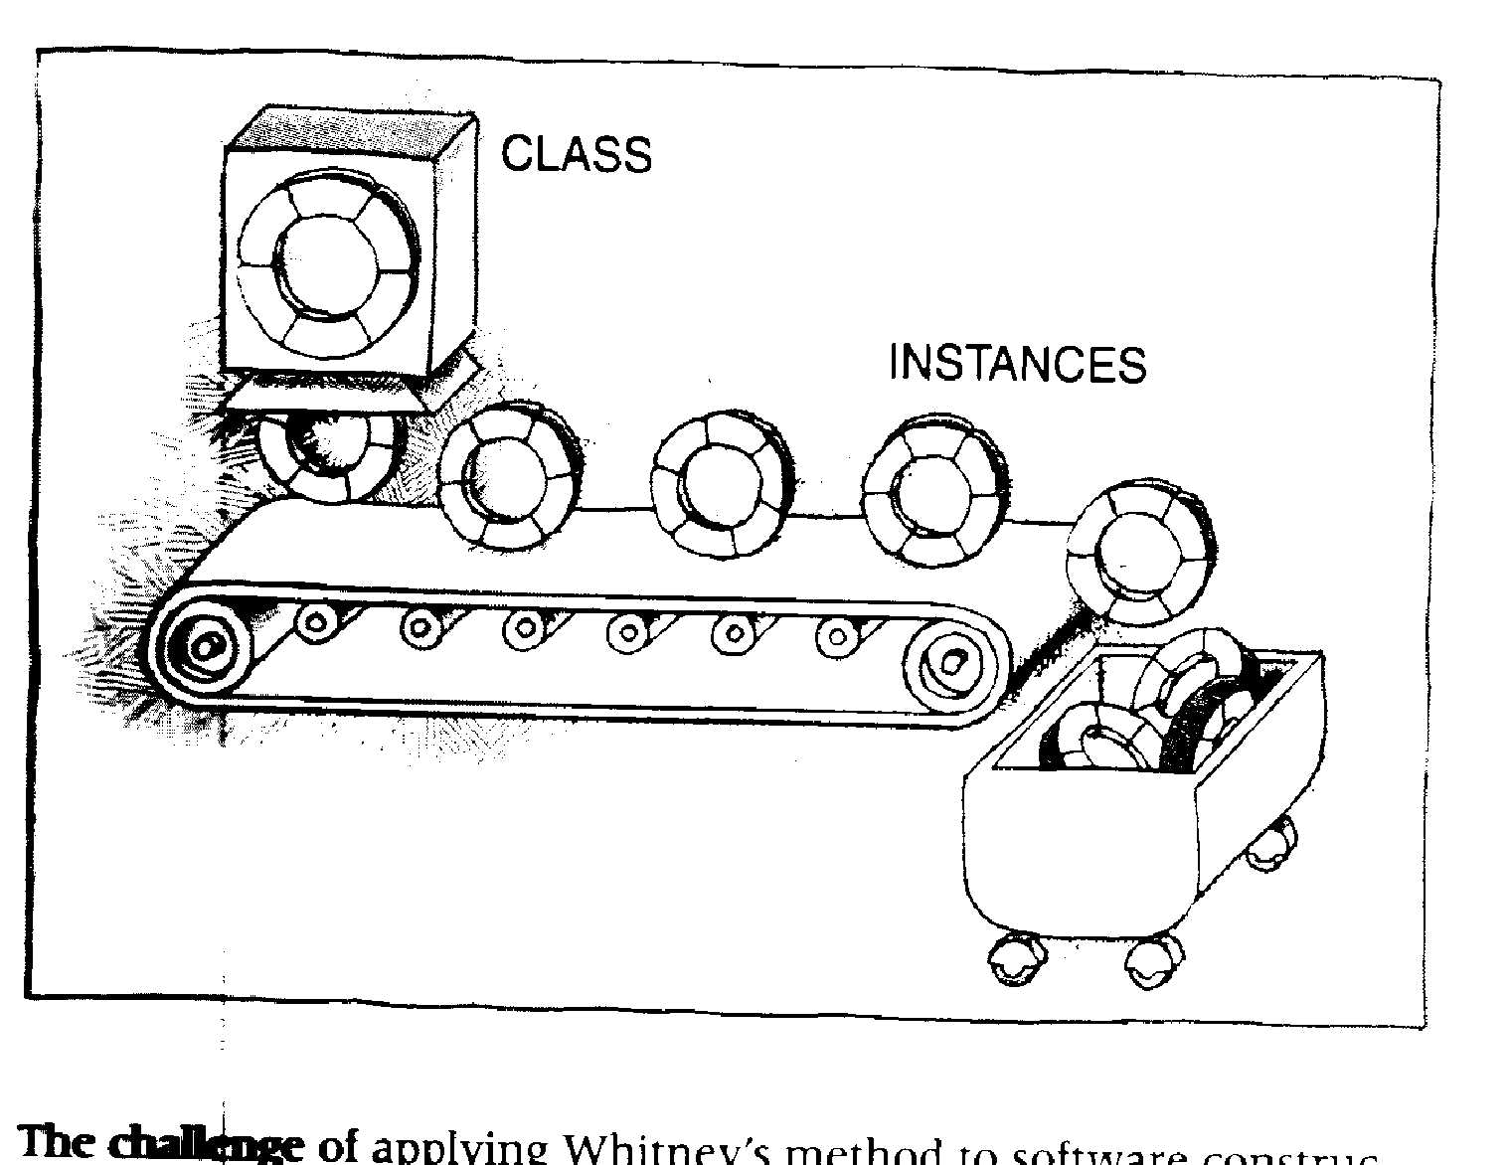
The challenge of applying Whitner’s method to software
constructs.

Slide 45
Class Syntax
class class name
{
private :
variable declaration ;
function declaration ;
public :
variable declaration ;
function declaration ;
};
If semicolon is missing compiler throws an error

Slide 46
Class Complex : declare class Complex
class Complex class is a keyword
{
private: access specifier
int m_real; data member
int m_imag; data member
public: access specifier
void Display (void); member function
….
}; note semicolon

Slide 47
Object instance of a class
void main (void) //client code
{
Complex c1; // c1 is an object of class Complex
}
Steps in creation of object
Memory is allocated
Constructor is called
Memory gets initialized

Slide 48
Class Complex : default constructor
class Complex
{
……
public:
Complex( ) default constructor
{ written as a inline function
m_real = 0 ;
m_imag = 0 ;
}
};

Slide 49
Class : Constructor
Constructor is a special function with same name as it’s class name
No need to specify return type for constructor. Not even void
Constructors are implicitly called when objects are created
A constructor without input parameter is default constructor
Constructor can be overloaded

Slide 50
Class Complex : parameterized constructor
class Complex void main (void)
{ {
…… Complex c2(10,20);
public: }
Complex(int r , int i )
{
m_real = r ;
m_imag = i ;
}
};

Slide 51
Class Complex : Few member functions
Class Complex
{
…
public:
void Display (void); //member function declaration
int GetReal(void); //accessor member function
void SetReal(int); // mutator member function
}

Slide 52
Class Complex : Few member functions
void Complex :: Display (void) void main (void)
{ {
char ch; :
ch = (m_imag < 0) ? ’-’ : ‘+’ ; c1.Display( );
cout<< m_real << ch c2.Display( );
<< abs( m_imag ) << “ i “ ; }
}
Notes:
‹#›
‹#›
State concept of this pointer.
State concept of scope resolution operator

Slide 53
‘this’ pointer
Every class member function has hidden parameter : the this pointer.
this is a keyword in C++
this points to an individual object.
this pointer always holds address of an object which is invoking the member function.

Slide 54
Class Complex : Few member functions
int Complex :: GetReal (void) void main (void)
{ {
Complex c1,c2(2,4);
return(m_real); int x = c1.GetReal( );
} int y = c2.GetReal( );
or }
int Complex :: GetReal(void)
{
return(this -> m_real);
}

Slide 55
Class Complex
Memory Allocation to objects
C1
C2
C3
m-real
m-imag
m-real
m-imag
m-real
m-imag
Member
functions

Slide 56
Class Complex
Create object on heap
void main(void)
{
Complex *p = new Complex (5,7);
……..
delete p ;
}
P
Complex
Object
stack
heap

Slide 57
Class Complex : const objects
To create constant object use const keyword
const Complex C1(2,3); // statement in main
const objects invoke const member function only
Characteristic of const functions is it is ‘Read Only’ fn.
Notes:
‹#›
‹#›
Create constant object
const Complex C1(2,3); // statement in main
Identify need of const functions
Show declaration of const functions
const objects invoke const member function only
Explain can non const objects access const member functions

Slide 58
Class Complex : const objects
int complex :: GetReal() const void main(void)
{ {
return (this -> real); const complex c5(5,7);
} int x = c5.GetReal();
}
Notes:
‹#›
‹#›

Slide 59
Conventional way of writing C++ Program
File : Complex.h
File : Complex.cpp
#ifndef COMPLEX_h
#define COMPLEX_h
# include<iostream.h>
Class Complex
{
…
};
#endif
#include” Complex.h”
void Complex :: Display()
{
…
}
{
…
}
Server Code
File : TestComplex.cpp
Compiler
#include “Complex.h”
int main(void)
{
Complex c1;
…
return 0;
}
Complex.obj
Client Code
TestComplex.obj
Compiler
Notes:
‹#›
‹#›
.h files are never separately compiled.
# include is an instruction to preprocessor. Preprocessor physically includes
‘the’ file in .cpp. Compiler compiles this file to create .obj
These separately compiled files are then linked by a linker. Linker resolves various function calls. Advantage of writing a code in these separate files is modular approach. The only file in which changes are made can be compiled independently.
Explain how conditional macros get executed.
Conditional macros are essential to avoid redefinition errors at compile time.

Slide 60
Declaration of Class String
class String
{
private: access specifier
int m_len; data member
char* m_pbuff; pointer as data member
public: access specifier
void Display (void); member function
….
};
Notes:
‹#›
‹#›

Slide 61
Class String : Default Constructor
class String void main(void)
{ {
…… String S1;
public: }
String( ) default constructor
{ written as a inline function
m_len = 0 ; constructors can also be
m_pbuff = new char; written in .cpp file using
*m_pbuff = ‘\0’; scope resolution operator
}
};
Notes:
‹#›
‹#›

Slide 62
Class String : Constructor Overloading
class String void main (void)
{ {
…… String s2(‘S’,10);
public: }
String (char ch , int len )
{
m_len = len ;
m_pbuff = new char [m_len + 1]; // +1 for ‘\0’ char
// for loop or
memset(m_pbuff,ch,m_len); //include memory.h
m_pbuff[m_len] = ‘\0’; //append ‘\0’
}
};
Notes:
‹#›
‹#›

Slide 63
Class String : Constructor Overloading
class String void main (void)
{ {
…… String s3(“SEED”);
public: }
String (const char *p )
{
m_len = strlen(p);
m_pbuff = new char [m_len + 1]; // +1 for ‘\0’ char
strcpy ( m_pbuff,p) //include string.h
}
};
Notes:
‹#›
‹#›

Slide 64
Class : Destructor
Destructor is also a special function with the same name as class name prefixed by ~ character.Eg ~Complex( ) ; or ~String( );
No need to specify return type or parameters to destructor function.
Destructor cannot be overloaded. Therefore a class can have only one destructor.
Destructor is implicitly called whenever an object ceases to exist.
Notes:
‹#›
‹#›

Slide 65
Class : Destructor
Destructor function de-initializes the objects when they are destroyed.
A destructor is automatically invoked when object goes out of scope or
when the memory allocated to object is de-allocated using the delete operator.
If a class contains pointer variable then it is mandatory on programmers part to write a destructor otherwise there is problem of memory leakage.
Notes:
‹#›
‹#›

Slide 66
Class : Destructor
Class String
{
…...
public:
~String( )
{
if(m_pbuff)
delete [ ] m_pbuff;
}
};
Notes:
‹#›
‹#›

Slide 67
Object Creation/Destruction
Sequence for object creation
1) Memory is allocated
2) Constructor is called
3) Memory is initialized
Sequence for object destruction
1) Destructor is called
2) If memory is allocated dynamically it is freed
3) Memory allocated to object is de-allocated only when object goes out of scope.
Notes:
‹#›
‹#›

Slide 68
Scope of an Object
Class Test
{ … …
public:
Test( )
{ cout<<“Constructor is invoked”<<endl; }
~Test( )
{ cout << “Destructor is invoked<<endl; “ }
};
Ask students to write the output
Notes:
‹#›
‹#›

Slide 69
Scope of an Object
Test t1;
void main (void)
{ cout<<“main begins”;
Test t2;
{
cout<<“Block begins”<<endl;
Test t3;
cout<<“Block Ends”<<endl;
}
cout<<“main ends”<<endl;
}
Ask students to write the output
Notes:
‹#›
‹#›
Answer is:
Constructor is invoked.
main begins.
Constructor is invoked.
Block begins.
Constructor is invoked.
Block Ends.
Destructor is invoked.
main ends.
Destructor is invoked.
Destructor is invoked.

Slide 70
Class String : Copy Constructor
String s4(s3); // To create s4 as a copy of s3
The implicit Copy Constructor does a member wise copy of the elements:
s3
s4
Gets copied
4
1001
4
1001
Gets copied
1001
S E E D \0
If one object goes out of scope this situation leads to the problem of dangling pointer.
Notes:
‹#›
‹#›

Slide 71
Class String : Copy Constructor
To avoid problem of dangling pointer it is mandatory to have a copy constructor in a class which contains a pointer variable
s3
s4
Gets copied
4
1001
4
3003
1001
3003
S E E D \0
S E E D \0
Copy constructor creates a new space in the heap for the string to be copied.
Notes:
‹#›
‹#›

Slide 72
Class String : Copy Constructor
class String void main (void)
{ {
…… String s4(s3);
public: }
String (const String &s ) //pass by reference
{
m_len = s.m_len;
m_pbuff = new char [m_len + 1];
strcpy ( m_pbuff,s.m_pbuff)
}
};
Notes:
‹#›
‹#›

Slide 73
Class String : Copy Constructor
While creating copy of an object you should know
Compiler provides a default copy constructor which does member wise copy.
If a class contains one of it’s data member as a pointer type variable, it’s mandatory on programmer’s part to write user defined copy constructor.
User defined copy constructor should take care of dangling pointer situation.
To avoid infinite recursion, pass the parameters by reference to the copy constructor.
Notes:
‹#›
‹#›

Slide 74
Static Data Members
Data to be shared by all objects is stored in static data members.
It’s a class variable
Only single copy exists
Scope and lifetime of static variable
Notes:
‹#›
‹#›

Slide 75
Static Member Functions
Static member functions can access static data members only.
Static member function is invoked using class name
class name : : function name()
Pointer this is never passed to a static member function
Notes:
‹#›
‹#›

Slide 76
Static Objects in Memory
C1
C2
C3
m-real
m-imag
m-real
m-imag
m-real
m-imag
count
Notes:
‹#›
‹#›

Slide 77
Static members
Only one copy of the variable exists(even when inherited)
It is a way of defining a global variable bound to a class
Can be accessed with or without object reference.
The members are initialized to default values
Static functions can access only static members
Are used for initialization of static members
Notes:
‹#›

Slide 78
Static members
class myclass { static int var; public: void display() { cout<<var; } void accept() { cin>>myclass::var; } }; int myclass ::var;
int myclass::var1;
void main() { myclass::var=200; myclass::var1=100; myclass obj1,obj2; cout<<obj1.var1<<obj2.var;
}
Notes:
‹#›

Slide 79
STATIC FUNCTIONS
USED TO SET VALUES OF STATIC MEMBERS ONLY
CANNOT ACCESS NON-STATIC MEMBERS BECAUSE THEY REQUIRE OBJECT REFERENCE
CAN BE CALLED DIRECTLY WITHOUT OBJECT REFERENCE
THERE IS ONLY ONE COPY OF THE FUNCTION
Notes:
‹#›

Slide 80
STATIC member function:
static return_type fun_name( )
{
----------------
}
calling static member function:
class name :: fun_name( ) ;
Notes:
‹#›

Slide 81
Static Members(Exercise)
class myclass { int var; static int statvar; public: static void setfunc() { statvar=100; var=20; //error } void set() { statvar=200; var=30; } };
Notes:
‹#›

Slide 82
Constant and mutable specifiers
Constant members class myclass { int x; public: void func(int m) { x=m; } };
void main() { myclass obj1,obj3; const myclass obj2=obj1; obj2=obj3; obj2.func(); }
Notes:
‹#›

Slide 83
Constant specifiers
class myclass { int x; int y; public: void func(int m)const { x=m; } }; void main() { myclass obj; obj.func(10); }
Notes:
‹#›

Slide 84
Constant specifier
class myclass { int x; mutable int y; public: void func(int m)const { y=m; } }; void main() { myclass obj; obj.func(10); }
Notes:
‹#›

Slide 85
Constant specifiers
Constant functions cannot change the data members
Constant functions can be invoked by both constant and non constant objects
To allow some of the variables to be changed mutable specifier is used
Constant objects cannot invoke non-constant member functions
Notes:
‹#›

Slide 86
Friends of Classes
A friend function of a class is a function that is not a member of a class, but has access to the private members of the class.
A friend function is declared with the keyword friend.
friend <return type><function name>(<parameter type list>);
Using friend functions is a way of breaking the rule of encapsulation. As such, friend functions should only be used when absolutely necessary.
A Friend function can be friend of many classes
A fiend function has no object reference and do not have the this pointer
Notes:
‹#›

Slide 87
Friend functions(examples)
class myclass { public: friend void func(); }; void func() {….} void main() { func(); }
Notes:
‹#›

Slide 88
Friend functions(exercise)
class myclass { int x; public: myclass(){ x=10; } friend void myfunc(); }; void myfunc() { cout<<x; } void main() { func(); }
Notes:
‹#›

Slide 89
Friend functions
class myclass { int x; public: myclass(){ x=10; } friend void myfunc(); }; class myclass1 { friend void func(); };
void myfunc() { ….. }
Notes:
‹#›

Slide 90
Friend functions
class myclass { int x; myclass(){ x=10; } public: void display() { cout<<x; } friend void myfunc(); };
void func() { myclass obj; obj.display(); }
Notes:
‹#›

Slide 91
Friend functions
class myclass { int x; public: myclass(){ x=10; } private: friend void myfunc(); };
void main() { func(); myclass obj; obj.func(); }
void func() { …. }
Notes:
‹#›

Slide 92
Friend functions
class myclass { int x; public: myclass(){ x=10; } void myfunc(){ ……..} }; class myclass1 { friend void myclass::func(); };
Notes:
‹#›

Slide 93
Friend classes
As mentioned before, it is possible to make an entire class a friend of another class.
When a class is declared as a friend of another class every member function of the friend class is a friend function to the other class.
Notes:
‹#›

Slide 94
Friend classes
class myclass1 { private: int var1; public: void func1() { myclass2 ob; cout<<ob.var2; } friend class myclass2; };
class myclass2 { private: int var2; public: void func2() { myclass1 obj; cout<<obj.var1; } friend class myclass1; };
Notes:
‹#›

Slide 95
Friend classes
class myclass1 { private: int var1; public: friend class myclass2; };
class myclass2 { private: int var2; public: void func2() { cout<<var1; } friend class myclass1; };
Notes:
‹#›

