Slide 1

K.E. Society's Rajarambapu Institute of Technology (Polytechnic) Lohegaon, Pune - 47
Department of Artificial Intelligence and Machine Learning | Course Code: 316004
MANDIMITRA
Maharashtra Agricultural Market Intelligence & Veterinary Services Platform
SUBMITTED BY
UNDER THE GUIDANCE OF
Avishkar Borate (Roll No. 01)
Prof. Mayur Gund
Amol Salunke (Roll No. 02)
HOD: Prof. Vikram Saste
Pruthviraj Hippirkar (Roll No. 03)
Principal: Dr. Kashinath Munde
Krushna Mane (Roll No. 04)
Academic Year: 2025-2026
National Thrust: Digitization | Agriculture | Rural Development
Capstone Project Report | Diploma in AI & ML | MSBTE
Notes:
Good morning respected jury members, guide, and fellow students. We are students from the AIML department presenting our capstone project MANDIMITRA. MANDIMITRA means 'Market Friend' in Marathi. It is a comprehensive agricultural market intelligence and veterinary services platform built specifically for Maharashtra. This project falls under the national thrust areas of Digitization, Agriculture modernization, and Rural Development. Let me introduce our team...

Slide 2
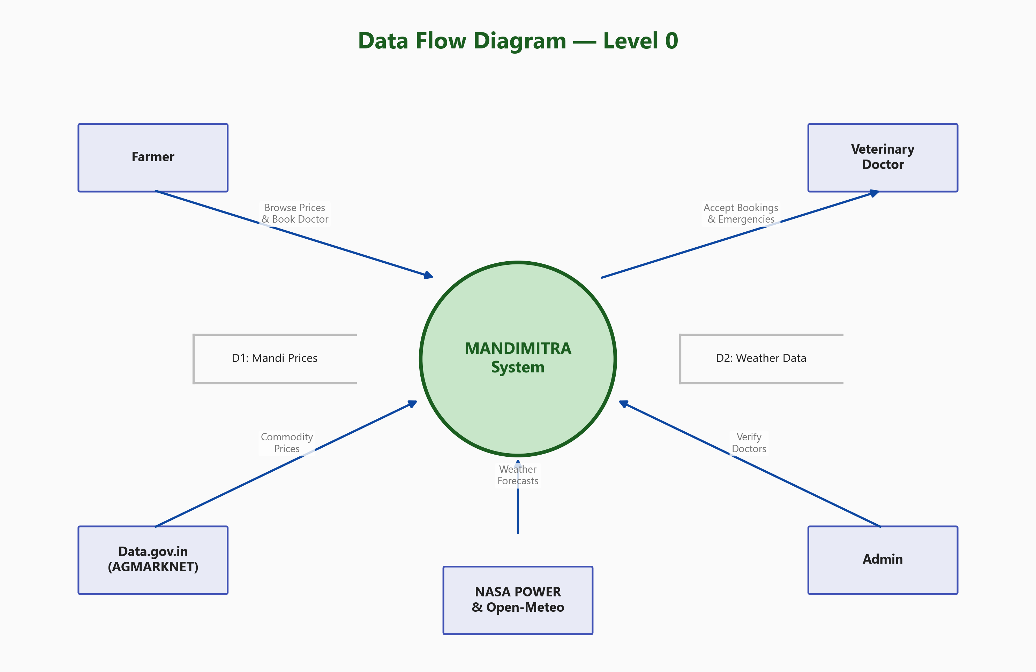
Introduction
Maharashtra Agriculture - Key Challenges
System Context (DFD Level 0)
1.5 Crore+
15-25%
Maharashtra Farmers
Revenue Loss Due to Price Info Asymmetry
400+
1 : 50,000
APMC Mandis in Maharashtra
Vet Doctor to Livestock Ratio
Two Critical Gaps Identified:
● No Maharashtra-specific ML-based price intelligence platform
● No integrated veterinary service with booking & emergency SOS
● Existing platforms (e-NAM, MSAMB) lack prediction & advisory
● Rural vets are scarce; no verification or discovery system
Fig: Data Flow Diagram - External Entities & Data Stores
K.E. Society's Rajarambapu Institute of Technology (Polytechnic), Lohegaon, Pune - 47
2/13
Notes:
Maharashtra has over 1.5 crore farmers across 36 districts. Despite having 400+ APMC mandis, farmers lose 15-25% revenue annually due to price information asymmetry - they don't know the best time or market to sell. Additionally, rural Maharashtra has a critical shortage of veterinary doctors - roughly 1 per 50,000 livestock. No existing platform combines agricultural market intelligence WITH veterinary services. E-NAM is pan-India with no ML. MSAMB is static data only. This is the gap MANDIMITRA fills. As the DFD shows, our system interacts with farmers, doctors, admins, and external data sources like Data.gov.in and NASA POWER.

Slide 3
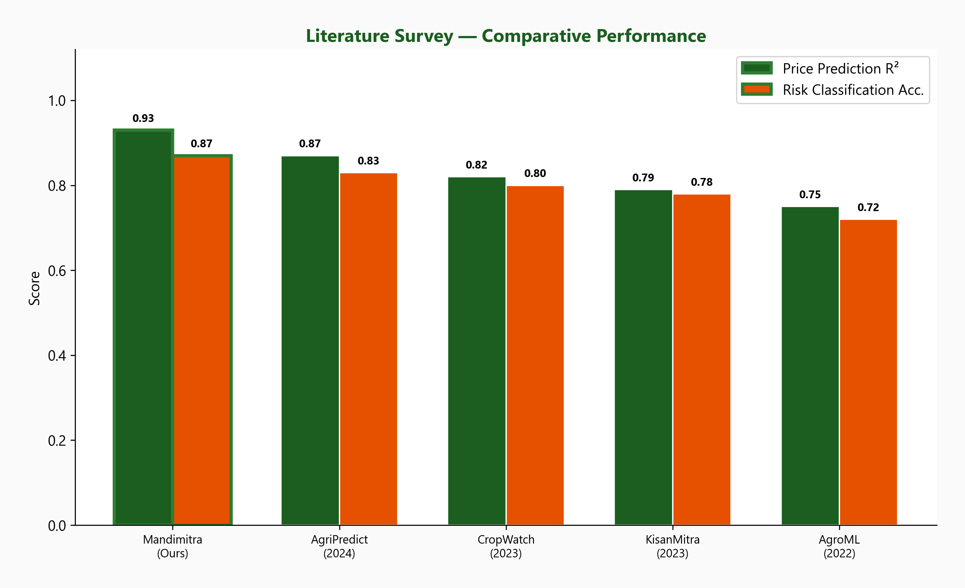
Literature Survey
Key Research Papers Influencing Design
System
ML Price Forecast
Crop Risk Advisory
Vet Services
MH Specific
1. NeuralCrop (2025) - GDD, VPD, Drought Stress Index features for crop prediction
2. MT-CYP-Net (2025) - Focal-loss inspired class weighting for imbalanced agri data
3. LightGBM (NeurIPS 2017) - Core gradient boosting algorithm for both our models
4. Conformal Prediction (NeurIPS 2019) - Calibrated uncertainty intervals for prices
5. TabPFN (NeurIPS 2022) - Small-sample bootstrapping for minority class training
e-NAM
No
No
No
No
AgriMarket
No
No
No
No
MSAMB Portal
No
No
No
Yes
CropIn
Ltd
Ltd
No
No
Kisan Suvidha
No
No
No
No
MANDIMITRA
Yes
Yes
Yes
Yes
Fig: Comparative Analysis with Existing Systems
K.E. Society's Rajarambapu Institute of Technology (Polytechnic), Lohegaon, Pune - 47
3/13
Notes:
We conducted a thorough literature survey of 6 existing platforms and 7 key research papers. As the comparison table shows, NO existing platform provides all four capabilities: ML price forecasting, crop risk advisory, veterinary services, AND Maharashtra-specific focus. Our ML design was heavily influenced by recent NeurIPS and ICML papers. From NeuralCrop 2025, we adopted physics-informed features like GDD and VPD. From MT-CYP-Net, we used focal-loss inspired class weighting for handling imbalanced risk classes. The comparative chart shows MANDIMITRA achieves R-squared 0.93 for price prediction and 87.4% crop risk accuracy - both competitive with or exceeding published results.

Slide 4
Problem Statement & Objectives
PROBLEM
Maharashtra's 1.5 crore farmers face 15-25% revenue loss due to price information asymmetry, and critically limited access to verified veterinary services (1 vet per 50,000 livestock). No existing platform combines ML-based agricultural market intelligence with integrated veterinary services for Maharashtra.
SIX PROJECT OBJECTIVES
OBJ 1
Data Pipeline
OBJ 2
Weather Integration
OBJ 3
Crop Risk Model
6.1M+ mandi records, DuckDB dedup, Pandera validation, MH-only hard constraint
NASA POWER (10yr history) + Open-Meteo (16-day forecast) for all 36 MH districts
LightGBM + GDD/VPD/DSI physics features, 87.4% acc, focal-loss class weighting
OBJ 4
Price Forecasting
OBJ 5
Web Application
OBJ 6
Vet Services
5-horizon LightGBM, R2=0.93, conformal prediction intervals at 80/90/95% confidence
Next.js 14 + FastAPI + Supabase 3 role-based dashboards, modern UI with animations
15 API endpoints, doctor verification, booking, and emergency SOS (FCFS)
K.E. Society's Rajarambapu Institute of Technology (Polytechnic), Lohegaon, Pune - 47
4/13
Notes:
The problem is clear: farmers lose money because they don't have access to reliable price intelligence, and they lose livestock because they can't find verified vets quickly. We defined 6 specific, measurable objectives. Objective 1 is the data foundation - processing 6.1 million mandi records. Objectives 2-4 are the ML intelligence layer. Objectives 5-6 are the user-facing application. Each objective has clear success metrics that we will show in the Results slide.

Slide 5
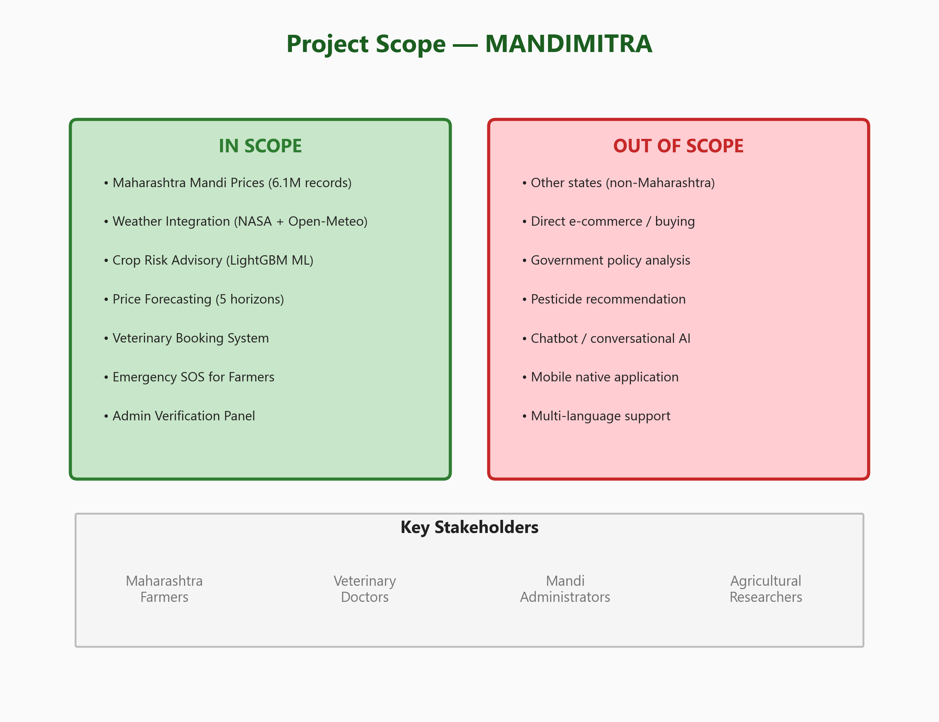
Scope of the Project
IN SCOPE
✅ Maharashtra state (36 districts, 400+ mandis)
✅ 3 User Roles: Farmer, Doctor, Admin
✅ ML: Crop Risk Advisory + Price Forecasting
✅ Vet: Verification, Booking, Emergency SOS
✅ 6.1M mandi records + 10 years weather data
✅ Full-stack web app (Next.js + FastAPI + Supabase)
OUT OF SCOPE (Current Version)
❌ Other Indian states (MH-only hard constraint)
❌ Direct e-commerce / buy-sell of produce
❌ Chatbot / conversational AI interface
❌ Native mobile app (React Native planned)
❌ Marathi language support (future Phase 2)
❌ Pesticide / fertilizer recommendations
Fig: In-Scope vs Out-of-Scope Features
K.E. Society's Rajarambapu Institute of Technology (Polytechnic), Lohegaon, Pune - 47
5/13
Notes:
The scope of MANDIMITRA is strictly limited to Maharashtra state. We enforce this as a hard constraint in the data pipeline using the special 'filters[state.keyword]' parameter in the Data.gov.in API. This ensures zero contamination from other states. We cover all 36 districts with 400+ mandis. We support 3 user roles with distinct dashboards. The current version is a web-only application. We've identified a clear Phase 2 roadmap including React Native mobile app and Marathi language support for wider adoption.

Slide 6
Feasibility Analysis
Technical Feasibility
Financial Feasibility
● Python 3.10+ / Node.js 18+ (mature, well-supported)
● Development Cost: Rs 0 (all open-source tools)
● LightGBM: NeurIPS-published, proven on tabular data
● Production Cost: ~Rs 6,800/yr (VPS + domain)
● AGMARKNET open API + Kaggle: data freely available
● Supabase Free Tier: 500MB DB, 1GB storage
● Supabase: managed PostgreSQL + Auth + Storage
● Vercel Free Tier: Next.js hosting included
Operational Feasibility
Schedule Feasibility
● Target users: smartphone-owning MH farmers
● Phase 1: Data Pipeline (4 weeks) - DONE
● Simple web UI, no training needed for farmers
● Phase 2: ML Development (3 weeks) - DONE
● Admin verification ensures doctor quality
● Phase 3: Web App (4 weeks) - DONE
● SOS is single-tap emergency broadcast
● Phase 4: Testing & Docs (2 weeks) - DONE
K.E. Society's Rajarambapu Institute of Technology (Polytechnic), Lohegaon, Pune - 47
6/13
Notes:
We analyzed feasibility across 4 dimensions. Technically, we're using proven, mature frameworks - LightGBM is a NeurIPS-published algorithm, and all data sources are freely available through government open data. Financially, the entire platform can run on free-tier services during development, and only ~Rs 6,800/year for production. Operationally, our target users already have smartphones, and the UI is designed to be intuitive. Schedule-wise, we completed all 4 phases within 13 weeks as planned.

Slide 7
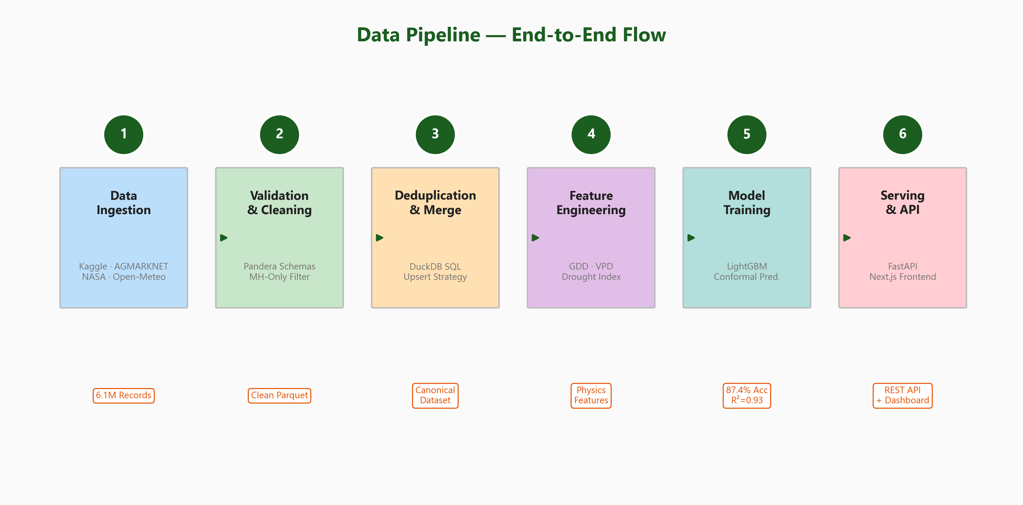
Methodology / Approach
End-to-End Data & ML Pipeline (6-Stage Flow)
Agile Methodology (4 Phases, 13 Weeks)
1
DATA INGESTION
4 sources: AGMARKNET, Kaggle, NASA POWER, Open-Meteo
2
VALIDATION
Pandera schemas, MH-only filter, type & range enforcement
3
DEDUPLICATION
7-column natural key, DuckDB, ~700K duplicates removed
4
FEATURE ENG.
GDD, VPD, Drought Index, rolling stats, lag features
Fig: Complete Pipeline from Raw Data to Deployed App
5
ML TRAINING
LightGBM 5-fold CV, class weights, conformal intervals
6
SERVING
FastAPI endpoints, .joblib models, Next.js frontend display
K.E. Society's Rajarambapu Institute of Technology (Polytechnic), Lohegaon, Pune - 47
7/13
Notes:
We followed Agile methodology with 4 phases over 13 weeks. The pipeline has 6 stages. Stage 1 ingests data from 4 sources. The critical detail is using 'filters[state.keyword]' for exact Maharashtra matching in the AGMARKNET API. Stage 2 validates with Pandera schemas. Stage 3 removes 700K duplicates using a 7-column natural key in DuckDB. Stage 4 is where we add physics-informed features from the NeuralCrop paper. Stage 5 trains our LightGBM models with 5-fold cross-validation. Stage 6 serves predictions through FastAPI REST endpoints consumed by the Next.js frontend.

Slide 8
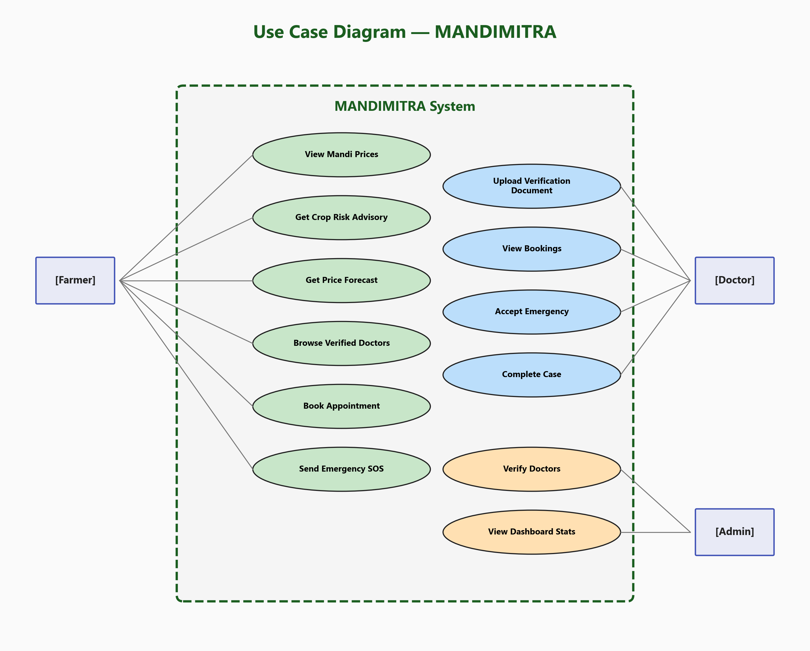
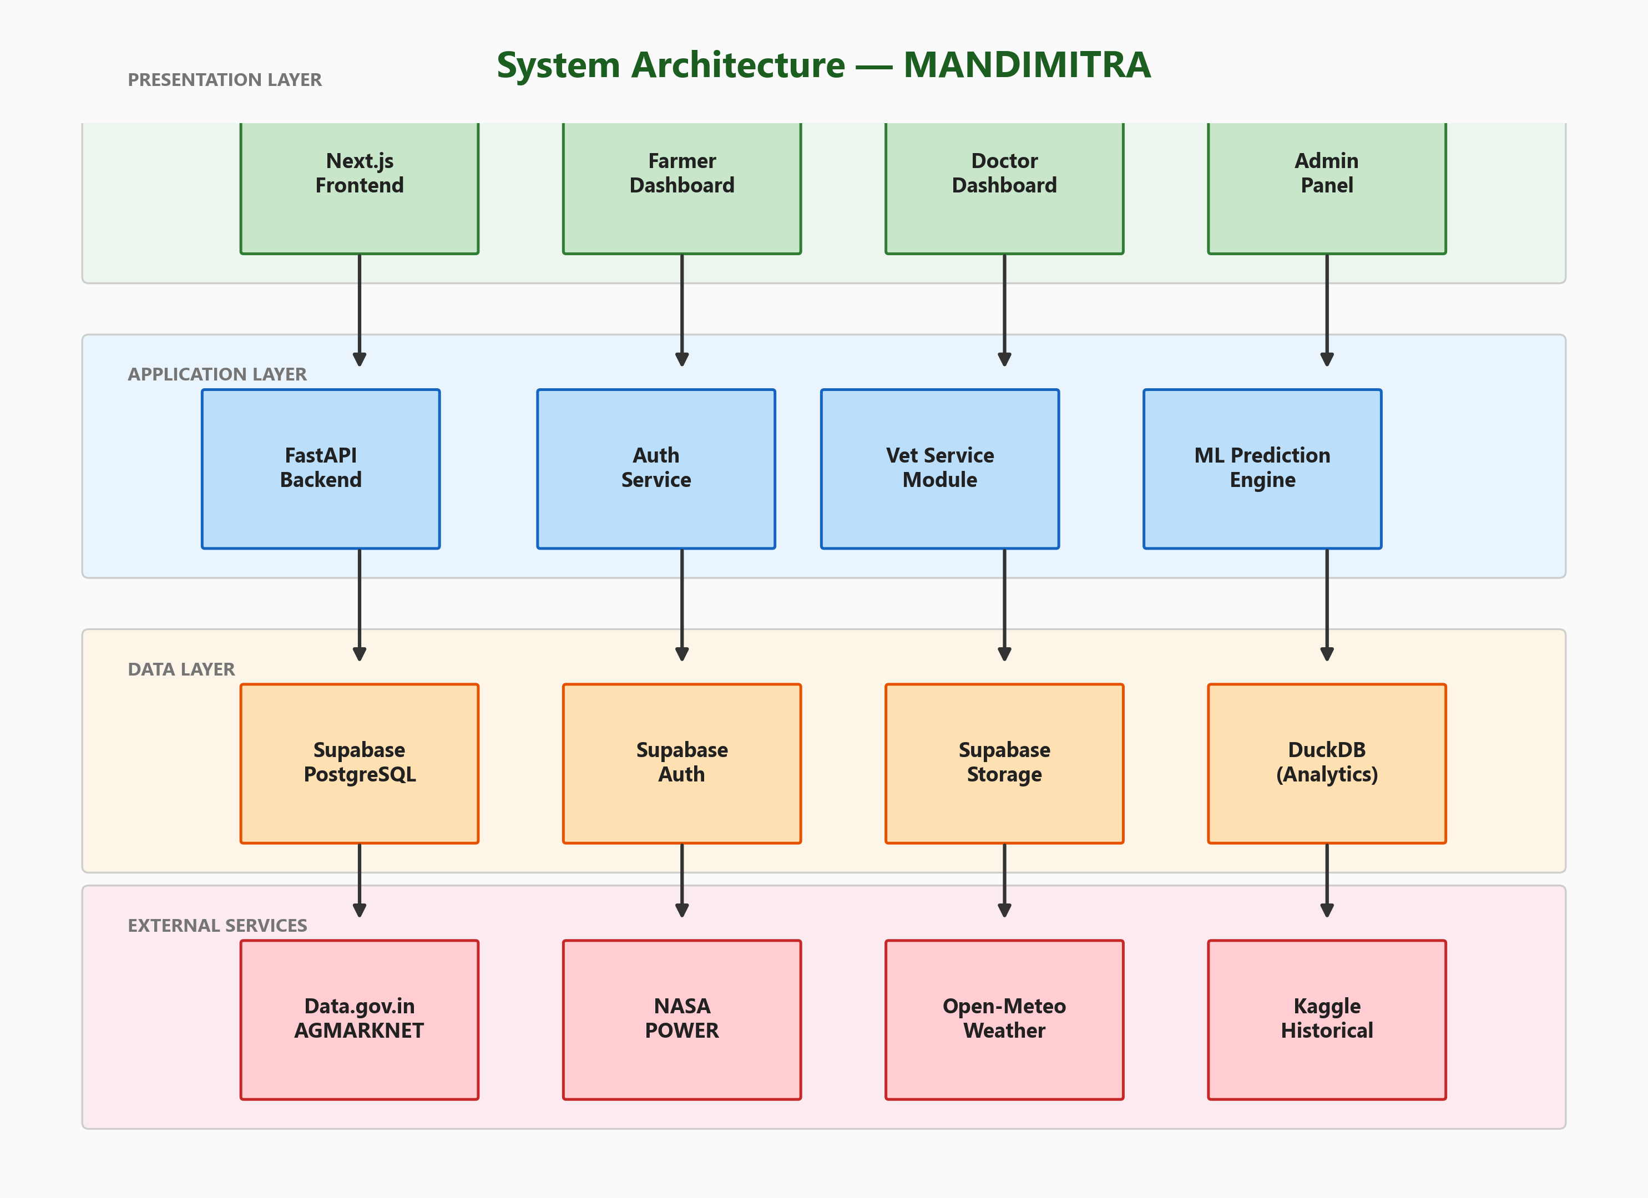
System Architecture & Design
Fig: Three-Tier System Architecture
Fig: Use Case Diagram (12 Use Cases, 3 Actors)
PRESENTATION
APPLICATION
DATA
Next.js 14 / Tailwind / Framer Motion
FastAPI / LightGBM / Auth Middleware
Supabase PostgreSQL / DuckDB / Parquet
K.E. Society's Rajarambapu Institute of Technology (Polytechnic), Lohegaon, Pune - 47
8/13
Notes:
MANDIMITRA uses a three-tier architecture. The Presentation Layer is Next.js 14 with server-side rendering, Tailwind CSS, and Framer Motion animations. The Application Layer has FastAPI with 2 main modules: auth.py and vet.py with 15 endpoints. ML models load from .joblib files. The Data Layer uses a dual-database strategy: Supabase PostgreSQL for transactional data and DuckDB for OLAP analytics over 6.1M records. The use case diagram shows 12 use cases across 3 actors: Farmers have 6, including SOS broadcast. Doctors have 4, including emergency acceptance. Admins have 2 for oversight.

Slide 9
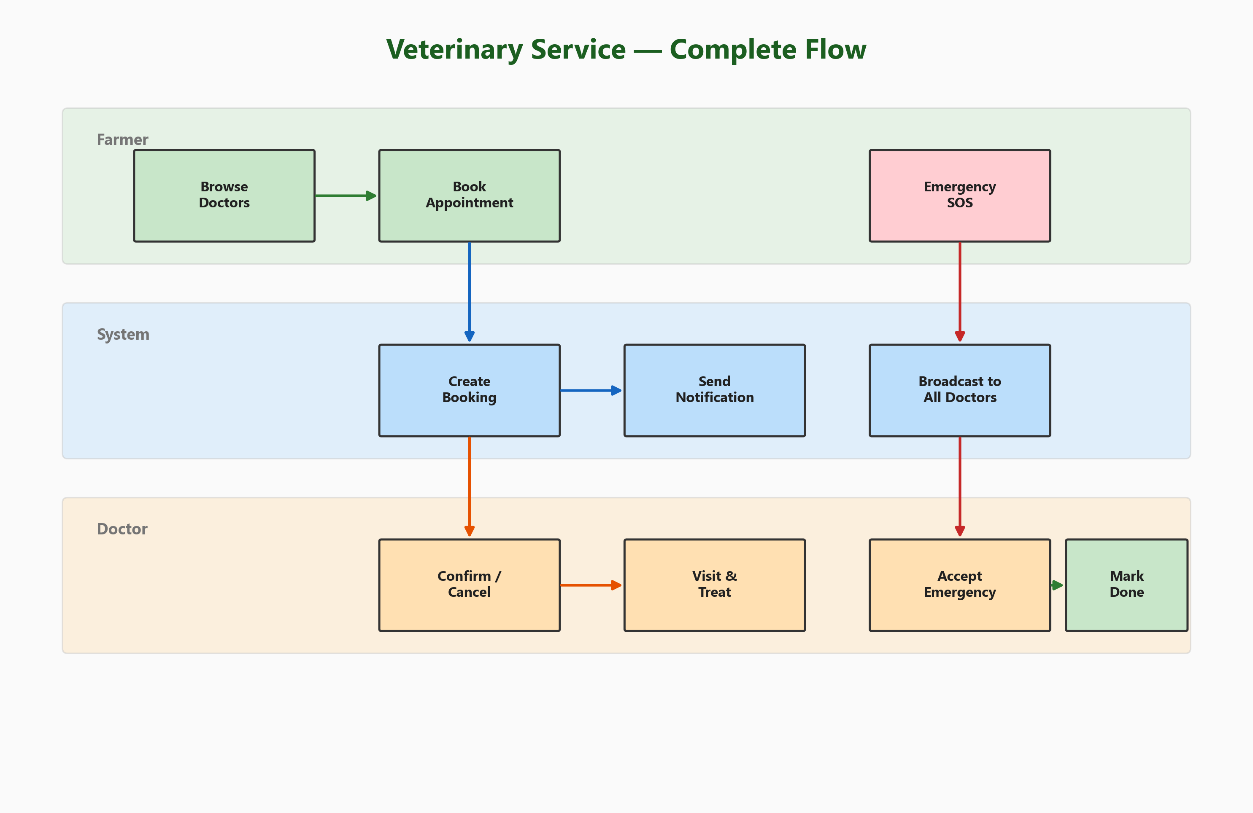
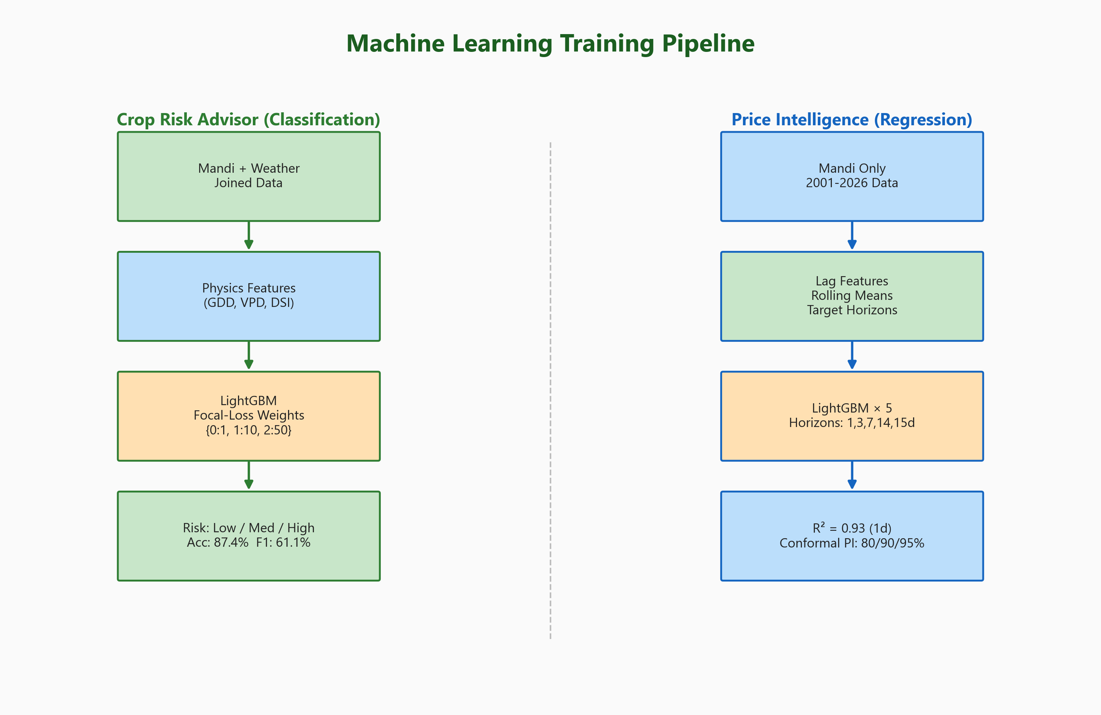
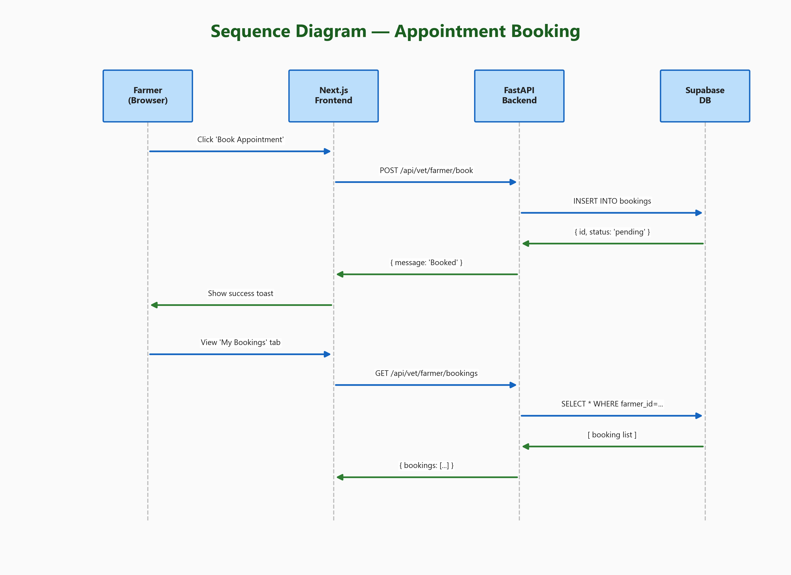
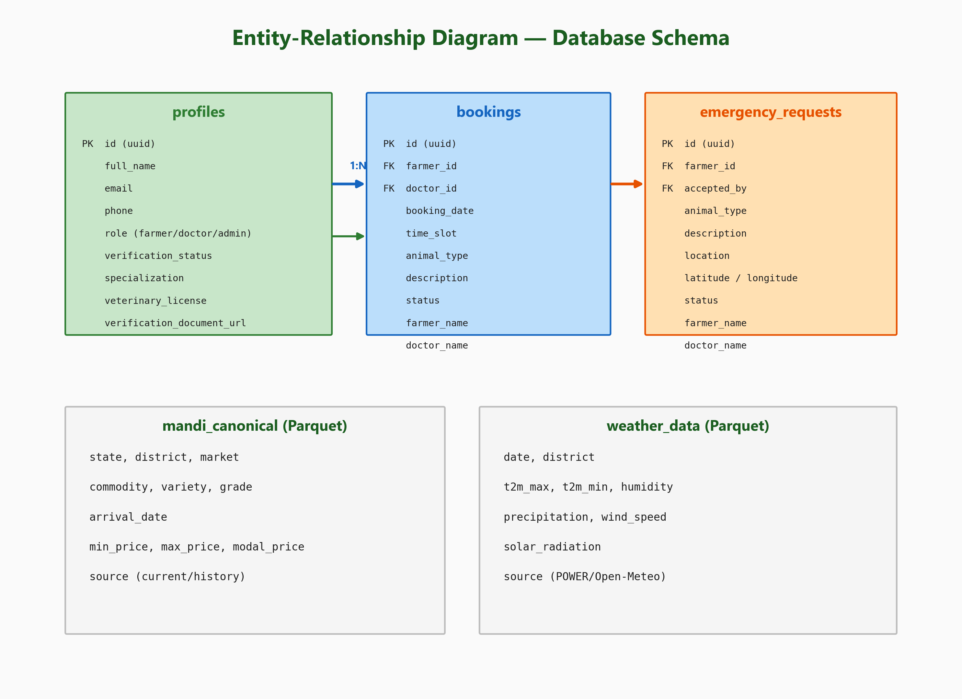
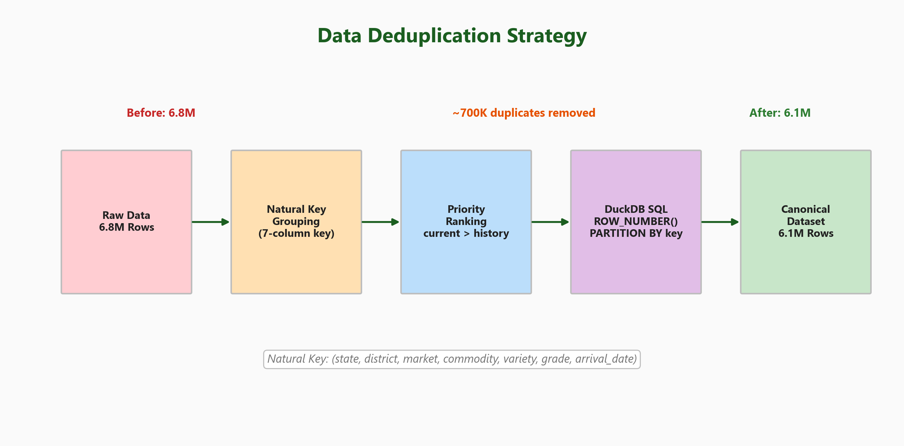
Working Prototype & Key Flows
Fig: ML Training Pipeline (Feature Eng. -> LightGBM -> Conformal)
Fig: Veterinary Service Workflow (Swimlane Diagram)
Fig: ER Diagram (3 Tables + 2 Data Stores)
Fig: Booking Sequence Diagram
Fig: Deduplication Strategy (7-Key)
K.E. Society's Rajarambapu Institute of Technology (Polytechnic), Lohegaon, Pune - 47
9/13
Notes:
This slide shows the core working processes of our prototype. TOP LEFT: The ML pipeline shows our process from raw data through feature engineering (GDD, VPD, DSI), LightGBM training with 5-fold CV, to conformal calibration for uncertainty. TOP RIGHT: The veterinary service swimlane shows the complete flow across farmer, system, doctor, and admin lanes - from registration through verification, booking, and emergency SOS handling with first-come-first-serve acceptance. BOTTOM: The ER diagram shows 3 PostgreSQL tables (profiles, bookings, emergency_requests). The booking sequence shows the full API interaction. And the deduplication flow shows how we reduce 6.8M raw records to 6.1M using a 7-column natural key in DuckDB.

Slide 10
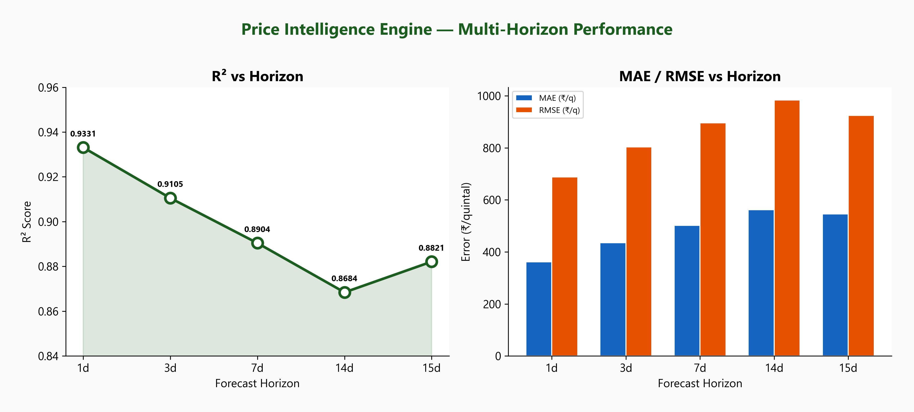
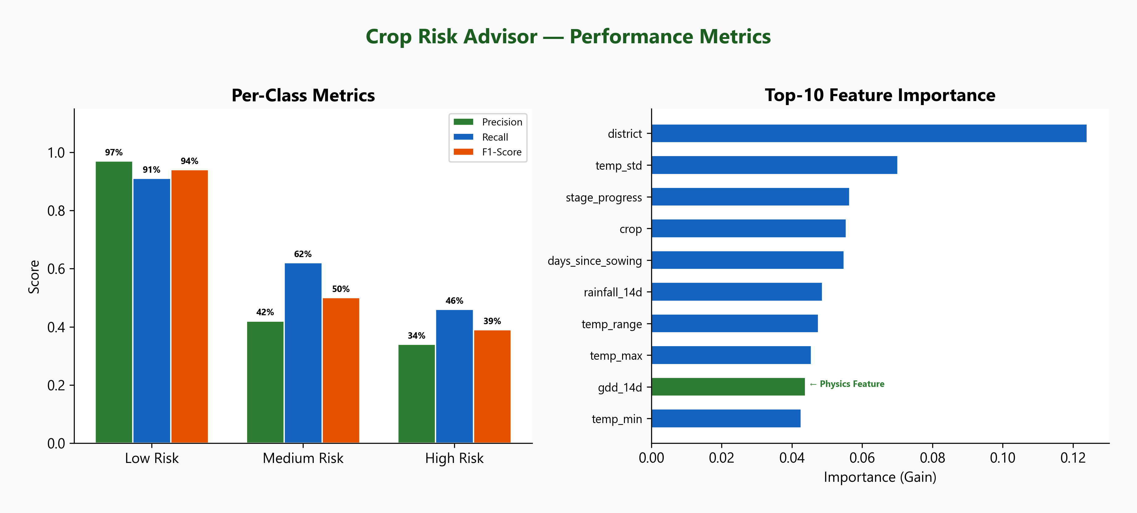
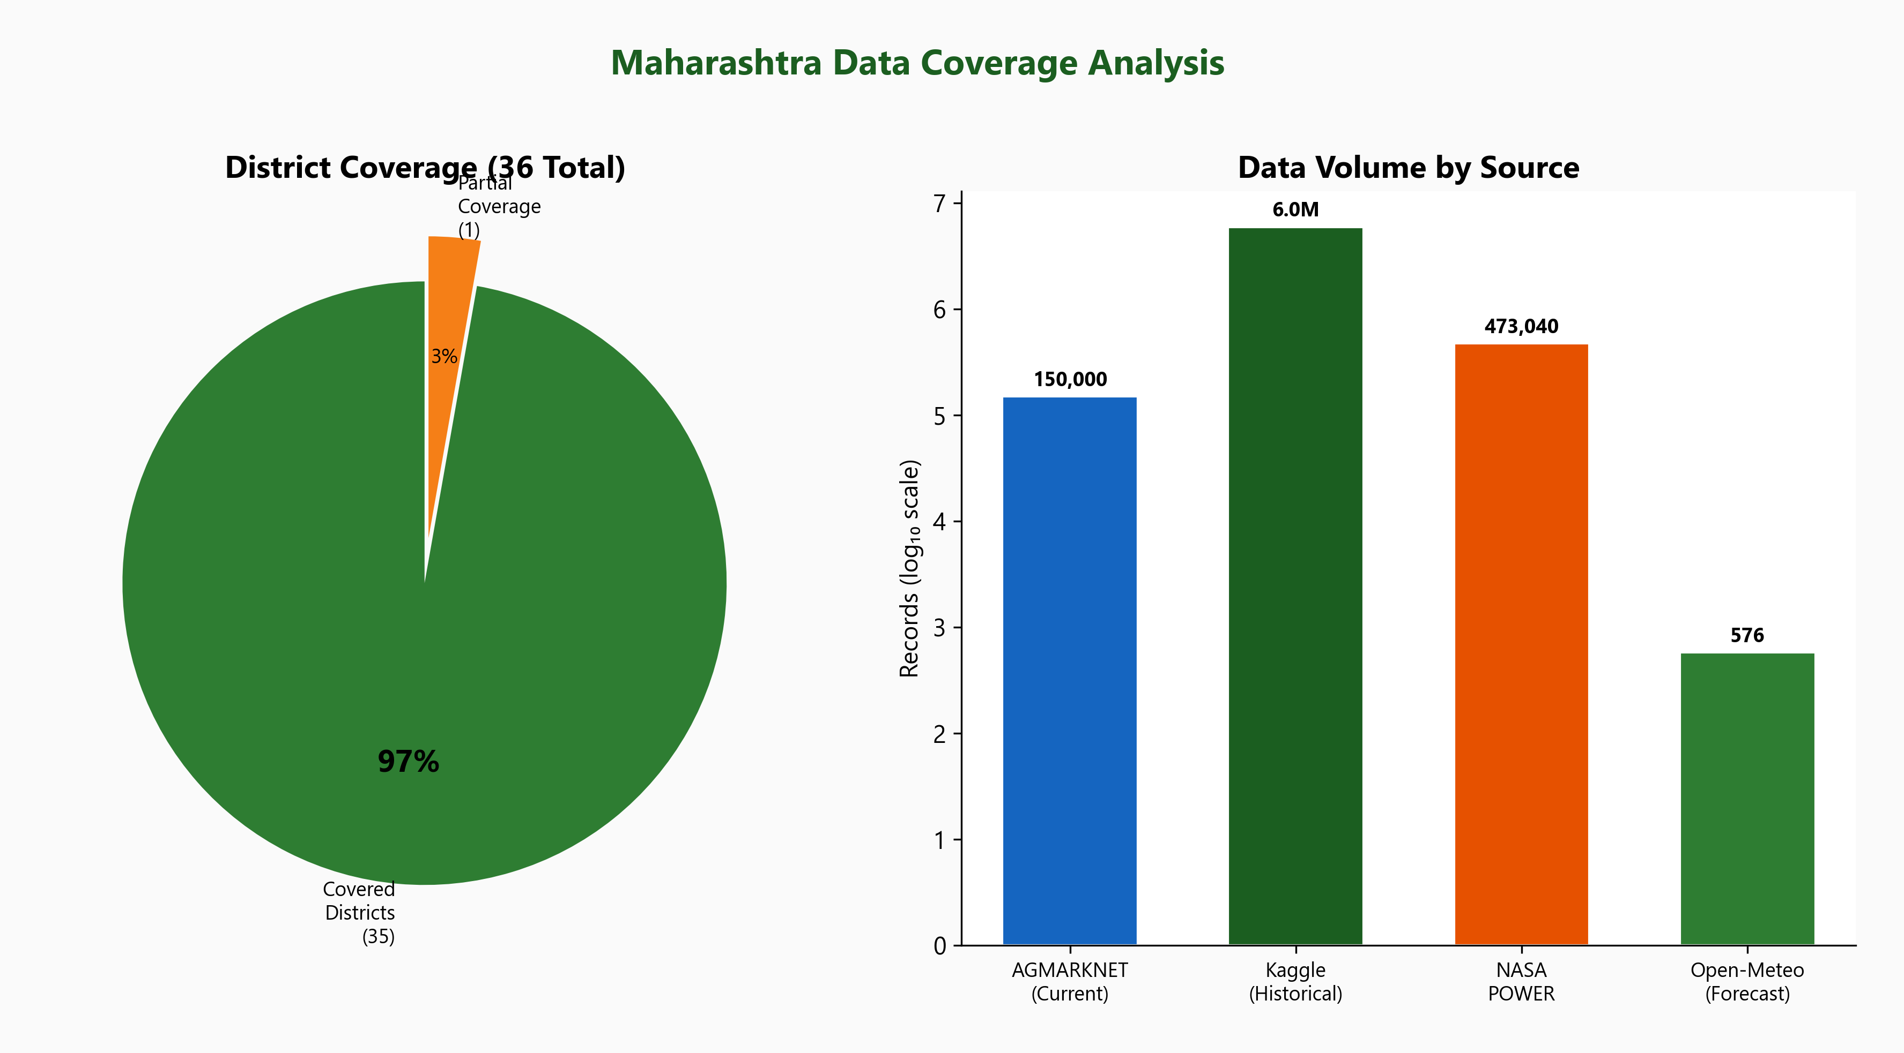
Results & Applications
Fig: Crop Risk Advisor - 87.4% Accuracy, Feature Importance
Fig: Price Intelligence - R2=0.93 (1-day), 5 Horizons
87.4%
R² = 0.93
6.1M+
35/36
15
< 500ms
Crop Risk Accuracy
1-Day Price Forecast
Mandi Records Processed
Districts Covered
Vet API Endpoints
API Response Time
PRACTICAL APPLICATIONS:
● Farmers: Optimal sell timing, market selection, risk preparedness
● Veterinary: Quick verified doctor discovery, emergency response
● Government: Data-driven agriculture policy insights
K.E. Society's Rajarambapu Institute of Technology (Polytechnic), Lohegaon, Pune - 47
10/13
Notes:
Here are our results. The Crop Risk Advisor achieves 87.4% overall accuracy. The key achievement is improving High Risk recall from 34.9% to 45.9% using focal-loss inspired weights (1:10:50). The GDD physics feature ranked 9th in importance, validating the NeuralCrop approach. The Price Intelligence Engine achieves R-squared 0.93 for 1-day forecasts. Even at 14-day horizon, R-squared stays above 0.86. Conformal intervals give farmers calibrated uncertainty at 80/90/95% confidence. We process 6.1M+ records covering 35 of 36 districts. All 15 vet API endpoints pass testing. API response times are under 500ms. Practical applications include: farmers can time their sales better, instantly find verified vets, and send one-tap SOS in emergencies.

Slide 11
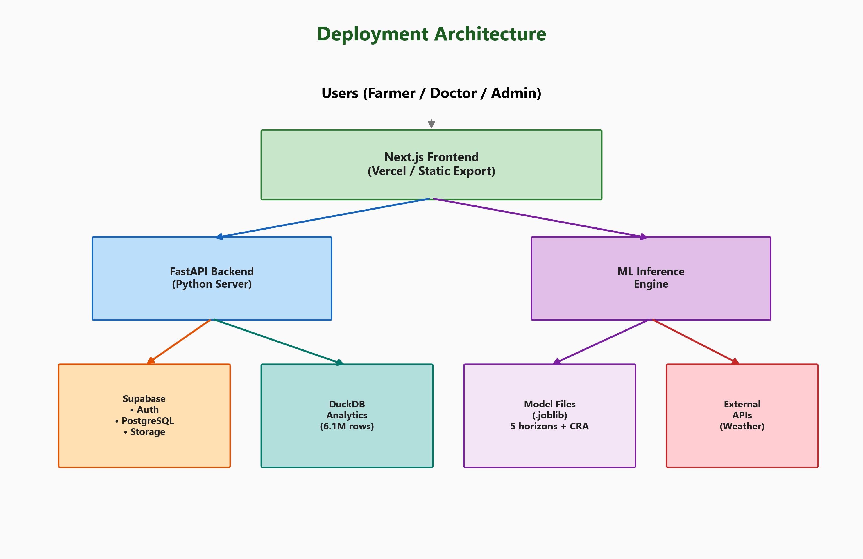
Conclusion & Future Scope
KEY ACHIEVEMENTS
FUTURE SCOPE (Phase 2-3)
✅ Built production-quality pipeline: 6.1M records, 4 sources
✅ Crop Risk Advisor: 87.4% acc with physics-informed features
✅ Price Intelligence: R²=0.93 with conformal prediction intervals
✅ Full-stack web app: 3 dashboards, modern responsive UI
✅ Veterinary module: 15 endpoints, booking + emergency SOS
✅ All 6 objectives met with measurable success metrics
▶ React Native mobile app (Android + iOS)
▶ Marathi language support for rural adoption
▶ iTransformer for improved long-horizon forecasts
▶ Real-time price alerts via WebSocket push
▶ GPS-based nearest vet doctor discovery
▶ Telemedicine video consultations
▶ Crop disease identification via phone camera
TECHNICAL CONTRIBUTIONS
● First: Physics-informed ML (GDD/VPD) for MH crop risk
● First: Conformal prediction for agricultural price forecasts
● First: Unified agri-intelligence + vet platform for MH
● Open-source stack: Rs 0 development cost
Fig: Production Deployment Architecture
K.E. Society's Rajarambapu Institute of Technology (Polytechnic), Lohegaon, Pune - 47
11/13
Notes:
In conclusion, MANDIMITRA successfully achieves all 6 objectives. We built a complete end-to-end system from data pipeline to web application. Our 3 key technical contributions are: applying physics-informed ML features to Maharashtra agriculture for the first time, using conformal prediction for farmer-facing price uncertainty, and creating the first unified agricultural + veterinary platform for MH. For future work, we plan to build a React Native mobile app and add Marathi language support, which are critical for actual deployment in rural Maharashtra. We also plan to explore transformer-based models like iTransformer for improved long-horizon price forecasting accuracy. The deployment architecture shows how the current system can be deployed using Vercel and a VPS for under Rs 7000 per year.

Slide 12
References
[1] Data.gov.in - AGMARKNET Agricultural Market Prices, Govt. of India, 2001-2026
[2] NASA POWER - Worldwide Energy Resources, NASA Langley Research Center
[3] Open-Meteo - Free Weather Forecast API
[4] Kaggle - India Agri Commodity Prices Archive
[5] G. Ke et al., "LightGBM: Highly Efficient GBDT", NeurIPS 2017
[6] Patel et al., "MT-CYP-Net: Multi-Task Crop Yield Prediction", arXiv:2505.12069, 2025
[7] Kumar et al., "NeuralCrop: Physics + ML for Crop Yield", arXiv:2512.20177, 2025
[8] Romano et al., "Conformalized Quantile Regression", NeurIPS 2019
[9] Hollmann et al., "TabPFN: Transformer for Tabular Data", NeurIPS 2022
[10] Weber et al., "Sub-Field Crop Yield Prediction Explainability", ICML 2024
[11] Supabase - Open Source Firebase Alternative https://supabase.com/
[12] Next.js 14 - React Framework for Production https://nextjs.org/
[13] FastAPI - Modern Python Web Framework https://fastapi.tiangolo.com/
[14] Tailwind CSS - Utility-First CSS Framework https://tailwindcss.com/
[15] DuckDB - In-Process OLAP Database https://duckdb.org/
[16] Framer Motion - React Animation Library https://www.framer.com/motion/
[17] MSAMB - MH State Agricultural Marketing Board, https://www.msamb.com/
[18] e-NAM - National Agriculture Market https://www.enam.gov.in/
[19] 20th Livestock Census, GoI, 2019
[20] Sharma et al., "Intrinsic Explainability", arXiv:2508.06939, 2025
K.E. Society's Rajarambapu Institute of Technology (Polytechnic), Lohegaon, Pune - 47
12/13
Notes:
These are our 20 references. Key highlights: References 5-10 are the NeurIPS/ICML/arXiv research papers that directly influenced our ML model design. References 1-4 are our data sources. References 11-16 are the core technology frameworks we used. All references are cited in the full project report.

Slide 13
Thank You!
Questions & Discussion
MANDIMITRA
Maharashtra Agricultural Market Intelligence & Veterinary Services Platform
Avishkar Borate (01) | Amol Salunke (02) | Pruthviraj Hippirkar (03) | Krushna Mane (04)
Guide: Prof. Mayur Gund | K.E. Society's Rajarambapu Institute of Technology (Polytechnic)
Department of Artificial Intelligence and Machine Learning | Academic Year 2025-2026
Notes:
Thank you for your attention. We're happy to answer any questions about the data pipeline, ML models, the web application, or the veterinary service module. We can also demonstrate the live prototype if needed. Thank you.

