Slide 1
Assam Agricultural University
Unified ERP & Payroll System
High-Level Design & Requirement Analysis
Discovery Findings · Proposed Architecture · Phasing
Initial Study Report · June 2026

Slide 2
Agenda
• Project context & objective
• Scope — three systems on one platform
• Proposed high-level architecture
• Salary → Bill → Disbursal workflow
• Master-driven (configurable) design
• Data, identifiers & integrations
• Delivery phasing — what we build first
• Open clarifications & risks
• Next steps
Assam Agricultural University — ERP / Payroll · High-Level Design
2

Slide 3
Project Context & Objective
Replace fragmented legacy systems with one web-based ERP
• Replacing today's separate systems:
– Existing HRMS — faculty/employee master, service & leave data
– Existing Payroll — salary structure, deductions, bill generation
– Finance processes — funds, budget, treasury (largely offline)
• Goal: one platform, single source of truth, full audit trail
– HRMS is the only module 'properly used' today — strongest data
– PAN + email act as the link between sub-systems & external APIs
– Master-driven: funds, heads, payscales, formulas all configurable
Assam Agricultural University — ERP / Payroll · High-Level Design
3

Slide 4
Scope — Three Systems, One Platform
Payroll (core)
EFMS (workflow)
FOC (funds)
• Master-driven salary calc
• Dynamic deductions
• Payslip + annual report
• Bill generation + PDF
• Loans, increments, arrears
• E-file movement
• 6 user types · 3 access levels
• Full lifecycle log
• Reporting-officer alerts
• Access-based routing
• Multiple fund sources
• Fund → head mapping
• Ceiling / allocation
• Purpose-bound spend
• Budget vs utilization
+ Supporting modules (phased): Pension · GPF · Claims · Asset/Estate · Store & Purchase · Budget Mgmt
Assam Agricultural University — ERP / Payroll · High-Level Design
4

Slide 5
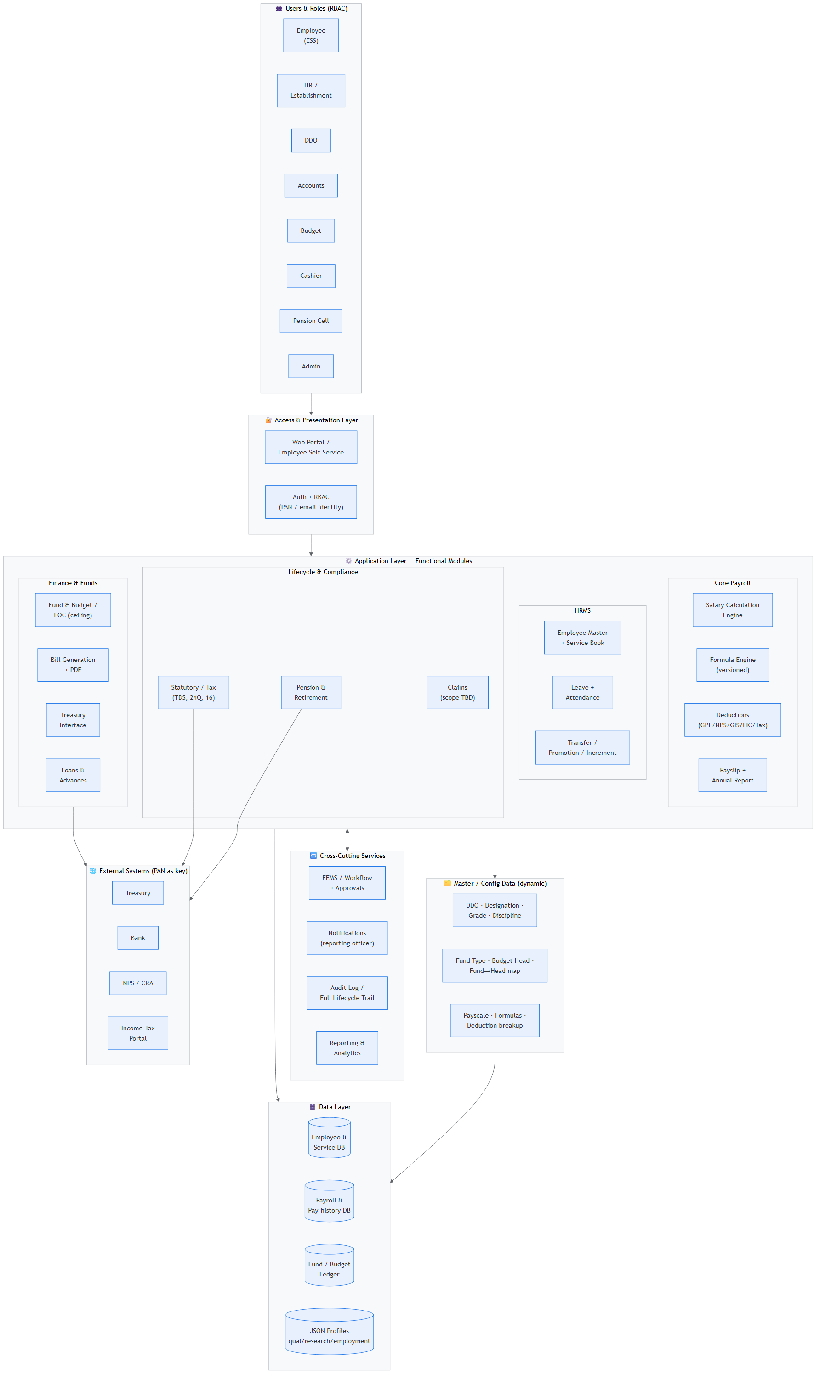
Proposed High-Level Architecture
Layered: Users → Access → Modules → Masters → Data → External
Assam Agricultural University — ERP / Payroll · High-Level Design
5

Slide 6
Architecture — Layer Walkthrough
• Access & RBAC
– Web portal + Employee Self-Service; identity via PAN/email; role-based access
• Application modules
– Core Payroll (calc engine, formula engine, deductions, payslip)
– HRMS (employee master, service book, leave, attendance, transfer/promotion)
– Finance (FOC/fund, bill + PDF, treasury interface, loans)
– Lifecycle/compliance (pension & retirement, statutory/tax, claims)
• Cross-cutting services
– EFMS workflow & approvals · notifications · audit log · reporting/analytics
• Master / Config + Data
– Dynamic masters (DDO, designation, grade, fund type, budget head, payscale, formulas)
– Data: employee/service, payroll history, fund ledger, JSON profiles
Assam Agricultural University — ERP / Payroll · High-Level Design
6

Slide 7
Salary → Bill → Disbursal Workflow
From attendance freeze to salary credit; retirement handoff to pension
Correction batches loop back to calc · returned bills re-enter at Accounts with reason · TA/DA stays manual (out of pay)
Assam Agricultural University — ERP / Payroll · High-Level Design
7

Slide 8
Master-Driven (Configurable) Design
The spine: a rule engine, not hard-coded logic
• Everything is a dynamic master entry, mapped together to form 'settings':
– DDO · Designation · Grade · Fund Type · Budget Head · Discipline · Nature Type
– Payscale → mapped to designation; Fund → Head; Designation → Fund Type
• Formula engine
– Formulas created in master, mapped to heads ('head assign')
– Deductions applied to all employees; breakup held in %
– Increments & corrections recomputed via formulas (changeable)
• Why it matters
– New heads/rules without code changes — but needs versioning + audit
– Open: formula authoring rights, mid-year recompute policy (see risks)
Assam Agricultural University — ERP / Payroll · High-Level Design
8

Slide 9
Data, Identifiers & Integrations
• Identifiers
– PAN + email = cross-system link; external APIs key on PAN
– Risk: PAN must be unique & present for all (incl. contractual/project)
• Existing data assets
– Employee personal/financial details (PAN, Aadhaar) for payroll
– Faculty profile, qualification, employment & research history in JSON
– 8 appraisal formats; transfer history (dept ↔ faculty shared keys)
• External systems
– Treasury · Bank · NPS/CRA · Income-Tax portal
• Retirement → handoff to pension dept; retirement age varies by cadre
Assam Agricultural University — ERP / Payroll · High-Level Design
9

Slide 10
Delivery Phasing
Quote the certain core; range the dependent scope
Phase 1 — Build now (high confidence)
Phase 2 — Dependent (price as range)
• Master/config data foundation
• Core payroll calc + formula engine
• Deductions (GPF/NPS/GIS/LIC/Tax)
• Payslip + annual report
• Bill generation + PDF + approval flow
• HRMS reuse (strongest existing data)
• EFMS / full workflow engine
• FOC + fund-source reconciliation
• Pension & retirement settlement
• Loans (full lifecycle) & claims
• Offline modules (Asset/Estate, Store)
• External API integrations
Rationale: Phase 2 carries the open unknowns (fund tracking, module reality) — don't fixed-price what's untracked.
Assam Agricultural University — ERP / Payroll · High-Level Design
10

Slide 11
Open Clarifications & Risks
To resolve in detailed requirement visit
• Top contradictions to resolve
– Fund mapping claimed vs admitted 'gap in tracking actual fund source'
– Salary model: pay-grade-wise vs designation-wise
– Modules listed vs only HRMS 'properly used' (live vs aspirational)
– Formula governance: who edits, versioning, mid-year recompute
• Scope boundaries to fix
– Tax: TDS-only vs full compliance (Form 16/24Q)
– Loan: full lifecycle vs deduction line; Pension: integrated vs handoff
– EFMS vs bill-workflow: one engine or two; TA/DA stays out of pay
• Key risks
– Legacy data quality/history span · PAN completeness · module data reality
Assam Agricultural University — ERP / Payroll · High-Level Design
11

Slide 12
Next Steps
• Detailed requirement visit
– Walk through a real monthly payroll run end-to-end
– Collect real filled samples: payslip, bill, formulas, fund trail
– Confirm module usage status (live / partial / unused / offline)
• Decisions to capture
– Resolve the four contradictions; lock Phase-1 scope & sign-off
– Enumerate fund sources + actual disbursal path
• Output
– Baselined BRD + finalized phasing → firm-up the budget estimate
Assam Agricultural University — ERP / Payroll · High-Level Design
12

Slide 13
Thank You
Questions & Discussion

