Slide 1
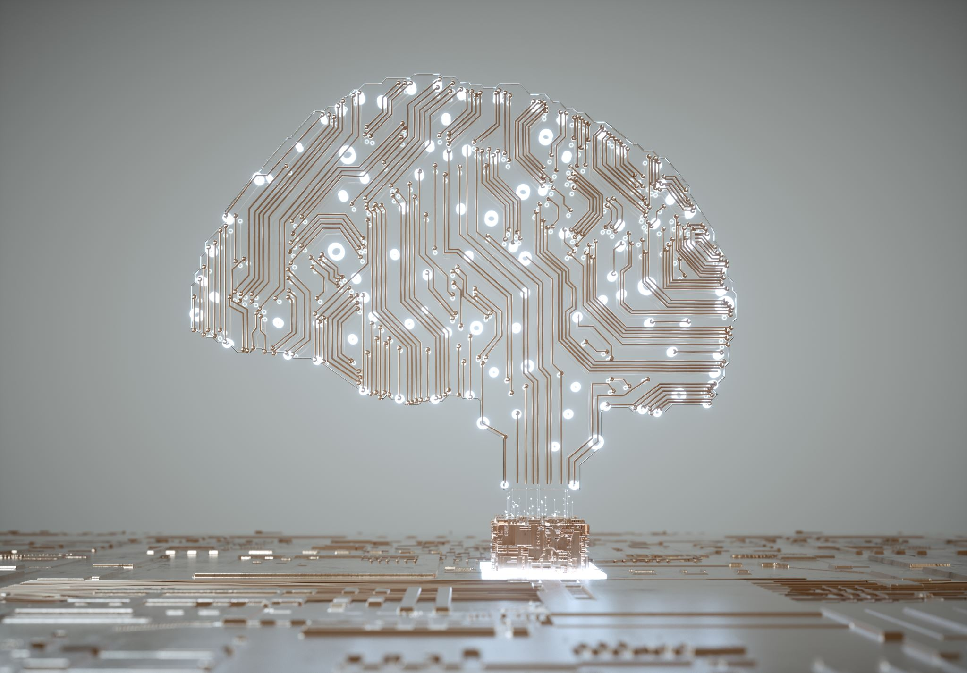
Intellectual Property Rights In Robotics Technology And Industrial Automation
By: Amaresh Muddebihal
20030141IT015 (IT, ACED)

Slide 2

Introduction
Overview of Robotics in Industry 4.0
The impact of robotics in transforming industries.
Key technologies: IoT, AI, machine learning, automation.
The role of robotics in increasing efficiency, accuracy, and safety.
Intellectual Property Rights (IPR) in Robotics
Legal protections for creations of the mind (inventions, designs).
Importance of IPR: Fosters innovation, protects inventions, and incentivizes creators.

Slide 3
Key IPR Challenges in Robotics
Patentability of Robotics Innovations
Legal frameworks struggle to cover innovations that blend hardware and software.
Ownership of Autonomous Creations
Robots and AI systems are increasingly capable of generating intellectual property—raising ownership questions.
Licensing and Technology Transfer Issues
Discrepancies in cross-border regulations complicate licensing.
Data Ownership in AI-Driven Robotics
Data is critical for robotics and AI, but disputes arise over who owns and controls the data generated.

Slide 4
Robotics and the Industrial Revolution 4.0
Technological Advancements Driving Robotics
Artificial Intelligence (AI): AI is enabling robots to perform tasks autonomously, analyze environments, and make decisions.
Machine Learning: Robots learn from data, improving their performance without explicit programming.
IoT (Internet of Things): Robots can communicate with other machines to gather and share data, enhancing automation and efficiency.
5G Technology: Low-latency networks support real-time data exchange, critical for robotics in applications such as remote control and surgical procedures.
Challenges in Robotics
Patenting AI Algorithms: AI technologies, which are driven by data and algorithms, pose unique challenges in patenting due to the difficulty of defining novel and inventive steps.
Data Ownership: As robotics systems generate significant data, ownership issues arise—who owns the data generated by robots? The operator, manufacturer, or developer?
Security & Privacy: Robots often work in sensitive environments (e.g., hospitals, factories) where data security and privacy are paramount.

Slide 5
Patentability Challenges
Complexity of Hardware and Software Integration:
Innovations in robotics often combine mechanical designs with AI algorithms, which are treated differently under patent law.
AI-Driven Systems Generate Unpredictable Solutions:
Solutions created by machine learning models are often not easily understood or directly linked to human input.
Ambiguity in Novelty and Inventive Step:
Courts find it difficult to assess whether AI-generated inventions meet the threshold for novelty.
Example:
iRobot faced patent disputes over robotic vacuum technologies, illustrating the challenges in defining valid patents in robotics.

Slide 6
Intellectual Property Rights in Robotics
Patent Protection
Challenges with Patents: Traditional patent law was designed to protect physical inventions, but robotics includes AI algorithms and software-driven technologies that don't always fit within conventional patent categories.
Software Patents: AI-driven robots involve software that controls their operation. Patentability of software can be tricky because it requires meeting criteria such as novelty, inventive step, and industrial application.
Patent Eligibility: Complexities arise in determining whether the robot’s design or AI algorithm constitutes a patentable invention.
Ownership of Autonomous Creations
AI-Generated Inventions: As AI becomes more advanced, questions arise regarding who owns inventions made by AI systems—whether it’s the programmer, the AI system, or the company utilizing the AI.
Proposals for "Electronic Personhood": Some argue that advanced AI should be treated as legal entities that can own patents and be held accountable for their actions.
Licensing and Technology Transfer
Technology Licensing: Robotics companies license their innovations to others, allowing them to commercialize or further develop the technology. Licensing agreements are complex, often involving international markets with different laws.
Cross-Border Licensing: Licensing technologies across borders faces challenges due to varying patent laws, intellectual property enforcement standards, and conflicting trade regulations.
Data Ownership in Robotics
Ownership Disputes: Data generated by robotics systems often becomes the subject of disputes. Manufacturers, AI developers, and users may each claim rights to data, which is vital for improving algorithms and optimizing operations.
Data as Intellectual Property: Increasingly, data is seen as a valuable asset, similar to traditional IP such as patents and trademarks.

Slide 7
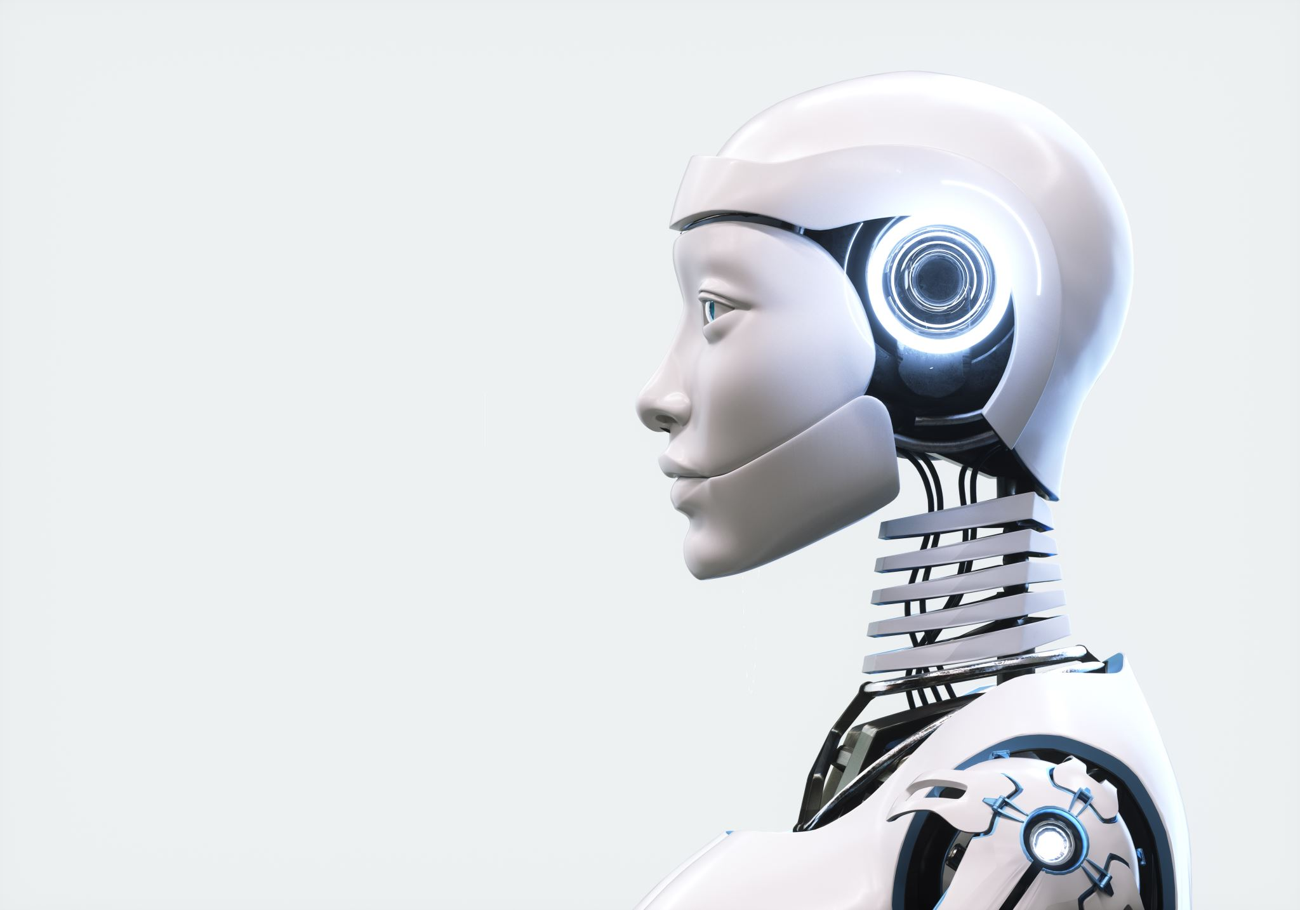
Data Ownership in Robotics
The Importance of Data in Robotics
Role of Data: Data is fundamental to machine learning, allowing robots to improve their performance over time. In fields like manufacturing and logistics, robots generate vast amounts of operational data.
Data as an Asset: Just as physical machines are valuable assets, so is the data they produce. This data can be patented or licensed, creating new avenues for intellectual property protection.
Disputes Over Data Ownership
Who Owns the Data?: As robots are deployed in various sectors, it is critical to define who holds the rights to the data they produce. Key stakeholders include the robot operator, the manufacturer, and the AI software developer.
Sharing and Collaboration: Data sharing often benefits the entire industry by improving the efficiency of systems and creating new business opportunities. However, establishing clear data ownership is crucial to protect interests and avoid conflicts.
Data Security and Privacy
Encryption and Access Controls: Protecting robot-generated data is essential for ensuring the privacy of individuals and companies. Secure data storage and strong encryption protocols can prevent unauthorized access.
Data Sharing Challenges: While data sharing can enhance AI and robotics development, it must be carefully managed to maintain control over sensitive information.

Slide 8
The Impact of Trade Secrets in Robotics
What Are Trade Secrets?
Definition: Trade secrets refer to confidential business information that provides a competitive edge, such as proprietary algorithms, manufacturing processes, and design blueprints.
Examples in Robotics: Robots’ software code, production techniques, and proprietary sensors could all be considered trade secrets.
Challenges in Protecting Trade Secrets
Leakage and Theft: In industries that rely on intellectual property, the risk of trade secret theft is significant. In the digital age, even well-protected information can be exposed via cyber-attacks or employee leaks.
Legal Protections: The current trade secret laws are insufficient in providing robust protection, especially in cross-border scenarios where enforcement mechanisms are weaker.
The Role of Trade Secrets in Innovation
Protection of Innovations: Robotics companies must protect trade secrets to retain their competitive advantage. However, overprotecting information can stifle collaboration and innovation.
Balancing Openness and Protection: A key challenge is determining when to share trade secrets to foster industry-wide innovation while safeguarding proprietary technologies.

Slide 9
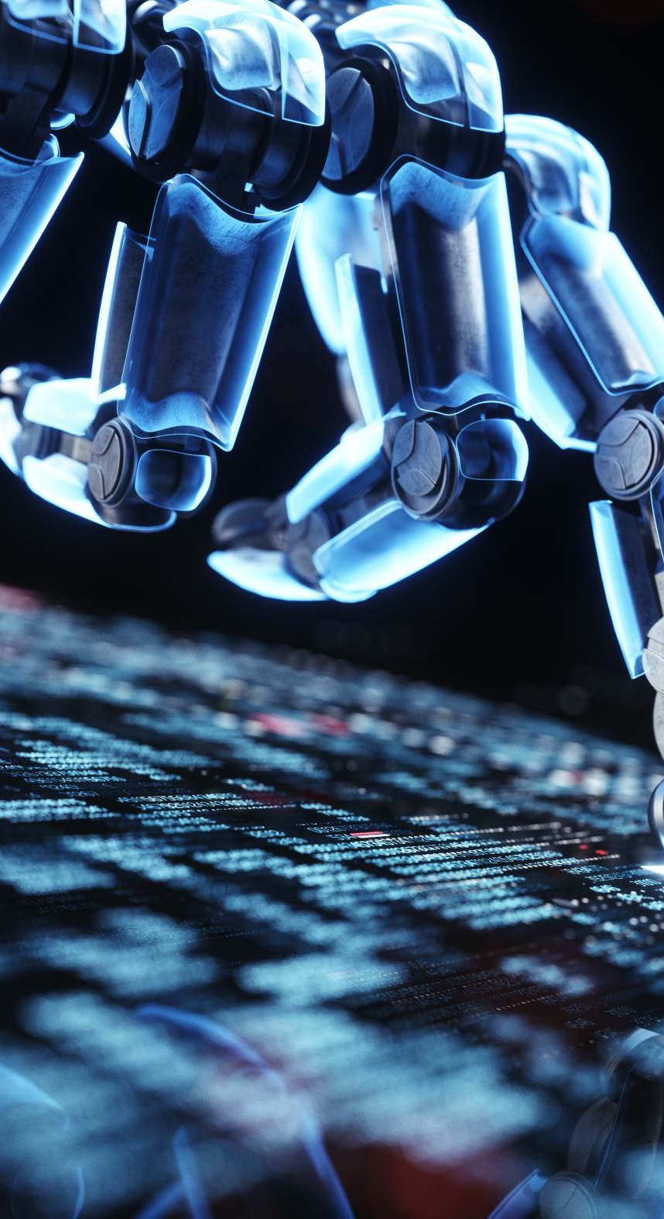
Proposed Solutions to IPR Challenges in Robotics
Reforming Patent Law for AI-Driven Robotics
Elastic Patent Claims: Patent claims must evolve to cover hardware/software hybrid systems. Patents should be adaptable to new technologies that combine AI and robotics.
AI-Specific Patent Rules: Set clear standards for the patenting of AI-driven inventions, including a process to determine human involvement and contribution.
Tiered Patent System: Implement a tiered patent system to provide different levels of protection for hardware, software, and AI components in robotics.
Establishing Ownership for Autonomous Creations
Co-Inventorship with AI: Recognize both human and AI contributions to robotic inventions as co-inventorship. This will ensure that both human creators and autonomous systems are credited.
Electronic Personhood: Treat advanced AI as legal entities, capable of holding patents and being responsible for their creations.

Slide 10
Case Study - Patent Disputes in Robotics
Background
iRobot and the Roomba: iRobot revolutionized the market with the Roomba robotic vacuum cleaner, introducing innovative navigation and cleaning technologies.
Patent Ownership: iRobot owns a significant number of patents related to the navigation and cleansing capabilities of its robots.
The Patent Controversy
Competitors have challenged iRobot's patents, arguing that the technologies used in the Roomba are based on prior inventions.
Key Argument: The technologies are non-patentable as they are incremental innovations and do not meet the necessary criteria for patentability, such as novelty and non-obviousness.

Slide 11
Implications and Challenges of Patent Disputes
Challenges in Determining Innovation
Incremental vs. Radical Innovation: Distinguishing between genuine technological advancements and minor modifications becomes increasingly difficult.
Prior Art: Identifying prior inventions that might influence patentability is a complex process, especially with robotics technologies that evolve rapidly.
The Growing Complexity of Patent Litigation
As the robotics market grows, patent disputes are becoming more frequent and complex.
Impact on Companies: These disputes create uncertainty for innovators and can slow down progress due to prolonged legal battles.
Future Outlook
Innovation vs. Patent Clarity: Striking a balance between protecting innovative technologies and encouraging future advancements is a growing concern for the industry.
Increased Litigation: Patent disputes in robotics will likely escalate, requiring more precise legal definitions and rules around what constitutes patentable technology.

Slide 12

Data Ownership Frameworks
Data-Driven Patents
Patenting Data: Treating data as a component of AI-driven robots could lead to new types of patents focused on data-driven inventions. This would incentivize the collection of high-quality datasets.
Ownership of Data: To prevent disputes, clear guidelines must be set about who owns the data and how it can be used, especially when it's generated by robots in sensitive environments.
Blockchain for Data Ownership
Tracking Data Ownership: Blockchain can create a transparent, tamper-proof record of who owns data and how it is shared. By using blockchain technology, stakeholders can monitor data usage, ensuring that privacy is respected.
Smart Contracts: Blockchain’s smart contracts could facilitate secure data exchanges, ensuring all parties are compensated fairly.

Slide 13
Conclusion
Robotics is Transforming Industries:
Robotics and AI are reshaping industries, making them more efficient and competitive.
Challenges in IPR Must Be Addressed:
Legal frameworks need to evolve to protect the interests of inventors and promote technological progress.
Collaboration is Key:
Governments, companies, and researchers must work together to create IPR policies that support innovation.
The Future of Robotics and IPR:
Clear policies will foster trust, collaboration, and long-term growth in the robotics sector.

Slide 14
Summary of Key Points
The rapid evolution of robotics technology presents significant IPR challenges, particularly around patenting, data ownership, and AI-generated inventions.
Addressing these challenges requires adaptive and flexible legal frameworks, reforming patent laws, and recognizing new types of intellectual property.
Future Outlook
AI and Robotics: As AI and robotics continue to advance, legal frameworks must evolve to accommodate new technological realities and ensure that innovation is incentivized.
IPR Innovations: Expect to see more dynamic IPR solutions that support the growth of AI-driven robotics, balancing protection with accessibility for continued industry progress.

Slide 15

Thank you

