Slide 1
NextHikes Project
Project Name - Feature Extraction and Price Prediction for Mobile Phone
Submitted by – Amarja Bene

Slide 2
Introduction
In a rapidly evolving mobile market, consumers want accurate pricing information, and businesses need to set competitive prices to stay ahead
The data in this project contains detailed information about various mobile phones, including their model, color, memory, RAM, battery capacity, rear camera specifications, front camera specifications, presence of AI lens, mobile height, processor, and, most importantly, the price.
The ultimate goal of the project is to find the factors that affects the mobile price.

Slide 3
Task Involved
Uploading Data
Data Pre-Processing
Data Exploration(EDA)
Feature Engineering
Model Building
Model Evaluation
Feature Important Analysis

Slide 4
Pre-processing Data
Describing dataset
Finding null values and replacing them
Finding duplicate values
Type conversion from object to integer
Dropping unwanted columns

Slide 5
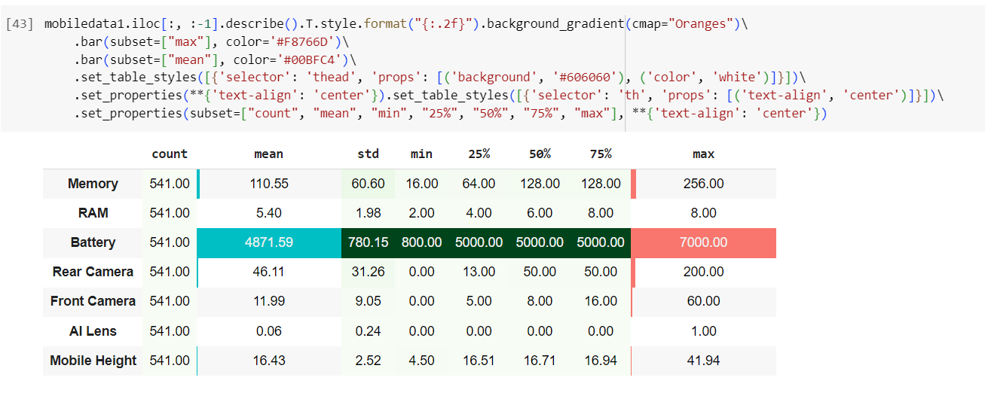
Feature Extraction

Slide 6
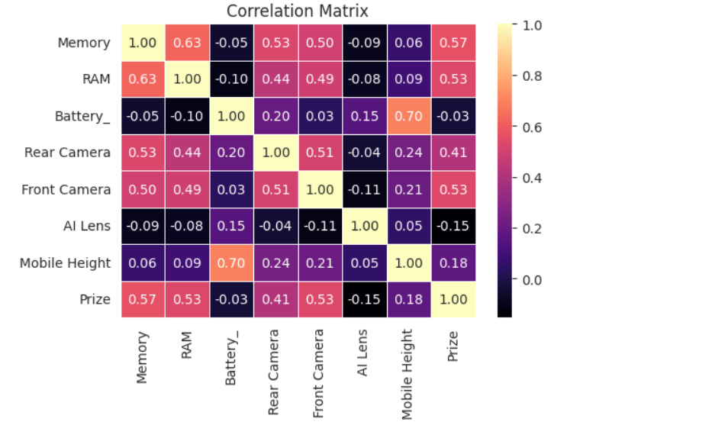
Correlation Matrix
The correlation coefficient has a range of -1 to +1. It exhibits positive correlation when it approaches +1. There is a
strong correlation between the mobile height, battery, memory, and RAM. Memory, RAM, and front camera have a strong link with the correlation matrix of mobile price. This suggests that the cost of the mobile device tends to rise in tandem with the RAM and Memory parameters.

Slide 7
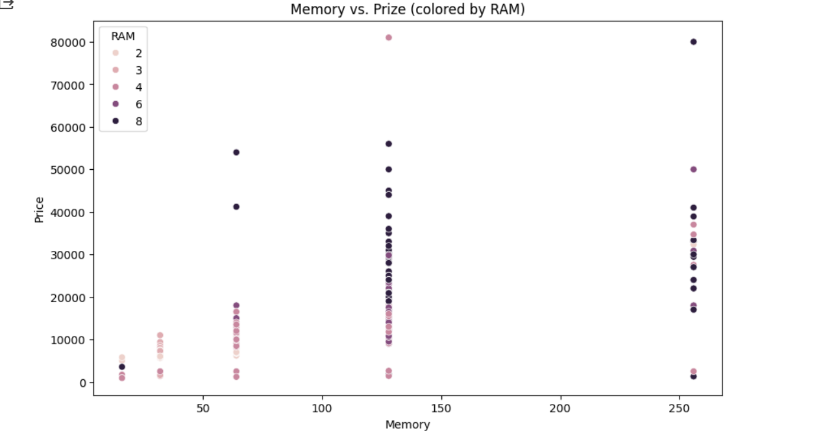
Analysing Relationship with Price
Relation between Memory and Price
The correlation between mobile phone prices and RAM and memory is displayed in this scatter plot. greater
memory and RAM are generally associated with greater pricing, as one might assume, yet there is still a
sizable variance within each group.

Slide 8
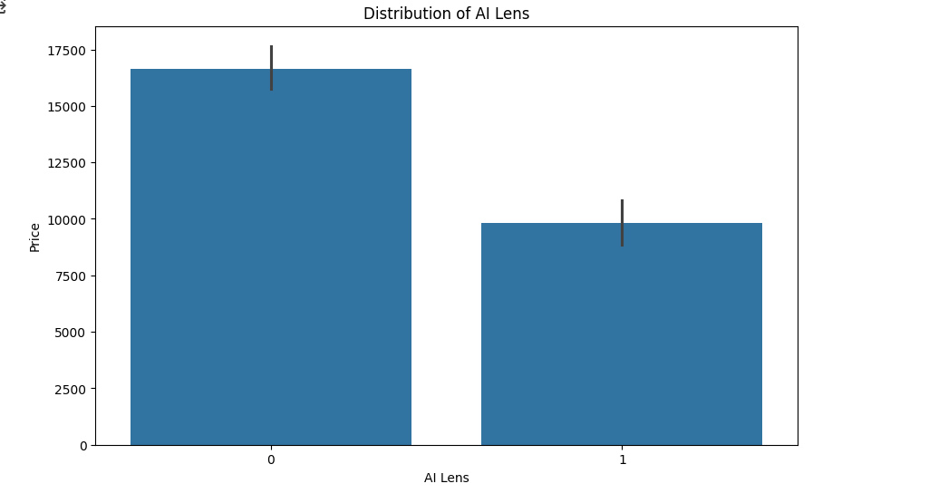
Relation of AI Lens Vs Price
The distribution of the binary variable "AI Lens," which has two possible values, is displayed
in this bar chart. Most of the smartphones in the dataset lack an AI lens (0).
The correlations between features and the target variable (price) are made clear by these
visuals.

Slide 9
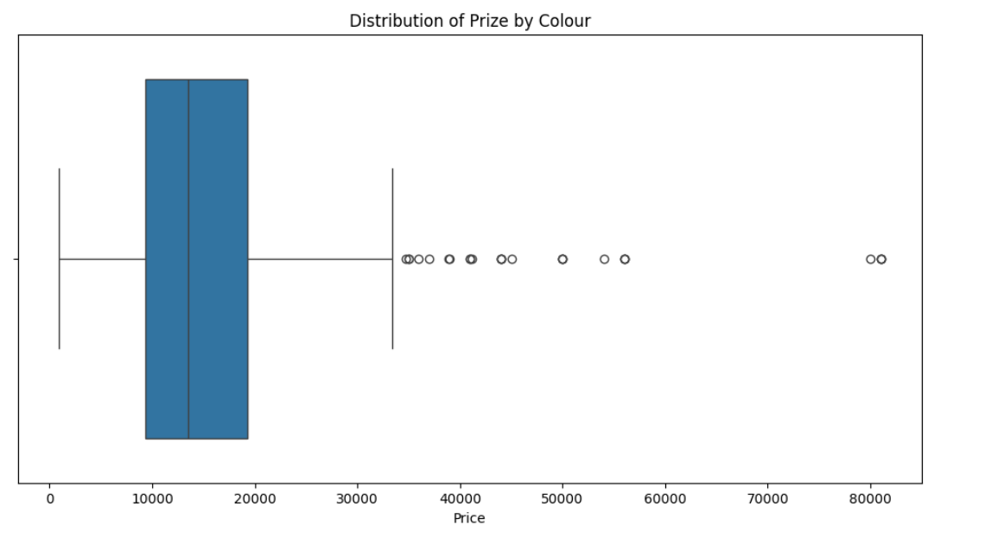
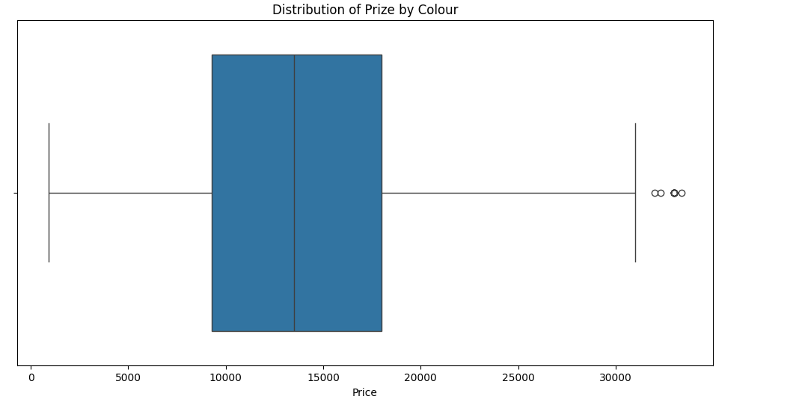
Price Distribution of Colour before and after treating outliers
Before Treating Outliers
After Treating Outliers

Slide 10
RAM and Memory's relationship is visualized using a scatter plot, where the hue corresponds
to the prize. It enables understanding of how the Prize varies with respect to various RAM and
memory configurations in mobile devices.
Distribution of RAM: A significant percentage of smartphones have 4 GB and 8 GB of RAM, followed
by 6 GB. Fewer devices have 2 GB and 3 GB of RAM.
The link between RAM and Memory is visualized via a scatter plot, where the hue corresponds to the Prize. It aids in comprehending how the Prize changes in connection to various RAM and memory configuration combinations in mobile devices. Although there are some exceptions that point to other variables influencing pricing, the plot indicates that higher RAM and Memory configurations typically have higher prices.

Slide 11
Feature Engineering
Transform the object columns to a level by using a label encoder.
The numerical column was scaled using Standardscaler, which rendered it suitable for inclusiveness in the model for predicting the precise mobile prize.

Slide 12
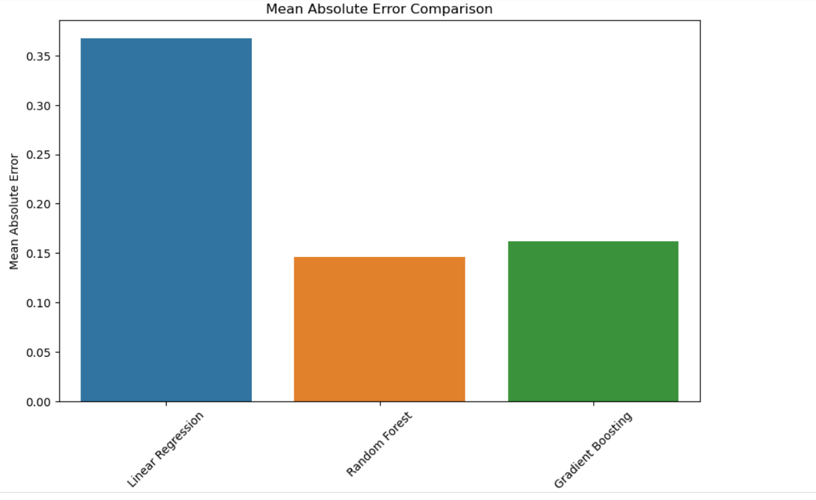
Model building And Model Evaluation
Used Linear regression, Gradient Boosting Regression and Random Forest Regression
The regression models (Linear Regression, Random Forest, Gradient Boosting) are presented in the table along
with the corresponding performance measures (MAE, MSE, RMSE). The Random Forest and Gradient Boosting
models perform better at prediction than Linear Regression, as demonstrated by their much lower errors
across every parameter.
Model | MAE | MSE | RMSE
Linear Regression | 0.384227 | 0.272355 | 0.521877
Random Forest | 0.150873 | 0.058804 | 0.242496
Gradient Boosting | 0.183315 | 0.079825 | 0.282533

Slide 13
Conclusions
This project is about Feature Extraction and Price Prediction for mobile phone using features like
Battery, RAM, Camera, Processor, and Price.
EDA techniques are used to analysis the relation and insight of data, data pre-processing
for finding null values or duplicate values if any.
Machine learning techniques are used to build a model which helps to predict the price of
mobile and by this its recommend that either to use Random Forest or Gradient Boosting both
are effective for predicting the prise of mobile phone.

Slide 14


