Slide 1
AI Emergency Response
& Disaster Management
Portfolio project. Local synthetic-data demonstration.
.NET 10, ASP.NET Core, SQL Server
Engineering demonstration only. Not an operational emergency service.
Notes:
Opening: Describe the difficulty of coordinating incomplete, overlapping incident reports and changing resource context. State that this is a local synthetic-data portfolio demo. The application is not hosted as a verified public demo, is not connected to emergency authorities, and is not approved for real emergency operations. Sources: README.md; docs/portfolio/feature-verification.md.

Slide 2
AI EMERGENCY RESPONSE
Emergency operations workflow
01
Report
A resident submits an incident report with location and reported facts.
02
Review
Authorized staff inspect status, impact, related reports, and unknowns.
03
Coordinate
Dashboard, map, and resource views provide operational context.
04
Act
Human permissions govern commands. AI remains advisory.
Citizens report. Responders and Operators review. EmergencyAdmin and SystemAdmin have higher-level controls.
02
Notes:
Explain that reports contain observations, not confirmed facts. Unknown values remain unknown. The DEMO18 situation manually groups three potentially overlapping reports. It is not a confirmed duplicate, AI summary, or automatic clustering result. Routes and permission boundaries are described in the source controllers and docs/portfolio/demo-walkthrough.md.

Slide 3
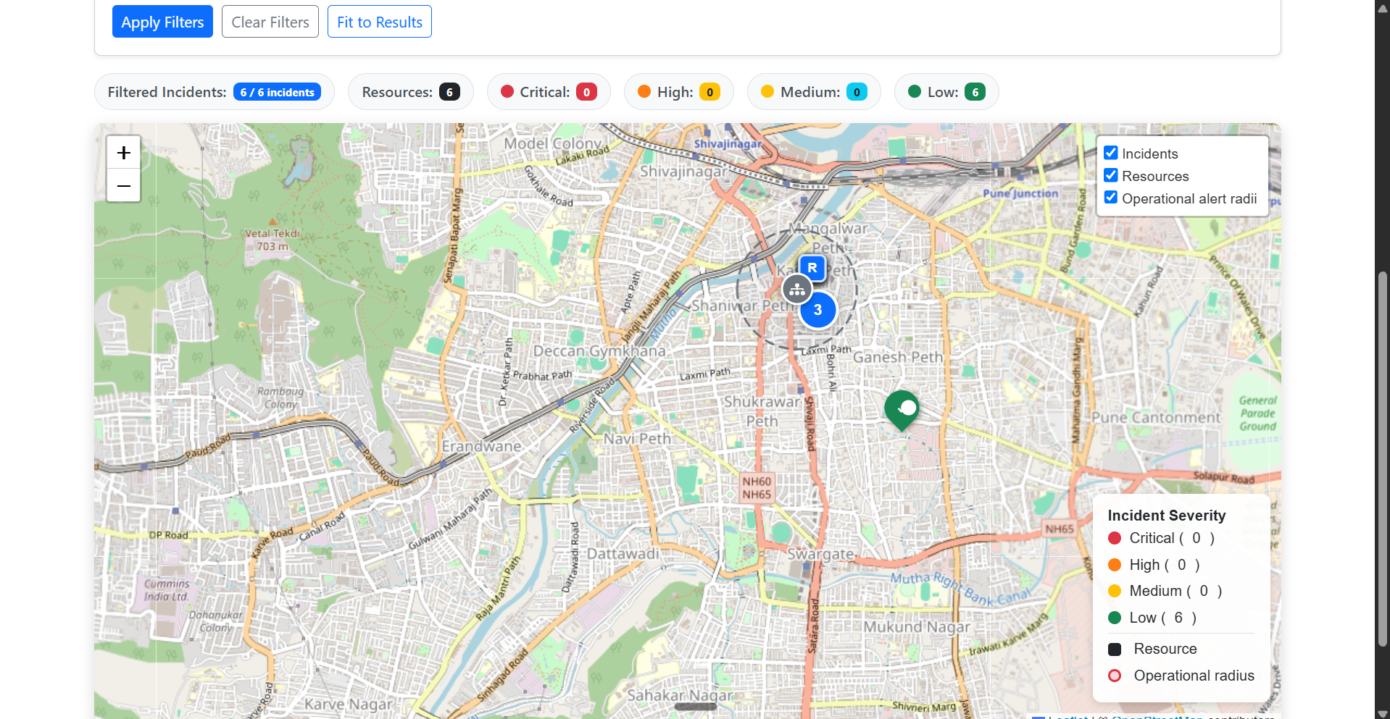
AI EMERGENCY RESPONSE
Application capabilities and available evidence
Incident reporting and review
Operations dashboard and queue
Leaflet map and resource command center
Copilot, situations, notifications
Actual Operator capture, 15 Oct 2026
Six synthetic incidents and resources shown.
Capture predates later UI polish. Attribution is partly clipped. Current final-state capture pending.
03
Notes:
This is a genuine image from docs/portfolio/screenshots/live-map.png, supplied and indexed from a local Chrome session on 2026-10-15. It predates UI changes in Parts 2.3.4–2.3.5. It shows map tiles/layers and six synthetic incidents/resources, but not selected-report drawer behavior, layer toggling, a complete attribution area, or reconnect. It is limited historical evidence, not a current final-state screenshot. Source: docs/portfolio/screenshots/README.md.

Slide 4
AI EMERGENCY RESPONSE
Architecture and technology
Browser
Razor + JavaScript
ASP.NET Core
MVC Web
ASP.NET Core API
SignalR + selected consumers
Application contracts
and Domain rules
Infrastructure
EF Core + integrations
SQL Server
Configured AI, Search,
private media/storage
Service Bus
selected jobs
C#, .NET 10, EF Core, SQL Server, Leaflet, SignalR, ML.NET, Docker, Azure Bicep
04
Notes:
The browser calls the MVC Web app and connects directly to the API SignalR hub. The API depends on Application and Infrastructure layers. SQL Server persists application data and the transactional outbox. Azure AI, Search, storage, and Service Bus require configuration. Selected consumers run inside the API; there is no standalone Worker host, and some queues remain in process. The diagram uses editable native PowerPoint shapes and connectors. Source: README.md and docs/architecture.

Slide 5
AI EMERGENCY RESPONSE
AI assistance, evidence, and permissions
Configured AI and Search can support extraction and Copilot.
Show the actual grounding and citation state.
Deterministic rules calculate severity and priority.
Proposals require explicit approval and revalidation.
Current action executors support notes or tags, not dispatch.
DEMO18 contains no generated AI output. Its flood group is manual; counts may overlap.
05
Notes:
The normal Development host does not provide a fake AI provider. Only ask a Copilot question when configured services and an approved synthetic source are available; otherwise show the unavailable state. Do not fabricate citations or forecasts. DEMO18's three flood-related reports are manually grouped and not confirmed duplicates. A seeded notification record does not prove message delivery. Sources: docs/portfolio/synthetic-demo-data.md; docs/portfolio/demo-walkthrough.md; Copilot controller and UI.

Slide 6
AI EMERGENCY RESPONSE
Engineering evidence and release status
Local release-preparation checks, 17 Oct 2026
Release build passed (49 warnings, 0 errors)
572 unit tests, 89 isolated SQL integration tests
28 UI JavaScript checks, 4 JavaScript syntax checks
No verified public host or Azure deployment.
Current browser and responsive acceptance pending.
Operational pilot remains NO-GO.
Development startup requires reviewed database migrations.
Next: align the local schema, run the real walkthrough, capture corrected screens, and review release blockers.
06
Notes:
The checks are from the actual 2026-10-17 Phase 2.3.6 run; they do not prove UI rendering, provider quality, performance at scale, or production readiness. The user has since supplied a local Development startup error: SQL Server reports missing DataClassification at AdminSeeder. Migration 20261008095318_AddDataClassification exists, but the configured DB/history was not inspected and no migration was applied. Verify the exact target before applying reviewed pending migrations. Azure deployment is out of scope. Sources: docs/portfolio/ui-ux-verification.md; docs/portfolio/feature-verification.md; docs/portfolio/demo-script.md.

