Slide 1






JedAI: The Force behind Entity Resolution
George Papadakis
Leonidas Tsekouras
Emmanouil Thanos
George Giannakopoulos
Themis Palpanas
Manolis Koubarakis

Slide 2
What is the JedAI Toolkit?
JedAI can be used in three ways:
As an open source library that implements numerous state-of-the-art methods for all steps of an established end-to-end ER workflow.
As a desktop application for ER with an intuitive Graphical User Interface that is suitable for both expert and lay users.
As a workbench for comparing all performance aspects of various (configurations of) end-to-end ER workflows.

Slide 3
How does the JedAI Toolkit work?
JedAI implements the following schema-agnostic, end-to-end workflow for both Clean-Clean and Dirty ER:
Step 1
Step 2
Step 3
Step 4
Step 5
Step 6
Step 7
Data Reading
Block
Building
Block
Cleaning
Comparison
Cleaning
Entity
Matching
Entity
Clustering
Evaluation & Storing
Reads files containing the entity profiles and the golden standard.
Creates
overlapping blocks.
Optional step that cleans blocks from useless comparisons (repeated, superfluous).
Optional step that operates on the level of individual comparisons to remove the useless ones.
Executes all retained comparisons.
Partitions the similarity graph into equivalence clusters.
Stores and presents performance results w.r.t. numerous measures.

Slide 4
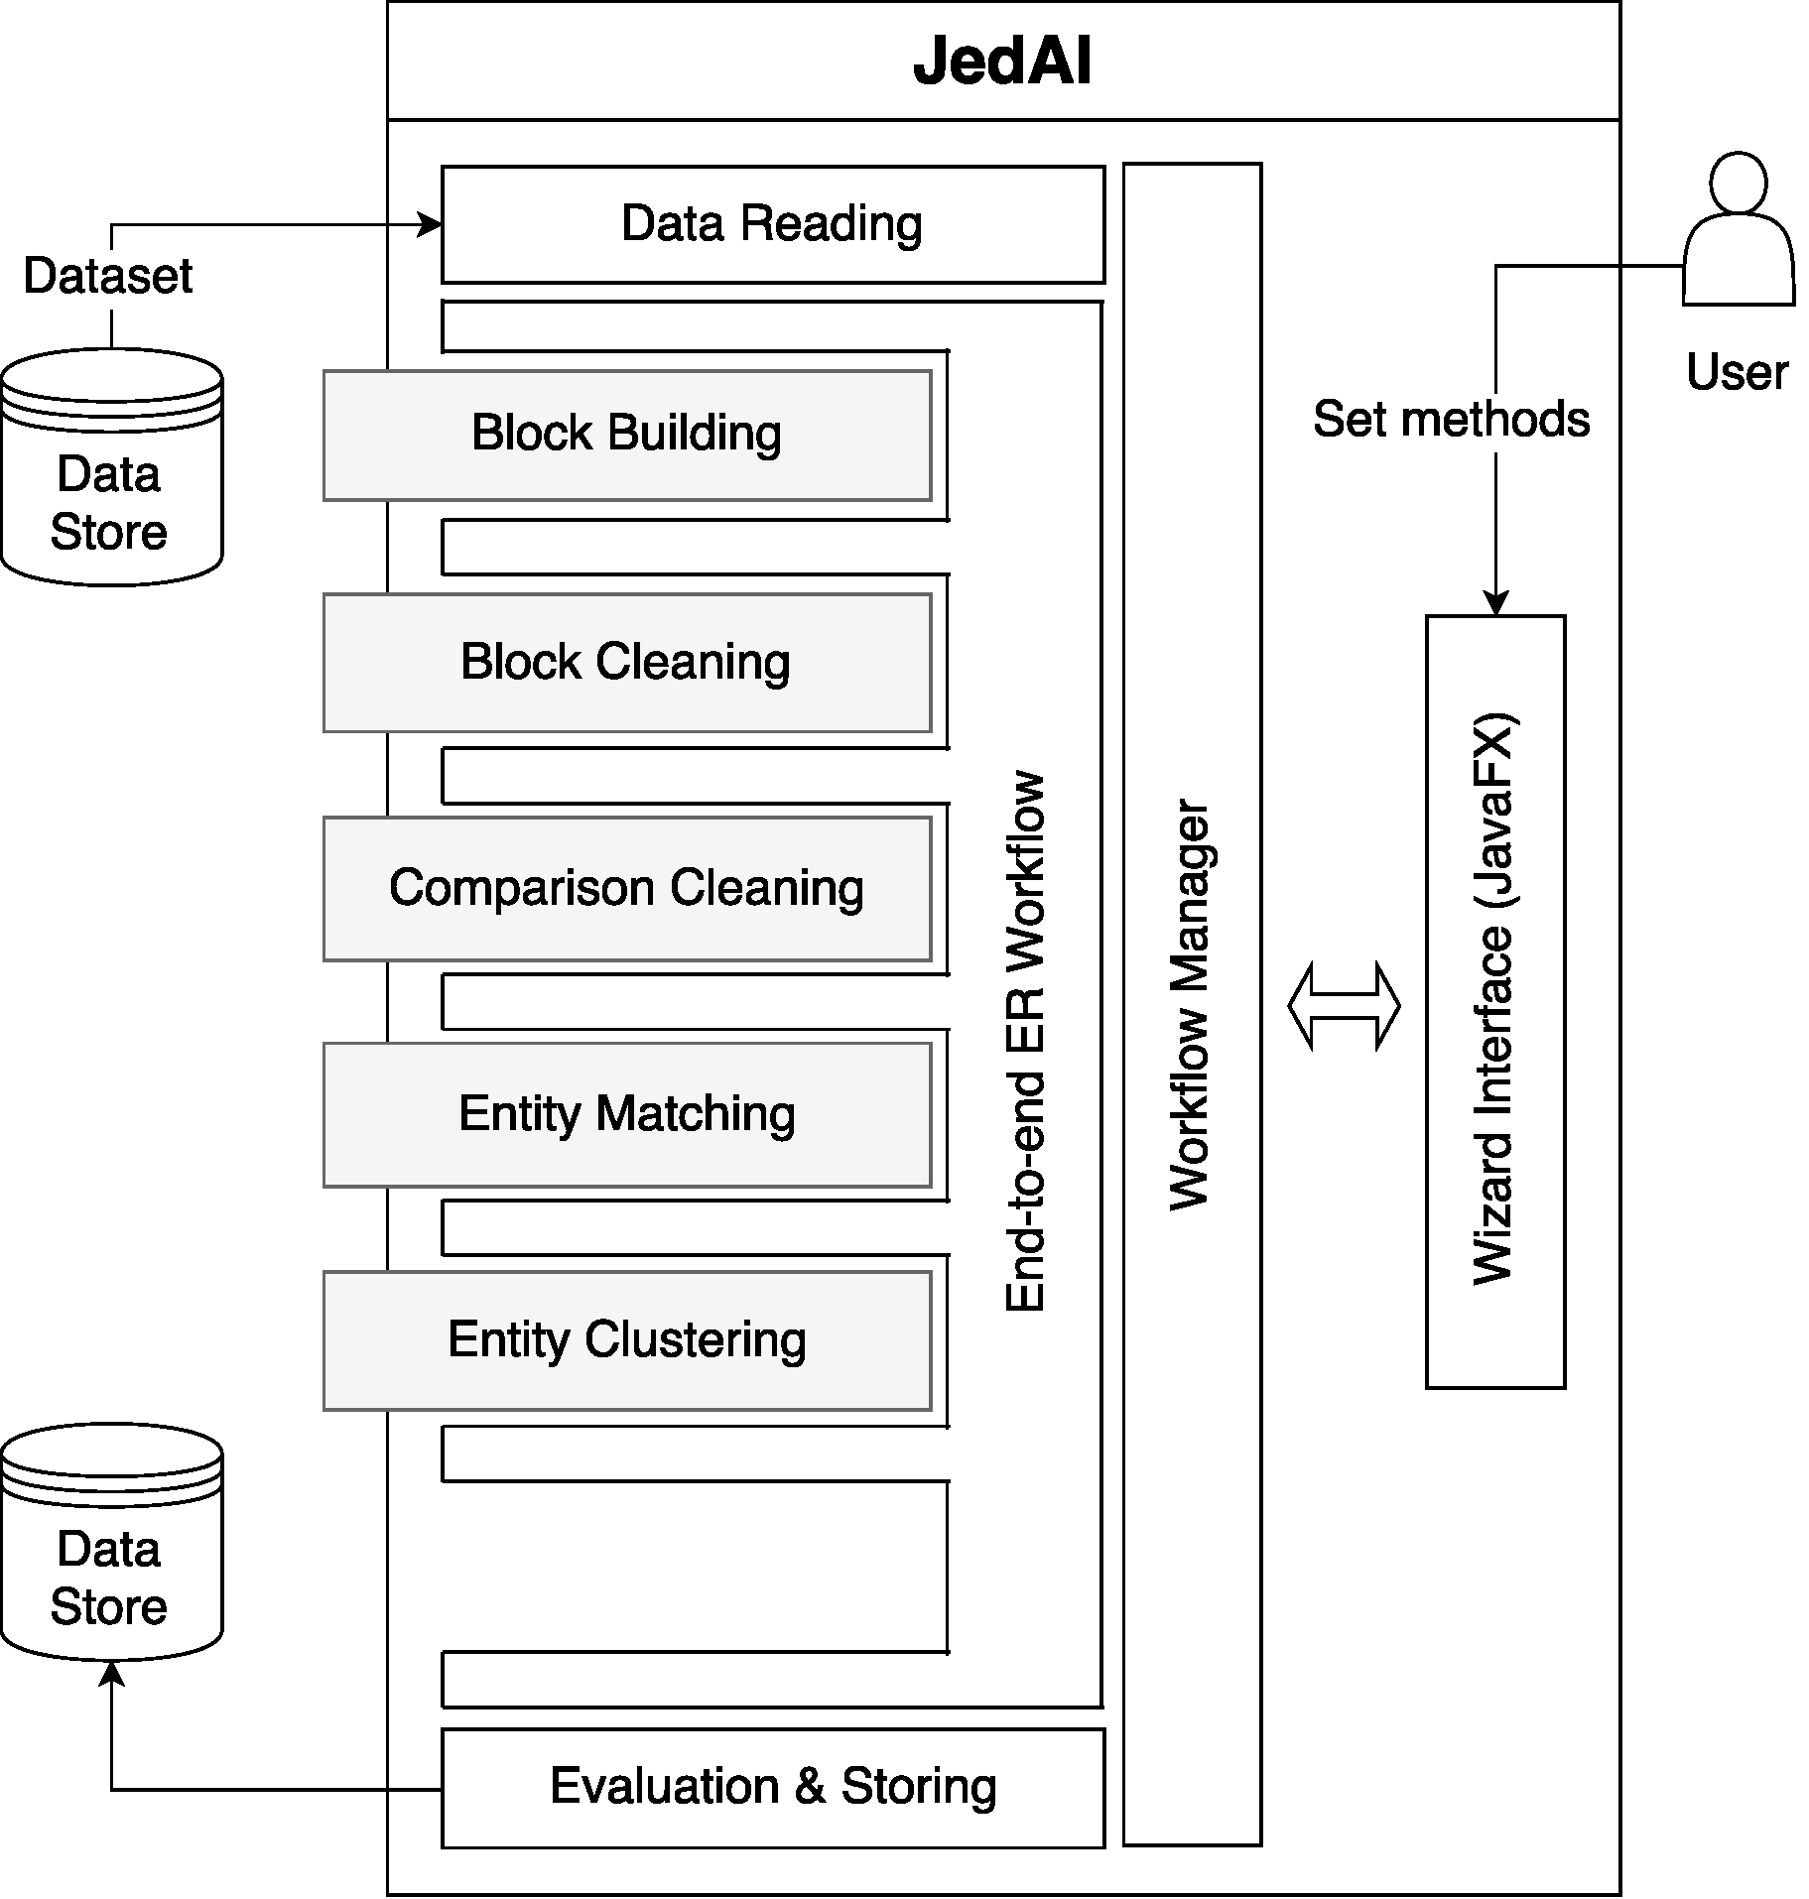
How is the JedAI Toolkit structured?
Modular architecture: one module per workflow step.
Extensible architecture (e.g., ontology matching)
???

Slide 5
How can I build an ER workflow?
JedAI supports several established methods for each workflow step:
Step 1
Step 2
Step 3
Step 4
Step 5
Step 6
Step 7
Data Reading
Block
Building
Block
Cleaning
Comparison
Cleaning
Entity
Matching
Entity
Clustering
Evaluation & Storing
Possible to read CSV, RDF/XML files & relational DBs in any combination!
Choose 1 out of 8 methods.
Specify any combination of 3 (4) complementary methods for Dirty (Clean-Clean) ER.
Choose 1 out of 7 methods (including Meta-blocking).
Combine 1 out of 2
methods with 12 textual representation models and 10 similarity measures.
Choose 1 out of 6 methods for Dirty ER. For Clean-Clean ER, 1 method is available.
Store results as a CSV file.

Slide 6
Which Blocking Methods are included?
Block Building | Block Cleaning | Comparison Cleaning
Token Blocking | Block Filtering | Comparison Propagation
Sorted Neighborhood | Size-based Block Purging | Cardinality Edge Pruning (CEP)
Extended Sorted Neighborhood | Cardinality-based Block Purging | Cardinality Node Pruning (CNP)
Attribute Clustering | Block Scheduling | Weighted Edge Pruning (WEP)
Q-Grams Blocking |  | Weighted Node Pruning (WNP)
Extended Q-Grams Blocking |  | Reciprocal CNP
Suffix Arrays |  | Reciprocal WNP
Extended Suffix Arrays

Slide 7
Where can I find JedAI Toolkit?
Project website: http://jedai.scify.org .
Github repositories:
JedAI Library: https://github.com/scify/JedAIToolkit .
JedAI Desktop Application and Workbench: https://github.com/scify/jedai-ui .
All code is implemented using Java 8.
All code is publicly available under Apache License V2.0.
Documentation (slides, videos, etc) available at https://github.com/scify/JedAIToolkit/tree/master/documentation .
When using JedAI, please cite: George Papadakis, Leonidas Tsekouras, Emmanouil Thanos, George Giannakopoulos, Themis Palpanas and Manolis Koubarakis: "JedAI: The Force behind Entity Resolution", in ESWC 2017.

Slide 8
Which datasets are available for testing?
Several datasets are available for testing at https://github.com/scify/JedAIToolkit .
Can be used for Dirty
ER, as well.
Clean-Clean ER (real) | D1 Entities | D2 Entities
Abt-Buy | 1,076 | 1,076
DBLP-ACM | 2,616 | 2,294
DBLP-Scholar | 2,516 | 61,353
Amazon-GP | 1,354 | 3,039
Movies | 27,615 | 23,182
DBPedia | 1,190,733 | 2,164,040
Dirty ER (synthetic) | Entities
10K | 10,000
50K | 50,000
100K | 100,000
200K | 200,00
300K | 300,00
1M | 1,000,000
2M | 2,000,000

Slide 9
What are the next steps?
Version 2.0:
Includes support for SPARQL endpoints, multicore functionality and configuration optimization.
Available at the end of September, 2017.
Version 3.0:
Includes support for ontology matching, progressive ER as well as a workflow builder.
Available at the end of December, 2017.
Version 4.0:
All functionality is implemented in Apache Spark.
Available at the end of December, 2018.

