Slide 1

Mid Semester Review
Project Title
AI/ML based Load Forecasting on Distribution Networks
Project Guide
Presented by
Dr. Karthikeyan .V
Assistant Professor
NIT Calicut
Amarjith T K (B220682EE)
Adarsh S (B220108EE)
Cherin Jacob Sabu (B220025EE)
Anargha A L (B220166EE)
Department of Electrical Engineering National Institute of Technology Calicut

Slide 2
System Design
Modified IEEE 13-bus distribution feeder adapted for Kerala 11 kV conditions
Grid-connected microgrid with renewable integration
Utility grid modeled as :
Remaining buses retained as electrical junctions to preserve feeder topology and voltage-drop behavior.
TYPE | BUS | LOAD
Slack / Source | Bus 650 | -
Load | Bus 634 Bus 671 Bus 684 Bus 692 | Residential Commercial Industrial Critical
DER | Bus 675 Bus 680 | Solar PV Wind Generation

Slide 3
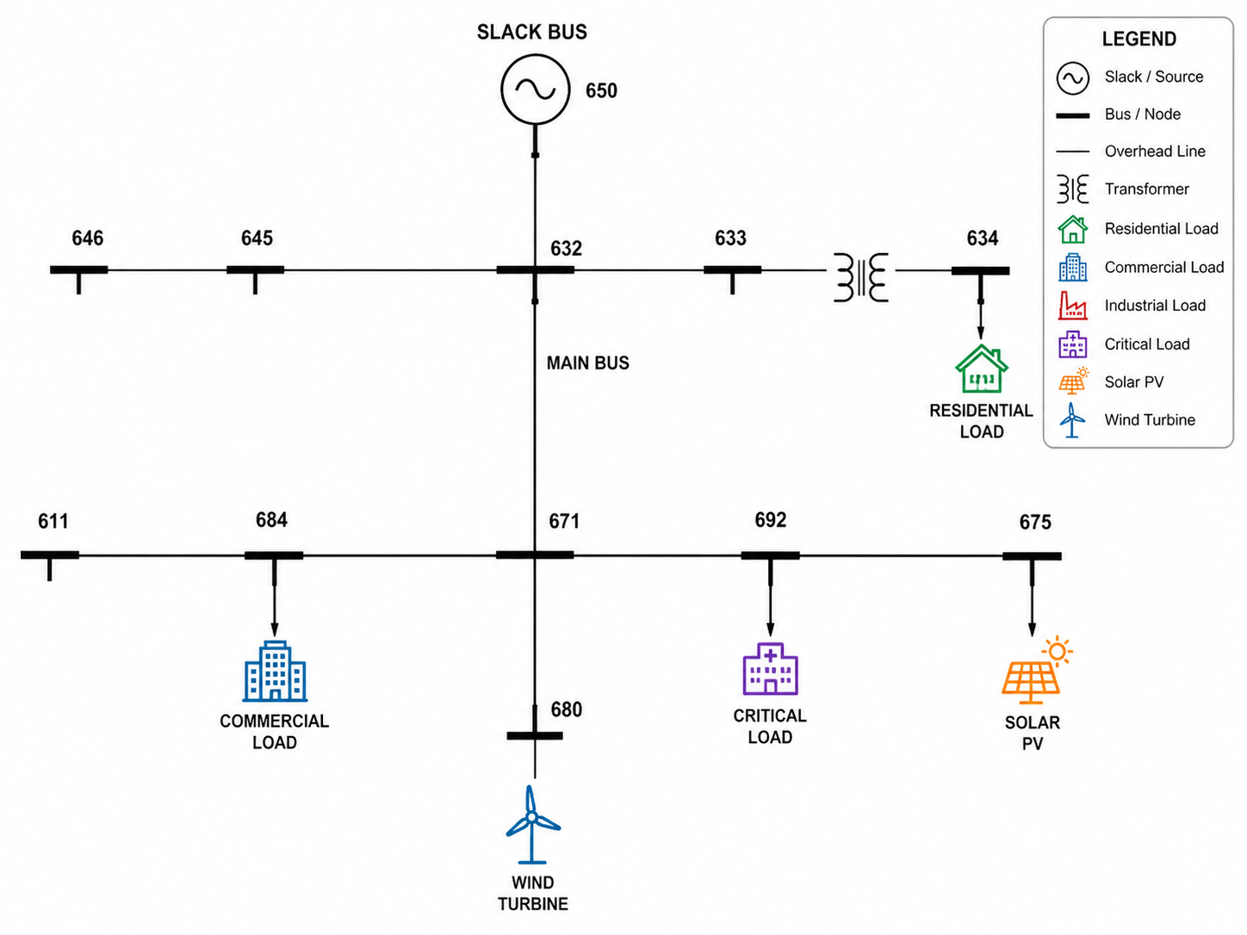
Single Line Diagram

Slide 4
System Ratings and Design Choices
Base System
Renewable DER
Load Sectors
Peak Allocation
IEEE 13-bus feeder
11 kV operating voltage
~4 MW max demand
Grid support for shortfall
Solar PV: 1.2 MW
Wind: 0.8 MW
Total DER: 2.0 MW
No battery storage
Residential: evening peak
Commercial: working hours
Industrial: daytime stable
Critical: always-priority
Residential: 1.5 MW
Commercial: 0.8 MW
Industrial: 1.1 MW
Critical: 0.4 MW
Design Rationale
Load Sector | Bus | Peak
Residential | 634 | 1.5 MW
Commercial | 684 | 0.8 MW
Industrial | 671 | 1.1 MW
Critical | 692 | 0.4 MW
Total Demand | — | ~3.8 MW
Residential sector captures the strong evening peak typical of Kerala households, driven by cooling and lighting loads.
Industrial load provides daytime stability with consistent factory operation patterns.
Commercial sector reflects working-hour demand from offices and retail.
Critical load represents always-priority supply for hospitals, telecom, and water infrastructure.

Slide 5
Weather-Driven Dataset for Kerala Microgrid
Kerala weather data used as the physical backbone for dataset creation
Each daily weather record expanded into 24 hourly timestamps
Weather variables used: temperature
humidity
wind speed
cloud cover
solar irradiance
Hourly patterns imposed to generate realistic sector-wise demand and renewable generation
Generated hourly outputs:
residential load commercial load industrial load
critical load
total load: solar generation, wind generation*
The dataset is not purely random. It is created using: realistic weather forcing hour-wise sector behavior renewable power equations feeder-level engineering constraints

Slide 6
CNN-LSTM Architecture for Hourly Microgrid Forecasting
Predict the next hour values of load and renewable generation using the previous 24 hours* of system history.
Weather inputs: temperature ,humidity* wind speed, cloud cover, solar irradiance,
Historical power inputs: residential load, commercial load, industrial load, critical load, solar generation, wind generation etc.
Model outputs:
LSTM layer- learns sequential dependencies across the time window
Dense output layer- produces next hour multivariate forecast
Planned model parameters
Sequence window: 24 hours
CNN filters: 64
Kernel size: 3
LSTM hidden units: 64
LSTM layers: 1
Batch size: 32
Epochs: 30
Learning rate: 0.001

Slide 7
CNN-LSTM Architecture for Hourly Microgrid Forecasting
Weather Inputs
1. Realistic Weather Forcing
Daily weather records from Kerala are decomposed into 24 hourly profiles using established meteorological patterns.
2. Hour-Wise Sector Behavior
Each load sector follows distinct diurnal patterns — residential peaks in evening, commercial during working hours, industrial steady through daytime.
3. Renewable Power Equations
Solar generation follows irradiance-based bell curves; wind generation uses wind-speed dependent power curves with rated/storm thresholds.
4. Feeder-Level Constraints
All generated data respects IEEE 13-bus topology, voltage limits, and line capacity constraints through OpenDSS power flow verification.
Temp
Humidity
Wind Spd
Cloud
Solar Irradiation
Generated Hourly Outputs
Residential Load
Commercial Load
Industrial Load
Wind Generated
Total Load
Critical Load
Solar Generated

Slide 8
Data Preparation and Model Training Pipeline
Dataset arranged in chronological order
Input variables and target variables normalized using min-max scaling
Sliding-window sequence generation used for time-series learning
Parameter | Value | Parameter
Sequence Window | 24 hours | Batch Size
CNN Filters | 64 | 32
Kernel Size | 3 | Epochs
LSTM Hidden Units | 64 | 30
Loss Function: Mean Squared Error
Optimizer: Adam
Learning Rate: 0.001
Framework: PyTorch

Slide 9
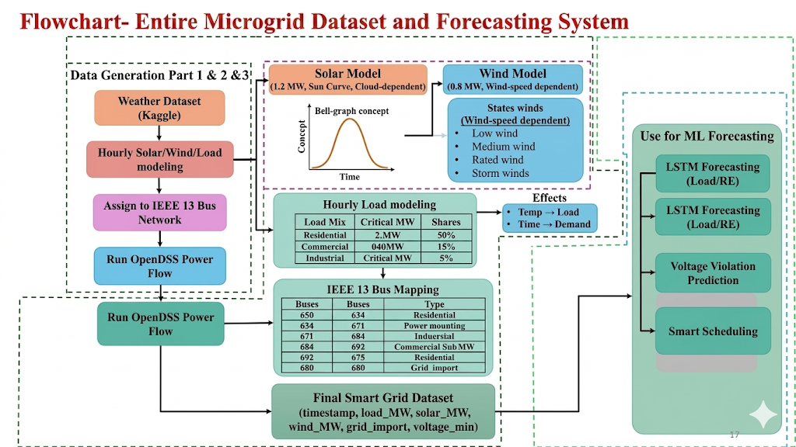

Slide 10
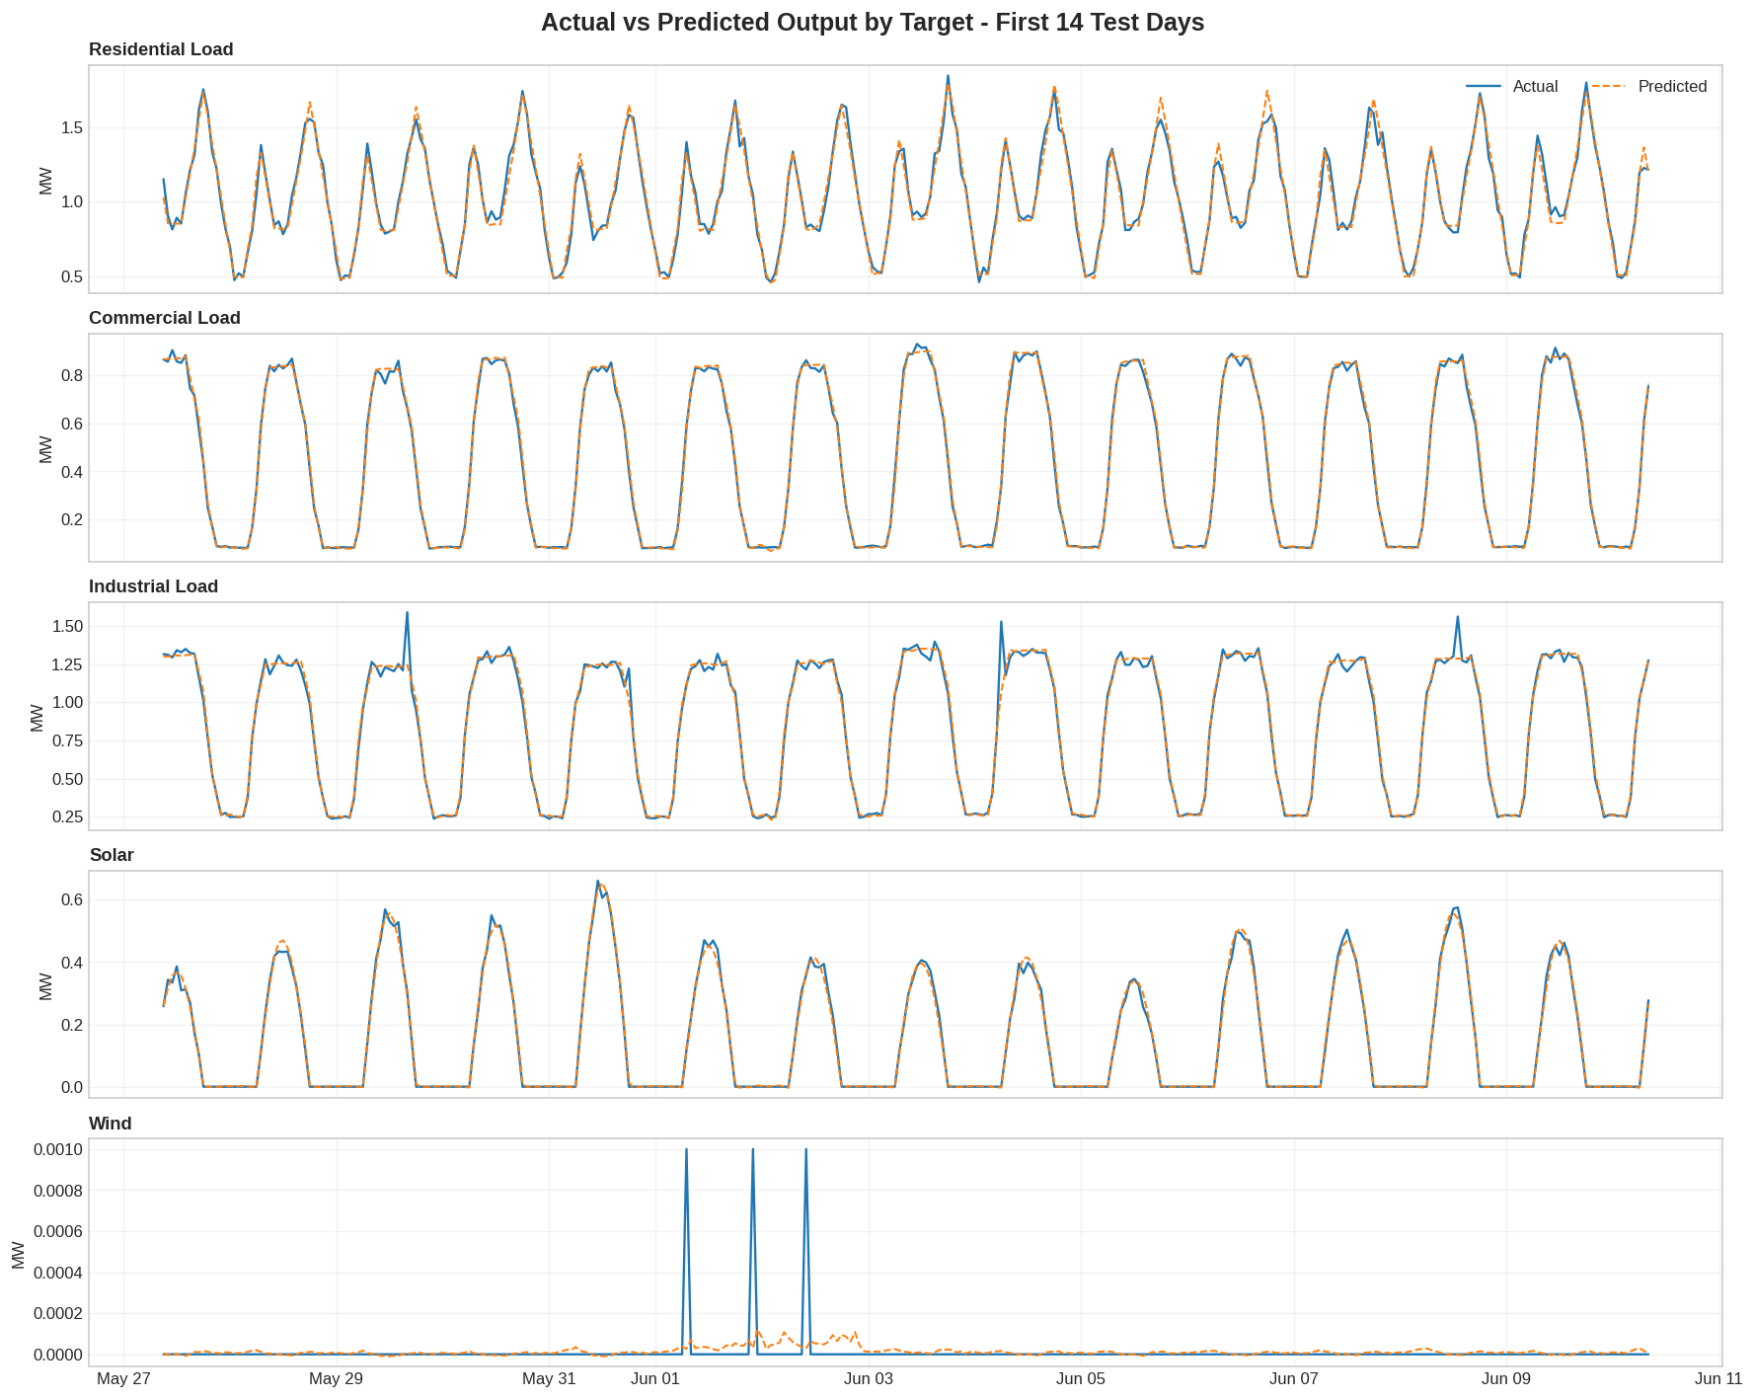
Forecasting Results: Actual vs Predicted

Slide 11
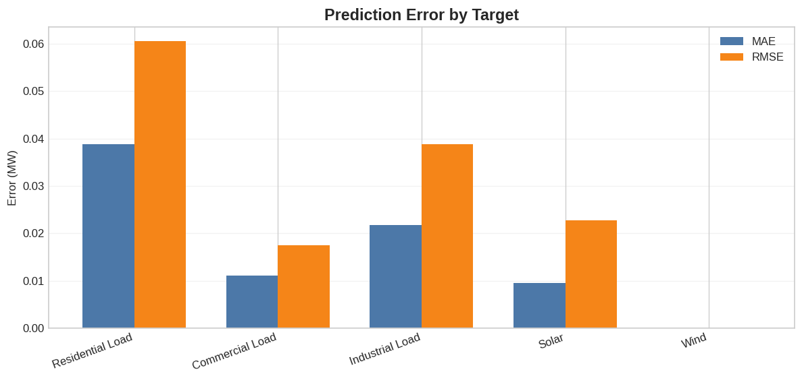
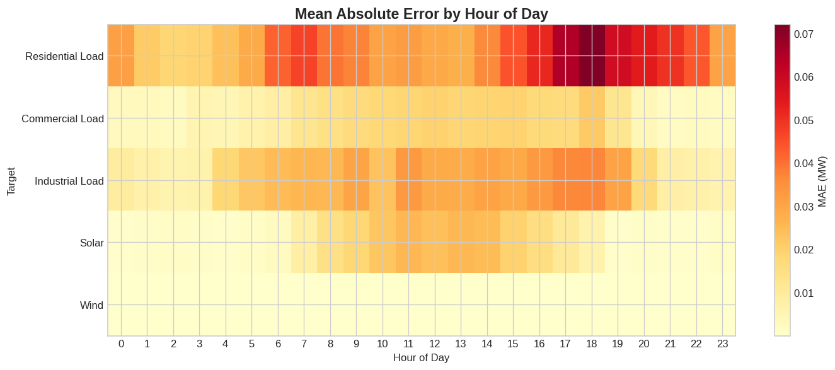

Slide 12
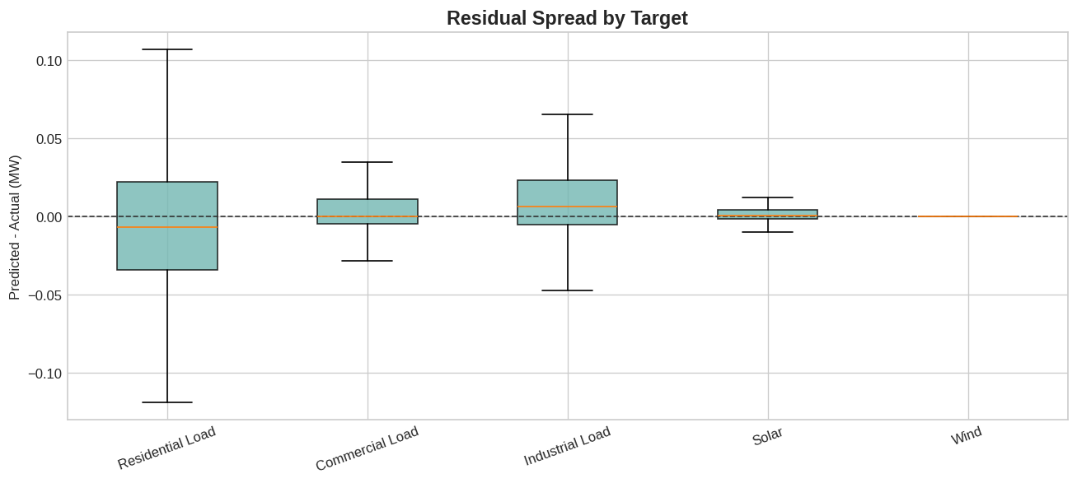
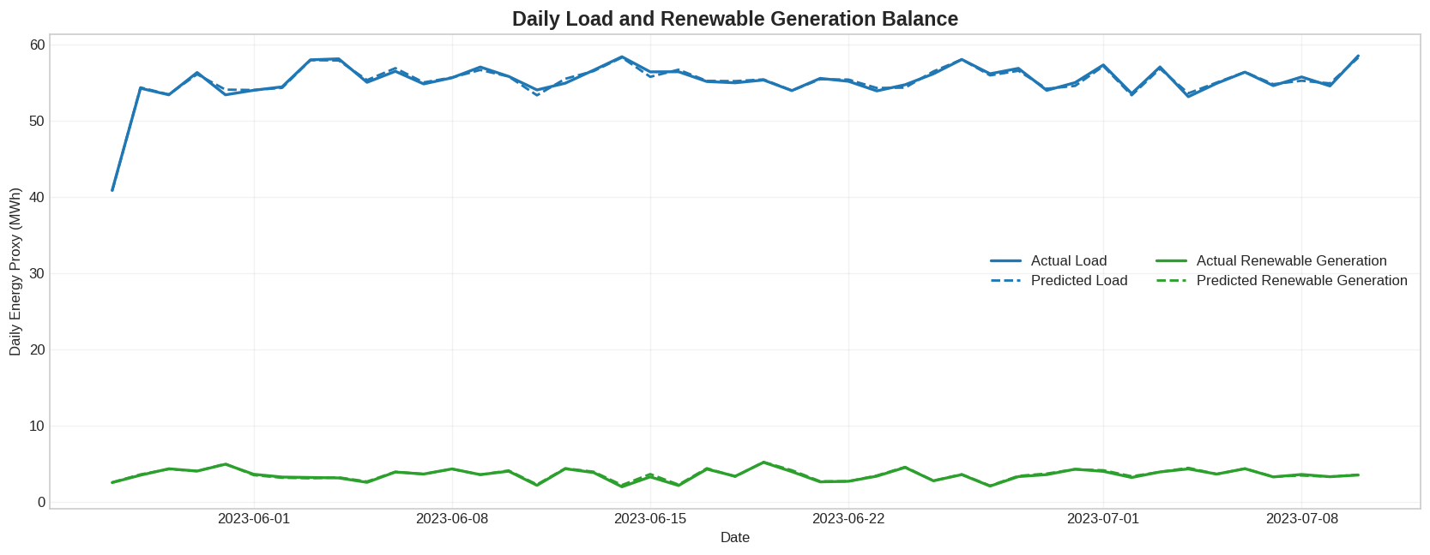

Slide 13
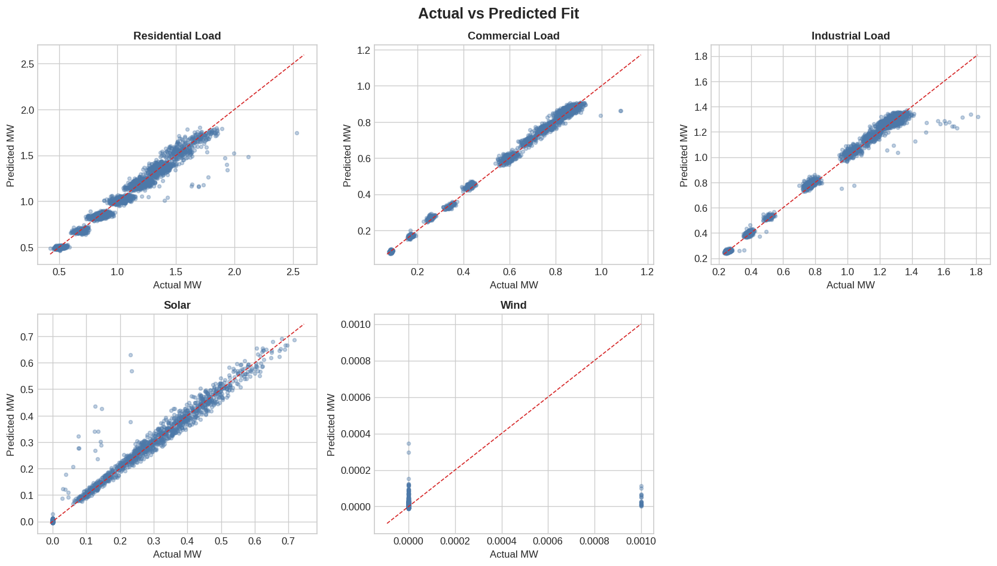

Slide 14
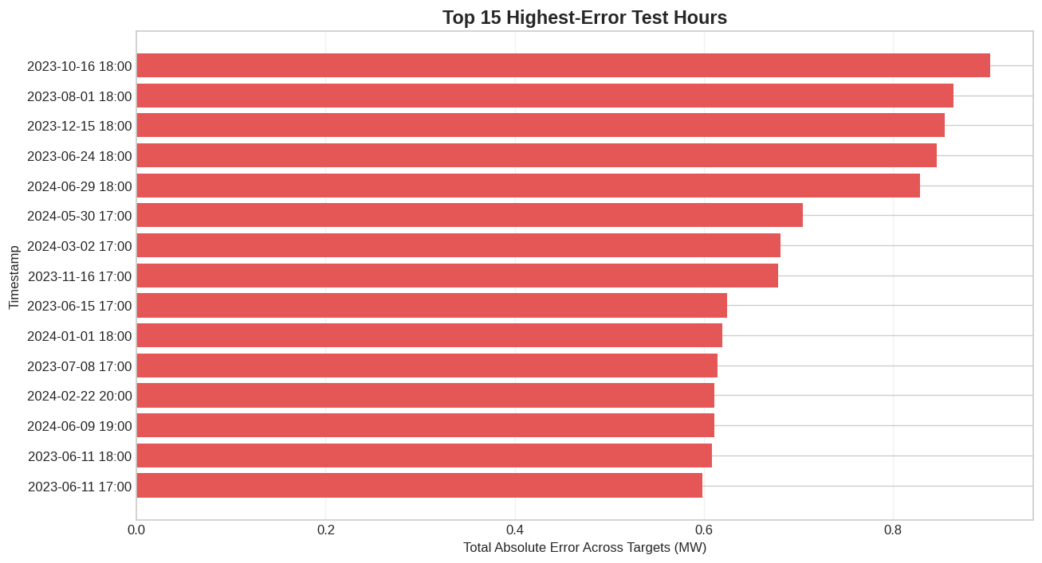

Slide 15
Work Timeline
Work | Month 1-2 | Month 3-4 | Month 5-6 | Month 7-8
Finalizing objectives
Collection and finalization of data
Deploying Server
Displaying historical data
Creation of LSTM model
Smart Energy Monitoring
Optimized control strategy
Validation of system under controlled, real-world conditions
Penalty and billing system integration

Slide 16
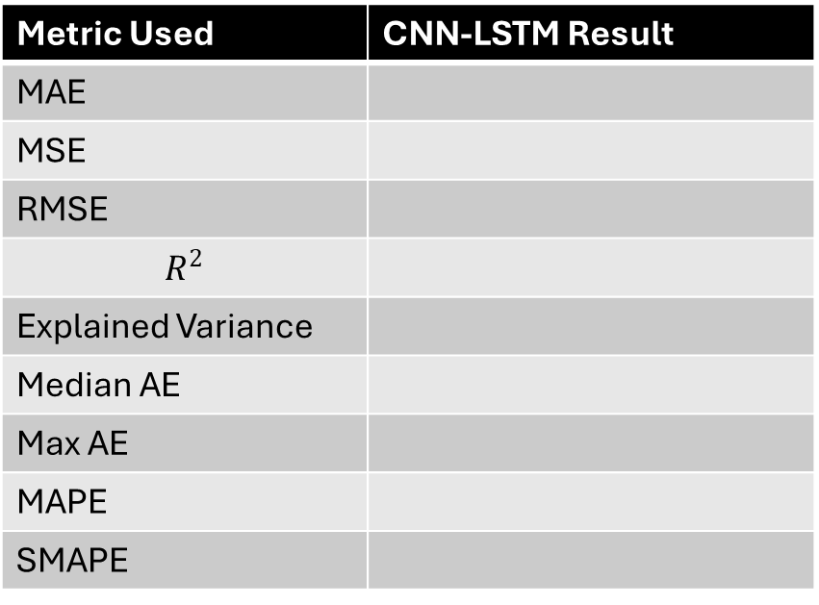
Performance Evaluation of CNN-LSTM
Metric Used | CNN-LSTM Result
MAE
MSE
RMSE
$$R^{2}$$
Explained Variance
Median AE
Max AE
MAPE
SMAPE

Slide 17
CNN-LSTM vs Baseline Forecasting Models
Model | MAE | RMSE | R² | MAPE | Remarks
Linear Regression |  |  |  |  | limited nonlinear learning
GRU |  |  |  |  | lighter recurrent model
LSTM |  |  |  |  | sequential learning only
CNN-LSTM |  |  |  |  | combines feature extraction and temporal learning

Slide 18
OpenDSS-Based Validation of AI Forecasts
Inputs to OpenDSS
Residential Load
Commercial Load
Industrial Load
Critical Load
Solar Gen
Wind Generation
OpenDSS Engine
Power Flow Solver
Physics-Based Validation
AI performs forecasting → OpenDSS performs load-flow → System feasibility is verified
Outputs from OpenDSS
Bus Voltages
Line Currents & Loading
Feeder Power Losses
Grid Import / Export
Voltage Violations
Overload Conditions
Physical Feasibility
Verified Operating States

Slide 19
Seven-Day Ahead Forecast and Hourly Load Flow Analysis
7 Days
1 Hour
168
Forecast Horizon
Time Resolution
Total Simulation Instances
Hourly Simulation Workflow
01
CNN-LSTM Prediction
02
OpenDSS Load Flow
03
Violation Check
Predicts sector-wise load and renewable generation for the next hour
Solves corresponding power flow for the predicted operating point
Checks for voltage and loading violations in system state

Slide 20
LLM-Assisted Analysis of OpenDSS Results
Open DSS produces numerical outputs for each hourly operating state
LLM layer converts technical outputs into readable operational insights
Helps identify stressed hours ,undervoltage periods , overload windows, renewable shortfall periods ,peak grid dependence, recurring evening-risk patterns
Example interpretation: evening peak hours increase feeder stress due to residential demand
daytime solar support reduces grid import*
wind variability affects renewable contribution during non-solar hours

Slide 21
Conclusion
Kerala-adapted IEEE 13-bus microgrid was designed
Weather-driven hourly synthetic dataset was generated
CNN-LSTM forecasted sector-wise load and renewable generation
OpenDSS validated the forecasted operating conditions
LLM-based analysis transformed simulation outputs into decision-support insights

