Slide 1

Employee attrition ANALYSIS
​
Amarjit Harsh
(231140004) (231140011)
Divyesh Parmar Rahul Singh
(231140008) (231140016)
Shivaji Jagatap
(231140023)

Slide 2
Data Source:
IBM HR Analytics Employee Attrition & Performance.
IBM has gathered information on employee satisfaction, income, seniority and some demographics. It includes the data of 1470 employees. The total number of variables is 35.
Link: https://inseaddataanalytics.github.io/INSEADAnalytics/groupprojects/January2018FBL/IBM_Attrition_VSS.html#step_6_test_accuracy

Slide 3
PRIMARY Objective
Examining factors affecting employee attrition, quantifying their influence and building a model to predict the probability of employees leaving based of these factors.

Slide 4
EMPLOYEE attrition
Employee attrition refers to the natural reduction in the number of employees in an organization over time, mainly due to voluntary resignations.
Attrition includes various forms of employee departures, such as resignations, retirements, and deaths, but discussions often focus on voluntary resignations initiated by employees.
According to Gallup, the cost of replacing an individual employee can range from one-half to two times the employee's annual salary.
Attrition rate of above 20 percentage is consider high and undesirable.

Slide 5
EMPLOYEE attrition
Overall job satisfaction
Overall experience
Job hecticness
Personal factors
Job satisfaction
Environment Satisfaction
Relationship Satisfaction
No of company’s works
Years at current company
Years in current role
Years with current manger
Travel involved in work
Work home travel distance
Overtime
Work Life Balance
Age
Gender
Marital status
Education

Slide 6
DESCREPTIVE STATISTICS
 | count | mean | std | min | 25% | 50% | 75% | max
Age | 1470 | 36.92381 | 9.135373 | 18 | 30 | 36 | 43 | 60
DailyRate | 1470 | 802.4857 | 403.5091 | 102 | 465 | 802 | 1157 | 1499
DistanceFromHome | 1470 | 9.192517 | 8.106864 | 1 | 2 | 7 | 14 | 29
Education | 1470 | 2.912925 | 1.024165 | 1 | 2 | 3 | 4 | 5
EmployeeCount | 1470 | 1 | 0 | 1 | 1 | 1 | 1 | 1
EmployeeNumber | 1470 | 1024.865 | 602.0243 | 1 | 491.25 | 1020.5 | 1555.75 | 2068
EnvironmentSatisfaction | 1470 | 2.721769 | 1.093082 | 1 | 2 | 3 | 4 | 4
HourlyRate | 1470 | 65.89116 | 20.32943 | 30 | 48 | 66 | 83.75 | 100
JobInvolvement | 1470 | 2.729932 | 0.711561 | 1 | 2 | 3 | 3 | 4
JobLevel | 1470 | 2.063946 | 1.10694 | 1 | 1 | 2 | 3 | 5
JobSatisfaction | 1470 | 2.728571 | 1.102846 | 1 | 2 | 3 | 4 | 4
MonthlyIncome | 1470 | 6502.931 | 4707.957 | 1009 | 2911 | 4919 | 8379 | 19999
MonthlyRate | 1470 | 14313.1 | 7117.786 | 2094 | 8047 | 14235.5 | 20461.5 | 26999

Slide 7
NumCompaniesWorked | 1470 | 2.693197 | 2.498009 | 0 | 1 | 2 | 4 | 9
PercentSalaryHike | 1470 | 15.20952 | 3.659938 | 11 | 12 | 14 | 18 | 25
PerformanceRating | 1470 | 3.153741 | 0.360824 | 3 | 3 | 3 | 3 | 4
RelationshipSatisfaction | 1470 | 2.712245 | 1.081209 | 1 | 2 | 3 | 4 | 4
StandardHours | 1470 | 80 | 0 | 80 | 80 | 80 | 80 | 80
StockOptionLevel | 1470 | 0.793878 | 0.852077 | 0 | 0 | 1 | 1 | 3
TotalWorkingYears | 1470 | 11.27959 | 7.780782 | 0 | 6 | 10 | 15 | 40
TrainingTimesLastYear | 1470 | 2.79932 | 1.289271 | 0 | 2 | 3 | 3 | 6
WorkLifeBalance | 1470 | 2.761224 | 0.706476 | 1 | 2 | 3 | 3 | 4
YearsAtCompany | 1470 | 7.008163 | 6.126525 | 0 | 3 | 5 | 9 | 40
YearsInCurrentRole | 1470 | 4.229252 | 3.623137 | 0 | 2 | 3 | 7 | 18
YearsSinceLastPromotion | 1470 | 2.187755 | 3.22243 | 0 | 0 | 1 | 3 | 15
YearsWithCurrManager | 1470 | 4.123129 | 3.568136 | 0 | 2 | 3 | 7 | 17

Slide 8
ECONOMETRIC MODELS & ESTIMATION METHODS

Slide 9

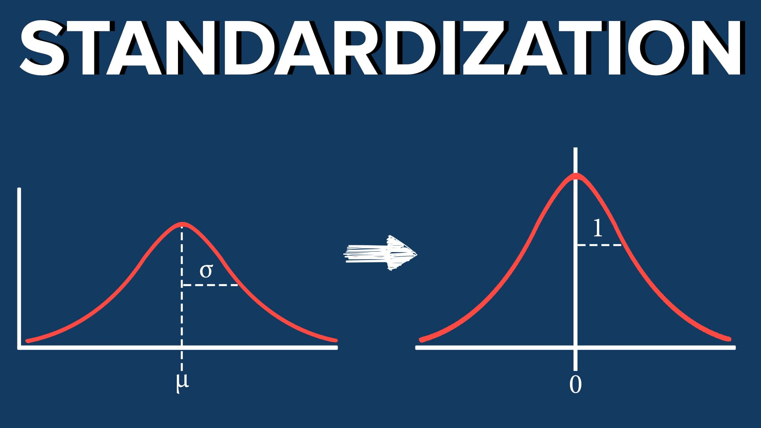


Flow of Modelling
Data Preparation
Standardization
Building model
Model testing
Mapping Categorical Variables
Scaling Data around a mean of 0
Removing insignificant variables
Pseudo R2, AIC, ROC, Accuracy, Precision

Slide 10
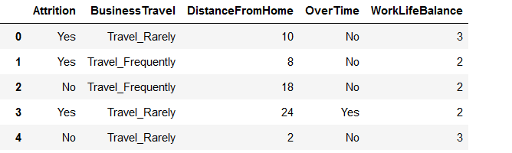
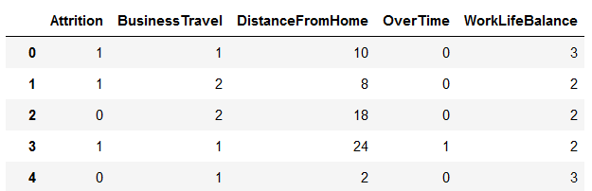
Data preparation
Mapping Categorical Variables to Numerical Values
Dependent Variable “Attrition” is Mapped to 1 and 0
1: Employee leaves
0: Employee Stays

Slide 11
Standardization
BusinessTravel | DistanceFromHome | OverTime | WorkLifeBalance
1 | 10 | 0 | 3
2 | 8 | 0 | 2
2 | 18 | 0 | 2
1 | 24 | 1 | 2
1 | 2 | 0 | 3
Original Data
BusinessTravel | DistanceFromHome | OverTime | WorkLifeBalance
-0.2583 | -0.1337 | 1.2424 | -0.9267
1.6248 | -0.6213 | 1.2424 | 0.4037
-0.2583 | 1.2069 | 1.2424 | -0.9267
1.6248 | 1.5725 | -0.8048 | -0.9267
1.6248 | -0.9869 | -0.8048 | -0.9267
Standardized Data

Slide 12
 |  | Logit 1 | Logit 2 | Logit 3 | Logit 4 | Logit 5 | Logit 6
Job hecticness | Bussiness travel | 0.3364 (0.114) | 0.0756 (0.023) | 0.0786 (0.023) | 0.0779 (0.022) | 0.0747 (0.022) | 0.0761 (0.022)
 | Distancefromhome | 0.1364 (0.114) | 0.0271 (0.023) | 0.0293 (0.023) | 0.0375 (0.022) | 0.0375 (0.022)
 | Overtime | 0.6743 (0.113) | 0.1536 (0.023) | 0.1630 (0.023) | 0.1576 (0.022) | 0.01527 (0.022) | 0.1544 (0.022)
 | Worklifebalance | -0.2794 (0.111) | -0.0455 (0.023) | -0.0531 (0.023) | -0.0361 (0.022)
Personal Factors | Age |  | -0.0807 (0.024) | -0.0667 (0.023) | -0.0411 (0.031)
 | Gender |  | 0.0586 (0.023) | 0.0615 (0.023) | 0.0437 (0.022) | 0.0465 (0.022) | 0.0645 (0.022)
 | Maritalstatus |  | 0.0950 (0.023) | 0.1004 (0.023) | 0.0921 (0.022) | 0.0942 (0.022) | 0.0955 (0.022)
 | Education |  | 0.0115 (0.024)
Regressor
Vs
Regression Model

Slide 13
Overall job satisfaction | Jobsatisfaction |  |  | -0.0403 (0.023) | -0.0339 (0.022)
 | Environmentsatisfaction |  |  | -0.0485 (0.023) | -0.0494 (0.022) | -0.0540 (0.022) | -0.0542 (0.022)
 | Relationshipsatisfaction |  |  | -0.0524 (0.023)
Overall experience | Totalworkingyears |  |  |  | -0.1133 (0.039) | -0.1378 (0.033) | -0.1358 (0.033)
 | Numcompanyworked |  |  |  | 0.1037 (0.025) | 0.1015 (0.024) | 0.0968 (0.024)
 | Yearsatcompany |  |  |  | 0.1329 (0.045) | 0.1153 (0.043) | 0.1162 (0.043)
 | Yearswithcurrentmanager |  |  |  | -0.0989 (0.041) | -0.1215 (0.036) | -0.1230 (0.036)
 | Yearsincurrentrole |  |  |  | -0.0433 (0.039)
Model Explanation
Continued…

Slide 14
Model testing
 | Logit 1 | Logit 2 | Logit 3 | Logit 4 | Logit 5 | Logit 6
Pseudo R2 | 0.1037 | 0.243 | 0.274 | 0.3509 | 0.333 | 0.3266
AUC | 0.5843 | 0.627 | 0.647 | 0.68 | 0.66 | 0.68
AIC | 480.62 | 449.36 | 441.39 | 418.105 | 417.89 | 417.39
Accuracy : 0.6631
PRECISION : 0.7391

Slide 15
Check for Multicollinearity

Slide 16
Independent Variables | VIF Value
Business Travel | 1.023510
Over Time | 1.021068
Gender | 1.026315
Marital Status | 1.032226
Environment Satisfaction | 1.019870
TotalWorkingYears | 2.219991
NumcompaniesWorked | 1.229104
YearsAtCompany | 3.783904
YearsWithCurrManager | 2.710849

Slide 17
FINAL MODEL
Our final Model would be Model 6 with independent variables:
Business Travel
Over Time
Gender
Marital Status
Environment Satisfaction
Total Working Years
Number Of Companies Worked
Year at a Company
Year working under Current Manager
P(Attrition=1) = 1 / (1 + exp(-(0.5119 + 0.0761 * BusinessTravel + 0.1544 * OverTime + (0.0645) * Gender + 0.0955 * MaritalStatus + (-0.0542) * EnvironmentSatisfaction + (-0.1358) * TotalWorkYear + 0.0968 * NumCompWork + 0.1162 * YearsAtComp + (-0.123) * YearsCurrManager )))

Slide 18
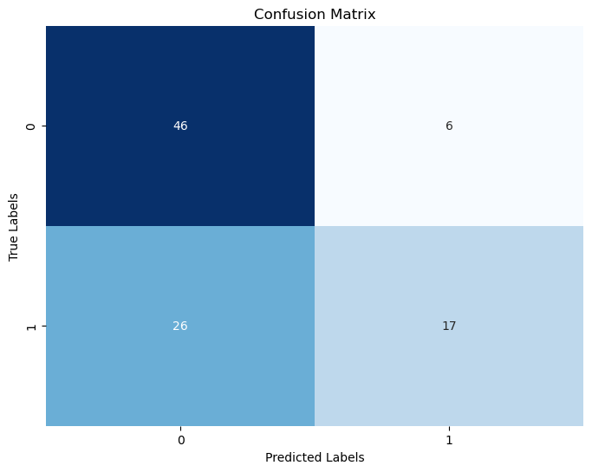
Confusion Matrix
46
6
Type II Error
Type I Error
26
17

Slide 19
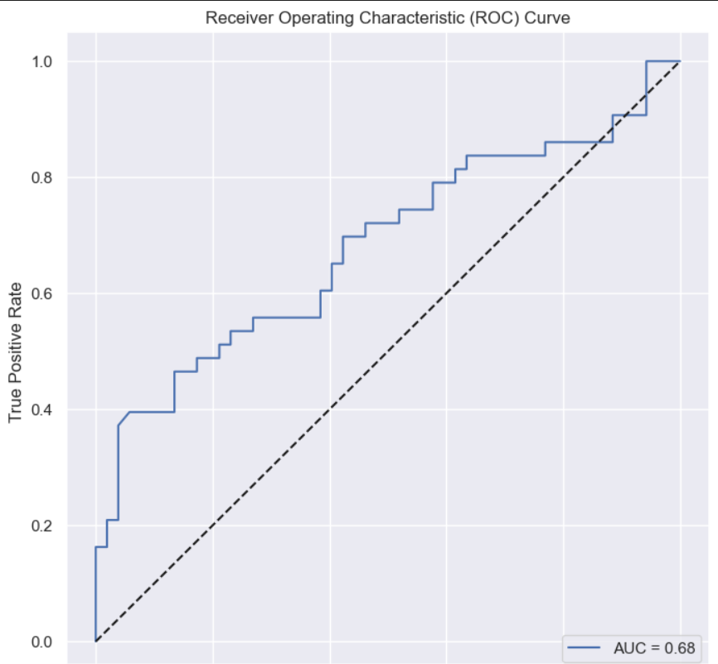
ROC Curve For Model 6

Slide 20
Omitted variables
Field of Work
Some sectors have high attrition rate than others.
For eg: IT sector has higher attrition rate compared to Manufacturing Sector
Economic Stability of Employee
An employee’s financial situation would dictate his decision to switch companies

Slide 21
conclusion
It has been concluded from the final Model that:
1. Though Overall Job Satisfaction is intuitively perceived to play a bigger role in retaining employees, it is observed that odds of leaving the company is higher when the jobs demands higher overtime and higher travel time.
2. Higher negative values of totalworkingyears and yearswithcurrmanager indicates lower chances of employees attrition as it shows more stability in the current company.
3. A value of 0.68 indicates that the model is better than random chance but may have room for improvement in terms of its discriminatory ability.

Slide 22
Suggestions
Address Work-Life Balance: Since overtime and frequent business travel are associated with higher attrition, companies should focus on promoting a healthy work-life balance. Implement policies that encourage reasonable working hours and minimize excessive travel demands.
Retention Strategies for Tenured Employees: Implement retention strategies specifically tailored for employees with longer tenures at the current company or with the current manager.

Slide 23
THANK YOU

