Slide 1

IMPACT OF ECONOMIC FREEDOM PARAMETERS ON LIBERAL DEMOCRACY
​
Amarjit Harsh
(231140004) (231140011)
Divyesh Parmar Rahul Singh
(231140008) (231140016)
Shivaji Jagatap
(231140023)

Slide 2
Economic freedom leads to and maintains democracy
Hayek- Lipset -Freidman Hypothesis

Slide 3
Literature review
,
,
Robert A. Lawson, J.R. Clark (2010). Examining the Hayek–Friedman hypothesis on economic and political freedom
Khan, Zakir S. (2012). Democracy and Economic Freedom : A Static Panel Data Analysis of South Asia.

Slide 4
PRIMARY Objective
To what extent economic freedom parameters have an impact on the dependent variable “Liberal Democracy Index” of different countries.

Slide 5
LIBERAL DEMOCRACY
A democratic system of governance in which individual rights and freedom are officially recognized and protected.
The Liberal Democracy Index (LDI) is a composite index that measures
the extent to which a country practices liberal democracy.
It is used to assess the quality and level of democracy within a country,
particularly focusing on liberal democratic values and institutions.
The LDI combines various indicators and factors to provide a comprehensive evaluation of a nation's democratic performance.

Slide 6
Liberal Democracy Index
Political Rights
Civil Liberties
Rule of LAW
Protection of minority rights
Election and electoral process
It evaluates factors such as the presence of free and fair elections, the existence of political parties, and the ability of citizens to participate in the political process without discrimination or suppression.
It encompass a range of rights and freedoms, including freedom of speech, freedom of the press, freedom of assembly, and protection against arbitrary arrest and detention.
The rule of law component assesses the strength and independence of the judiciary, the effectiveness of the legal system, and the extent to which the government and citizens are subject to the same laws.
The LDI often includes an evaluation of the protection of minority rights, including the rights of ethnic, religious, and other minority groups.
The conduct of elections, including their fairness, transparency, and inclusivity, is evaluated in this component.

Slide 7
ECONOMIC FREEDOM
Economic freedom is based on the concept of self-ownership. Because of this self-ownership, individuals have a right to choose—to decide how to use their time and talents to shape their lives.
Cornerstones of economic freedom are personal choice, voluntary exchange, open markets and clearly defined and enforced property rights.
When economic freedom is present, the choices of individuals will decide what and how goods and services are produced.

Slide 8
Economic freedom index
Size of government
Freedom to trade internationally
Legal system and property rights
Sound money
regulation
Government spending, taxation, and the size of government-controlled enterprises increases, government decision making is substituted for individual choice and economic freedom is reduced.
In its broadest sense, buying, selling, making contracts, and so on- is essential to economic freedom
Protection of person and their rightfully acquired property is a central element of both economic freedom and civil society. Indeed, it is the most important function of government.
Inflation erodes the value of rightfully earned wages and savings. Sound money is thus essential to protect property rights.
Governments also impose onerous regulations that limit the right to exchange, gain credit, higher or work for whom you wish or freely operate your business.

Slide 9
Descriptive Statistics
Variables\range | Min | 1st Quartile | Median | Mean | 3rd Quartile | Max
Size of Government | 3.947490 | 6.060207 | 6.866689 | 6.812897 | 7.592880 | 9.227860
Legal System property Rights | 2.318546 | 4.409099 | 5.161128 | 5.376235 | 6.277716 | 8.680019
Sound money | 4.667936 | 7.531882 | 9.012818 | 8.512712 | 9.444010 | 9.904135
Freedom to trade internationally | 3.407368 | 6.306658 | 7.236472 | 7.196113 | 8.267513 | 9.554968
Regulation | 4.804698 | 6.631479 | 7.238622 | 7.152064 | 7.809919 | 9.286701
Liberal Democracy Index | 0.027 | 0.2347 | 0.417 | 0.438 | 0.675 | 0.888

Slide 10
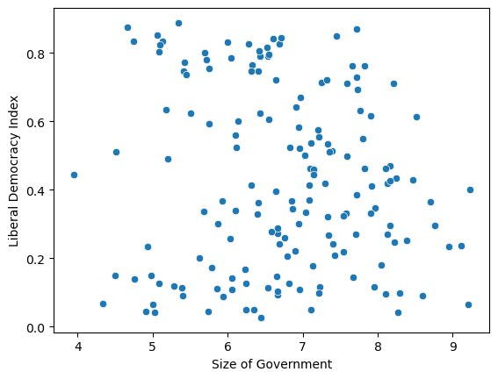
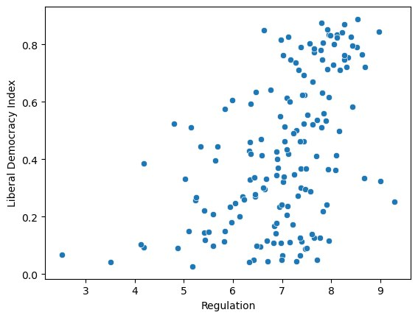
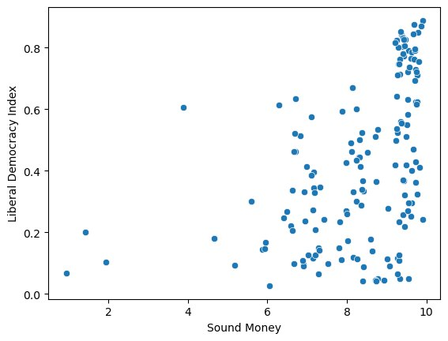
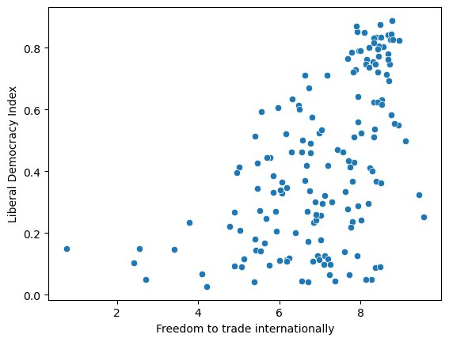
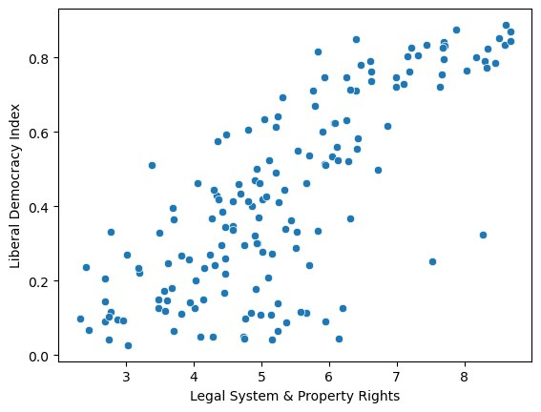
Scatter plots
Observations:
Linear relationship is obtained between Liberal Democracy Index and Legal System & Property Rights
Size of Government is fairly spread out
Most of the countries score good on the Sound Money parameters.
Size of Government
Regulations
Sound Money
Freedom to Trade Internationally
Legal System & Property Rights

Slide 11
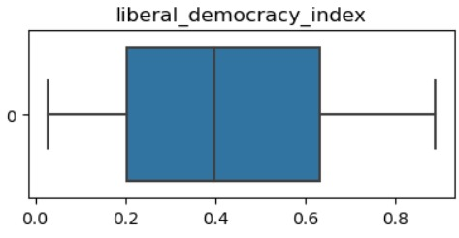
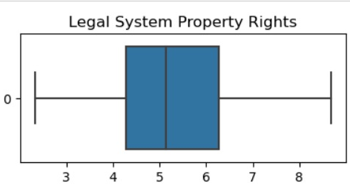
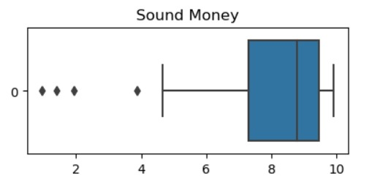
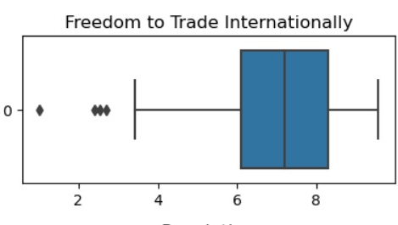
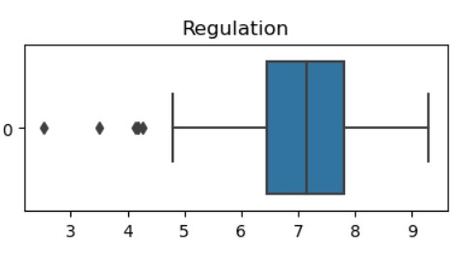
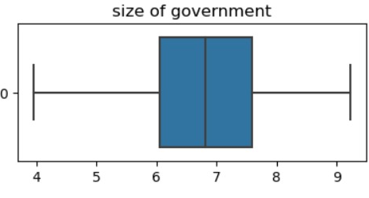
Boxplots
Outlier are detected using percentile method
Observations:
Sound Money
ZIMBABWE: Reserve Bank of Zimbabwe abolished the multiple-currency system and replaced it with a new Zimbabwe dollar, which caused the lower sound money value.
SUDAN: Sudan was facing severe economic crisis in 2019 hence the low sound money value.
ARGENTINA: The 2019 inflation rate of 54.6% can be associated with the low currency value.
2. Freedom to Trade Internationally
Out of the 5 outliers we get for freedom to trade internationally 4 come from the African continent.
Burundi, Algeria, Sudan and Libya.
Iran has poor rating for this metric because of it being sanctioned by the US and its allies.
3. Regulation
Sudan’s democratic transition has been marred by political instability that slowed the pace of rights and rules of the law reforms.

Slide 12
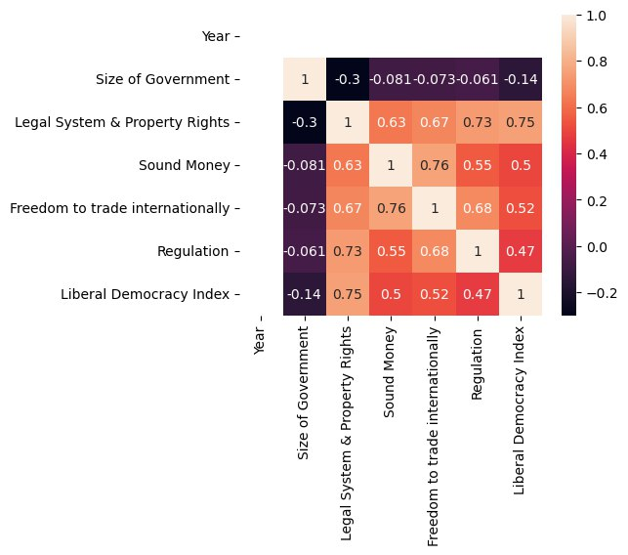
Correlation matrix
High correlation is observed between liberal democracy index and Legal System and property Rights.
For sound money, freedom to trade internationally and regulation medium correlation of around 0.5 is observed with the liberal democracy index.
Size of Government has a very low and negative correlation with our dependent variable.
However, correlation does not always mean that there is causation.
We use p-values to test the statistical significance of each parameter.
Also, since high to medium correlation is observed between our independent variables we need to check for multicollinearity in our model as well.

Slide 13
ECONOMETRIC MODELS

Slide 14
Model 1
Applying Linear Regression Model by considering the independent variable Legal System & Property Rights (LSP) and the Liberal Democracy Index (LDI)of a country. By the following formula: -
LDI ≈ β0 + β1 × LSP
 | coefficient | Std error | t-value | Pr(>|t|)
Intercept (β₀) | -0.2366 | 0.051 | -4.662 | 0.00
LSPR (β₁) | 0.1245 | 0.009 | 13.822 | 0.00
Multiple R-squared: 0.560 Adjusted R-squared: 0.557

Slide 15
Model 2
Applying Multiple Linear Regression Model by considering the independent variable Legal system & Property Rights(LSPR), and Freedom to Trade Internationally(FTI) against the dependent variable Liberal Democracy Index (LDI). By the following formula:-
LDI ≈ β₀ + β₁ × LSPR + β₂× FTI
 | Coefficient | Std. Error | t-statistics | Pr(>|t|)
Intercept | -0.2621 | 0.083 | -3.167 | 0.002
LSPR | 0.1213 | 0.012 | 9.942 | 0
FTI | 0.0059 | 0.015 | 0.390 | 0.697
Multiple R-squared: 0.561 Adjusted R-squared: 0.555
Since the P-value for Freedom to Trade Internationally is calculated to be more than the significance level for our model, we can say that the variable is statistically insignificant and hence we remove this variable from our further models.

Slide 16
Model 3
Applying Multiple Linear Regression Model by considering the independent variable Legal system & Property Rights(LSPR) adding new variable, Regulation (RL) and removing the Freedom to Trade Internationally(FTI) variable against the dependent variable Liberal Democracy Index (LDI). By the following formula
LDI ≈ β₀ + β₁ × LSPR + β₂× RL
 | Coefficient | Std. Error | t-statistics | Pr(>|t|)
Intercept | -0.0131 | 0.115 | -0.114 | 0.909
LSPR | 0.1451 | 0.013 | 11.130 | 0
RL | -0.0469 | 0.022 | -2.165 | 0.032
Multiple R-squared: 0.574 Adjusted R-squared: 0.568

Slide 17
Model 4
Applying Multiple Linear Regression Model by considering the independent variable Legal system & Property Rights(LSPR), Regulation (RL) and Size of Government (SoG) variable against the dependent variable Liberal Democracy Index (LDI). By the following formula:-
LDI ≈ β₀ + β₁ × LSPR + β₂× RL + β₂× SoG
 | Coefficient | Std. Error | t-statistics | Pr(>|t|)
Intercept | -0.1894 | 0.139 | -1.363 | 0.175
LSPR | 0.1565 | 0.014 | 11.272 | 0
RL | -0.0586 | 0.022 | -2.657 | 0.009
SoG | 0.0292 | 0.013 | 2.191 | 0.030
Multiple R-squared: 0.587 Adjusted R-squared: 0.579

Slide 18
Model 5
Applying Multiple Linear Regression Model by considering the independent variable Legal system & Property Rights(LSPR), Regulation (RL) and Size of government (SoG) variable against the dependent variable Liberal Democracy Index (LDI). By the following formula
LDI ≈ β₀ + β₁ × LSPR + β₂× RL + β₃× SoG + β₄× SM
 | Coefficient | Std. Error | t-statistics | Pr(>|t|)
Intercept | -0.2910 | 0.115 | -2.526 | 0.013
LSPR | 0.1521 | 0.014 | 11.051 | 0
RL | -0.0455 | 0.019 | -2.426 | 0.016
SoG | 0.0284 | 0.013 | 2.257 | 0.025
SM | 0.0040 | 0.011 | 0.364 | 0.716
Since the P value for Sound Money is observed to be greater than the significance level hence the variable is statistically insignificant. Therefore, we drop the Sound Money variable from our Model.

Slide 19
Check for Multicollinearity
We use VIF value to check for presence of multicollinearity in our model. If VIF values are significantly below the threshold level of severe multicollinearity, then it indicates that there is little to know multicollinearity among the independent variables in our regression model.

Slide 20
Model 4
Variables | VIF Value
Legal_system_ and_property_rights | 2.49
regulation | 2.28
Size_of_ government | 1.16

Slide 21
CHECK FOR Heteroskedasticity

Slide 22
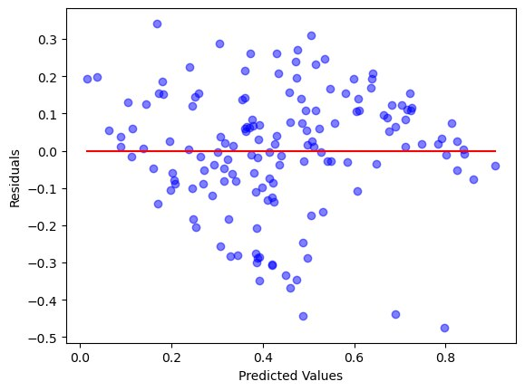
Visual Inspection of Residuals
From above graph, we can see that the residual is randomly scattered about the line y=0, it indicates that the model is a reasonable fit for our data and that the assumption of linear regression are met to significant extent. Hence our model does not exhibit bias in his prediction and have roughly constant variance across the range of predicted values. So, our assumption of homoskedasticity is met.

Slide 23
White’s Test for HETEROSKEDASTICITY
Null Hypothesis, H₀: Homoskedasticity
Alternate Hypothesis, H_{A}: Heteroskedasticity
Mathematically we can perform White’s test to check for heteroskedasticity.
After performing the test, we observed that,
p-value for our model 4 = 0.811 > significance level(0.05)
Therefore, we accept the null hypothesis.

Slide 24
FINAL MODEL
Our final Model would be Model 4 with independent variables: Legal System and Property Rights, Regulations and Size of government coming out be statistically significant to our dependent variable, Liberal Democracy Index. The relationship can be represented as:
LDI ≈ (-0.1894) + (0.1565) × LSPR + (-0.0586) × RL + (0.0292) × SoG
(0.139) (0.014) (0.022) (0.013)
Multiple R-squared: 0.587 Adjusted R-squared: 0.579

Slide 25
conclusion
It has been concluded for above equation that:
A positive coefficient for "Legal System & Property Rights" suggest that when it is stronger or more protective of individual rights and property, it tends to contribute positively to a country's liberal democracy index
A higher value SoG keeping other variable constant is that the government has lesser control of enterprises owned by individual, the individual choice is not overshadowed by the government decision. Thus, improving level of liberal democracy.
Sound Money and Freedom to Trade Internationally is not a significant parameter for Liberal Democracy Index.
Economic parameters can determine liberal democracy index to up to 58.7%

Slide 26
THANK YOU

