Slide 1

Customer Retention Project

Slide 2
Contents
Introduction
What is Customer Retention and its benefits
Tools, Dataset and Assumption
Analysis
Conclusion
Limitations and Scope for future work

Slide 3
Introduction
Through this slides we will be looking at the analysis made on the customer retention rate for Indian e-commerce companies
We will be analysing the retention rate with the help of a survey answered by e-commerce customers on online retail companies and the factors that influence their purchase decision
We will also be looking at the expectations of the customer on a good e-commerce website

Slide 4
What is Customer Retention ?
Customer retention refers to the activities and actions companies and organizations take to reduce the number of customer defections.
The goal of customer retention programs is to help companies retain as many customers as possible, often through customer loyalty and brand loyalty initiatives.
It is important to remember that customer retention begins with the first contact a customer has with a company and continues throughout the entire lifetime of the relationship.

Slide 5
Benefits of Customer Retention ?
Retention is Cheaper than Acquisition
Loyal Customers are More Profitable
You’ll Earn More Word of Mouth Referrals
Customers Will Explore Your Brand
Loyal Customers are More Forgiving
Customers Will Welcome Your Marketing
You Earn Wiggle Room to Try New Things

Slide 6
Data And Assumptions
The gathered data contains 269 surveyors and 47 answers from each one of them
We have asked questions and recorded answers on 4 major categories.
The basic information of the population.
How was the online purchase made
Important factors for making purchase decision and drives satisfaction
Which e-commerce sites satisfies the above factors to make purchase decision and drives satisfaction
The Assumption for this analysis is that, when we recommend something to a friend, it is most likely that we are using it, we will be using it in future and we are satisfied with the service/experience we’ve received.

Slide 7
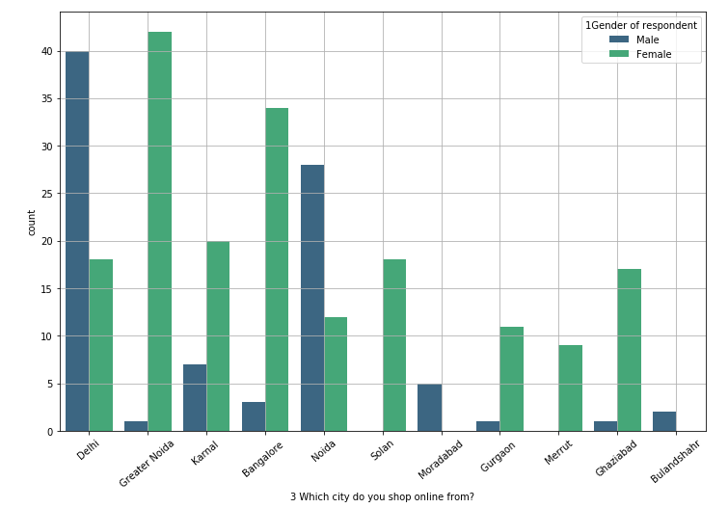
Analysis (Stats and Python)
The Analysis is for the Indian e-commerce websites and the survey was randomly made from the buyers of different cities of India.

Slide 8
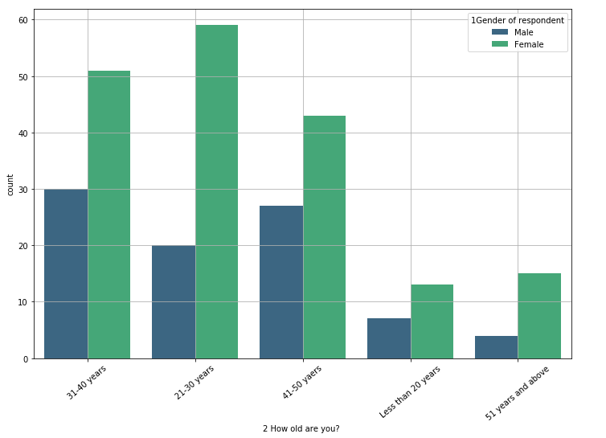
The population data consists of surveys from both male and female buyers from all age ranges, which is used to determine the factors that influence the customer retention rate.

Slide 9
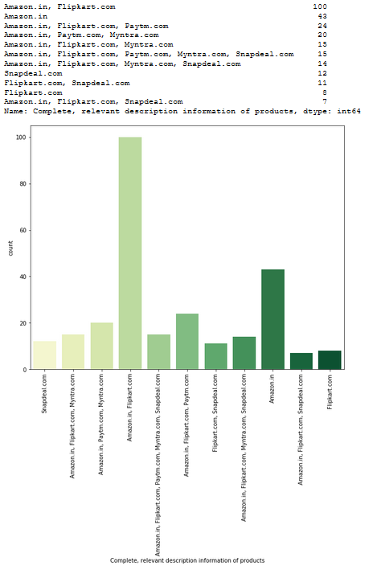
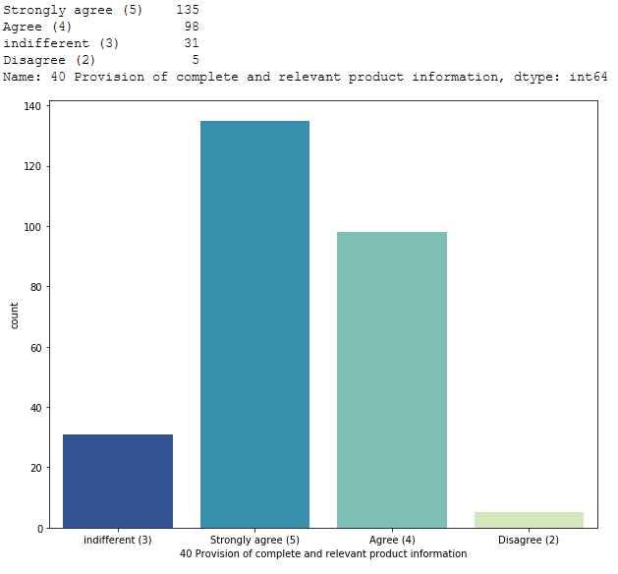
Here, we are comparing the buyer’s expectation in any e-commerce website (Online Shopping Platform) with the actual companies which meet their expectations.
It is important for the companies to display all relevant information on listed products.
Most of the buyers believe Amazon and Flipkart provides this experience

Slide 10
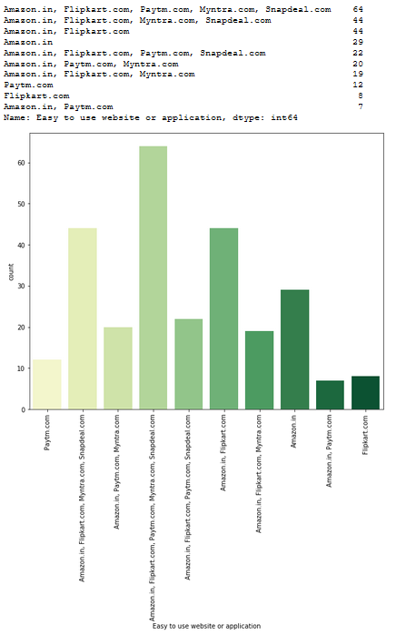
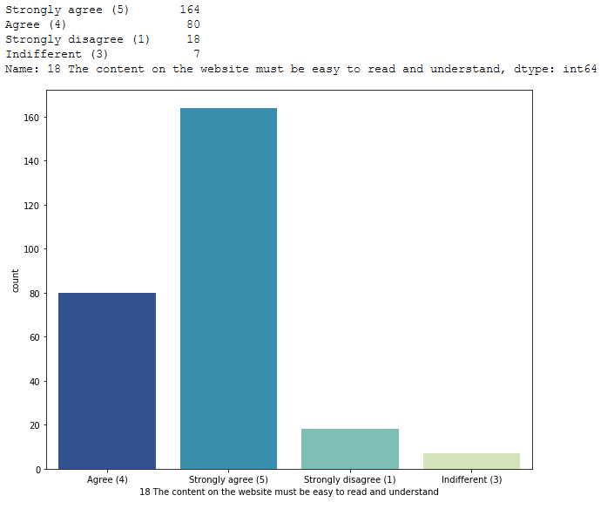
Most of the buyers believe that the content on a e-commerce website must be easy to read and understand.
Here the expectations of the buyer is met by almost all the company, however the majority population mentioned Flipkart and Amazon.

Slide 11
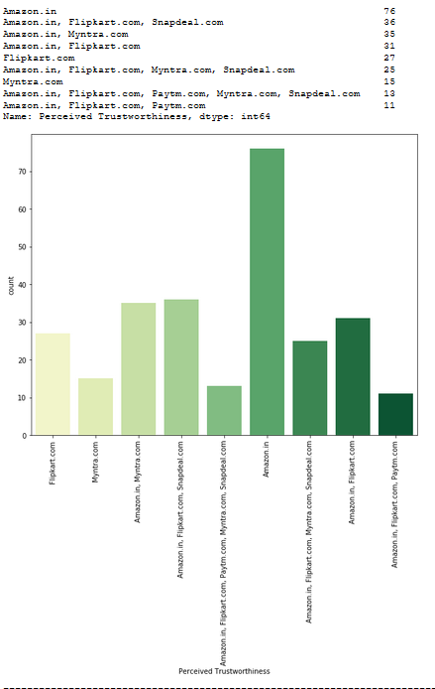
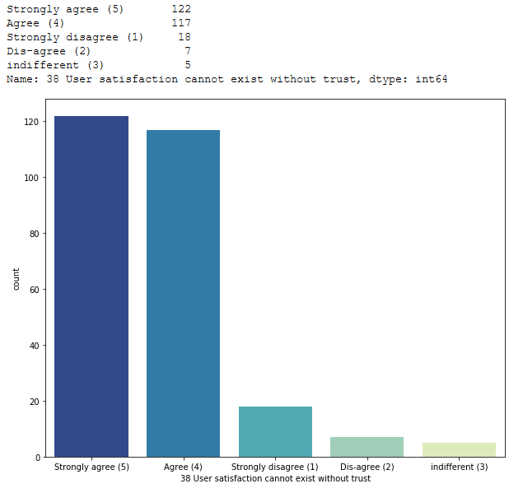
Buyers believe that the user satisfaction cannot exist without trust in an e-commerce website
Here we can clearly see from the above graphs, Amazon tops the list for the trust they have gained among the buyers.

Slide 12
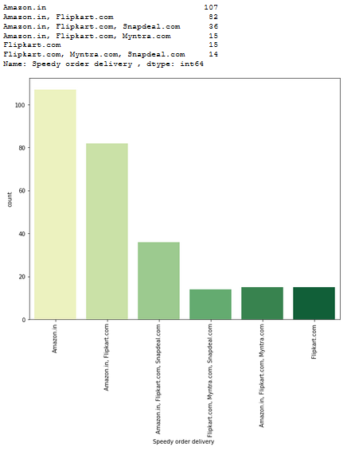
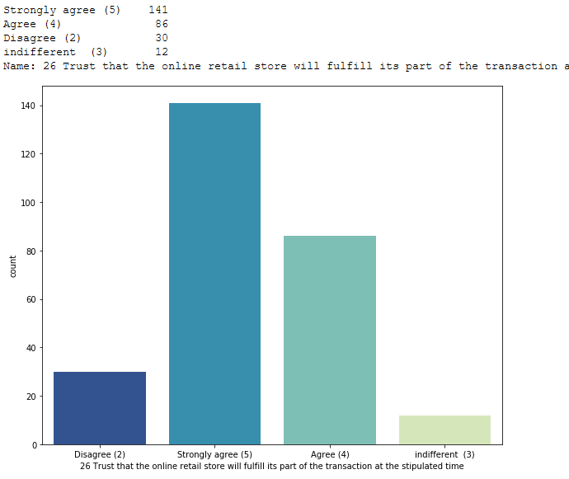
Buyers trust that online retail store will fulfill its part of the transaction at the stipulated time, which is delivering products on time
Buyers believe that Amazon and Flipkart deliver the order faster than other e-commerce website

Slide 13
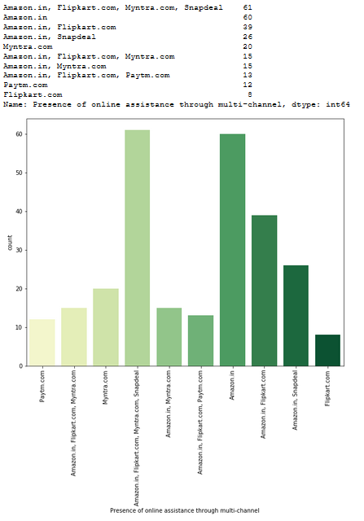
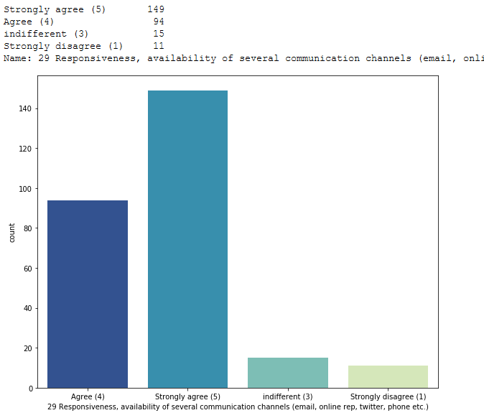
Buyer’s prefer to have availability of online assistance through multiple channels in order to buy with confidence
When it comes to availability of online assistance to multiple channels, Flipkart and Amazon tops the list

Slide 14
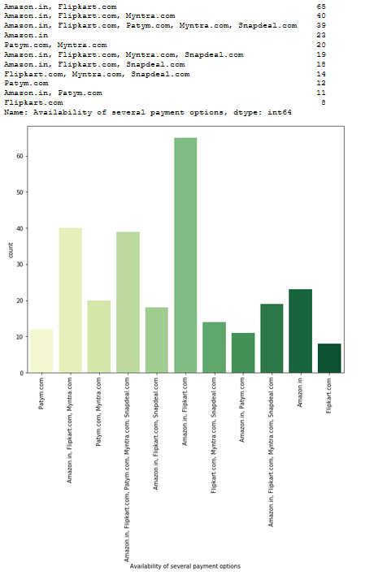
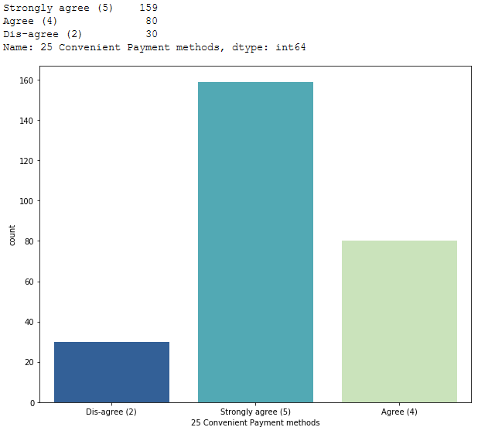
Buyers prefer to have convenient payment methods, when making a online purchase
Again, Flipkart and Amazon provides the convenience of multiple payment options.

Slide 15
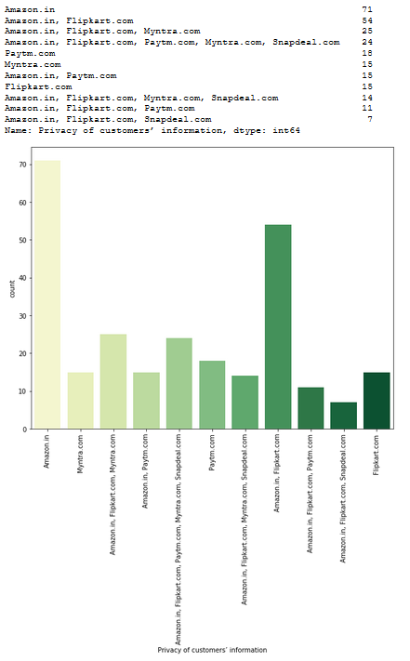
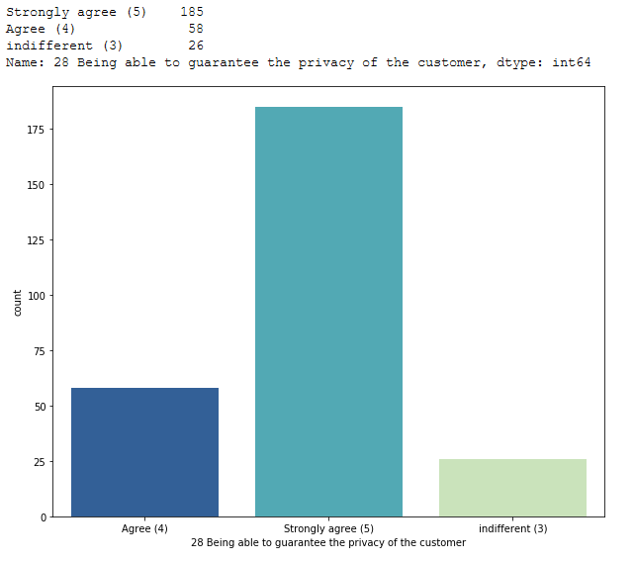
Most important part according to the buyer is that a e-commerce website should be able to provide complete privacy to its buyers in-order to shop with confidence
We can clearly see that most of the buyers agree that Amazon and Flipkart are able to provide complete privacy to its buyers.

Slide 16
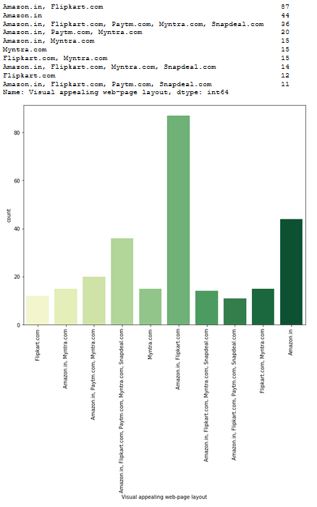
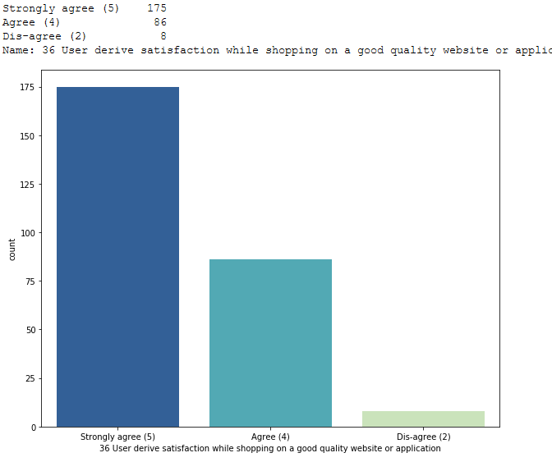
Buyers believe that a visually appealing website is necessary and it gives a sense of satisfaction when the quality of website is good
Even when it comes to visually appealing and good quality website, most of the buyers voted for Amazon and Flipkart.

Slide 17
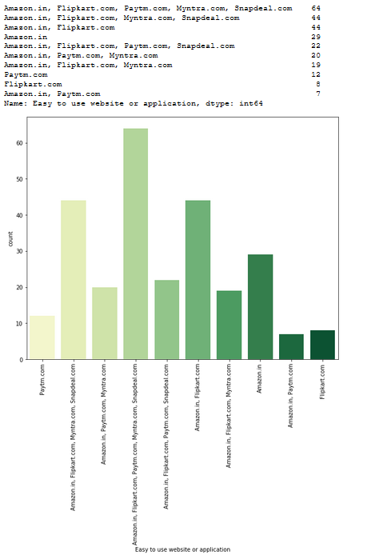
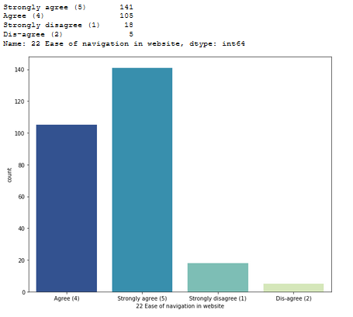
Buyers believe that ease of navigation is important in a e-commerce website
Most of the people voted for Amazon.in, Flipkart.com, Paytm.com, Myntra.com and Snapdeal.com that their websites are easy to use.

Slide 18
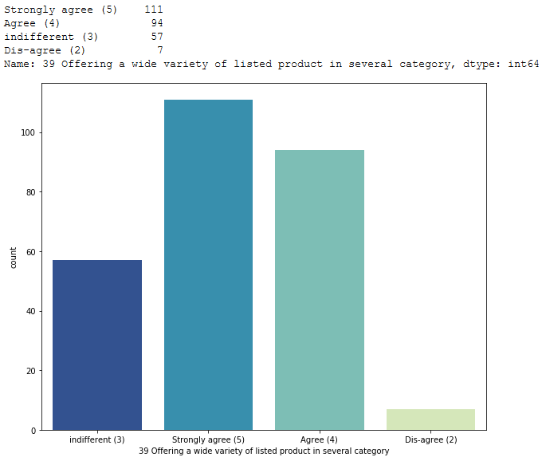
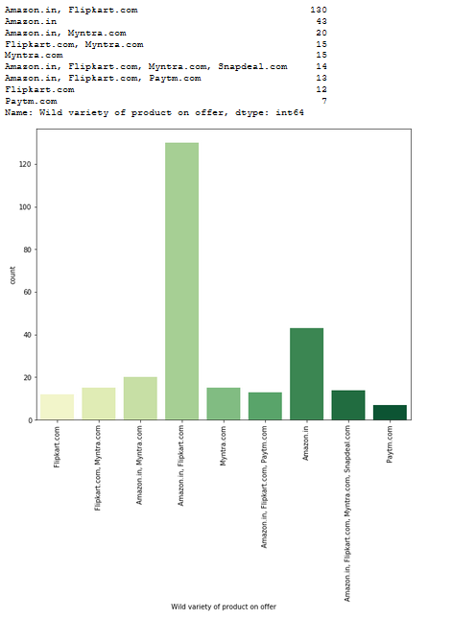
Buyers agree that a good e-commerce website should offer a wide variety of products over the categories
As per the answers from the buyers, Amazon and Flipkart are topping the list for offering wide variety of products

Slide 19
So far we have seen the supporting factors that Amazon and Flipkart have higher retention rate because they offer higher satisfaction through what they have to offer to the customers in their e-commerce sites.
This doesn’t imply that the other e-commerce sites have lower retention rate and we would need a proof for the same.
Therefore, we would need to analyse the data more to look at few factors that contribute to the lower retention rate for other e-commerce sites.

Slide 20
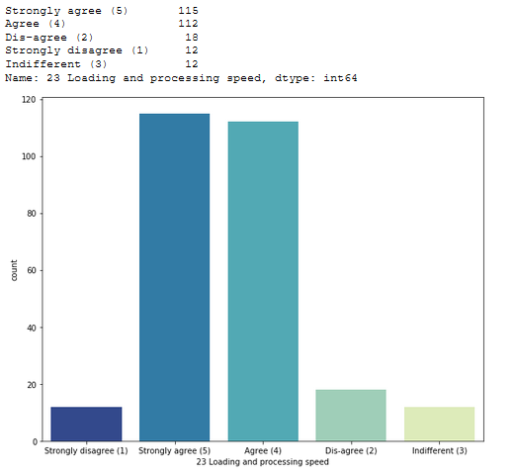
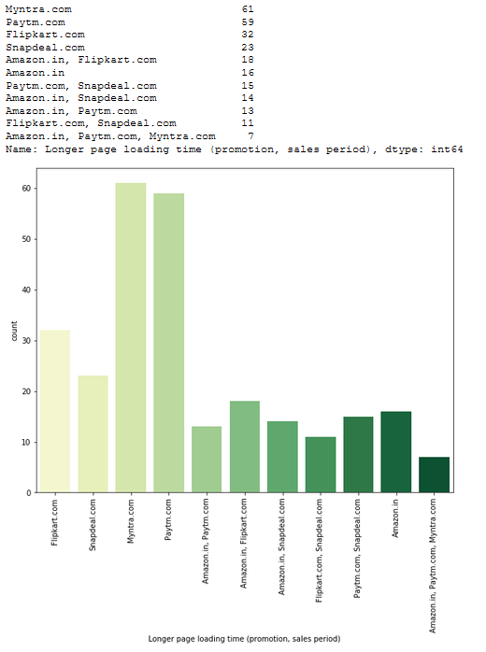
Buyers agree that the e-commerce sites should offer good processing speed for a better buyer experience, which makes customers to buy from them again. However, the highest number of buyers voted that the sites like Myntra and Paytm fail to offer the same.

Slide 21
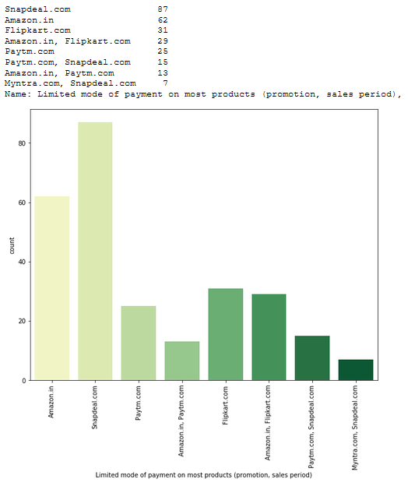
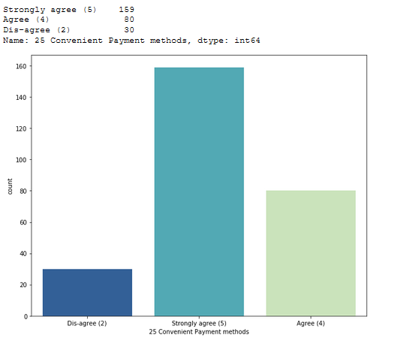
Buyers believed that having convenient payment methods are necessary in a e-commerce website. As we can see most of the buyers voted that Snapdeal and Amazon provided limited payment modes

Slide 22

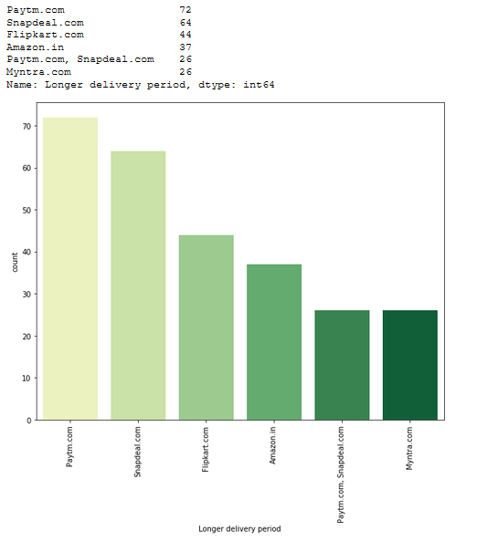
From the below analysis, we can say that the comparisons between companies that offered quicker delivery of the products and the companies that had longer delivery periods according to the buyers, who believed that receiving the products on time/faster was required to make a purchase decision. Here Paytm and Snapdeal has longer delivery periods.

Slide 23
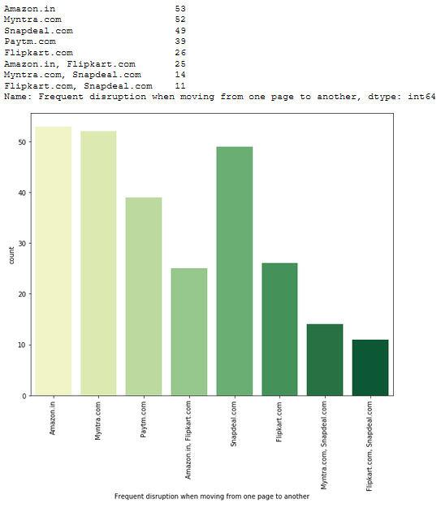
Having frequent disruptions when moving from one page to another doesn’t promote a better buyer experience. And we can see that the highest votes were for Amazon, Myntra and Snapdeal.

Slide 24
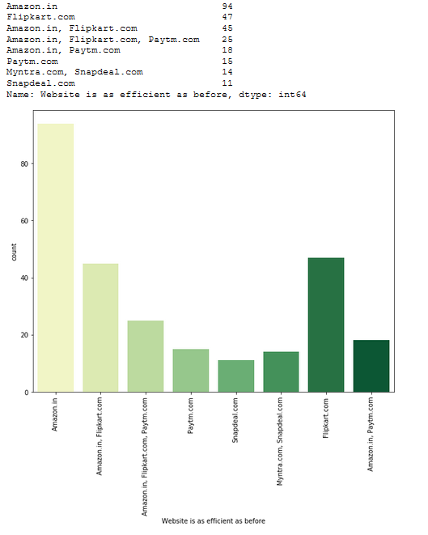
Although Amazon was the highest voted website for having frequent disruption. They have fixed it and most of the buyers believe they are as efficient as before when compared to other sites

Slide 25
Assumption
Initially we assumed that customers recommend e-commerce websites to their friends, if they are satisfied with the service and they are frequently using the websites for online shopping.
In order to prove that the customer expectations on a e-commerce website should influence the websites they recommend to their friends.
This implies that the websites recommended to their friends should meet the customer expectation and it is highly likely to be re-visited by the buyers for future purchases.
This hypothesis proves that the buyer who recommends a e-commerce site to a friend is the retained buyer of the respective e-commerce companies.

Slide 26
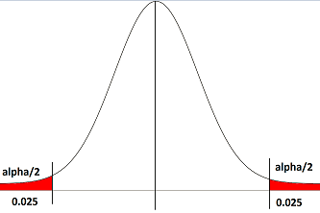
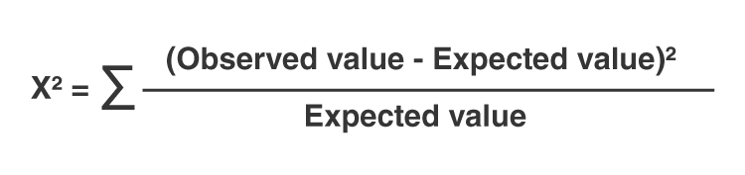
Here in order to prove the correlation between the customer expectation and the website recommendation to a friend, we have used chi-squared test.
The alpha value assumed was 0.05 (5%) and we have to find the p-value for each customer expectation variables.
Null Hypothesis (Ho) was that the customer expectation variable has no relation with the website recommendation to a friend (p > alpha)
Alternate Hypothesis (Ha) was that the customer expectation variable influences the website recommendation to a friend (p < alpha)

Slide 27
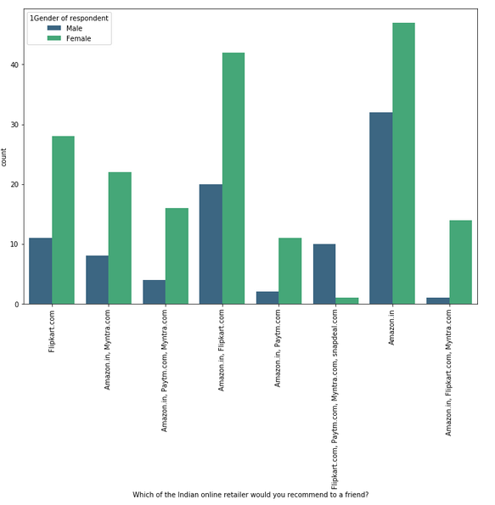
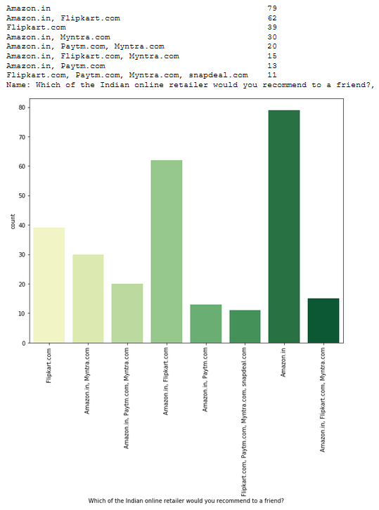
Using the chi-squared test (between two categorical variable) we found that all the major customer expectation on a e-commerce companies were influencing the “buyer recommending a e-commerce website to a friend” (p value was less than ‘alpha’ for all the major customer expectation variables with “buyer recommending a e-commerce website to a friend” )

Slide 28
Conclusion
As per our analysis, I can say that the companies with highest retention and customer satisfaction rates are Amazon.in and Flipkart.com because their positives are line with the buyer preferences and they are most likely to use these websites for purchases in future.
The company with moderate retention rate is Myntra.com
Further, the company with very low retention rate and customer satisfaction is with Paytm and Snapdeal because most of the factors are not in line with the customer preferences and they are less likely to use this website again for online purchases.
Customer satisfaction plays a major role in retention, A company should first understand what customers expects while purchasing online (e-commerce) and build a better buying experience which will in turn retain the customer. An unforgettable experience is what drivers customers to buy again and again.

Slide 29
The main factors that drives customer satisfaction are.
Easy to read and understandable content
Relevant information on all the products
Easier website design and navigation
User friendly Interface
Convenience in payment methods
Trust and On time delivery.
Better Customer Service
Secure and offers complete privacy to their customers
Discounts and Monetary Benefits

Slide 30
Limitations and Scope for future work
The data used to analyse the customer retention was very less
The answers towards the e-commerce sites were combination of two or more e-commerce sites, the survey answers should have been limited to maximum 2 websites in order to understand the retention rates better.
It would have been beneficial to include a question asking that “ Which website would you purchase from again?”

Slide 31


