Slide 1
JULY 26 PURCHASE UNIT -5
JULY-2026 EXPENSES LAKS
JULY-2026 Purchase cost reduced action plan
Description | laks | Improvement point | Responsibility Person
Core purchase | 44.9 | Shell core in-house core production improved & Amin core need start the in-house | Management

Slide 2
JULY Sand Core Cost Flow
CORE LIST | PRICE INR | PURCHASE QTY | TOTAL INR | CORE TYPE
HMI-279 SHELL CORE | 38 | 25900 | 984200 | SHELL
TML CORE SUPPLIER | 38 | 31710 | 1204980 | SHELL
F00N212055 CPN6 CORE | 93.5 | 7492 | 700502 | SHELL
CPN6-148 CORE | 181.12 | 2192 | 397015.04 | SHELL
CP4-1153 CORE | 38 | 27540 | 1046520 | SHELL
JCB -211 SHELL CORE | 36 | 4320 | 155520 | SHELL
CP4 CORE 1139 | 25 | 27823 | 695575 | SHELL
CPN6-212429 | 25 | 1000 | 25000 | SHELL
FLY WHEEL 2234739 core set | 665 | 181 | 120365 | AMIN
INLET MANIFOLD 2231998 core | 490 | 232 | 113680 | AMIN
FLY WHEEL 1084747 | 317 | 50 | 15850 | AMIN
CONDUCTOR -144 | 200 | 130 | 26000 | AMIN
INTAKE ELBOW CORE -187 | 280 | 32 | 8960 | SHELL
PIPE AIR CORE-2544 | 440 | 165 | 72600 | AMIN
PIPE AIR CORE-3009 | 412.2 | 175 | 72135 | AMIN
DUCT AIR CORE -4219244 | 1503 | 180 | 270540 | AMIN
BASE OIL FILTER CORE SET 4697579 | 182 | 186 | 33852 | SHELL
PIPE AIR 5630 | 300 | 503 | 150900 | AMIN
ELBOW 7978 | 354.27 | 200 | 70854 | AMIN
DUCT AIR CORE -4219245 | 950 | 120 | 114000 | AMIN
9Y BASE AS O FILTER CORE 9Y7149 | 90 | 229 | 20610 | SHELL
ELBOW 6759 | 78 | 200 | 15600 | AMIN
TOTAL |  |  | 6315258.04
86% Sand core Outsourced .
Result:-
Inhouse sand core making process to be established 80% with addition of 3machines, to reduce supplier dependency & Bottleneck.
Transportation cost getting save directly.

Slide 3
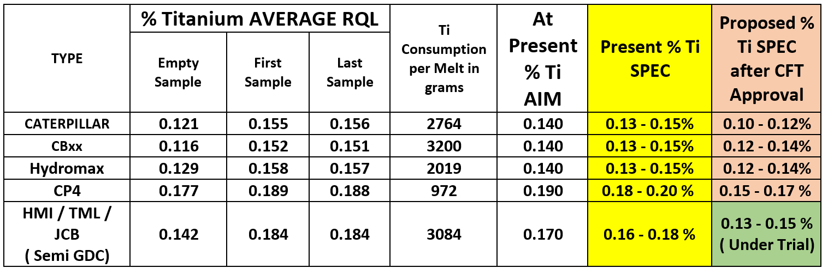
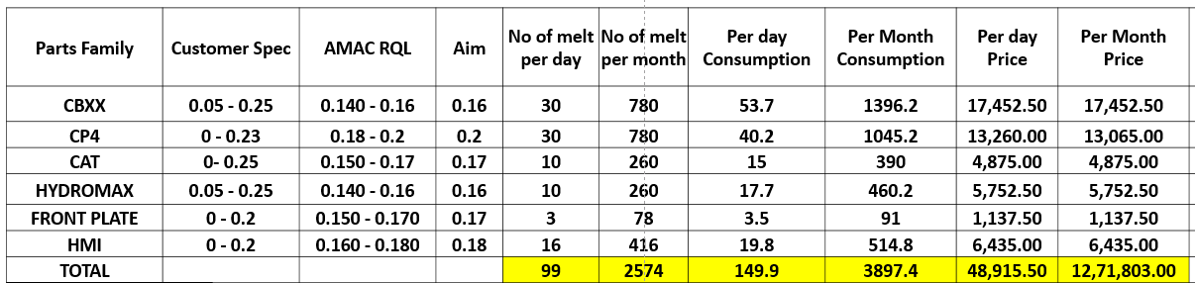
MASTER ALLOY CONSUMPTION COST
NOTE: TiB : Master Alloy Purchase cost is high
Action Plan : Internal specification Review & control the consumption
Raw material ingot making with maximum spec

Slide 4
Sand Core Cost Flow
Result:-
Inhouse sand core making process to be established 80% with addition of 3machines, to reduce supplier dependency & Bottleneck.
Per Month average sand core purchase 38 lacks
Transportation cost getting save directly.
Per month sand disposal cost 2.11 Lacks
Sand disposal challenge Action plan : IGC recycling sand supplier arranged , Recycling sand price :17 rupees per kg
Given take policy sand disposal per kg :2 rupees , Used sand disposal price per kg :5 rupees

Slide 5
Material Purchase
542 MT
Monthly requirements

