Slide 1
Exam 70-533 Implementing Microsoft Azure Infrastructure Solutions
Design and Implement Azure App Service Apps (10-15%)
Create and Manage Compute Resources (20-25%)
Design and Implement a Storage Strategy (10-15%)
Implement virtual networks (15–20%)
Design and Deploy ARM Templates (10-15%)
Manage Azure Security, and Recovery Services (25-30%)
Manage Azure Operations (5-10%)
Manage Azure Identities (5-10%)
Speaker Information:
https://www.microsoft.com/en-ie/learning/exam-70-533.aspx
Notes:
Presentation: 105 minutes
Lab: 50 minutes
After completing this module, students will be able to:
Identify suitable workloads for the cloud.
Identify services and capabilities that Microsoft Azure provides.
Use Azure portals to manage Azure services and subscriptions.
Use Windows PowerShell to manage Azure services and subscriptions.
Use Azure Command-Line Interface (CLI) to manage Azure services and subscriptions.
Describe the primary characteristics of Azure Resource Manager.
Use Azure services to enhance management and monitoring of Azure.
Required materials
To teach this module, you need the Microsoft PowerPoint file 20533D_01.pptx.
Preparation tasks
To prepare for this module, you should:
Read all this module’s materials.
Practice performing the demonstrations and labs.
Work through the Module Review and Takeaways section to determine how you will use the information to reinforce student learning and promote knowledge transfer to on-the-job performance.
As you prepare for this class, it is imperative that you complete the labs yourself. This gives you an understanding of how the labs work, as well as the concepts that each lab covers. This enables you to provide meaningful hints to students who might have issues while working in the labs. Furthermore, it will help guide your lecture to ensure that you discuss the concepts that the labs cover.
20533D
1: Introduction to Microsoft Azure

Slide 2
Create and Manage Compute Resources (20-25%)
Deploy workloads on Azure Resource Manager (ARM) virtual machines (VMs)
Perform configuration management
Design and implement VM storage
Monitor ARM VMs
Manage ARM VM availability
Scale ARM VMs
Manage Containers with Azure Container Services (ACS)
120 min
https://www.microsoft.com/en-ie/learning/exam-70-533.aspx
http://download.microsoft.com/download/8/4/8/848DD46A-05F2-4021-A118-036FC06647C5/533_OD_Changes.pdf

Slide 3
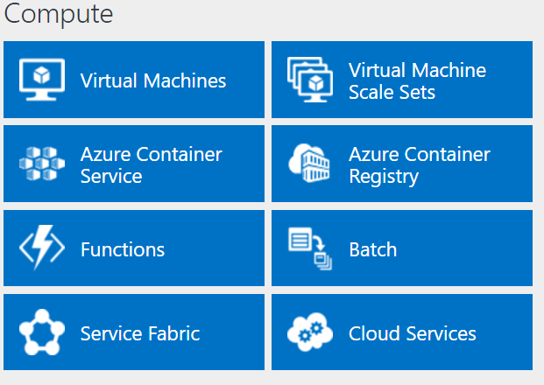
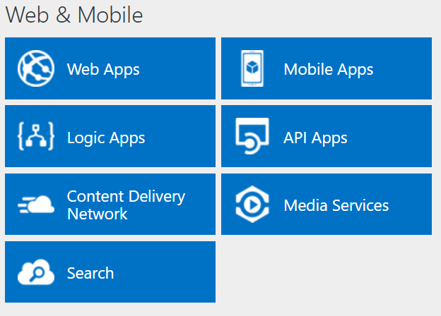
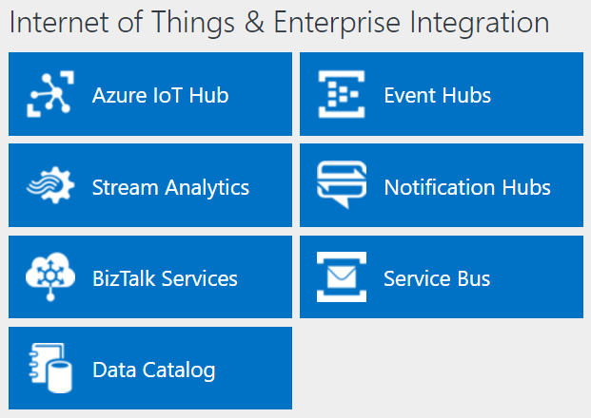
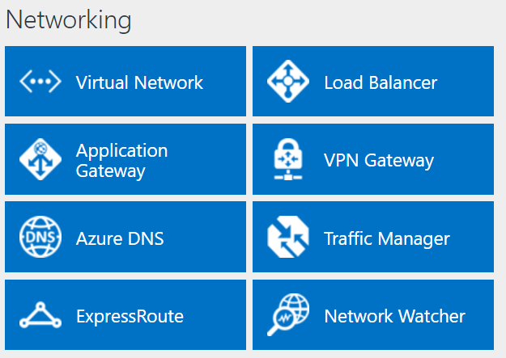
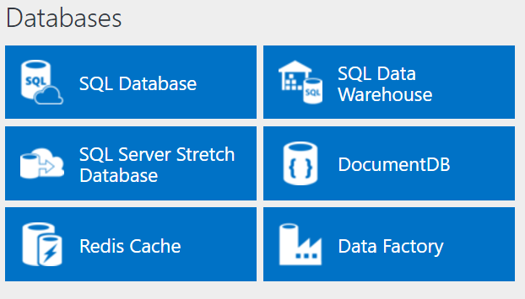
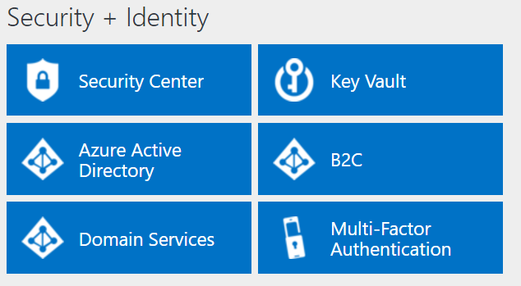
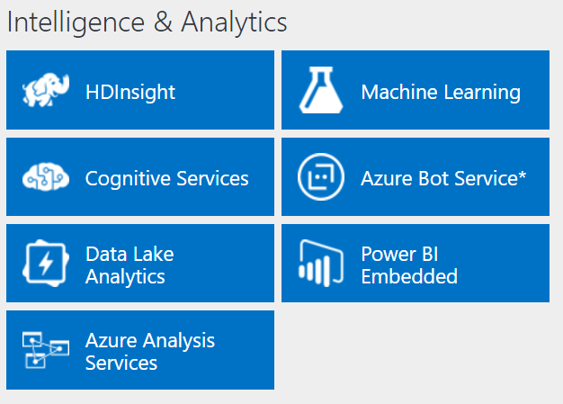
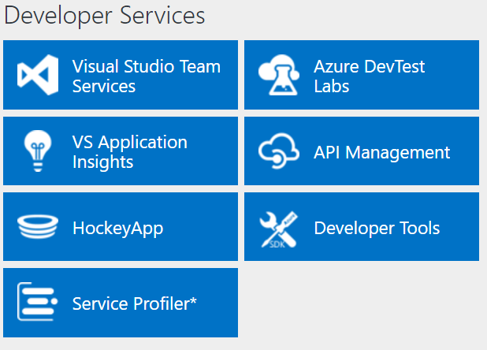
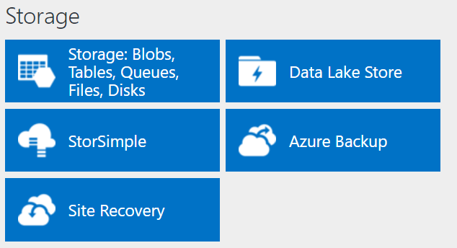
http://azureplatform.azurewebsites.net/
* Preview Services
Notes:
Preview Version 1.7 (2017-04-20)

Slide 4
Create and Manage Compute Resources (20-25%)
Deploy workloads on Azure Resource Manager (ARM) virtual machines (VMs)
Identify workloads that can and cannot be deployed; run workloads including Microsoft, run workloads including Linux; create VMs; connect to a Windows/Linux VM; deploy workloads; deploy Bring Your Own License (BYOL) images
Perform configuration management
Automate configuration management by using PowerShell Desired State Configuration (DSC) and VM Agent (custom script extensions); enable remote debugging
Design and implement VM storage
Configure disk caching; plan storage capacity; configure operating system disk redundancy; configure shared storage using Azure File service; configure Azure File Share snapshots; configure geo-replication; encrypt disks; implement ARM VMs with Standard and Premium Storage
Monitor ARM VMs
Configure ARM VM monitoring; configure alerts; configure diagnostic and monitoring storage location
Manage ARM VM availability
Configure multiple ARM VMs in an availability set for redundancy; configure each application tier into separate availability sets; combine the Load Balancer with availability sets; configure fault domains and update domains
Scale ARM VMs
Scale up and scale down VM sizes; deploy ARM VM Scale Sets (VMSS); configure ARM VMSS auto-scale
Manage Containers with Azure Container Services (ACS)
Deploy a Kubernetes cluster in ACS; create and manage container images; scale applications using Docker, DC/OS, Swarm, or Kubernetes; configure for open-source tooling; migrate container workloads to and from Azure; monitor Kubernetes by using Microsoft Operations Management Suite (OMS); implement Azure Container Registry
http://download.microsoft.com/download/8/4/8/848DD46A-05F2-4021-A118-036FC06647C5/533_OD_Changes.pdf

Slide 5
Deploy workloads on Azure Resource Manager (ARM) virtual machines (VMs)
Identify workloads that can and cannot be deployed; run workloads including Microsoft, run workloads including Linux; create VMs; connect to a Windows/Linux VM; deploy workloads; deploy Bring Your Own License (BYOL) images

Slide 6
Introduction to Azure Resource Manager templates
When creating and working with resource templates, consider:
Which resources you are going to deploy
Where your resources will be located
Which version of the resource provider API you will use
Whether there are dependencies between resources
When you will specify values of resource properties
The template consist of the following sections:
{
"$schema": "http://schema.management.azure.com/schemas/2015-01-01/deploymentTemplate.json#",
"contentVersion": "",
"parameters": { },
"variables": { },
"resources": [ ],
"outputs": { }
}
Notes:
Explain the sections of the Azure Resource Manager template and the function of each. Use a complete template-code sample to show students the syntax and examples for each template section.
20533D
1: Introduction to Microsoft Azure

Slide 7
Exploring the syntax of Azure Resource Manager templates
Azure Resource Manager template components:
Parameters
Variables
Resources
Outputs
Azure Resource Manager template function types:
Numeric
String
Array
Deployment value
Resource
Notes:
Explain the syntax and format of the different components of the Azure Resource Manager template. Explain the purpose and categories of template functions. Note that template operations are complex and the details of individual functions are outside the scope of this course.
20533D
1: Introduction to Microsoft Azure

Slide 8
Demonstration: Viewing and deploying a GitHub Azure Quickstart template
In this demonstration, you will see how to:
Visualize an Azure Resource Manager template
Deploy an Azure Resource Manager template from GitHub
Notes:
Demonstration Steps
Visualize an Azure Resource Manager template
Start a web browser and navigate to https://github.com/Azure/azure-quickstart-templates/tree/master/101-storage-account-create.
Click Visualize.
Point out that this example is extremely simple, so the diagram consists of only a single storage account. However, with more complex templates, the ability to visualize their components can clarify their architecture.
Click the rectangle representing the storage account. Point out that this displays the corresponding element of the JavaScript Object Notation (JSON) template.
Deploy an Azure Resource Manager template from GitHub
In the web browser, navigate back to https://github.com/Azure/azure-quickstart-templates/tree/master/101-storage-account-create
Click Deploy to Azure.
If prompted, authenticate with the user account that is the System Administrator of your Azure subscription.
On the Create a Standard Storage Account blade, point out the text boxes representing template parameters.
Click Edit template.
On the Edit template blade, review the structure of the template, including the template components described in the earlier topics of this lesson.
Click Discard.
Deploy the template into a new resource group named 20533D0103-DemoRG in the Azure region that is closest to the classroom location and that is available in your subscription.
Wait until the deployment successfully completes.
20533D
1: Introduction to Microsoft Azure
(More notes on the next slide)

Slide 9
Identifying workloads for Azure VMs
Azure virtual machines support:
Windows Server:
All currently supported versions (CSA required for older ones)
All roles and features, except:
DHCP, Direct Access, RMS, Windows DS
iSNS, MPIO, NLB, PNRP, SNMP, Storage Manager for SANs, WINS, Wireless LAN Service
Linux:
CentOS, CoreOS, Debian, Oracle Linux, Red Hat, SUSE, openSUSE, and Ubuntu
Windows Server software:
FIM, MIM, SharePoint Server, SQL Server, System Center, and more
Notes:
Identify workloads that are both suitable and unsuitable for Azure VMs. Review the Windows Server roles and features that have special considerations for Azure VMs.
20533D
3: Implementing virtual machines

Slide 10
Virtual machine sizing
General purpose:
Balanced CPU-to-memory ratio
A0-A7, Av2, D, Dv2, Dv3, DS, DSv2, Dsv3 series
Compute optimized:
High CPU-to-memory ratio
Fs and F series
Memory optimized:
High memory-to-CPU ratio
D, Dv2, DS, DSv2, Ev3, Esv3, Ms, G, and GS series
Storage optimized:
High-performance disk I/O
Ls series
GPU:
Graphic Processing Unit support
NV and NC series
High performance compute:
Fastest CPUs and optional high-throughput RDMA
H series and A8-A11
Notes:
Describe the categories of Azure VM sizes.
20533D
3: Implementing virtual machines

Slide 11
Azure VM availability
Azure VMs in an availability set:
Logical grouping of two or more Azure VMs
Must be assigned during Azure VM deployment
Up to 3 fault domains
Up to 20 update domains
99.95% availability SLA
Considerations:
Add multiple virtual machines to the same availability set
Place application tiers in separate availability sets
Combine availability sets with load balancing
Standalone VMs:
99.9% availability SLA if using Premium storage disks
Notes:
Explain how availability sets allow for greater availability of Azure VMs that use the same or similar configurations. Explain the concept of fault domains and update domains in the context of availability sets. Identify the considerations for configuring availability sets. Point out that there is a 99.9% availability Service Level Agreement (SLA) available for individual VMs if they use Premium storage.
20533D
3: Implementing virtual machines

Slide 12
Determining the deployment method
Tools for deploying Azure VMs:
Azure portal
Azure PowerShell
Azure CLI
Azure Resource Manager templates
Create Azure VMs from:
Azure Marketplace images
Custom images
Managed
Unmanaged
Notes:
Identify the primary tools and methods that you can use to create virtual machines in Azure. Describe the process of generating managed and unmanaged custom images.
20533D
3: Implementing virtual machines

Slide 13
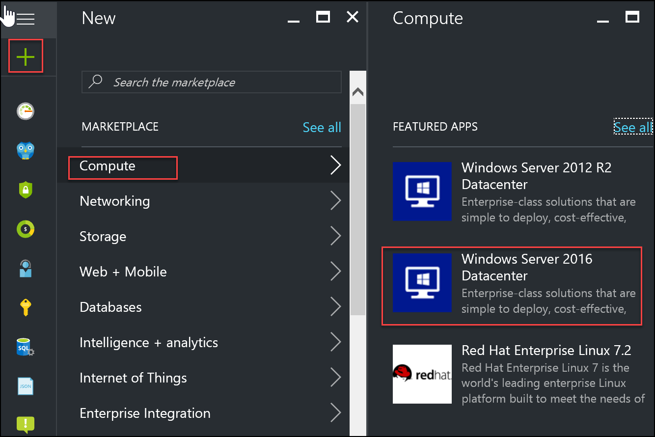
Using the Azure portal to create virtual machines
Notes:
Explain the process of creating a virtual machine by using the Azure portal.
20533D
3: Implementing virtual machines

Slide 14
Using Azure PowerShell to create an Azure VM with managed disks
Marketplace image–based deployment
Authenticate and select the target subscription
Create a resource group
Create a virtual network and a subnet
Create a public IP address
Create a NIC
Create a NSG and associate it with the subnet
Set admin credentials for the OS
Assign the OS to the VM configuration
Assign the image to the VM configuration
Add the OS settings to the VM configuration
Add the NIC to the VM configuration
Create the virtual machine
Custom image–based deployment
Notes:
Describe the process of creating an Azure VM with a managed disk from a Marketplace image with Azure PowerShell. Compare this process to using a custom image. Mention the Quick Start option.
20533D
3: Implementing virtual machines

Slide 15
Using Azure CLI to create an Azure VM with managed disks
Quick start
Complete deployment
Custom image–based deployment
az login
az account set –subscription <subscription name>
az group create --name <resource group name> ` --location <Azure region>
az vm create --resource-group <resource group name> ` --name <VM name> --image <Azure Marketplace image> ` --generate-ssh-keys
Notes:
Describe different options available when deploying Azure VMs via Azure Command-Line Interface (CLI). Point out that they match the options available when using Azure PowerShell.
20533D
3: Implementing virtual machines

Slide 16
Creating VMs by using a deployment template
Deploy a template by using:
Azure PowerShell
Azure CLI
Deploy to Azure link on GitHub
Custom deployment blade in the Azure portal
Visual Studio
Visualize a template by using:
Azure Resource Manage Template Visualizer
New-AzureRmResourceGroupDeployment ` -Name <DeploymentName> ` -ResourceGroupName <ResourceGroupName `
-TemplateUri <TemplateUri>
azure group deployment create
Notes:
Explain the methods of deploying Azure VMs defined by using Azure Resource Manager templates.
20533D
3: Implementing virtual machines

Slide 17
Demonstration: Creating a VM by using the Azure portal
In this demonstration, you will see how to create a VM from the Azure portal by using a Marketplace image
Notes:
Additional Reading: Deploy a new Windows VM named 20533D03DemoVM1 into a new resource group named 20533D03-DemoRG01 by following the steps listed on “Create a Windows virtual machine with the Azure portal” at: https://aka.ms/pzxh13
Additional Reading: Deploy a Linux VM named 20533D03DemoVM2 into a new resource group named 20533D03-DemoRG02 by following the steps listed on “Create a Linux virtual machine with the Azure portal” at: https://aka.ms/ajqf8q
Note: Do not wait for the deployment to complete. Continue with the next topic.
Preparation Steps
Before starting this demonstration, ensure that you have performed the “Preparing the lab environment” demonstration in this module’s first lesson. Also, ensure that the setup script has completed and that you completed the previous demonstration in this module.
Demonstration Steps
In Microsoft Edge, navigate to the Azure portal.
Sign in by using the Microsoft account that is the Service Administrator of your subscription.
From the hub menu, create a new Windows Server 2016 Datacenter Azure VM in the Azure region that is closest to the classroom location and that is available in your subscription. Specify the following settings (accept all other settings with their default values):
Name: 20533D03LabVM1
User name: Instructor
Password: Pa55w.rd1234
Resource Group: The existing resource group that you created in the previous demonstration, named 20533D0301-DemoRG
Size: Standard_D1_v2
20533D
3: Implementing virtual machines
(More notes on the next slide)

Slide 18
Connecting to an Azure VM
Windows VMs:
RDP:
User-based authentication
Generates .rdp file from the Azure portal or via Azure PowerShell
WinRM:
Generates a certificate and uploads it to Azure Key Vault
References the URL of the certificate in the VM configuration
Linux VMs:
SSH:
User based or certificate-based authentication
Use an SSH client
Remote Desktop:
xfce4 – desktop environment
xrdp – RDP server
When using SSH key to authenticate, assign a password to the admin user
Notes:
Describe the primary methods of connecting to Windows and Linux running in Azure VMs.
20533D
4: Managing Azure VMs

Slide 19
Demonstration: Connecting to a Linux Azure VM via SSH
In this demonstration, you will see how to connect to a Linux Azure VM via SSH
Notes:
Demonstration Steps
Use the procedure described at https://aka.ms/x1beh6 to create an Secure Shell (SSH) certificate for a PuTTY to a Linux Azure VM.
Create a new Linux Ubuntu Azure VM named 20533D04DemoVM1 in a new resource group named 20533D0401-DemoRG.
Connect to 20533D04DemoVM1 via PuTTY by using certificate-based authentication.
20533D
4: Managing Azure VMs

Slide 20
Configuring security of Azure VMs
Network security groups
Restrict access to individual IP addresses
Combine with OS-level protection
Azure Key Vault
Store secrets and keys
Use Azure AD authentication to control access
Azure Drive Encryption
Encrypt OS and data volumes on Windows and Linux VMs
Integrate with Azure Key Vault
Encrypt by using existing keys
Notes:
Note: This topic has one additional slide.
Describe different mechanisms that enhance security of Azure VM deployments. Explain Azure Disk Encryption capabilities, focusing on Key Vault and Azure Active Directory (Azure AD).
20533D
4: Managing Azure VMs

Slide 21

Configuring VM security
Keys/secrets are protected
in customer key vault
OS and data disks are protected in customer
storage account
Azure Resource Manager/ Windows PowerShell
cmdlets/ Azure CLI
Encrypt
config
VM
Encrypt
config
Azure Storage
Customer
Notes:
Describe the process of implementing Azure Disk Encryption.
20533D
4: Managing Azure VMs

Slide 22
Perform Configuration Management
Automate configuration management by using PowerShell Desired State Configuration (DSC) and VM Agent (custom script extensions); enable remote debugging

Slide 23
Azure PowerShell modules
PowerShell modules for Azure include:
Azure PowerShell (Azure Resource Manager)
Azure Service Management PowerShell (classic)
Azure Active Directory PowerShell
Azure Information Protection PowerShell
Azure Service Fabric PowerShell
Azure ElasticDB PowerShell
Available via:
Web Platform Installer
PowerShell Gallery
MSI packages (GitHub)
Notes:
Introduce the modules available for Azure administration by using Windows PowerShell, and their installation methods.
20533D
1: Introduction to Microsoft Azure

Slide 24
Authenticating to Azure by using Windows PowerShell
Azure AD user authentication:
A Microsoft account
A work or school account
An Azure AD security principal (Add-AzureRmAccount)
Certificate-based authentication:
Azure Resource Manager:
Obtain a certificate (self-signed or CA-issued)
Create a service principal associated with the certificate
Delegate permissions to the service principal through RBAC
Classic:
Obtain a management certificate in Azure or issue one on-premises
Store the private key on the local computer and the public key in Azure
The certificate grants full permissions to the subscription
Notes:
Explain the primary methods for authenticating by using Windows PowerShell.
20533D
1: Introduction to Microsoft Azure

Slide 25
Azure PowerShell cmdlets for Azure classic deployment model and Azure Resource Manager
Functionality | Classic | Azure Resource Manager
Sign in to Azure | Add-AzureAccount | Login-AzureRmAccount
Create a virtual machine | New-AzureVM | New-AzureRmVM
Create a web app | New-AzureWebsite | New-AzureRmWebapp
Notes:
Too many Azure cmdlets exist to discuss all of them in detail. The rest of the course will introduce the students to many of them. The key points in this topic are:
Azure Resource Manager cmdlets have Rm in the cmdlet name; for example, New-AzureRmVM.
You can use standard Windows PowerShell commands like Get-Command and Get-Help to see more information about the available Azure cmdlets in each module.
20533D
1: Introduction to Microsoft Azure

Slide 26
Demonstration: Using Azure PowerShell
In this demonstration, you will see how to use Azure PowerShell to:
Create a resource group
Create a storage account
Delete a resource group with its resources
Notes:
Demonstration Steps
Create a resource group
Open the Windows PowerShell Integrated Scripting Environment (Windows PowerShell ISE) as an Administrator.
From the Windows PowerShell ISE console, sign in to your Azure subscription by running the following command:
Add-AzureRmAccount
From the Windows PowerShell ISE console, use the New-AzureRmResourceGroup cmdlet to create a new storage group called 20533D0101-DemoRG in the Azure region that is closest to the classroom location and that is available in your subscription.
Use the Get-AzureRmResourceGroup to verify that the new resource group was successfully created.
Create a storage account
From the Windows PowerShell ISE console, create a new storage account by using the New-AzureRmStorageAccount cmdlet with the following settings:
Resource group name: 20533D0101-DemoRG
Location: the same location as the resource group
Storage account name: a unique name between three and 24 characters, consisting of lower-case letters, digits, or dashes and starting with a letter.
SkuName: Standard_LRS
Use the Get-AzureRmStorageAccount cmdlet to verify that the new storage account was successfully created.
20533D
1: Introduction to Microsoft Azure
(More notes on the next slide)

Slide 27
Azure CLI versions
Available in two versions:
Azure CLI 1.0:
Supports azure resource manager and classic deployment model
Azure commands
Based on node.Js
Azure CLI 2.0:
Supports azure resource manager deployment model only
Az commands
Based on python
Can be installed on Windows, Linux, and OS X
Integrates with Linux shell scripting tools
Included in the Azure Cloud Shell
Notes:
Introduce both Azure Command-Line Interface (CLI) versions and explain the differences between them.
20533D
1: Introduction to Microsoft Azure

Slide 28
Installing Azure CLI
Installation process depends on:
The azure CLI version
The target operating system
Prerequisites:
Azure CLI 1.0: Node.js https://nodejs.org/en/download/
Azure CLI 2.0: Python https://www.python.org/downloads/
Installation:
Azure CLI 1.0
Node package manager - npm install –g azure-cli
Docker host - docker run it microsoft/azure-cli
GitHub-based installers
Azure CLI 2.0
Ubuntu, Debian, Bash on Windows - apt-get tool
Linux and Mac OS – curl http://aka.ms/InstallAzureCli
Windows, Linux, Mac OS – GitHub-based installers
Notes:
Describe different methods of installing Azure CLI 1.0 and Azure CLI 2.0.
20533D
1: Introduction to Microsoft Azure

Slide 29
Using Azure CLI to access your Azure subscription
To authenticate:
run:
az login (Azure CLI 2.0)
azure login (Azure CLI 1.0)
type autogenerated code at http://aka.ms/devicelogin
To select a target subscription, run:
az account set (Azure CLI 2.0)
azure account set (Azure CLI 1.0)
To switch between deployment models (Azure CLI 1.0), run:
azure config mode arm (default)
azure config mode asm
Notes:
Describe the basic steps to access an Azure subscription by using both Azure CLI 1.0 and Azure CLI 2.0.
20533D
1: Introduction to Microsoft Azure

Slide 30
Overview of VM Agent and VM extensions
VM Agent:
Recommended but optional for Azure VMs
Mandatory for Linux
VM Extensions:
Azure VM Access Extension
Chef Client and Puppet Enterprise Agent
Custom Script extension for Windows and Linux
DSC extension for Windows and Linux
Azure Diagnostics extension for Windows and Linux
Docker extension
Microsoft Antimalware extension and many others
Notes:
Describe the role of VM Agent and the most common VM Extensions. Point out that the extensions discussed in this topic are just a few of those available to Azure VMs.
20533D
4: Managing Azure VMs

Slide 31
What is the VM Agent Custom Script extension?
Custom Script VM Agent extension enables to run:
Windows PowerShell scripts
Linux shell scripts
Implement by:
Azure portal
Azure PowerShell
Set-AzureRmVMCustomScriptExtension
Set-AzureRMVMExtension
Azure CLI
az vm extension set
Azure Resource Manager templates
Notes:
Describe different ways of implementing the Custom Script extension.
20533D
4: Managing Azure VMs

Slide 32
What is the VM Agent DSC extension?
Leverages Windows DSC and DSC for Linux:
Windows Management Framework–based (Windows)
Open Management Infrastructure–based (Linux)
Implemented as VM Agent extensions:
DSC extension for Windows Azure VMs
Azure DSCForLinux extension for Linux Azure VMs
Deployment support:
Azure portal
Windows PowerShell
Azure CLI
Azure Resource Manager templates
Notes:
Describe the basic characteristics of Desired State Configuration (DSC) on Windows and Linux Azure VMs. Explain the process of implementing DSC-based configurations on both platforms.
20533D
4: Managing Azure VMs

Slide 33
Lesson 2: Implementing Azure Automation
Introducing Azure Automation Azure Automation as a component of Azure Creating Azure Automation accounts and assets Using Automation runbooks on-premises Demonstration: Creating an Azure Automation account and assets
Notes:
Question
You need to be able to execute Azure Automation runbooks on your on-premises computers. What additional Azure service do you need to configure?
( ) Option 1: ExpressRoute
( ) Option 2: OMS
( ) Option 3: Service Bus
( ) Option 4: Cloud service
( ) Option 5: App Service
Answer
( ) Option 1: ExpressRoute
( √) Option 2: OMS
( ) Option 3: Service Bus
( ) Option 4: Cloud service
( ) Option 5: App Service
Feedback
The only service that is necessary for running Automation runbooks on-premises is OMS. ExpressRoute might improve the performance of Automation activities, but it is not required. In general, Automation does not have a dependency on the PaaS services listed above.
20533D
11: Implementing Azure-based management and automation

Slide 34
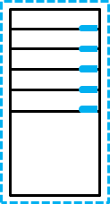









Introducing Azure Automation
Local server
Local resources Hybrid Runbook Worker
VMs
Azure resources
DSC configurations
Runbooks
Azure Automation
Automation solution
OMS workspace
Local
External resources
Azure
Internet
Notes:
Describe the high-level architecture of Azure Automation.
20533D
11: Implementing Azure-based management and automation

Slide 35
Azure Automation as a component of Azure
Compute
Networking
Data & Storage
Web & Mobile
Virtual Machines
Virtual Network
Disk Storage
Virtual Machine Scale Sets
Azure DNS
Web Apps
Blob Storage
Application Gateway
Mobile Apps
Cloud Services
File Storage
Containers
Traffic Manager
Queue Storage
Logic Apps
Container Registry
ExpressRoute
Table Storage
Content Delivery Network
Container Service
Load Balancer
StorSimple
Other services
Azure AD
MFA
Site Recovery
Key Vault
Log Analytics
Network Watcher
Azure AD DS
Automation
Azure Monitor
Azure B2C
Backup
Azure Security Center
Azure Advisor
Notes:
Use this slide to describe the relationship of Azure Automation to other Azure services. The principal subject of this topic (Azure Automation) has been highlighted in red.
20533D
11: Implementing Azure-based management and automation

Slide 36
Creating Azure Automation accounts and assets
Create an Automation account by using:
Automation & Control from the Azure Marketplace
Automation service from the Azure Marketplace
OMS Management solutions
Azure Automation assets are grouped into the following categories:
Modules
Schedules
Certificates
Connections
Variables
Credentials
Notes:
Describe the methods for creating an Automation account and describe Automation assets.
20533D
11: Implementing Azure-based management and automation

Slide 37
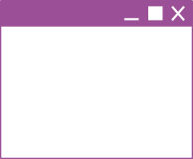



Using Automation runbooks on-premises
Runbooks work against local resources
Hybrid Runbook Worker
Runbooks work against
cloud resources
Azure
resources
Runbooks
Runbooks delivered
to on-premises
machine
Azure
Automation
Enterprise
Azure
Notes:
Describe the architecture of cross-premises Azure Automation deployments and the process of implementing Hybrid Runbook Workers.
20533D
11: Implementing Azure-based management and automation

Slide 38
Introduction to Azure Automation runbooks
Graphical runbooks:
Based on PowerShell workflows or PowerShell scripts
Edited by using the graphical editor in the Azure portal
Textual runbooks:
Based on PowerShell workflows or PowerShell scripts
Edited by using the textual editor in the Azure portal or imported from workflows and scripts created on-premises
Converting runbook types:
No support for converting between graphical and textual
Support for converting between graphical workflows and runbooks during import
Notes:
Describe the different types of runbooks and the differences between them.
20533D
11: Implementing Azure-based management and automation

Slide 39
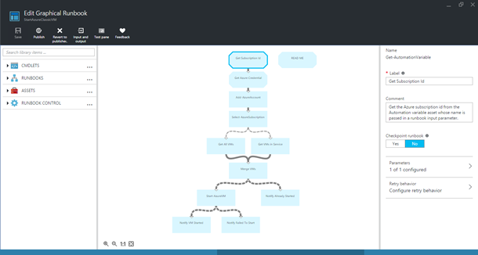
Graphical authoring of Automation runbooks
Library
Canvas
Configuration
Notes:
Explain the process of authoring a graphical runbook.
20533D
11: Implementing Azure-based management and automation

Slide 40
Overview of PowerShell workflows
Workflows support:
Long-running activities
Repeatable activities
Frequently executed activities
Running activities in parallel across one or more machines
Interruptible activities that you can stop and restart
Notes:
Point out the differences between workflows and traditional PowerShell scripts, including the ability to perform a set of activities in parallel and automatically restart from the most recent checkpoint.
20533D
11: Implementing Azure-based management and automation

Slide 41
Textual authoring of PowerShell workflow runbooks
Workflow syntax/keywords:
Parallel
Foreach –parallel
Sequence
InlineScript
Checkpoint-workflow
Suspend-workflow
workflow test {
InlineScript { Code }
parallel {
Command A
Command B
sequence {
Command C
Command D
}
}
}
Notes:
While PowerShell workflow activities use the same naming convention as Windows PowerShell cmdlets, there are some syntactical differences between them. In addition, it is possible to include Windows PowerShell cmdlets within a workflow by enclosing them in an InlineScript block.
20533D
11: Implementing Azure-based management and automation

Slide 42
Textual authoring of PowerShell runbooks
To create Automation PowerShell scripts:
Write code in textual editor
Add PowerShell cmdlets from integration modules imported into the Automation account
Reference Automation assets
Add runbooks
Notes:
Describe the basic steps involved in authoring PowerShell runbooks.
20533D
11: Implementing Azure-based management and automation

Slide 43
Implementing Automation DSC
Configurations
Node configurations
(.mof configuration
documents)
Configuration SharePoint {
Node WebService {
#Install the IIS Role
WindowsFeature IIS {
Ensure = “Present”
Name – “Web-Server”
}
#Install ASP.NET 4.5
WindowsFeature ASP {
Ensure = “Present”
Name – “Web-Asp-Net45”
}
}
}
Nodes
SharePoint.WebService
Compiled,
put on pull
server
via
compilation
jobs
Applied
via node pulls
One or more per
Automation account
One or more
per configuration
One or more
per node configuration
Notes:
Describe the process of implementing Automation Desired State Configuration (DSC).
20533D
11: Implementing Azure-based management and automation

Slide 44
Design and implement VM storage
Configure disk caching; plan storage capacity; configure operating system disk redundancy; configure shared storage using Azure File service; configure Azure File Share snapshots; configure geo-replication; encrypt disks; implement ARM VMs with Standard and Premium Storage

Slide 45
Azure VM and Disk Sizing?
Virtual machine sizes:
Basic tier (development and test workloads):
Five sizes: A0 to A4
Standard tier (production workloads):
Multiple series: A, Av2, D, Dv2, Dv3, DS, DSv2, DSv3, Ev3, Esv3, F, Fs, G, GS, Ms, NV, NC
80+ sizes with up to 128 vCPUs, 2048 GB of RAM, and 64 disks
Virtual machine disks:
Size limit: 4TB
Performance limit:
Standard. 60 MBps or 500 8-KB IOPS per disk
Premium. 250 MBps or 7500 256-KB IOPS per disk
Disk type and format: .vhd fixed only
Virtual machine generations: Generation 1 only
Notes:
Describe the primary features of Azure VMs.
20533D
3: Implementing virtual machines

Slide 46
What are Azure VMs?
Virtual machine sizes:
Basic tier (development and test workloads):
Five sizes: A0 to A4
Standard tier (production workloads):
Multiple series: A, Av2, D, Dv2, Dv3, DS, DSv2, DSv3, Ev3, Esv3, F, Fs, G, GS, Ms, NV, NC
80+ sizes with up to 128 vCPUs, 2048 GB of RAM, and 64 disks
Virtual machine disks:
Size limit: 4TB
Performance limit:
Standard. 60 MBps or 500 8-KB IOPS per disk
Premium. 250 MBps or 7500 256-KB IOPS per disk
Disk type and format: .vhd fixed only
Virtual machine generations: Generation 1 only
Notes:
Describe the primary features of Azure VMs.
20533D
3: Implementing virtual machines

Slide 47
What are Azure VMs?
Virtual machine sizes:
Basic tier (development and test workloads):
Five sizes: A0 to A4
Standard tier (production workloads):
Multiple series: A, Av2, D, Dv2, Dv3, DS, DSv2, DSv3, Ev3, Esv3, F, Fs, G, GS, Ms, NV, NC
80+ sizes with up to 128 vCPUs, 2048 GB of RAM, and 64 disks
Virtual machine disks:
Size limit: 4TB
Performance limit:
Standard. 60 MBps or 500 8-KB IOPS per disk
Premium. 250 MBps or 7500 256-KB IOPS per disk
Disk type and format: .vhd fixed only
Virtual machine generations: Generation 1 only
Notes:
Describe the primary features of Azure VMs.
20533D
3: Implementing virtual machines

Slide 48
Identifying workloads for Azure VMs
Azure virtual machines support:
Windows Server:
All currently supported versions (CSA required for older ones)
All roles and features, except:
DHCP, Direct Access, RMS, Windows DS
iSNS, MPIO, NLB, PNRP, SNMP, Storage Manager for SANs, WINS, Wireless LAN Service
Linux:
CentOS, CoreOS, Debian, Oracle Linux, Red Hat, SUSE, openSUSE, and Ubuntu
Windows Server software:
FIM, MIM, SharePoint Server, SQL Server, System Center, and more
Notes:
Identify workloads that are both suitable and unsuitable for Azure VMs. Review the Windows Server roles and features that have special considerations for Azure VMs.
20533D
3: Implementing virtual machines

Slide 49
Virtual machine sizing
General purpose:
Balanced CPU-to-memory ratio
A0-A7, Av2, D, Dv2, Dv3, DS, DSv2, Dsv3 series
Compute optimized:
High CPU-to-memory ratio
Fs and F series
Memory optimized:
High memory-to-CPU ratio
D, Dv2, DS, DSv2, Ev3, Esv3, Ms, G, and GS series
Storage optimized:
High-performance disk I/O
Ls series
GPU:
Graphic Processing Unit support
NV and NC series
High performance compute:
Fastest CPUs and optional high-throughput RDMA
H series and A8-A11
Notes:
Describe the categories of Azure VM sizes.
20533D
3: Implementing virtual machines

Slide 50
Azure VM availability
Azure VMs in an availability set:
Logical grouping of two or more Azure VMs
Must be assigned during Azure VM deployment
Up to 3 fault domains
Up to 20 update domains
99.95% availability SLA
Considerations:
Add multiple virtual machines to the same availability set
Place application tiers in separate availability sets
Combine availability sets with load balancing
Standalone VMs:
99.9% availability SLA if using Premium storage disks
Notes:
Explain how availability sets allow for greater availability of Azure VMs that use the same or similar configurations. Explain the concept of fault domains and update domains in the context of availability sets. Identify the considerations for configuring availability sets. Point out that there is a 99.9% availability Service Level Agreement (SLA) available for individual VMs if they use Premium storage.
20533D
3: Implementing virtual machines

Slide 51
Virtual machine storage
Azure VM
C:\
operating system disk
D:\
Temporary disk
(contents can be
lost)
F:\Data disks
Azure blob
Notes:
Describe virtual disks of Azure VMs. Most students will likely be familiar with the virtual disks that Microsoft Hyper‑V uses. If that is the case, you can focus on virtual disks that Azure supports.
20533D
3: Implementing virtual machines

Slide 52
Overview of unmanaged and managed disks
Unmanaged disks:
Up to 200 storage accounts per region
Up to 40 disks per Standard storage account
Storage accounts for VMs in the same availability set might be in the same storage stamp
A custom image must be in the same storage account as VM disks
Managed disks:
Up to 10,000 disks per region
Storage account performance limits not relevant
Disks of VMs in the same availability set in different stamps
A custom image must be in the same region as VM disks
Notes:
Compare and contrast unmanaged disks and managed disks.
20533D
3: Implementing virtual machines

Slide 53
Managing VM disks
Attach an OS or data disk:
Unmanaged disks:
New (empty)
Existing blob
Managed disks:
New (empty)
Existing blob
Snapshot
Detach a data disk
Modify disk settings:
Host caching mode
Disk size (up to 4 TBs)
Storage account type (standard unmanaged disks only)
Performance tier (managed disks only)
Notes:
Describe the main Azure VM disk management tasks.
20533D
4: Managing Azure VMs

Slide 54
Azure VM disk mobility
Azure virtual disk files:
.vhd format (.vhdx not supported)
Fixed type (dynamic not supported)
4-TB maximum size (use multi-disk volumes if larger size is needed)
Azure virtual disk mobility:
Upload and download:
Add-AzureRmVHD and Save-AzureRmVHD
az storage blob upload and az storage blob download
Attach and detach:
Add-AzureRmVmDataDisk and Remove-AzureRmVMDataDisk
azure vm disk attach-new and azure vm disk detach
Import/Export service (for larger disk sizes)
AzCopy and Azure portal
Azure virtual disk files copy and snapshot:
Managed and unmanaged disks (full snapshots only)
Notes:
Describe cross-premises and Azure-only scenarios that involve disk copy, attach, detach, and snapshot operations.
20533D
4: Managing Azure VMs

Slide 55
Managing disk volumes in Azure VMs
OS multi-disk management tools:
Server Manager (Storage Spaces)
Windows PowerShell (Storage Spaces)
LVM (Linux)
mdadm (Linux)
Multidisk volumes considerations:
Aggregate I/O throughput
Support for volumes larger than 4-TB disk size limit
Maximum number of data disks depends on VM size
Notes:
Depending on the students’ preference, focus on Storage Spaces–based Windows multidisk configuration or on Logical Volume Manager (LVM)/mdadm multidisk configuration on Linux.
Point out that, in either case, the steps to configure a multidisk volume are identical to those applicable to on-premises computers.
20533D
4: Managing Azure VMs

Slide 56
Monitor ARM VMs
Configure ARM VM monitoring; configure alerts; configure diagnostic and monitoring storage location

Slide 57
Monitoring Azure VMs
Metrics:
Available for VMs running Windows and Linux
Displayed in the Azure portal
Diagnostics:
Implemented as a VM extension
Stored in Azure Storage (tables and blobs)
Windows – basic metrics, performance counters, logs, ETW, crash dumps, Application Insights data, boot diagnostics
Linux – basic metrics and boot diagnostics
Alerts:
Based on metric, condition, threshold, and time period
Can trigger
Email notification
Webhook
Azure Automation runbook
Azure Logic App
Notes:
Describe metrics, diagnostics, and alerts available for Linux and Azure VMs.
20533D
4: Managing Azure VMs

Slide 58
Manage ARM VM availability
Configure multiple ARM VMs in an availability set for redundancy; configure each application tier into separate availability sets; combine the Load Balancer with availability sets; configure fault domains and update domains

Slide 59
Scale ARM VMs
Scale up and scale down VM sizes; deploy ARM VM Scale Sets (VMSS); configure ARM VMSS auto-scale

Slide 60
Scaling Azure VMs
Scale sets provide VM autoscaling:
With managed disks:
Up to 1000 VMs when using VM Marketplace image
Up to 100 VMs when using custom images
With unmanaged disks:
Up to 100 VMs when using VM Marketplace image
Up to 40 VMs when using custom images (overprovision = $true)
Up to 20 VMs when using custom images (overprovision = $false)
5 fault domains and 5 update domains
Stateless workloads
Implement by using:
Microsoft.Compute resource provider
Microsoft.Insights resource provider
Notes:
Note: This topic has one additional slide.
Review the basic characteristics of scale sets. Introduce and describe scale sets in Azure. Explain that scale sets are only available in the Azure Resource Manager deployment model. Point out the key components of a scale set configuration in Azure Resource Manager templates.
20533D
4: Managing Azure VMs

Slide 61
Vertical scaling of Azure VMs
Vertical scaling:
Current configuration must comply with constraints of the target VM size:
Hardware characteristics
Maximum number of network adapters or disks
Requires temporary downtime:
Restart if resizing within the same cluster
Stop (deallocate) if resizing requires cluster change
Horizontal scaling:
Azure Resource Manager: VM Scale Sets
Classic: preprovisioned VMs
Notes:
Describe vertical and horizontal scaling of Azure VMs.
20533D
4: Managing Azure VMs

Slide 62
Manage Containers with Azure Container Services (ACS)
Deploy a Kubernetes cluster in ACS; create and manage container images; scale applications using Docker, DC/OS, Swarm, or Kubernetes; configure for open-source tooling; migrate container workloads to and from Azure; monitor Kubernetes by using Microsoft Operations Management Suite (OMS); implement Azure Container Registry

Slide 63
Module Overview
Implementing Windows and Linux containers in Azure Implementing ACS
Notes:
20533D
7: Implementing containers in Azure

Slide 64
Lesson 1: Implementing Windows and Linux containers in Azure
Demonstration: Preparing the lab environment for the remainder of this module Introduction to containers Introduction to Docker Implementing Docker hosts in Azure Deploying containers on Azure VMs Demonstration: Installing a Docker host and containers on an Azure VM Creating multicontainer applications with Docker Compose Implementing Azure Container Registry
Notes:
Question
What is the default image that Docker Machine deploys?
( ) Option 1: Windows Server 2016
( ) Option 2: Ubuntu Server
( ) Option 3: Red Hat Enterprise Linux
( ) Option 4: SUSE Linux Enterprise Server
( ) Option 5: CoreOS Linux
Answer
( ) Option 1: Windows Server 2016
( √) Option 2: Ubuntu Server
( ) Option 3: Red Hat Enterprise Linux
( ) Option 4: SUSE Linux Enterprise Server
( ) Option 5: CoreOS Linux
Feedback
By default, Docker Machine deploys the Canonical Ubuntu Server 16.04.0-LTS image. You can modify this default by including the --azure-image parameter with the value representing the intended image.
20533D
7: Implementing containers in Azure

Slide 65
Demonstration: Preparing the lab environment for the remainder of this module
In this demonstration, you will learn how to prepare the lab environment for the remainder of this module
Note: To prepare the lab environment for this module, you must complete this task
Notes:
You must perform this task to prepare the lab environment for the demonstrations in this module.
Have the students perform the steps with you so that they will also configure the lab environment correctly for the labs in this module.
This course relies on custom Azure PowerShell modules, including Add-20533DEnvironment to prepare the lab environment for demonstrations and labs, and Remove-20533DEnvironment to perform clean-up tasks at the end of the module. The modules are in E:\Modules on the 20533D-MIA-CL1 VM.
Important: Note that the Remove-20533DEnvironment script will delete the Azure subscription resources that you provisioned when running Add-20533DEnvironment.
Preparation Steps
Start the MSL-TMG1 and 20533D-MIA-CL1 VMs, and then sign in to 20533D-MIA-CL1 as Student with the password Pa55w.rd. You should have provisioned an Azure subscription ahead of time.
Demonstration Steps
Prepare the lab and demonstration environment
On the taskbar, right-click Windows PowerShell, and then click Run as administrator. In the User Account Control dialog box, click Yes.
Type the following command, and then press Enter:
Add-20533DEnvironment
At the prompt, type the module number, and then press Enter.
Confirm your selection, and then press Enter.
Note: This script might affect existing Azure services in your subscription. We recommend that you use an Azure subscription that was provisioned specifically for this course.
20533D
7: Implementing containers in Azure
(More notes on the next slide)

Slide 66
Notes:
Note: The script will configure your lab environment, preparing it for the demonstrations and labs in this module.
Leave the Windows PowerShell window open. You will use this in the upcoming demonstration and lab.
20533D
7: Implementing containers in Azure

Slide 67
Introduction to containers
App 1
App 2
App 3
Binaries/libraries
Binaries/libraries
Binaries/libraries
Container engine
Operating system
VM
Hardware
Notes:
Describe the concept of containers. Explain their primary purpose and point out the key differences between containers and virtual machines (VMs).
20533D
7: Implementing containers in Azure

Slide 68
Introduction to Docker
Docker terminology:
Image
Container
Dockerfile
Build
Docker toolbox:
Docker client
Docker Engine
Docker Compose
Docker Machine
Docker Registry
Kitematic
Docker Swarm
Notes:
Explain the basic Docker terminology.
20533D
7: Implementing containers in Azure

Slide 69
Implementing Docker hosts in Azure
Install the Docker VM extension:
Use an Azure Resource Manager template, Azure PowerShell, or Azure CLI
Intended for Windows or Linux Azure VMs
Provision a Docker Azure VM from Azure Marketplace:
Intended for Windows or Linux Azure VMs
Run the Docker Machine Azure driver:
Download from docker.com (Windows, Linux, or Mac OS X)
Run docker-machine create --driver azure
Use the --azure image parameter to specify the intended image
Intended for Windows and Linux Azure VMs
Use NuGet provider:
Intended for Windows Azure VMs
Deploy an ACS cluster:
Intended for clusters of Docker Windows or Linux hosts and containers
Notes:
Describe the different methods of implementing Docker hosts in Azure.
20533D
7: Implementing containers in Azure

Slide 70
Deploying containers on Azure VMs
Connect to an Azure VM Docker host:
Docker Machine
RDP
SSH
Use the Docker client to:
Create containers
Stop containers
Remove containers
Create images
Browse for images
Notes:
Describe the different ways to connect to Azure VM Docker hosts. Explain how you can use the Docker client to manage containers. Point out that Azure Container Instances simplifies deployment of individual containers by eliminating the need to explicitly provision the underlying Docker hosts.
20533D
7: Implementing containers in Azure

Slide 71
Demonstration: Installing a Docker host and containers on an Azure VM
In this demonstration, you will learn how to install a Docker host and containers on an Azure VM
Notes:
Preparation Steps
Make sure to complete the “Prepare the lab environment for the remainder of this module” demonstration.
Demonstration Steps
Follow the instructions provided in https://aka.ms/qu1kh3. When running docker-machine to provision an Azure VM, include the --azure-resource-group parameter and set its value to 20533D0701-DemoRG.
20533D
7: Implementing containers in Azure

Slide 72
Creating multicontainer applications with Docker Compose
Install Docker Compose:
Included by default when using:
Azure Marketplace Docker images
The Azure VM Docker extension
Docker Machine
Create docker-compose.yml:
Include all containers
Specify container dependencies
Specify deployment parameters
Run docker-compose up
Notes:
Describe the process of implementing multicontainer applications by using Docker Compose.
20533D
7: Implementing containers in Azure

Slide 73
Implementing Azure Container Registry
Create the Azure Container Registry service:
Classic:
Requires a separate storage account
Configurable via the Azure portal
Managed: Basic, Standard, and Premium
Configurable via the Azure portal and Azure CLI
Use the Azure Container Registry service:
docker login
docker pull
docker tag
docker push
docker pull or docker run
Notes:
Describe the two types of Azure Container Registry services–classic and managed–and explain the differences between them. Point out that there are two authentication and authorization methods, but emphasize that students should use the Admin user method only for single-user scenarios.
Describe the steps to upload and download images when using Container Registry.
20533D
7: Implementing containers in Azure

Slide 74
Lab A: Implementing containers on Azure VMs
Exercise 1: Implementing Docker hosts on Azure VMs Exercise 2: Deploying containers to Azure VMs Exercise 3: Deploying multicontainer applications with Docker Compose to Azure VMs Exercise 4: Implementing Azure Container Registry
Logon Information
Virtual machine: 20533D-MIA-CL1
User name: Admin
Password: Pa55w.rd
Estimated Time: 30 minutes
Notes:
Exercise 1: Implementing Docker hosts on Azure VMs
Exercise 2: Deploying containers to Azure VMs
Exercise 3: Deploying multicontainer applications with Docker Compose to Azure VMs
Exercise 4: Implementing Azure Container Registry
20533D
7: Implementing containers in Azure

Slide 75
Lab Scenario
A. Datum Corporation plans to implement some of its applications as Docker containers on Azure VMs. To optimize this implementation, you intend to combine multiple containers by using Docker Compose. A. Datum would also like to deploy its own private Docker registry in Azure to store containerized images. Your task is to test the functionality of tools that facilitate deployment of Docker hosts and Docker containers. You also need to evaluate Azure Container Registry.
Notes:
20533D
7: Implementing containers in Azure

Slide 76
Lab Review
Which method would you use when deploying Docker hosts on Azure VMs? What authentication and authorization method do you intend to use when implementing Azure Container Registry?
Notes:
Question
Which method would you use when deploying Docker hosts on Azure VMs?
Answer
The answers might vary but they will likely include one of the following methods:
Using the Docker VM extension.
Using the Docker images available from Azure Marketplace.
Using the Docker Machine Azure driver.
Using the NuGet provider Windows PowerShell module.
Question
What authentication and authorization method do you intend to use when implementing Azure Container Registry?
Answer
You can use the Admin user account, but only in single-user scenarios. Otherwise, multiple users will be authenticating with the same set of credentials, making it practically impossible to determine who carried out a particular action. In multiuser scenarios, we recommend creating one or more service principals in the Azure Active Directory (Azure AD) instance associated with your Azure subscription and then assigning them to Azure Container Registry. At that point, individual users will be able to authenticate when accessing the registry by using a designated service principal name and its password. In addition, with this approach, it becomes possible to implement Role-Based Access Control (RBAC). You can grant the Reader, Contributor, or Owner role to each of the service principals, based on the types of tasks they need to perform.
20533D
7: Implementing containers in Azure

Slide 77
Lesson 2: Implementing ACS
Overview of container-clustering solutions in Azure Creating and managing an ACS Docker Swarm cluster Creating and managing an ACS Kubernetes cluster Creating and managing an ACS DC/OS cluster Demonstration: Creating an ACS DC/OS cluster
Notes:
Question
What are the primary characteristics of Docker Swarm–based ACS deployments?
( ) Option 1: Support for Docker APIs
( ) Option 2: YAML-based container deployments
( ) Option 3: Cluster management via a web-based interface
( ) Option 4: Cluster management via a command-line interface
( ) Option 5: Requirement to create an Azure AD service principal
Answer
( √) Option 1: Support for Docker APIs
( ) Option 2: YAML-based container deployments
( ) Option 3: Cluster management via a web-based interface
( √) Option 4: Cluster management via a command-line interface
( ) Option 5: Requirement to create an Azure AD service principal
Feedback
Docker Swarm–based ACS deployments offer full support for Docker APIs, including management via Docker client command-line tools. YAML-based container deployments are part of Kubernetes and DC/OS-based container clustering. An Azure AD service principal is necessary when deploying Kubernetes-based clusters.
20533D
7: Implementing containers in Azure

Slide 78
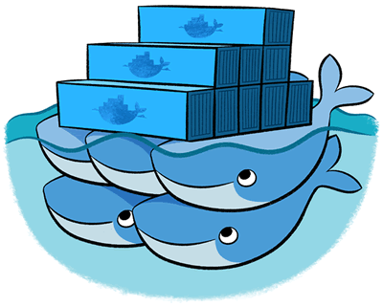
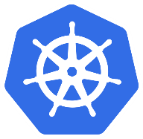

Overview of container-clustering solutions in Azure
Notes:
Explain the primary differences and similarities between the three orchestrators available when deploying ACS clusters.
20533D
7: Implementing containers in Azure

Slide 79
Creating and managing an ACS Docker Swarm cluster
Create a Docker Swarm cluster in ACS:
Requires an SSH RSA key
Specify the master and agent counts
Specify the agent VM size
Connect to the Docker Swarm cluster:
Establish an SSH tunnel to the master FQDN
Set DOCKER_HOST to 172.16.0.5:2375
Deploy containers to the Docker Swarm cluster:
Use docker run for individual containers
Use docker-compose for multicontainer applications
Notes:
Describe the process of deploying Docker Swarm–based ACS clusters and deploying containers in them.
20533D
7: Implementing containers in Azure

Slide 80
Creating and managing an ACS Kubernetes cluster
Create a Kubernetes cluster in ACS:
Requires an SSH RSA key
Requires an Azure AD service principal with the Contributor role to cluster resources
Specify the number of master and agent nodes
Specify the agent VM size
Connect to the Kubernetes cluster:
Install kubectl
Authenticate via SSH and download Kubernetes credentials
Deploy containers to the Kubernetes cluster:
Create a YAML-formatted manifest file
Run kubectl create and reference the manifest file name
Notes:
Describe the process of deploying Kubernetes-based ACS clusters and deploying containers in them.
20533D
7: Implementing containers in Azure

Slide 81
Creating and managing an ACS DC/OS cluster
Create a DC/OS cluster in ACS:
Requires an SSH RSA key
Specify the number of master and agent nodes
Specify the agent VM size
Connect to the DC/OS cluster:
Establish an SSH tunnel
Connect to the DC/OS web portal via http://localhost
Install DC/OS CLI
Deploy containers to the DC/OS cluster:
Create a YAML-formatted Marathon configuration file
Run dcos marathon app add and reference the file name
Notes:
Describe the process of deploying Datacenter Operating System (DC/OS)–based ACS clusters and deploying containers in them.
20533D
7: Implementing containers in Azure

