Slide 1
AMARNATH M
(2021503318)
Final Project
3/21/2024 Annual Review

Slide 2
PROJECT TITLE
Real Estate Price prediction using ANN

Slide 3
AGENDA
The project aims to develop an real estate price prediction system utilizing deep learning algorithms trained on housing data of various countries.
This involves preprocessing the dataset, creating and training a deep learning model, assessing its accuracy, and implementing it for price prediction.

Slide 4

PROBLEM STATEMENT
Develop an Artificial Neural Network (ANN) model to predict real estate prices based on features such as living area, number of bedrooms, bathrooms, and garage spaces. The goal is to create a reliable model that accurately estimates property prices, aiding both buyers and sellers in making informed decisions in the real estate market.

Slide 5

PROJECT OVERVIEW
This project focuses on developing a machine learning model using an Artificial Neural Network (ANN) to predict real estate prices. The model will be trained on a dataset containing various features like living area, bedrooms, bathrooms, and garage spaces, with the target variable being the price of the properties. The aim is to create a robust predictive model that can assist stakeholders in the real estate industry, such as buyers, sellers, and agents, in estimating property values accurately.
Visual representation:
We can include a simple diagram illustrating the basic structure of a deep learning model, showcasing its input layer, hidden layers, and output layer.

Slide 6
OBJECTIVE:
1. Develop a Predictive Model: Create an ANN model that can accurately predict real estate prices based on various features such as living area, bedrooms, bathrooms, and garage spaces.
2. Improve Decision Making: Provide stakeholders in the real estate industry, including buyers, sellers, and agents, with a tool to make informed decisions by estimating property values more accurately.
3. Enhance Market Understanding: Gain insights into the factors that influence real estate prices and how they interact, helping to understand market dynamics better.
4. Optimize Resource Allocation: Optimize resource allocation by guiding investment decisions, pricing strategies, and property valuations based on data-driven predictions.
5. Evaluate Model Performance: Assess the performance of the ANN model using evaluation metrics like Mean Squared Error (MSE) and Mean Absolute Error (MAE) to ensure its reliability and effectiveness in predicting prices.

Slide 7
YOUR SOLUTION AND ITS VALUE PROPOSITION
The ANN model for real estate price prediction offers several value propositions in key areas:
1. Accurate Price Estimation: By leveraging advanced machine learning techniques, the model provides highly accurate estimates of real estate prices based on multiple factors such as living area, bedrooms, bathrooms, and garage spaces.
2. Informed Decision Making: Stakeholders such as buyers, sellers, and real estate agents can make data-driven decisions regarding property transactions, investments, pricing strategies, and market positioning, leading to better outcomes.
3. Market Insights: The model offers insights into the underlying factors influencing real estate prices, enabling a deeper understanding of market dynamics, trends, and potential opportunities or risks.

Slide 8
The Wow Factor in Your Solution
Data-Driven Insights: By analyzing extensive datasets and learning from historical trends, the model offers valuable insights into the factors influencing real estate prices, empowering stakeholders with actionable information for strategic decision-making.
2. Real-Time Adaptability: The model's capability to adapt and make predictions in real-time enables stakeholders to stay agile and responsive to market changes, facilitating timely and informed decisions.
3. Risk Reduction: With its accurate predictions and market understanding, the model helps mitigate risks associated with overvalued or undervalued properties, enabling more secure investments and transactions.

Slide 9
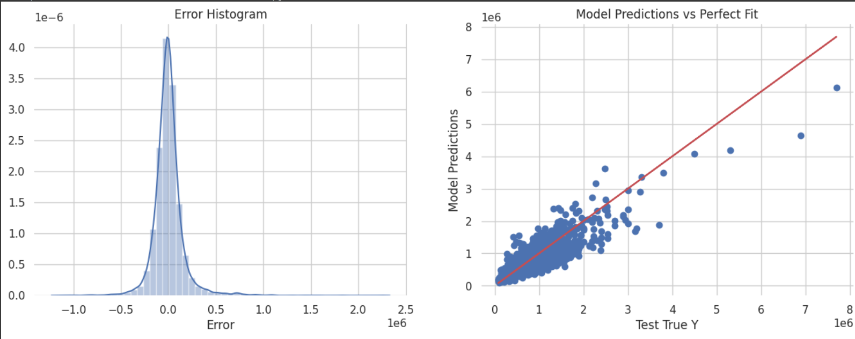
RESULTS

Slide 10
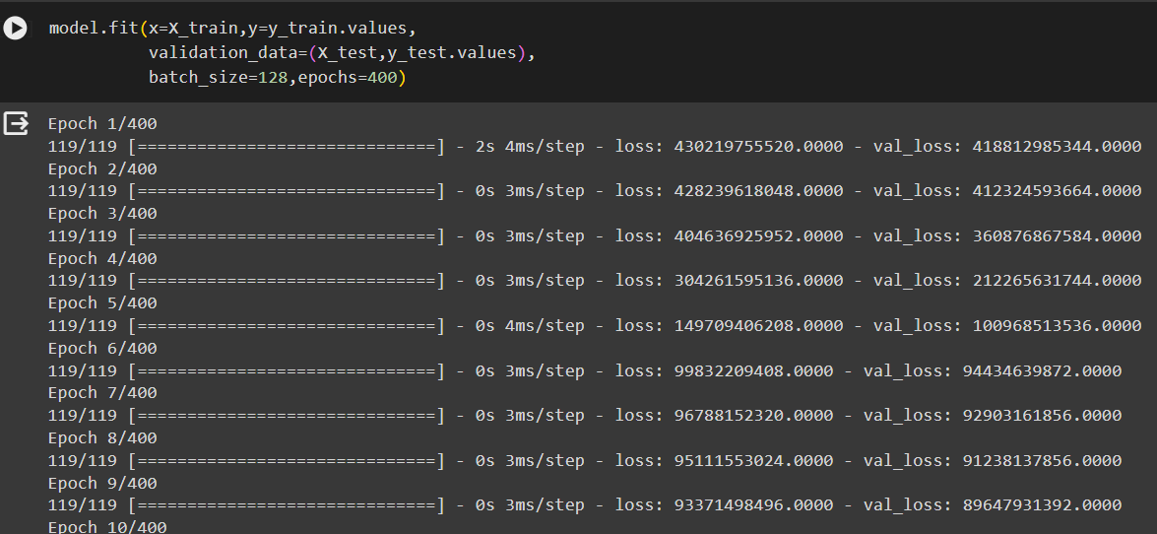
Training the model

Slide 11
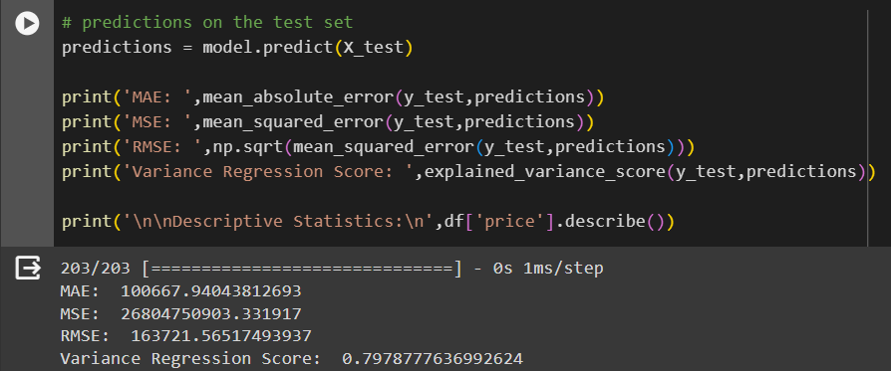
Accuracy

Slide 12
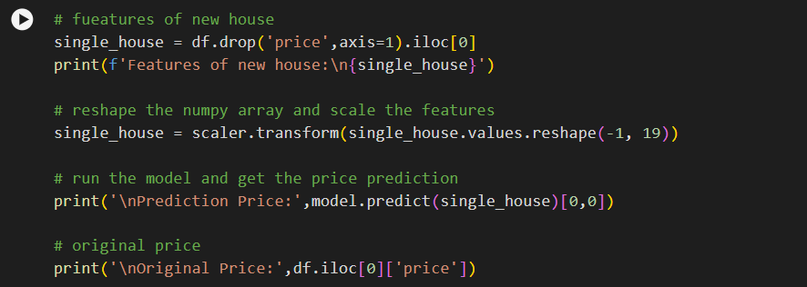
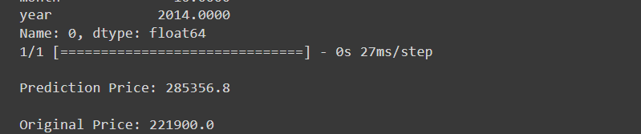
Results
DRIVE LINK:
https://drive.google.com/file/d/1NDuj4yq0unKilJgdeKx-86g9aDgm7air/view?usp=sharing

