Slide 1
Machine Learning
Decision Trees

Slide 2
Introduction to Decision Trees
A decision tree is a supervised machine-learning algorithm.
Used for classification and regression tasks.
Works by splitting data into branches based on feature values.

Slide 3
Key Concepts in Decision Trees
Internal Nodes: Points where a decision or split occurs.
Branches: Represent the possible outcomes of a decision at a node.
Root Node: The starting point of the tree, representing the first decision.
Leaf Node: Terminal points that provide the final classification or prediction.

Slide 4
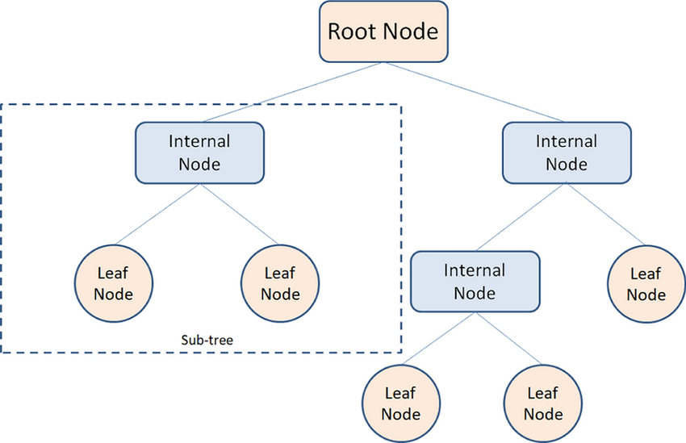

Slide 5
Types of Decision Trees
Classification Trees: Output is a category (e.g., Yes/No, species type)
Regression Trees: Output is a continuous value (e.g., price, temperature).

Slide 6

Gini Index
What is the Gini Index?
The Gini Index measures impurity or purity used to split nodes in a decision tree.
Formula
where p​ is the probability of a sample being classified into class i, and C is the number of classes.

Slide 7
Entropy and Information Gain
What is Entropy and Information Gain?
Entropy: Measures uncertainty or disorder in a dataset. The goal is to reduce entropy with each split.
Information Gain: Information Gain is the reduction in entropy (uncertainty) after a dataset is split based on a particular feature. A higher Information Gain indicates that a feature provides a better split of the data and reduces uncertainty more effectively

Slide 8
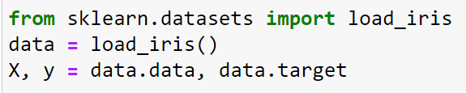
Real World Example
Iris dataset
Steps:
Importing and Loading the Iris Dataset

Slide 9
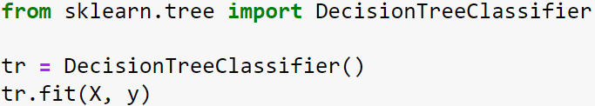

2. Importing and Initializing the Decision Tree Classifier
3. Importing Necessary Libraries for Visualization

Slide 10

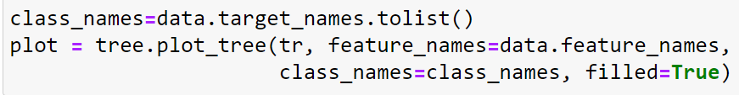
4. Setting Up the Figure for Visualization
5. Customizing and Plotting the Decision Tree

Slide 11
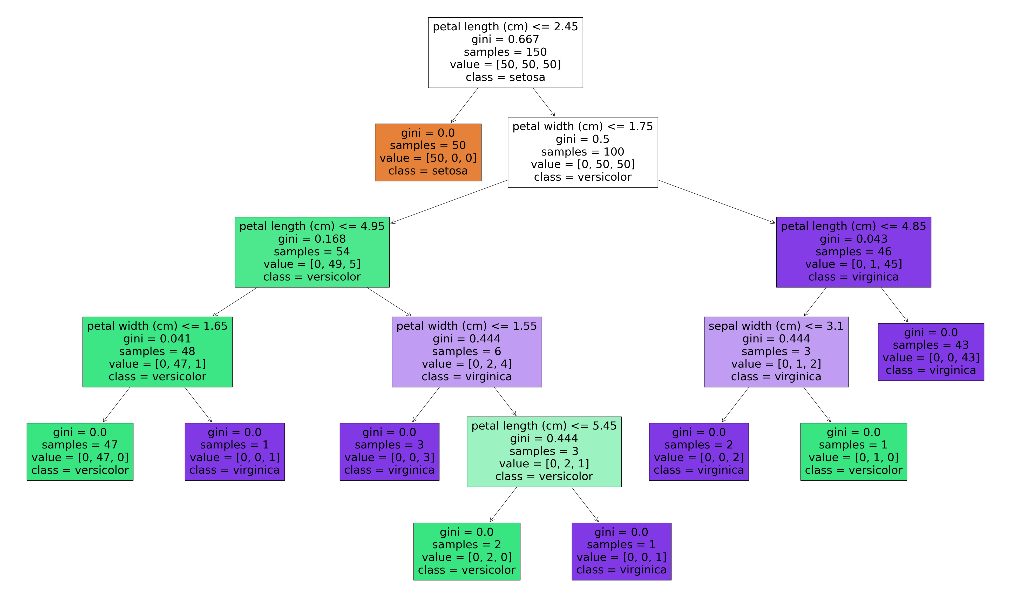
Final Visualization of the Decision Tree

Slide 12
Conclusion
The decision tree effectively classifies the Iris dataset, achieving perfect separation of setosa based on petal length. Key features like petal width and petal length drive the splits, demonstrating their importance in distinguishing versicolor and virginica, though the minor overlap between these two classes introduces slight impurity. Overall, the model provides accurate, interpretable classifications with well-defined feature importance.

Slide 13
Thank you

