Slide 1
Fin-Bro
Your smart financial advisor, making timely suggestions for sound decisions."
Github: https://github.com/Amarnath-Rao/Finbro

Slide 2
Details
Contents Title
Contents Title
Contents Title
Output
Problem Statement
Solution
Challenges
To Build a dynamic support system for financial decision-making.
Envision a system that notifies executives or sales personnel when significant transactions or investments hit crucial points.
Gen-Ai chatbot using LLM
FinBro engages in dynamic conversations, offering personalized financial insights, budgeting tips, and investment advice.
2. Trained ML model to predict the current trade and critical values which alerts user with notified email service
API keys to integrate with a chatbot
2.Low quality dataset
3.
Finally, We were able to develop a model with 80% accuracy and our Finbot is working well and giving interactive feedback. It uses Support and Resistance strategy

Slide 3

We created an
Highly Qualified Professional
Bot Using LLM
Step into the future of finance with FinBro's enchanting chatbot experience. Beyond mere functionality, it's a dynamic conversational companion that doesn't just understand your financial queries; it engages with you, offering insightful advice and tailored solutions. This isn't just a chatbot; it's an intelligent storyteller of your financial journey, turning complexity into clarity with a dash of creativity and a treasure trove of knowledge.

Slide 4

ML model Description
"Explore the future of finance with our Machine Learning model—a game-changer in proactive trading. By analyzing datasets, it identifies critical points, alerting users via email about potential shifts in trading or significant price drops. Stay ahead in the market game with real-time insights, courtesy of our intelligent ML model, empowering you to make informed decisions and navigate the financial landscape with confidence."

Slide 5
Challenges faced
45%
Access to Open AI
Accessing OpenAI for free is challenging due to limitations on usage without a paid subscription, hindering seamless exploration and utilization of its capabilities. These restrictions pose barriers for users seeking cost-free access to OpenAI's powerful tools and services
2. Shortage of Dataset
Shortage of data can hinder model generalization, leading to overfitting and reduced accuracy on new data. It also limits the model's ability to capture the complexity of real-world scenarios, potentially resulting in biased or unreliable predictions.

Slide 6
What Makes us Unique?
Our project, FinBro stands out in the financial technology landscape for several reasons:
Comprehensive Financial Companion: FinBro is not just a chatbot; it's a holistic financial companion integrating machine learning. It combines personalized financial advice, budgeting assistance, and investment insights with the ability to predict critical points in trading—a unique and comprehensive approach.
Dynamic Conversational Interface: Unlike conventional financial tools, FinBro engages users in dynamic conversations. The chatbot utilizes advanced language models to understand user queries, providing natural and insightful responses that go beyond static interfaces found in many other financial applications.
Proactive Trading Insights: The integration of a machine learning model that predicts critical points in trading sets FinBro apart. Sending timely email alerts based on market analysis, empowers users to stay ahead of market fluctuations, enabling proactive decision-making.
Automation with Personalization: FinBro not only automates financial processes but does so with a personal touch. From personalized investment recommendations to dynamic budget adjustments, it tailors its responses to each user's unique financial situation and goals.
Email Alerts for Actionable Insights: The feature that sends email alerts about critical trading points adds a practical and actionable dimension to our project. Users receive real-time notifications, ensuring they are informed and can take timely actions in response to market changes.
In summary, FinBro distinguishes itself by offering a comprehensive, personalized, and proactive financial experience that goes beyond traditional financial applications. The fusion of a chatbot with advanced machine learning capabilities positions FinBro as a forward-thinking solution in the realm of financial technology

Slide 7
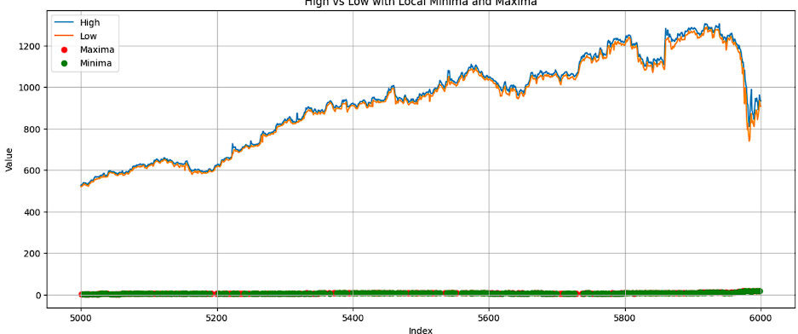
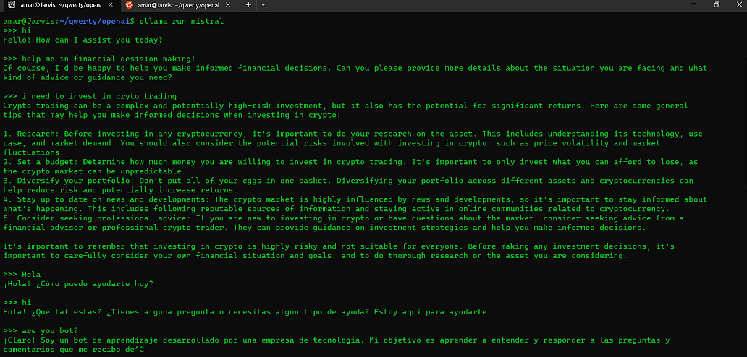
Infographic Style
You can simply impress your audience and add a unique zing and appeal to your Presentations. Easy to change colors, photos and Text. Get a modern PowerPoint Presentation that is beautifully designed.
Future Outcome: -> Multiple user auth data -> Model efficiency
-> Accurate Datasets
Tech Stack:
GenAI
MachineLearning
DataScience
Deep Learning
Github
https://github.com/Amarnath-Rao/Finbro

Slide 8
THANK YOU

